Slide 1
Utilizing Data Clustering for Hypotheses Discovery in Multimodal Exercise and Health Interventions with Limited Sample Size
Mckay Russell, Guanrong Cai, Steven Merino, Clemente Rodriguez, Zachary Scholefield Jared Moore, George Salem, & Chengwei Lei
26th December 2022

Slide 2
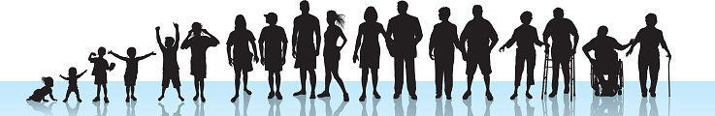
Aging
Aging population ↑
Molecular and cellular damage↑
Physical and cognitive function ↓
Risk of diseases ↑
Figure credit: Myheart.net

Slide 3
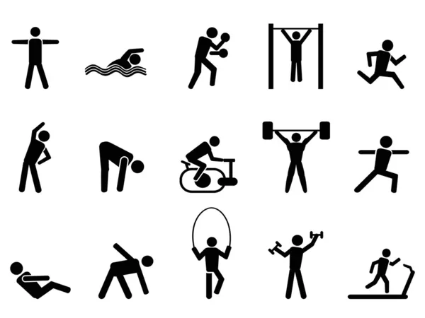
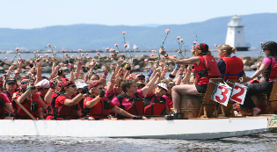
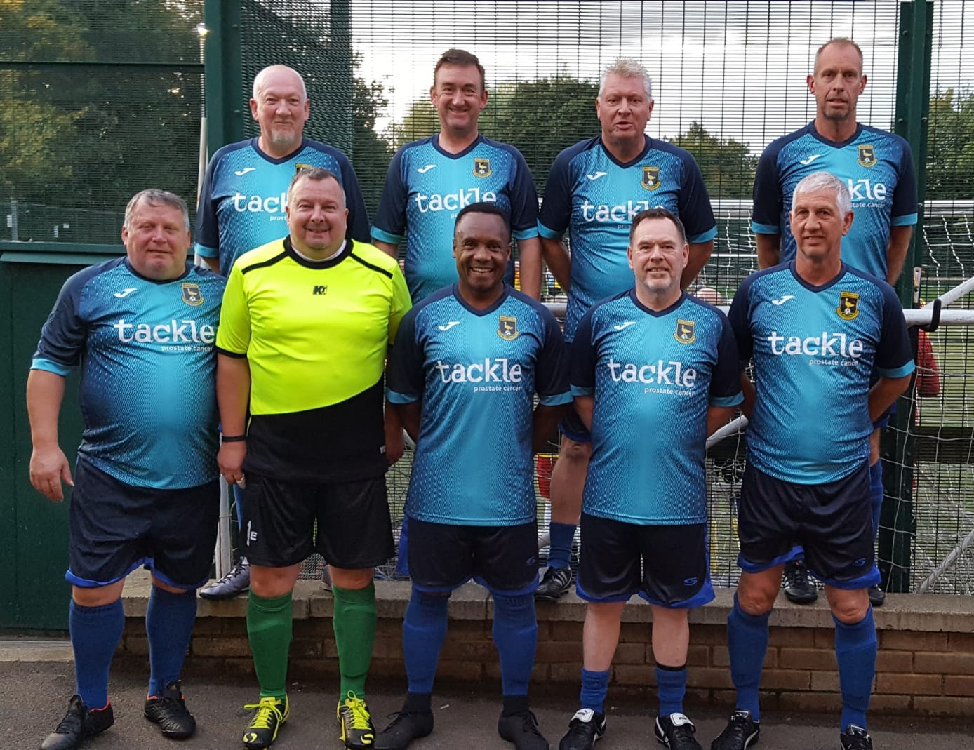
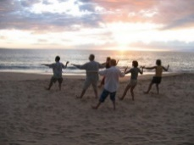
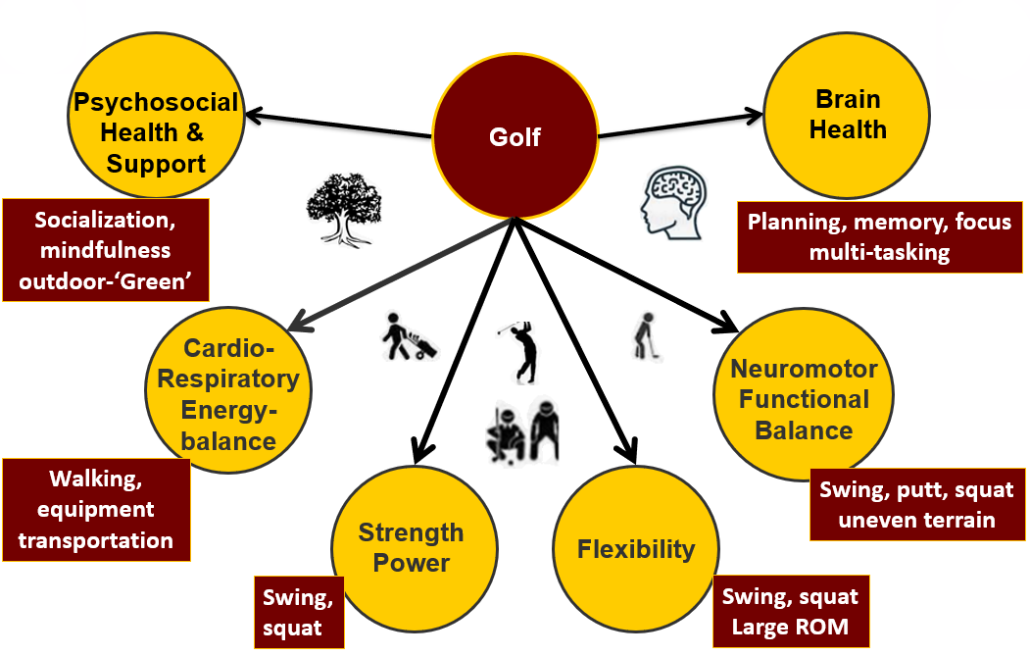
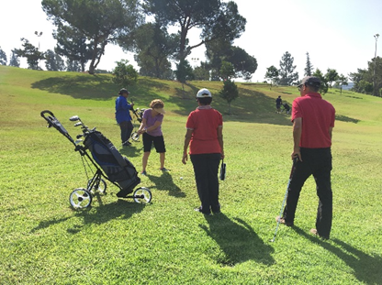
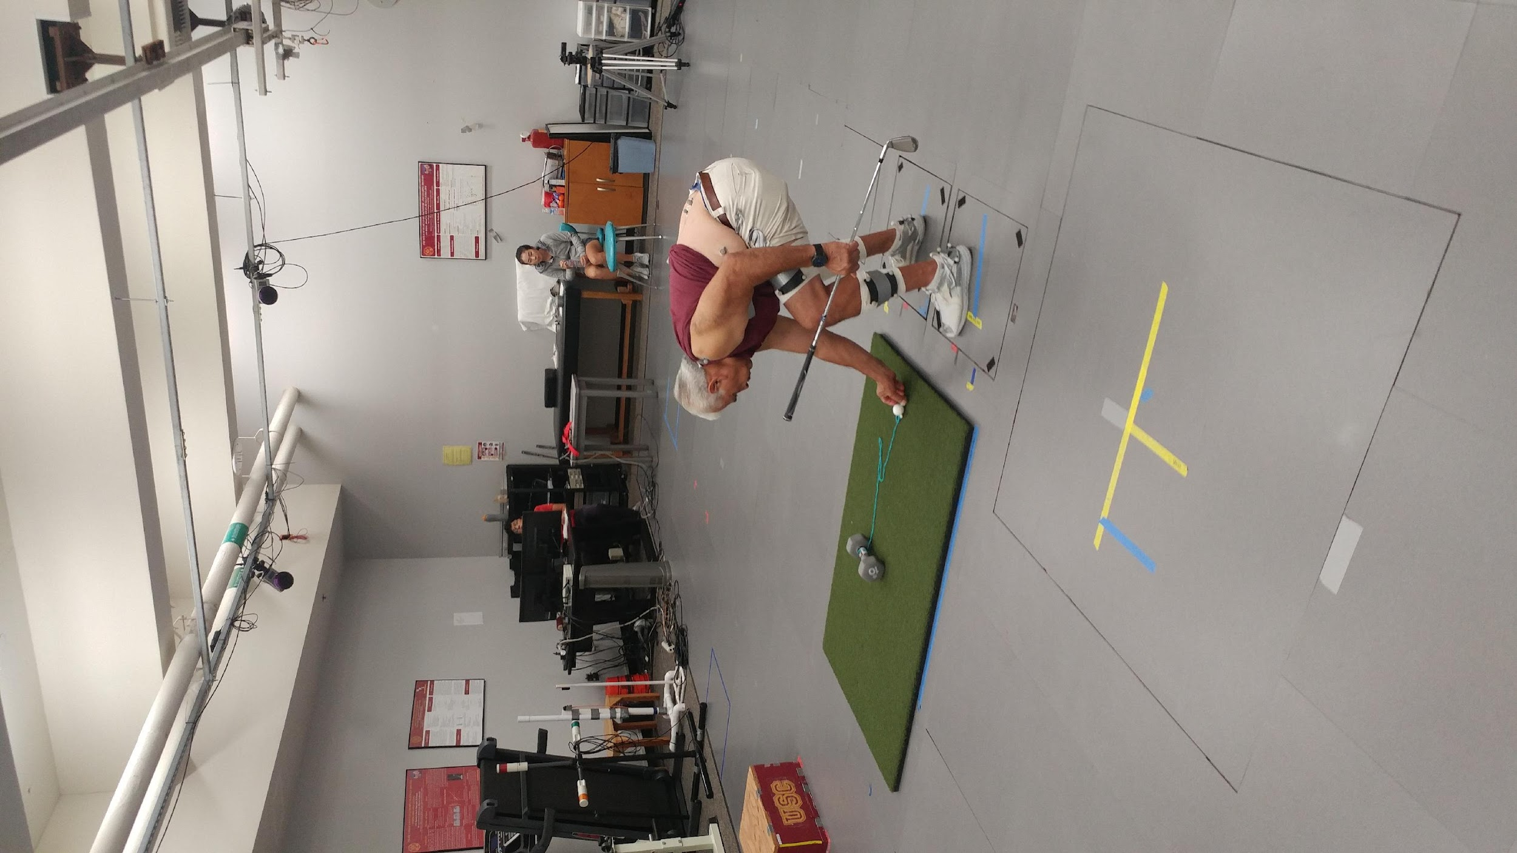
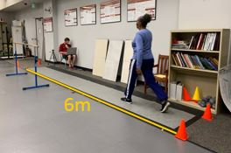
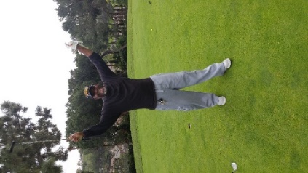
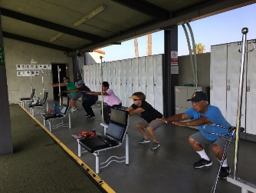
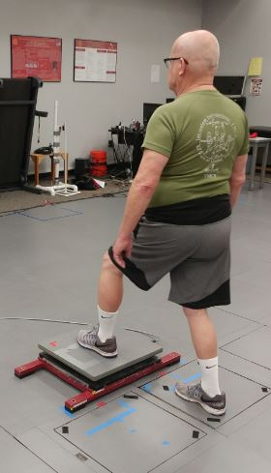
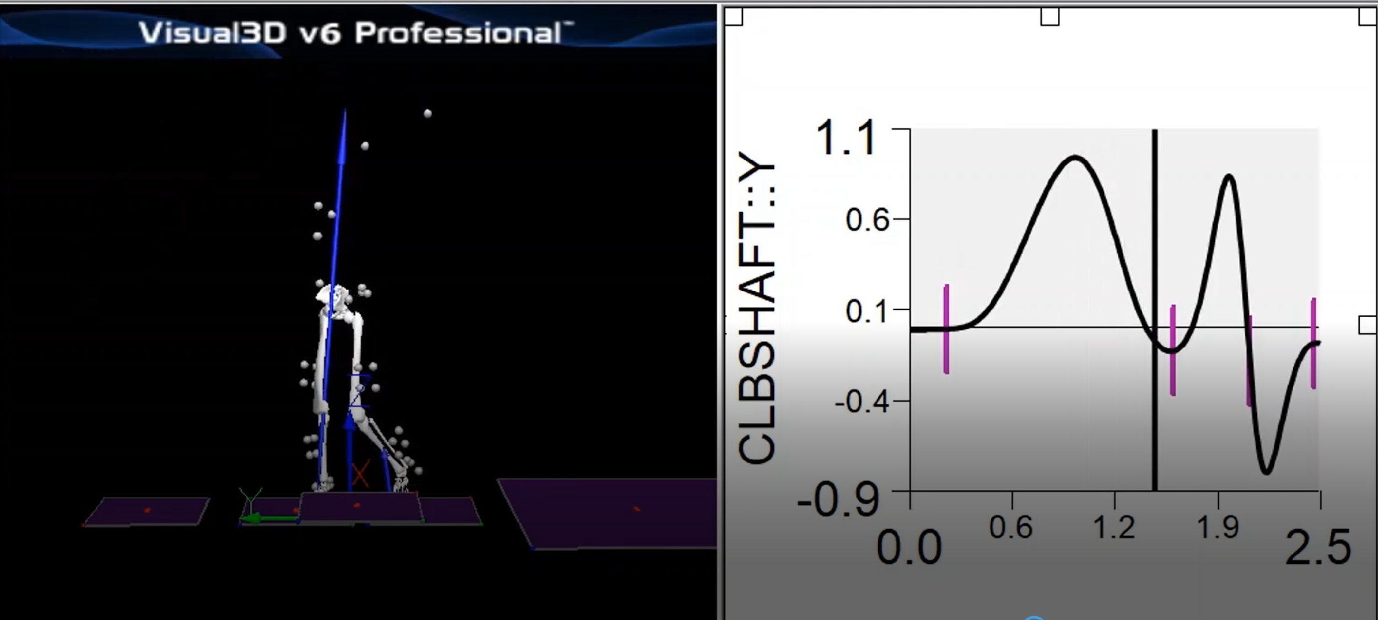
Multimodal Exercise Programs + Recreational Activities
Physical activity engagement
HRQoL
Physical
Cognitive
Psychosocial
Physical Activity Guidelines for Americans, 2nd Ed. 2018
Du Bois et al. IJGS. 2021
Community-Based Rehabilitation: CBR Guidelines. WHO. 2010
Caspersne, Powell, & Christenson Public Health Rep. 1985
Notes:
Multimodal recreational exercise programs that include sufficient physical and cognitive stimuli improve health and wellness. I am interested in exercise prescription as it relates to aging and health restoration. Specifically, I plan to examine the feasibility, safety, efficacy, and mechanisms-of-action related to golf recreational exercise programs, designed to improve psychosocial, cognitive, and physical health status in healthy and clinical populations (i.e. cancer survivors).

Slide 4
Issues with multimodal exercise intervention research:
Resource & time intensive
Large number of assessments
Limited sample size
Physical Activity Guidelines for Americans, 2nd Ed. 2018
Du Bois et al. IJGS. 2021
Community-Based Rehabilitation: CBR Guidelines. WHO. 2010
Caspersne, Powell, & Christenson Public Health Rep. 1985

Slide 5
Purpose
To develop an analytical framework that applies mathematical abstraction and modeling of the typical pilot exercise intervention data and modified K-means clustering algorithm in order to generate novel hypotheses that could be useful for understanding intervention efficacy and future study design.

Slide 6

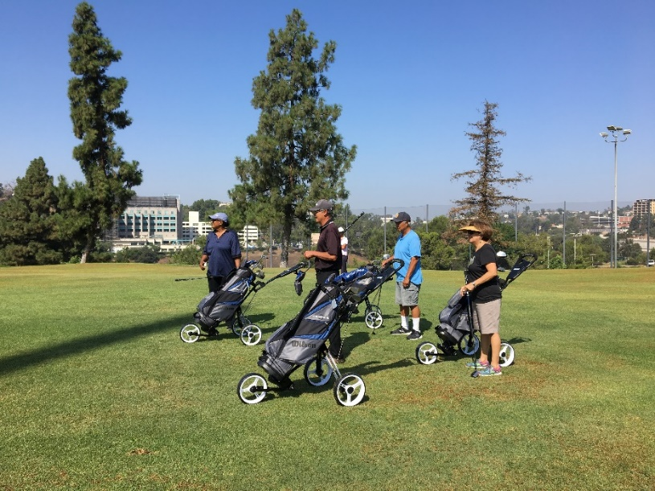
Golf Program Overview
Weeks | Conditioning | Golf Training
1-3 | Golf Specific Drills + Exercises 45 minutes | Introduction to Golf Swing Training 45 minutes
4-7 | Golf Specific Drills + Exercises 20-30 minutes | Golf Play 2-5 holes
8-10 | Dynamic Warm Up 10 min | Golf Play 6-9 holes
11-12 | Dynamic Warm Up 10 min | Uninstructed Golf Play 8-9 holes
14 participants (7M); 2 sessions/week; 90 minutes/session
Notes:
This table shows the progressive design of the comprehensive golf training program.
Groups of 3-4 golfers met with a PGA professional instructor two times weekly for 10 weeks. Each session will last 90 minutes and consisted of a dynamic warm-up, golf specific drills and exercises, and some form of golf play. The first three weeks of the intervention included 45 minutes of golf specific exercises and 45 minutes of swing training and introduction to the rules and etiquette of golf.
Weeks 4-7 consisted of 20-30 minutes of drills and exercises and golf play beginning on 2 holes and progressing to 5 holes
Weeks 8-10 consisted of a 10 minute dynamic warm up followed by golf play on 6-7 holes. This training program was standardized across all sessions.

Slide 7
PHYSICAL TESTS
COGNITIVE TESTS
BIOMECHANICS
FUNCTIONAL
Agility – 8 ft up and go
Cardio – 6 min walk
Strength – 30 s chair stand + Handgrip
GAIT
Self-selected, Fast (Single Task),
and Dual Task
STRENGTH
Hip Abductor, Quadriceps
Calf
REACTION TIME
Rapid Step Test
NIH TOOLBOX FOR COGNITION
Attention
Episodic Memory
Working Memory
Cognitive Flexibility
Processing Speed
Composite
CALIFORNIA VERBAL LEARNING TEST
Immediate Recall
Short-Delay Recall
Long-Delay Recall
Total T Score
KINEMATICS & KINETICS
Golf Swing
Bend & Pickup task
BALANCE
Single Leg Stance,
Semi-Tandem, Tandem
Notes:
I’ll only speak about the results that I’ve looked into more closely.
Joint moments support moments for golf swings. By totaling the number of swings and bend&pickups. Compare with other exercises such squatting, lunging, and yoga.

Slide 8
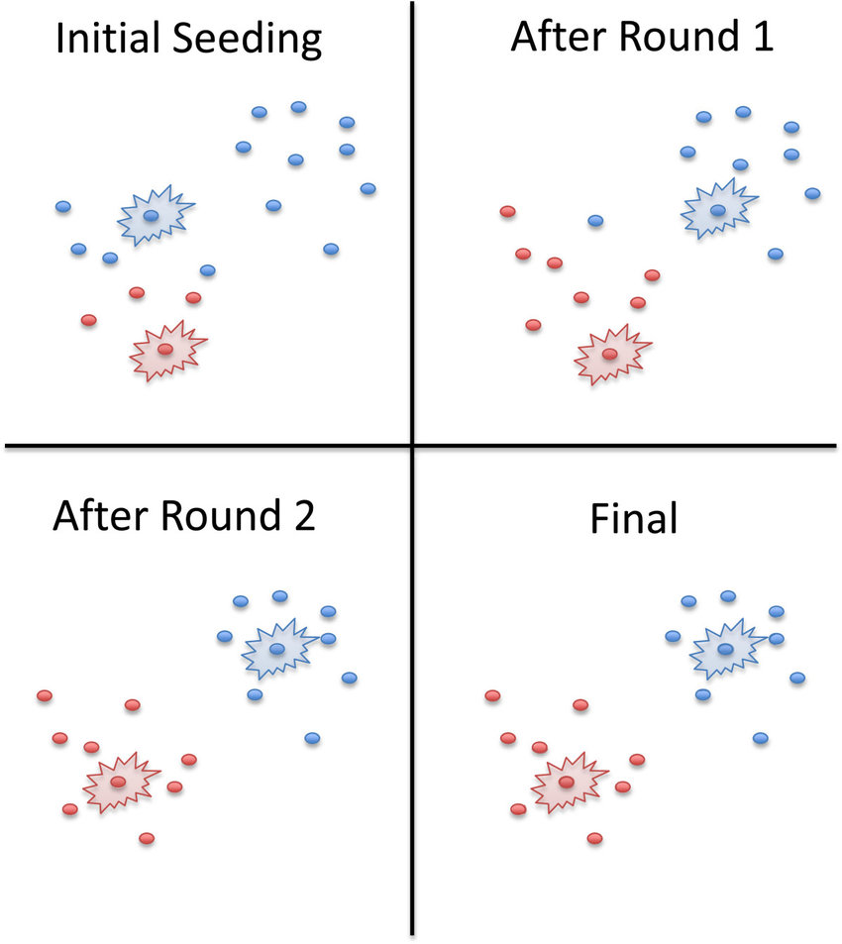
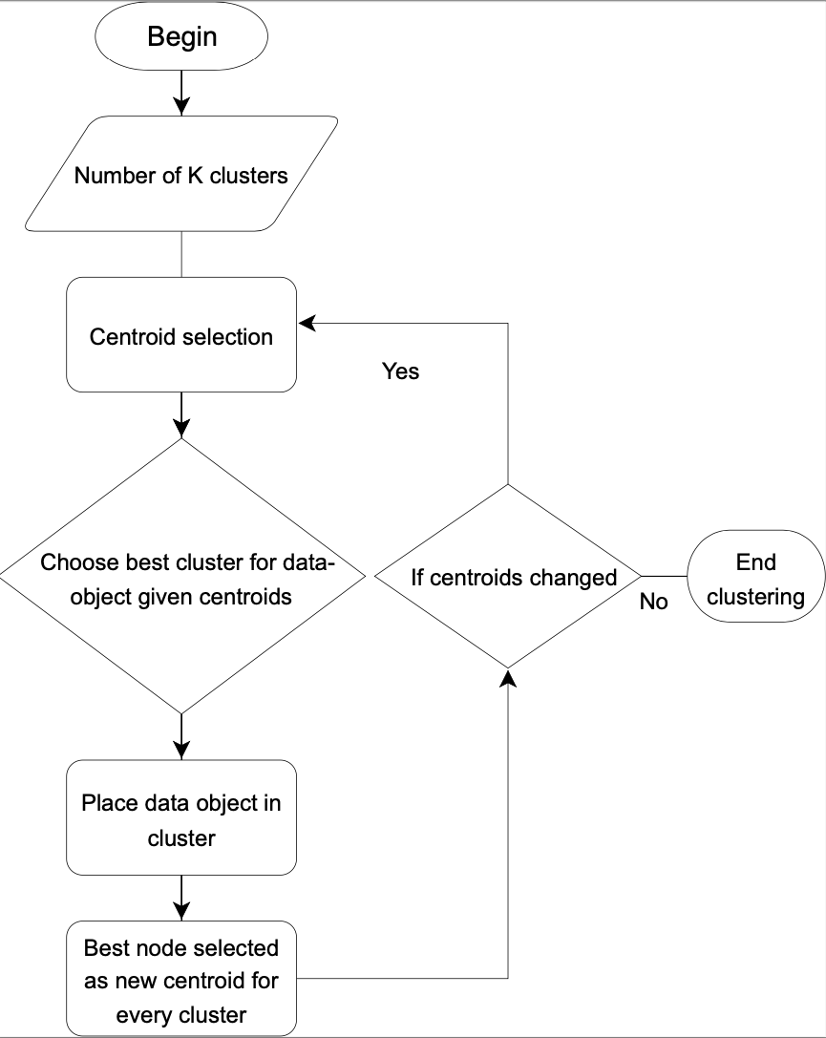
Method: Modified K-means

Slide 9
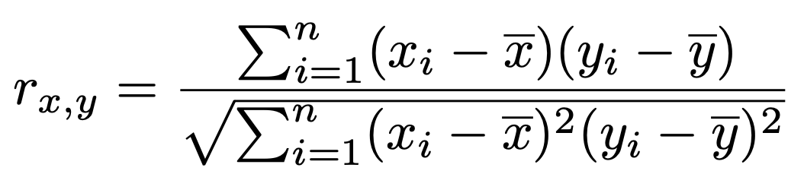
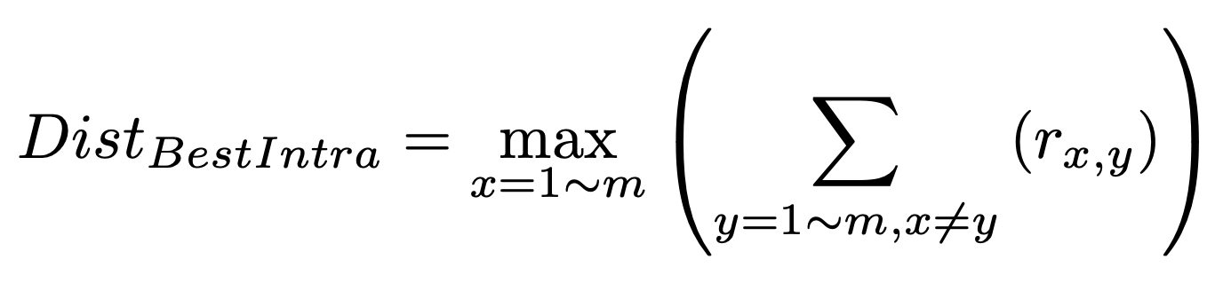
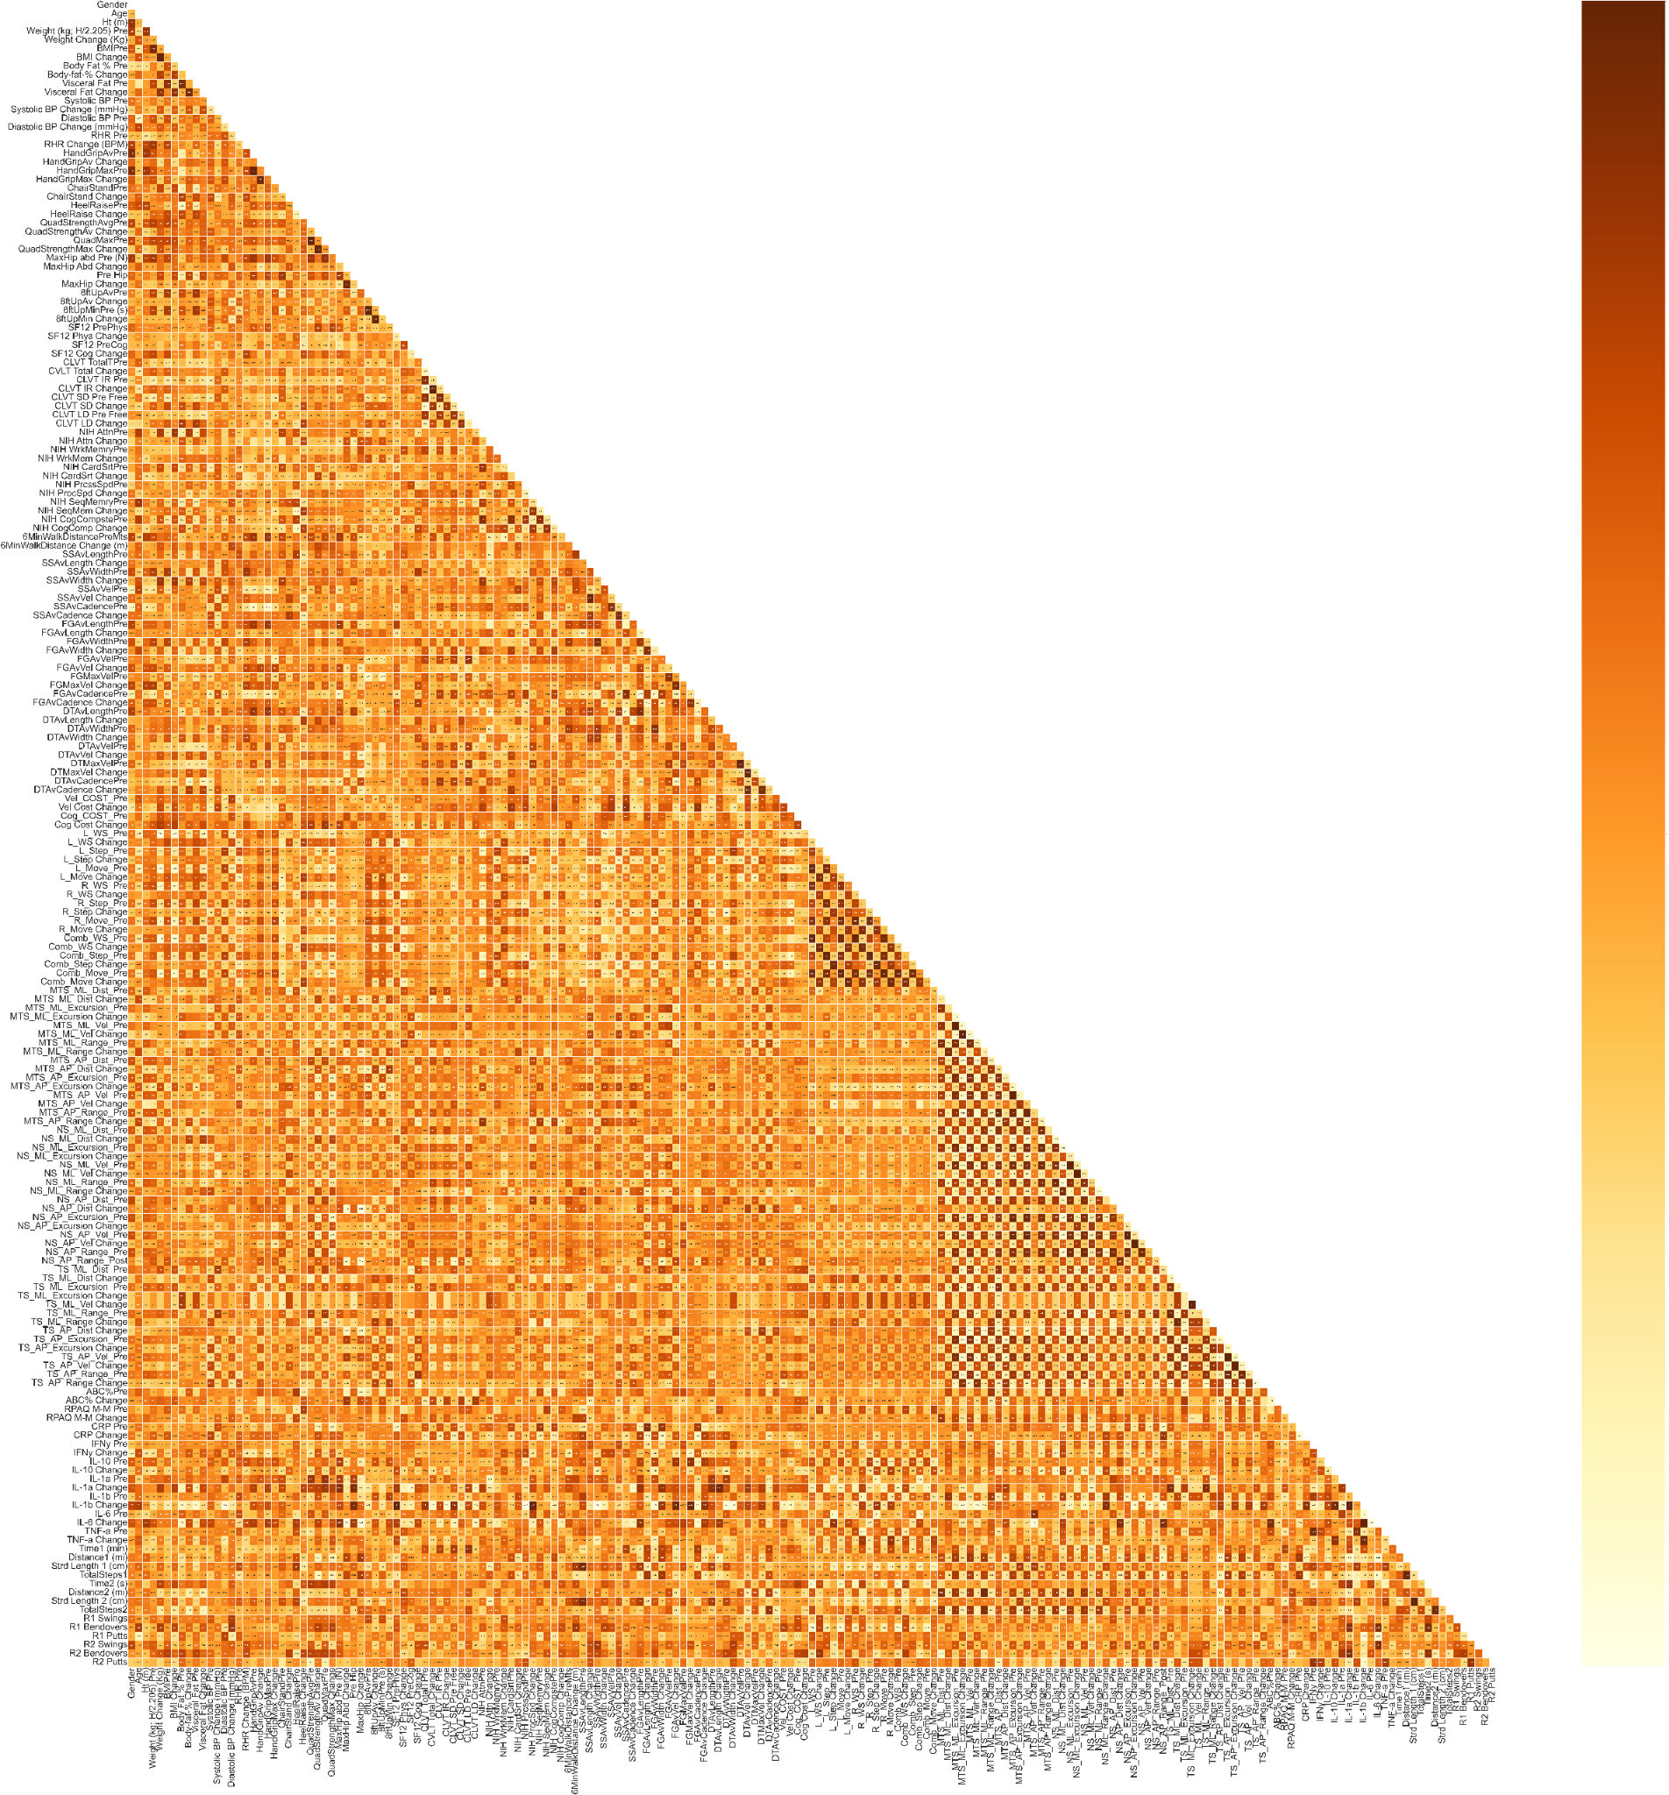
Method: Algorithm modification
Distance measurement:
Pearson’s correlation coefficient (1)
Absolute values
Centroid Selection:
Random selection to initiate
Sum of correlation coefficients (2)

Slide 10
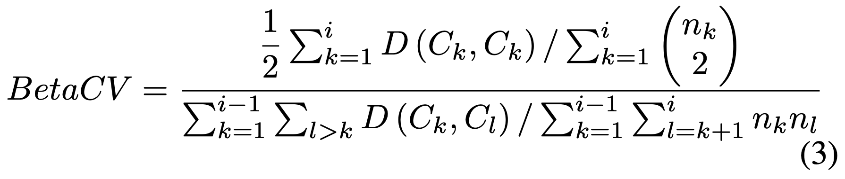
Method: Performance Evaluation
Performance evaluation using BetaCV:
Intra-cluster data point similarities vs. inter-cluster data point similarities

Slide 11
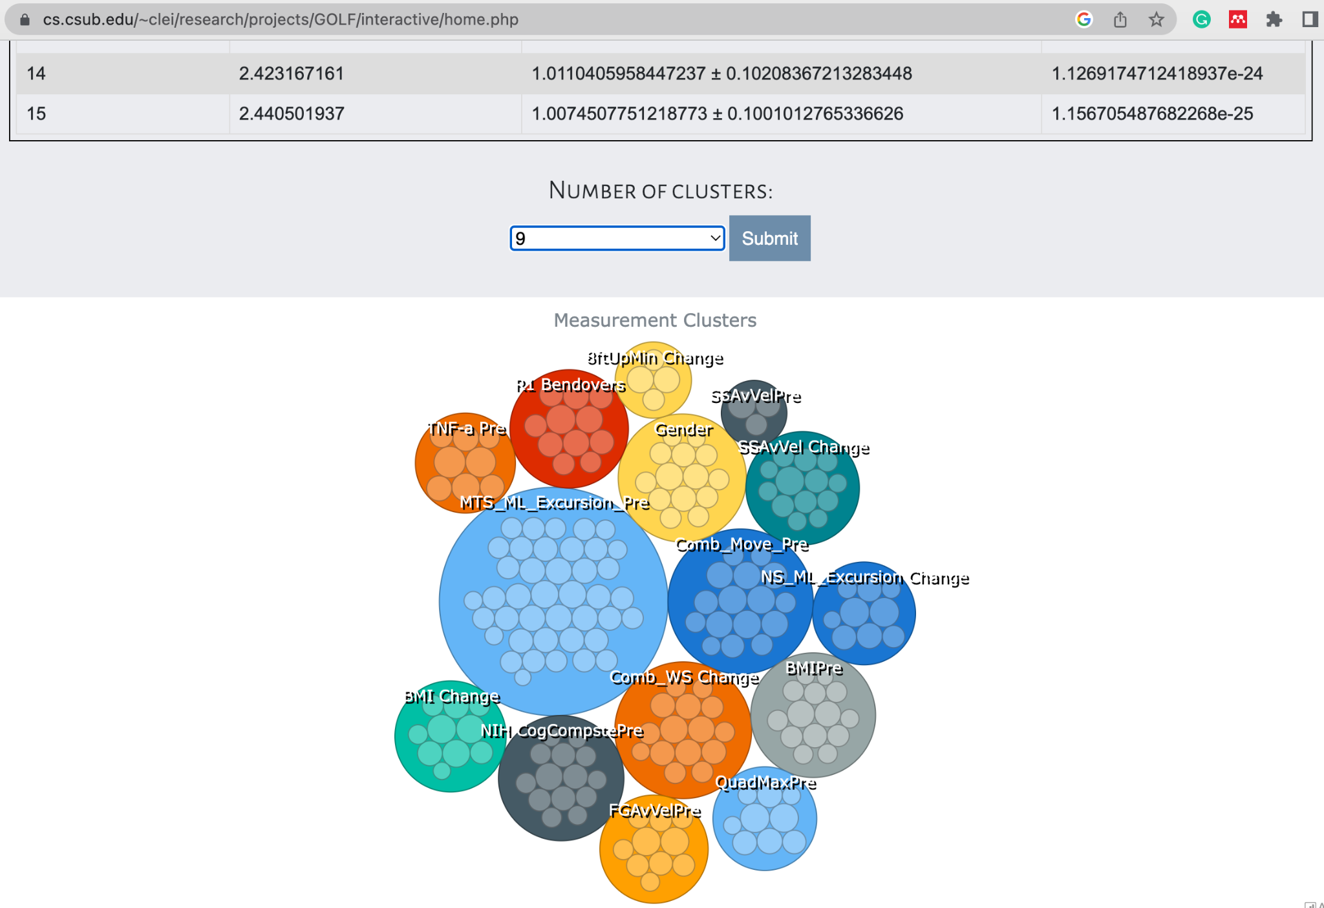
Results

Slide 12
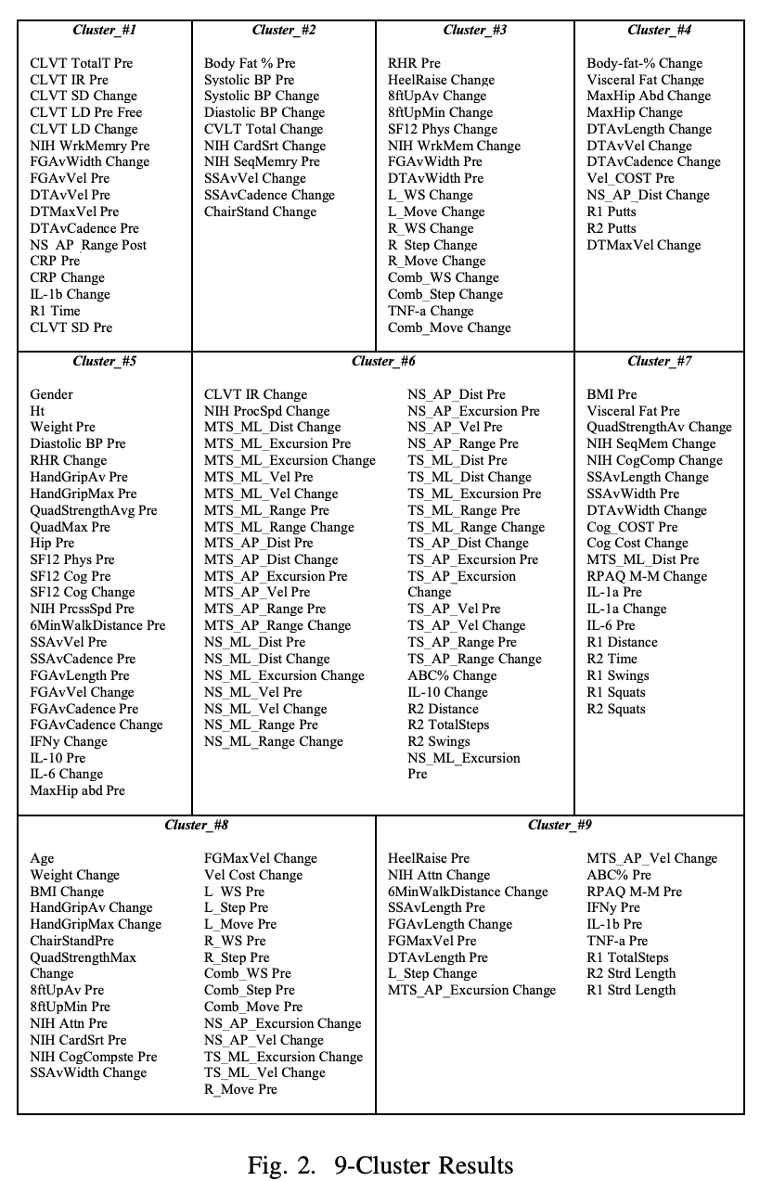
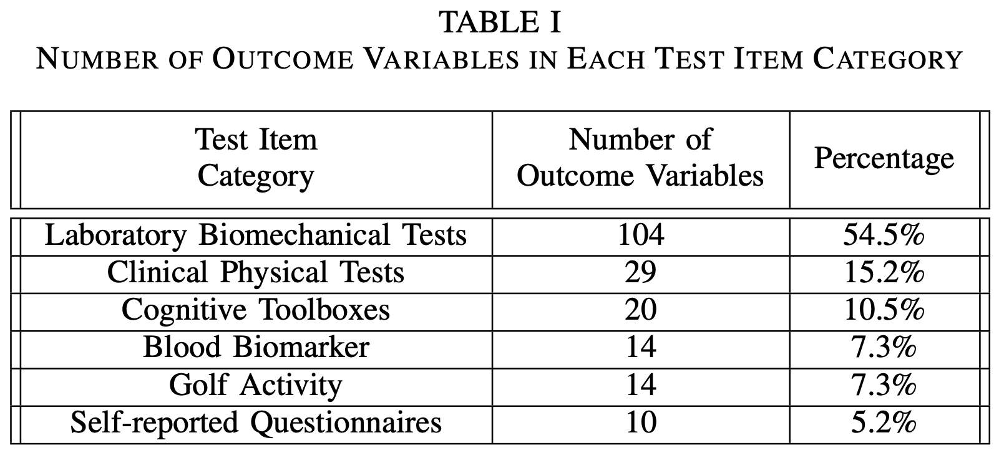
Results

Slide 13
Discussion
Example hypothesis:
Variables Influenced by Body Fat (Cluster_#2)
Golf course activities, inflammatory biomarker, and cognition (Cluster_#7)
Variables Influenced by Age (Cluster_#8)

Slide 14
Conclusion
This study used a data-driven analytical framework unlike the traditional a-priori hypothesis-driven framework in kinesiology. The clustering results provided an abundance of novel perspectives to examine the limited pilot data set, which elucidated interesting hypotheses to be further tested.

Slide 15
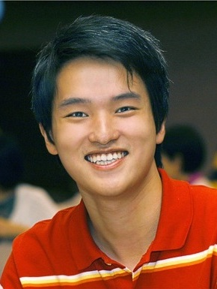
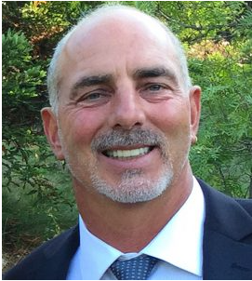
Thank you!
Dr. Chengwei Lei, PhD Dr. George Salem, PhD
California State Uni., Bakersfield Uni. of Southern California
Co-authors: Mckay Russell, Guanrong Cai, Steven Merino, Clemente Rodriguez, Zachary Scholefield Jared Moore

Slide 16






Golf
Psychosocial
Health
Brain
Health
Socialization, mindfulness
outdoor-‘Green’
Planning, memory, focus
multi-tasking
Cardio-
Respiratory
Energy-
balance
Neuromotor
Functional
Balance
Walking,
equipment transportation
Swing, putt, squat
uneven terrain
Strength
Power
Flexibility
Swing,
squat
Swing, squat
Large ROM
Adopted from Kanwar et al. Ment. Health Phys. Act. 2021
Notes:
Why golf?
Golf is a multi-modal recreational sport which includes physical tasks walking on uneven terrain, bending over to pick up or mark a ball, and the golf swing. The psychosocial and cognitive benefits are evident and are likely attributed to it’s social, mindfulness, and outdoor nature and the requirement of strategic planning, multitasking, gross and fine motor control and motor learning. When used correctly and safely, it is a great tool help increase/maintain physical activity level across the lifespan. Multi-modal activities are recommended by ACSM activity guidelines for adults. That is why we want to quantify the physical tasks within golf to guide future design.
Adults should do at least 150 minutes (2 hours and 30 minutes) to 300 minutes (5 hours) a week of moderate-intensity, or 75 minutes (1 hour and 15 minutes) to 150 minutes (2 hours and 30 minutes) a week of vigorous-intensity aerobic physical activity, or an equivalent combination of moderate- and vigorous-intensity aerobic activity. Preferably, aerobic activity should be spread throughout the week.
Body-weight exercises (push-ups, pull-ups, planks, squats, lunges) are considered as strengthening activity.

Slide 17
Golf
Psychosocial
Health
Brain
Health
Socialization, mindfulness
outdoor-‘Green’
Planning, memory, focus
multi-tasking
Cardio-
Respiratory
Energy-
balance
Neuromotor
Functional
Balance
Walking,
equipment transportation
Swing, putt, squat
uneven terrain
Strength
Power
Flexibility
Swing,
squat
Swing, squat
Large ROM
Physical Activity Guidelines for Americans, 2nd Ed.
Luscombe et al. BMJ Open. 2017
Tsuji et al. J. Sports Sci. 2019
Murray et al., Br J Sports Med 2017
Notes:
Why golf?
Golf is a multi-modal recreational sport which includes physical tasks walking on uneven terrain, bending over to pick up or mark a ball, and the golf swing. The psychosocial and cognitive benefits are evident and are likely attributed to it’s social, mindfulness, and outdoor nature and the requirement of strategic planning, multitasking, gross and fine motor control and motor learning. When used correctly and safely, it is a great tool help increase/maintain physical activity level across the lifespan. Multi-modal activities are recommended by ACSM activity guidelines for adults. That is why we want to quantify the physical tasks within golf to guide future design.
Adults should do at least 150 minutes (2 hours and 30 minutes) to 300 minutes (5 hours) a week of moderate-intensity, or 75 minutes (1 hour and 15 minutes) to 150 minutes (2 hours and 30 minutes) a week of vigorous-intensity aerobic physical activity, or an equivalent combination of moderate- and vigorous-intensity aerobic activity. Preferably, aerobic activity should be spread throughout the week.
Body-weight exercises (push-ups, pull-ups, planks, squats, lunges) are considered as strengthening activity.

Slide 18
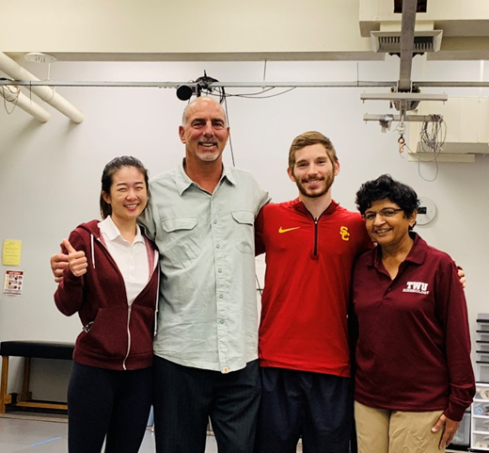
Institute for Senior Golf Science
Golf for Healthy Aging Study (GHA)
Kanwar, K. D., Moore, J. L., Hawkes, R., & Salem, G. J. (2021). Golf as a physical activity to improve walking speed and cognition in older adults: A non-randomized, pre-post, pilot study. Mental Health and Physical Activity, 21(May), 100410. https://doi.org/10.1016/j.mhpa.2021.100410
Golf Intervention for Veterans Exercise Study (GIVE)
Du Bois, A. M., Marcione, N. A., Castle, S. C., Moore, J. L., & Salem, G. J. (2019). The Golf Intervention for Veterans Exercise (GIVE) Study: Golf training program and study design - A methodological protocol. International Journal of Golf Science, 7(2), 1–16.
Du Bois, A. M., Marcione, N. A., Powers, C. M., Flanagan, S. P., Schroeder, E. T., & Castle, S. C. (2021). The Effects of a Comprehensive Golf Training Program on Measures of Physical Performance and Dynamic Balance in Older Military Veterans. International Journal of Golf Science, 9(1), 1–16.
PI: George Salem, PhD

Slide 19


Physical Activity During Golf Play
Time taken for 9 holes of golf (minutes) | 88 ± 9.09
Distance walked (miles) | 1.785 ± 0.37
Total steps taken | 4100 ± 968.09
Total swings taken (practice + actual) | 41 ± 9.94
Total putting strokes made | 29 ± 7
Number of squats | 24 ± 8
Mean ± SD for 14 participants over one round of 9-hole golf play
Notes:
It was a short par 3 course. A thing to note is that they had a limit of two practice swings for each shot to conform to the time limit.

Slide 20

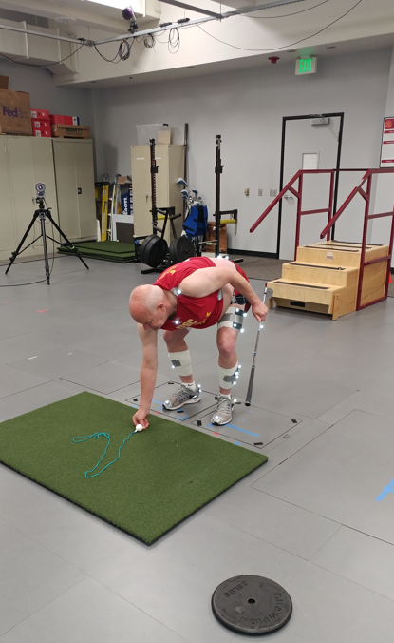
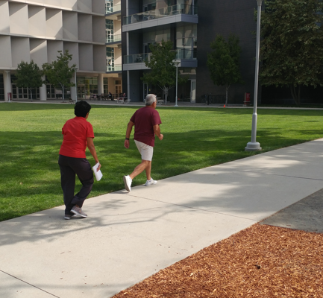
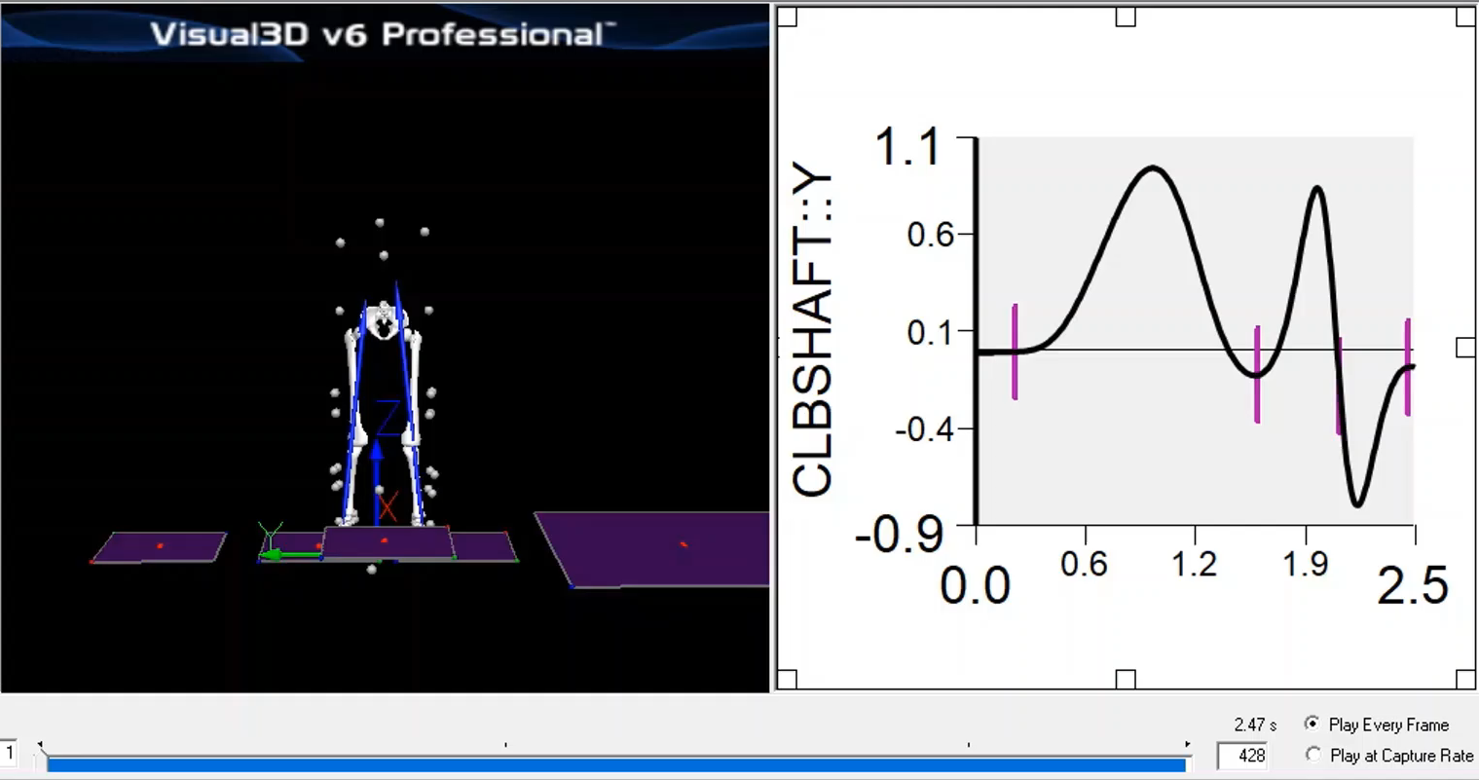
Program Efficacy Assessments
PHYSICAL
FUNCTIONAL
STRENGTH
BODY COMPOSITION
GAIT
BIOMECHANICAL DEMANDS
REACTION TIME
ACTIVITY LEVEL
BLOOD BIOMARKERS
PHYSICAL
Notes:
We used an extensive list of assessment tools, which covers 3 main areas of health, to evaluate the efficacy or effectiveness of the program.
Since we’re biomechanists by training in a physical therapy department, we had many assessments of physical health and

Slide 21
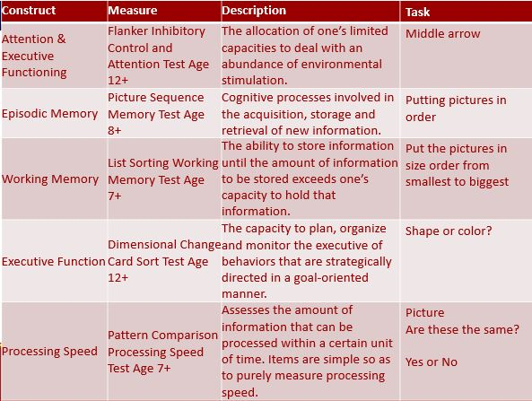
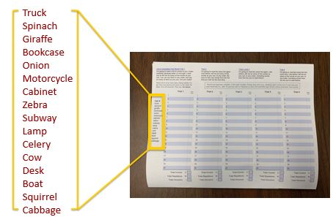
Program Efficacy Assessments
COGNITION
PHYSICAL
FUNCTIONAL
STRENGTH
BODY COMPOSITION
GAIT
BIOMECHANICAL DEMANDS
REACTION TIME
ACTIVITY LEVEL
BLOOD BIOMARKERS
NIH TOOLBOX FOR COGNITION
Memory
Cognitive flexibility
Processing Speed
CALIFORNIA VERBAL LEARNING TEST
Aspects of Recall
PHYSICAL
Notes:
For cognition, we used two validated testing batteries NIH toolbox
Episodic Memory
Working Memory
Cognitive Flexibility
Processing Speed
Composite
CALIFORNIA VERBAL LEARNING
Immediate Recall
Short-Delay Recall
Long-Delay Recall
Total T Score
The SF-12 uses the same eight domains as the SF-36:
1) Limitations in physical activities because of health problems.
2) Limitations in social activities because of physical or emotional problems
3) Limitations in usual role activities because of physical health problems
4) Bodily pain
5) General mental health (psychological distress and well-being)
6) Limitations in usual role activities because of emotional problems
7) Vitality (energy and fatigue)
8) General health perceptions

Slide 22
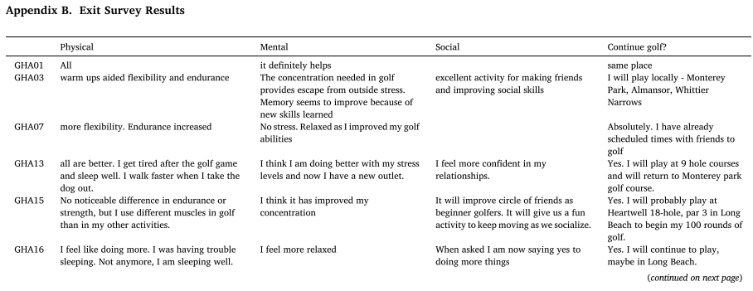
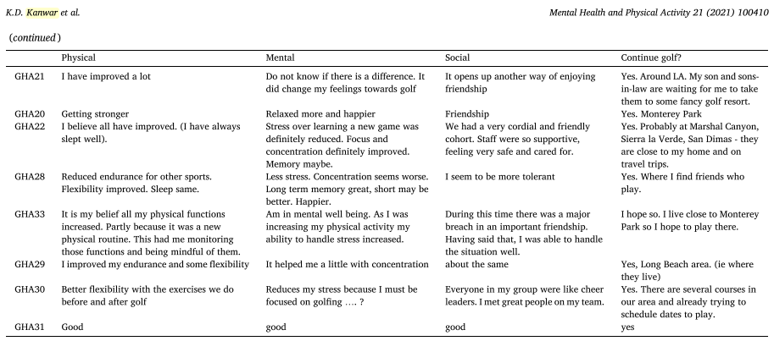
Program Efficacy Assessments
PSYCHOSOCIAL
SELF-REPORTED
Physical wellness
Mental wellness
Social wellness
Via SF-12 & Exit Survey
Adopted from Kanwar et al. Ment. Health Phys. Act. 2021
Notes:
The SF-12 uses the same eight domains as the SF-36:
1) Limitations in physical activities because of health problems.
2) Limitations in social activities because of physical or emotional problems
3) Limitations in usual role activities because of physical health problems
4) Bodily pain
5) General mental health (psychological distress and well-being)
6) Limitations in usual role activities because of emotional problems
7) Vitality (energy and fatigue)
8) General health perceptions

Slide 23
Physical Tests Results Summary
Variable | Pre | Post | % | ES
8’ TUG test (s) | 5.37 ± 0.64 | 4.82 ± 0.7 | 10.39 | 1.29
Hip Abduction Strength (N/BW) | 2.55 ± 0.51 | 2.73 ± 0.48 | 7.29 | 1.03
Chair Stand (reps) | 16 ± 4 | 19 ± 4 | 18.27 | 0.90
Heel Raise (reps) | 14 ± 3 | 15 ± 2 | 9.09 | 0.77
Hand Grip Strength (kg) | 33.68 ± 10.53 | 36.41 ± 11.11 | 8.12 | 0.71
Fast Gait Velocity (m/s) | 1.95 ± 0.17 | 2.09 ± 0.21 | 6.87 | 0.63
6 minute walk | 591.31 ± 43.93 | 615.85 ± 70.16 | 6.9 | 0.46
Notes:
Heel raise and chair stand both 30 s
Effect sizes were moderate to very large
These improvements could be attributed to the number of physical challenges they encounter during golf

Slide 24
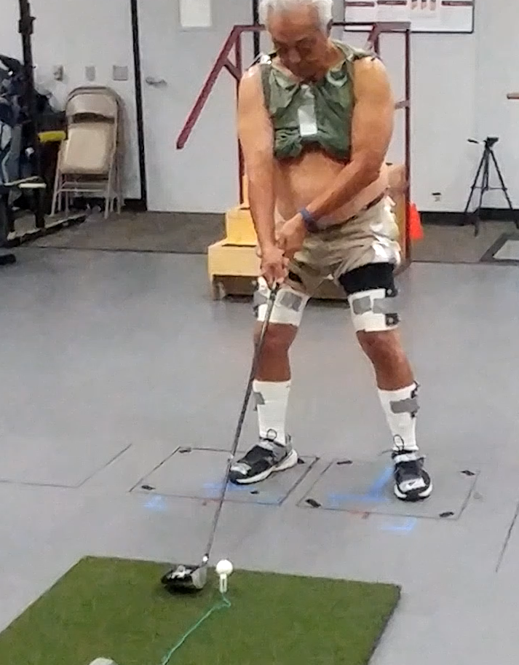

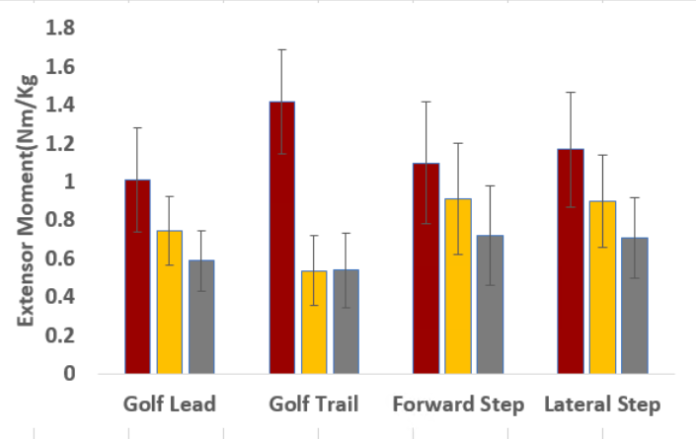
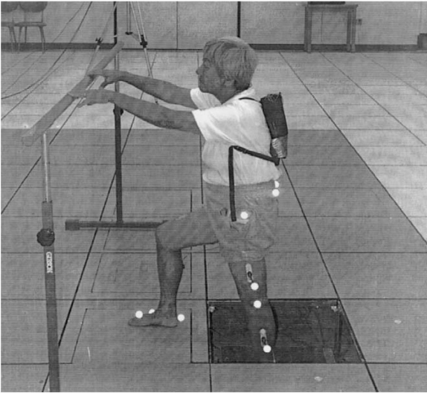
Biomechanical Results
Adapted from Wang et al. Clin Biomech. 2003
Notes:
We then took the 7 iron peak extensor moments and compared them to previously published data from our lab on stepping activities.
We didn’t run stats, but from the visual comparison we can see that the peak moments in the golf swing appear to be similar those of forward and lateral stepping. The golf swing appears to be more hip dominant in our sample, particularly in the trail hip.

Slide 25

Golf & Cognition
↑ California Verbal Learning Test II Composite Score
↑ NIH Toolbox Cognition Battery Composite Score
↑ Dual-Task Gait Speed
Kanwar et al. Ment. Health Phys. Act. 2021

Slide 26
Inflammation
Inflammaging - low grade, persistent inflammation that increases with age¹
↑ Inflammation Cancer Development²
-Cell Proliferation
-Angiogenesis
-Inflammatory Mediators
CRP
IL-1𝜷
IL-6
IL-8
TNF-𝛼
MMPs
Franeschi & Campisi, J Gerontology, 2014
Mantovani et al., Nature, 2008

Slide 27
Anti-Inflammatory Effects of Exercise
TNF-𝜶 independent IL-6 production¹
-stimulates anti-inflammatory processes
HIIT reduces MMP-9 in patients with breast cancer²
Can golf promote anti-inflammatory benefits?
𝛼𝛼a
IL-10
IL-1ra
TNF-𝜶 inhibition
Petersen & Pedersen, J Applied Phys, 2005
Lee et al., Scientific Reports, 2021

Slide 28
Golf & Inflammation
 | Pre | Post | Hedge’s g
CRP | 3.01 ± 2.21 (mg/mL) | 1.51 ± 1.50 (mg/mL) | 0.73
IFN-𝜸 | 11.28 ± 7.04 (pg/mL) | 9.67 ± 7.67 (pg/mL) | 0.20
TNF-𝜶 | 19.29 ± 8.67 (pg/mL) | 17.24 ± 8.15 (pg/mL) | 0.23
IL-10 | 22.68 ± 12.85 (pg/mL) | 21.43 ± 10.91 (pg/mL) | 0.10
*Presented at American Association of Immunologists National Conference 2021

Slide 29
What have we learned?
Feasibility
Long-term physical activity engagement
Beneficial to aspects of physical, cognitive, & psychosocial health

Slide 30
Exercise Oncology
Exercise Oncology
Number of RCTs grew exponentially
ACSM 1st Roundtable Guidance, 2010
- 227 available RCTs
ACSM 2nd Roundtable, 2018
Number of RCTs grew exponentially
ACSM 1st Roundtable Guidance, 2010
- 227 available RCTs
ACSM 2nd Roundtable, 2018
- more than 800 available RCTs
Notes:
Fast forward to the recent decades, I gathered information on what I thought were two landmark events in exercise oncology in America, with global influence.
Number of RCTs grew exponentially since 1990
And 20 years later in the First ACSM roundtable discussion focused on the side effect of cancer and whether exercise was safe. By then they had 227 available RCTs.
Second roundtable was much more interdisciplinary (14 organizations worldwide) and international (UK, Canada, Aus, Netherland, Germany), focused on boarder spectrum. By then the number of RCTs almost increased 4fold
American College of Sports Medicine Roundtable Report on Physical Activity, Sedentary Behavior, and Cancer Prevention and Control¹
Exercise Guidelines for Cancer Survivors: Consensus statement from an International Multidisciplinary Roundtable²
Exercise is Medicine in Oncology: Engaging clinicians to help patients move through cancer³
Despite the growing body of evidence, there is still much left to answer in exercise oncology due to the complexity of cancer pathology in different types of cancer, the number of potential exercise modalities, and time points of intervention.

Slide 31
Exercise Guidelines for Cancer Survivors
Strong Evidence | Moderate Evidence | Insufficient Evidence
1. Anxiety 2. Depressive Symptoms 3. Fatigue 4. Health-related QOL 5. Lymphedema* 6. Physical functions* | 7. Bone health 8. Sleep | 9. Cardiotoxicity 10. Chemotherapy-induced peripheral neuropathy 11. Cognitive function 12. Falls 13. Nausea 14. Pain 15. Sexual function 16. Treatment tolerance
Notes:
So these are the health outcomes and/or symptoms that have been studied in current exercise oncology studies.
Strong evidence: there was consensus that benefit has been consistently demonstrated and a FITT prescription was developed for these cancer-related health outcomes. These FITT prescriptions are regarding traditional aerobic and resistance training or combined. There has been no formal investigation using golf as an modality, but there are some evidence regarding other modalities such as yoga, breathing exercises, dragon boating, recreational sports, rock climbing, triathalon, or HIIT, but there are on going research.
Moderate evidence: there was mixed evidence in the effects of exercise in cancer survivors in these measures
Insufficient evidence: doesn’t mean that exercise is not beneficial for these outcomes; rather, is shows that there is a gap in the current literature regarding the effects of exercise in these outcomes.
Lymphedema: mostly safety and not worsen vs. improvement;
Preliminary results show that effects observed in breast cancer may not translate to other types of cancers
Physical functions: self-reported and not objectively measured.
Another thing that I want to point out is that all of these health outcomes in the strong evidence column pertain to breast and prostate cancer, except for lymphedema which only pertains to breast cancer. But this is unsurprising because they are two of the most common types of cancers.

Slide 32
Exercise Guidelines for Cancer Survivors
Strong Evidence | Moderate Evidence | Insufficient Evidence
1. Anxiety 2. Depressive Symptoms 3. Fatigue 4. Health-related QOL 5. Lymphedema* 6. Physical functions* | 7. Bone health 8. Sleep | 9. Cardiotoxicity 10. Chemotherapy-induced peripheral neuropathy 11. Cognitive function 12. Falls 13. Nausea 14. Pain 15. Sexual function 16. Treatment tolerance
Notes:
So these are the health outcomes and/or symptoms that have been studied in current exercise oncology studies.
Strong evidence: there was consensus that benefit has been consistently demonstrated and a FITT prescription was developed for these cancer-related health outcomes. These FITT prescriptions are regarding traditional aerobic and resistance training or combined. There has been no formal investigation using golf as an modality, but there are some evidence regarding other modalities such as yoga, breathing exercises, dragon boating, recreational sports, rock climbing, triathalon, or HIIT, but there are on going research.
Moderate evidence: there was mixed evidence in the effects of exercise in cancer survivors in these measures
Insufficient evidence: doesn’t mean that exercise is not beneficial for these outcomes; rather, is shows that there is a gap in the current literature regarding the effects of exercise in these outcomes.
Lymphedema: mostly safety and not worsen vs. improvement;
Preliminary results show that effects observed in breast cancer may not translate to other types of cancers
Physical functions: self-reported and not objectively measured.
Another thing that I want to point out is that all of these health outcomes in the strong evidence column pertain to breast and prostate cancer, except for lymphedema which only pertains to breast cancer. But this is unsurprising because they are two of the most common types of cancers.

Slide 33
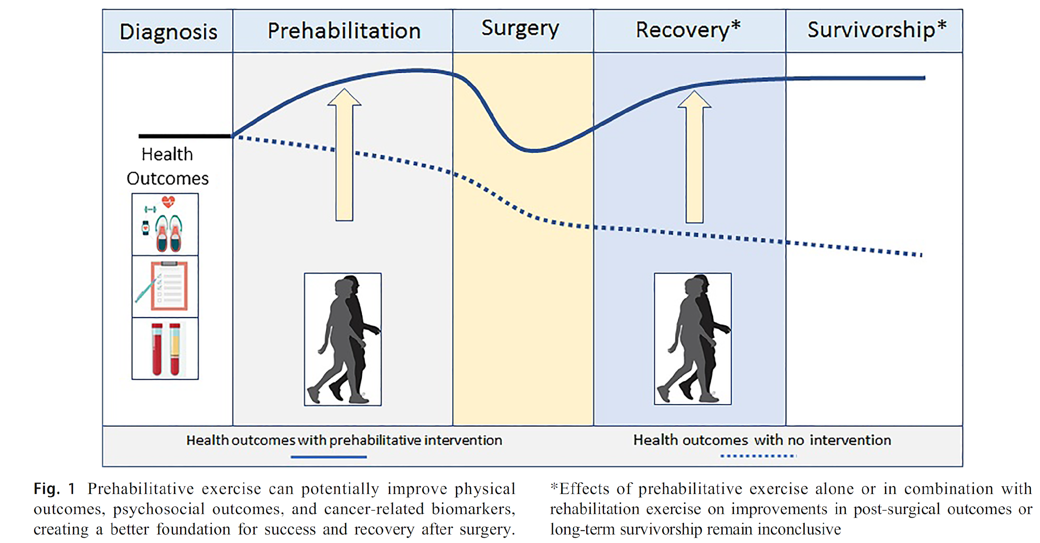
Theoretical Framework: Prehabilitative Exercise on Health Outcomes
Adopted from Lee et al., Curr Oncol Rep. 2020
Notes:
Review on prehabilitation intervention studies to summarize the effects of prehabilitative exercise interventions on the physical, psychosocial, and biological outcomes among patients with cancer. They proposed this theorical framework that illustrated the potential of prehabilitative exercise benefiting cancer prognosis, and setting up a better foundation for success and recovery after surgery.
Prehab window (7 to 52 days, median of 21 days), and all surgical treatments.

Slide 34
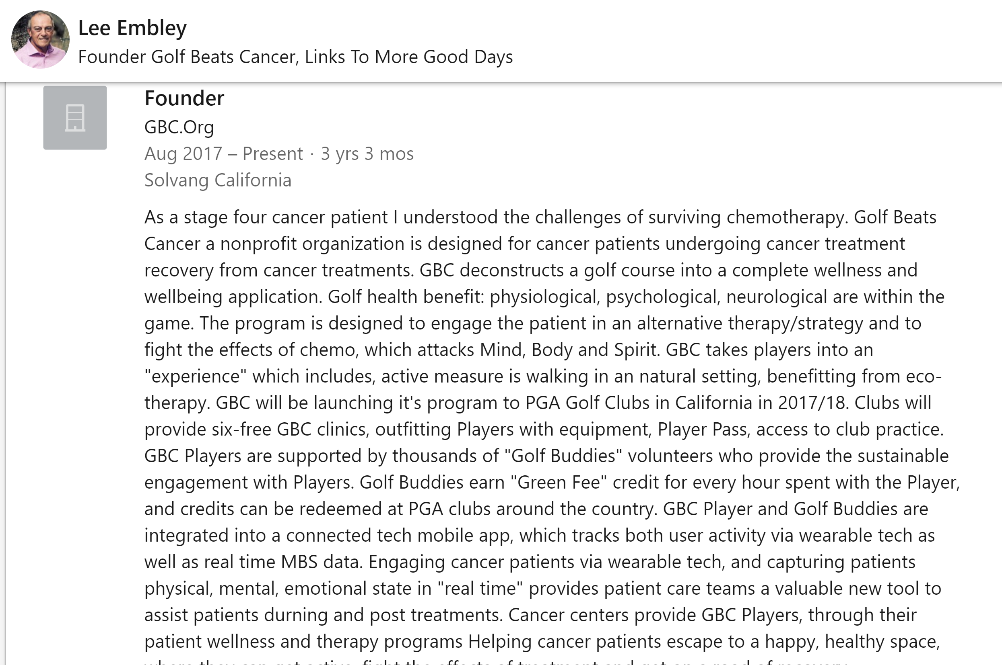
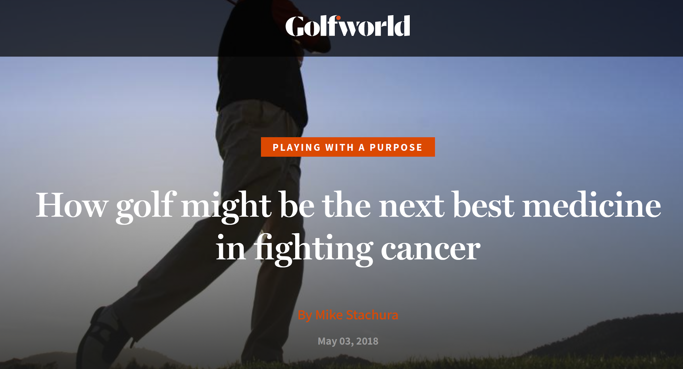
Stachura. Golf Digest. 2018
Linkedin. linkedin.com/in/lee-embley-2607a03/
Notes:
Although no formal investigation has examined effects of a golf training program with cancer. There has been report of a non-profit organization name Golf Beats Cancer founded by a cancer patient and survivor, Mr. Embley. This article reported that Golf Beats Cancer partnered with American Cancer Society to host a 2day 5k and golf fundraising event. This article also included comments from Mr. Lee’s oncologist, Dr. Kass, who is very supportive of the idea of his patients participating in golf. Again, this is not a formal investigation in any way, but it shows that there are clinicians and patients out there who think that golf has something to offer to cancer survivors. We’re in the process of connecting with this group to hopefully learn something from their experience.

Slide 35


Exercise Intensity & Volume Modulators
Warm-up
  Population specific exercises
  Golf specific exercises
Golf Practice
  Long-game
  Short-game
Golf Play
  Intensity: methods of club transportation, pace of play, course profile
  Volume: # of holes played, distance per hole
Notes:
Here I listed some of the exercise prescription modulators of golf play I deemed important and relevant when thinking about designing an effective training program with golf.
Number of holes played and distance per hole would add up to total distance of the course. Clarification here, total distance of the course doesn’t equal to distance traveled by the player because they almost never walk in the shortest distance from the tee box to the hole. So quantification and monitoring of the distance and physical activity level could be very important to different populations.

Slide 36
BC-Related Health Outcomes
Physical-Physiological | Psychosocial-Cognitive
Lymphedema Fatigue HRQoL Weakness Poor ROM Cardiotoxicity Altered movement pattern or muscle recruitment Pain | Anxiety Depressive symptoms Emotional distress Body image Sleep Chemotherapy-induced neuropathy
Campbell et al., Med Sci Sports Exerc. 2019
Hayes et al. Cancer. 2012
Eaton et al. Curr. Breast Cacner Rep. 2020
Notes:
Besides theses common health outcomes and symptoms that pertains to most types of cancer, breast cancer has a specific set of
Lymphedema is caused by a disruption of the lymphatic system that in the initial stages leads to the accumulation of fluid in the interstitial tissue space (that is, increases in extracellular fluid) and eventually clinically manifests as swelling of the arm, breast, shoulder, neck, or torso)

Slide 37
Summary
Exercise – beneficial to health outcomes
Golf – unique characteristics & multimodal
Potential utilization in cancer survivors
Notes:
Outdoor in green enviroment, social aspect in a group setting among people who have similar experience, mindful activity in nature, cognitively challenging

Slide 38
Discussion
What specific populations could benefit the most?
What health outcomes are of the most interest?
How much does psychosocial status potentially influence physical health outcomes?
Notes:
Last one potentially

Slide 39


Thank you for your time!
Acknowledgements

Slide 40
Content
Multimodal Recreational Exercise
Exercise Oncology
Summary
Discussion

