Slide 1
A Hidden Markov Model Based Intelligent Platform for Characterizing Behaviors

Slide 2
Introduction
Data science in psychology
AI to help diagnoses
RP-VITA
R. Y. Masri and H. Mat Jani, “Employing artificial intelligence techniques in mental health diagnostic expert system,” 2012 International Conference on Computer & Information Science (ICCIS), 2012.
Notes:
Background
Recent advancements made with data science in the field of psychology
Despite this, diagnosing these disorders can prove to be a challenge and may require large amounts of time and personalized testing for each individual.
How the diagnosis of behavioral disorders can be deduced using several key behavioral abnormalities.
Talk about benefits of the individualized profiles etc.

Slide 3
General direction of work
Diagnosis of behavioural disorders
Builds personalized profiles.
Notes:
Background
Recent advancements made with data science in the field of psychology
Despite this, diagnosing these disorders can prove to be a challenge and may require large amounts of time and personalized testing for each individual.
How the diagnosis of behavioral disorders can be deduced using several key behavioral abnormalities.
Talk about benefits of the individualized profiles etc.

Slide 4
Similar research in this area

Slide 5
Computational psychology
Statistical modeling to aid diagnosis of mental illnesses
Effects of COVID-19 on mental health
K. Ćosić, S. Popović, M. Šarlija, I. Kesedžić, and T. Jovanovic, “Artificial Intelligence in prediction of mental health disorders induced by the COVID-19 pandemic among health care workers,” Croatian Medical Journal, vol. 61, no. 3, pp. 279–288, 2020. C. Yanan, N. Ao, Y. Xiao and X. Jiang, “A Depression-Risk Mental Pattern Identified by Hidden Markov Model (HMM) in Undergraduates”, 19-Jan-2022. [Online]. Available: psyarxiv.com/shdte.
Notes:
Background
Recent advancements made with data science in the field of psychology
Despite this, diagnosing these disorders can prove to be a challenge and may require large amounts of time and personalized testing for each individual.
How the diagnosis of behavioral disorders can be deduced using several key behavioral abnormalities.
Talk about benefits of the individualized profiles etc.

Slide 6
Computational psychology
In early stages but has benefits such as:
Ease of use
Privacy
Wider user range
Notes:
Finish off with blurb from end: In our project, we aim to address these issues by creating a dynamic, updating, and personalized model which could apply to mental health assessments and help psychologists gauge patient behaviors through a relatively simplistic medium while

Slide 7
Our Goal
Simple games
Wide user range
Dynamic and personalized profiles
Notes:
Finish off with blurb from end: In our project, we aim to address these issues by creating a dynamic, updating, and personalized model which could apply to mental health assessments and help psychologists gauge patient behaviors through a relatively simplistic medium while

Slide 8
What simple game?
Rock-Paper-Scissors
Identifiable behaviors
Well-known
H. Zhang, F. Moisan, and C. Gonzalez, “Paper-rock-scissors: An exploration of the dynamics of players’ strategies,” Proceedings of the Human Factors and Ergonomics Society Annual Meeting, vol. 64, no. 1, pp. 268–272, 2021. E. Brockbank and E. Vul, “Formalizing opponent modeling with the rock, paper, scissors game,” Games, vol. 12, no. 3, p. 70, 2021. Brockbank, E., Vul, E. (2020). Recursive adversarial reasoning in the rock, paper, scissors game.
Notes:
Wider range of users

Slide 9
Our Algorithm
Notes:
Only introduce

Slide 10
Statistical-based Approach
Similar uses:
Observational psychology
Diagnoses of mental illnesses
Notes:
Our algorithm uses a statistical based approach. While new, other applications in psychology have beghun using it such as in obs. And diagnosis.

Slide 11
Hidden Markov Model (HMM)
Probabilistic/Statistical Model
Describes probabilities within a system
Transition or Emission Probabilities
Predicts a hidden variable from an observed one
Notes:
So in our situation we attempt to use statistical modeling to infer a players behavior from their gameplay and as a result, we choose a Hidden markov model as it fits our situation.

Slide 12
The HMM can described by Θ {T(i, j), E(i, k), π(i) }:
1) Transition probability:
T(i, j) = P(S=i , S=j ); i, j ∈ S{1,2,...,M};
2) Emission probability:
E(i, k) = P(S=i , O=k ); i ∈ S{1,2,...,M}; k ∈ O{O₁O₂,...,O_{N}};
3) Initial state probability:
π(i)= P {S = i}; i ∈ S{1,2,...,M}.
P{X, Y |Θ} = P{X|Y, Θ}P{Y|Θ}, X_{t} is observation vector; Y_{t} is the state vector at time point t .
Notes:
The probability from state i at time point t transits to state j at next time point t+1.The system has set of states S = {S₁, S₂,...,S_{M}}.
The probability for state i, and the observation is k . The set of observations O = {O₁O₂,...,O_{N}}
Based on these parameters, the probability that the HMM will generate the observation sequence X = X₁ X₂ ... X_{L} with the underlying state sequence Y = Y₁ Y₂ ... Y_{L}. This joint probability P {X,Y | Θ} can be computed by

Slide 13
Simple Example of a HMM for Weather
0.6
0.7
0.4
Rainy
Sunny
0.3
Notes:
Basic weather model

Slide 14
Simple Example of a HMM for Weather
0.6
0.7
0.4
Rainy
Sunny
0.3
Rainy Emission Prob:
Rain Jacket- 90%
Shorts - 10%
Sunny – Emission Prob:
Shorts - 90%
Rain Jacket- 10%
Notes:
To make a HMM more complete, we will have emission. Meaning 90% rainy etc.

Slide 15
Transition Probabilities
Emission Probabilities
Chance of one state moving to another
Depends on previous states
Probabilities of individual events
Observable
Independant
Notes:
Explain repeat upgrade and downgrade

Slide 16
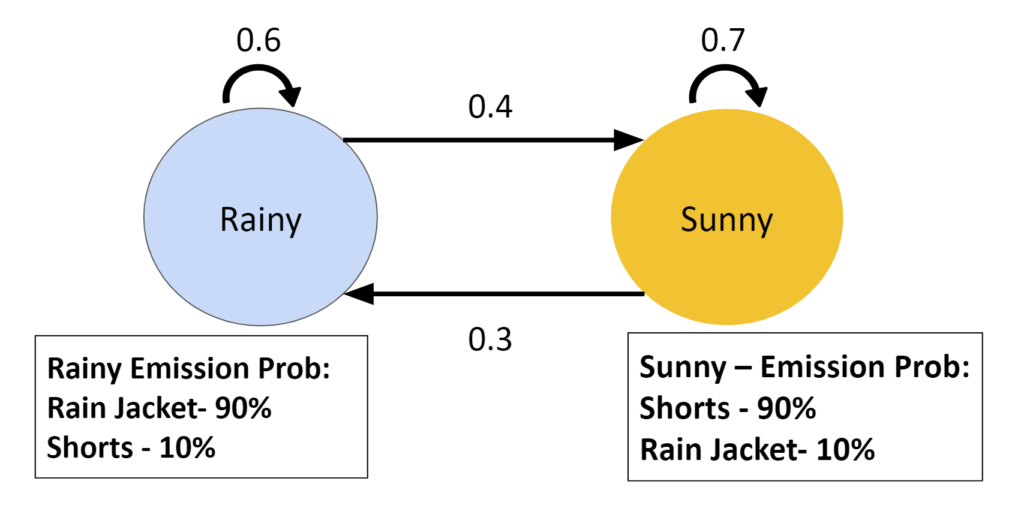
How can we use HMMs?
Studying in the library without windows, can only observe clothing of others
I.e shorts, jacket, shorts, shorts shorts
Using HMM, outside weather can be predicted from observations
Notes:
-this is a very basic example, draw the conclusion from the obs. Ratio, but using HMM can get more accurate (say). The method used in an HMM for prediciton is called the viterbi method

Slide 17
The Viterbi Algorithm
Max for row 1 at pos n
Max for row 2 at pos n
Max for row 3 at pos n
1
Out
Out
T(0,0)
T(1,0)
2
Self
Self
T(2,0)
3
Op
Op
N

Slide 18
The Viterbi Algorithm
Max for row 1 at pos n+1
Max for row 2 at pos n+1
Max for row 3 at pos n+1
1
1
Out
T(0,0)
T(1,0)
2
2
Self
T(2,0)
3
3
Op
N
N+1

Slide 19
The Viterbi Algorithm
1
1
1
T(0,0)
T(1,0)
2
2
2
T(2,0)
3
3
3
N
N+1
N+2

Slide 20
Viterbi algorithm:
Get the BEST sequence of states path guess X = (x₁, x₂, ….x_{n}); x_{t} ∈ S ={s₁,s₂, ….s_{m}}
from the HMM model Θ {T(i, j), E(i, k), π(i) } and the observations Y=(y₁, y₂, ….. y_{n})
y_{t} ∈ O={o₁, o₂, …..o_{n}},
At each time point j (total n) and each state i, calculate the max possibility and saved into P(m, n) table’s P(i, j) cell. This max possibility can be calculated base on t-1 time point value and T(i, j), E(i, k)
P(i, j) = MAX ( P(k, j-1) * T(k, i) * E(i,y_{j}) ); k is the index of state
k
At this max point’s, the k value is indicate what path it comes and saved into R(m, n) table’s R(i, j) cell
R(i, j) = argmax_{k} ( P(k, j-1) * T(k, i) * E(i,y_{j}) )
Max P(i, N) is best guess, trace back from R(i,N) will get the BEST sequence of states path

Slide 21
3 states chosen for analysis
Outcome focused players
Risk taker’s
Self-Focused Players
Rigid or Persevering thinkers
Opponent-Focused players
Evidence based thinkers
Notes:
Back to our project, 3 states. This 3 states are irrelabtn from the 3 choices in RPS, you cna have 2 or 4 etc. we reason we choose three states is because of paper

Slide 22
Why these States?
K. McCaul, “Winning, losing, mood, and Testosterone,” Hormones and behavior, vol. 26, no. 4, pp. 486–504, 1992. T. Cox and J. H. Kerr, “Self-reported mood in competitive squash,” Personality and Individual Differences, vol. 11, no. 2, pp. 199–203, 1990. N. Esfahani, H. G. Soflu, and H. Assadi, “Comparison of mood in basketball players in Iran league 2 and relation with Team Cohesion and Performance,” Procedia - Social and behavioral Sciences, vol. 30, pp. 2364–2368, 2011.
Notes:
Any other significant states need to be added, it can al/ be added
Documented in other papers
Multitude of behaviours, these are easy to pick up in in RPS?
Mulotitude of behaviors, more siginficant/other behvavior could be added through adiditon of anotyher states. These have been chosen as they have been documented as bheavuours present in games and other adversarial sitautiosn in other research.

Slide 23
Example Model
Our Model
Out
Rainy
Sunny
Self
Op
Notes:
Based on the observations of the jacket we can predict weather; similarly based on RPS choices, we can get behaviro pattern. behavior

Slide 24
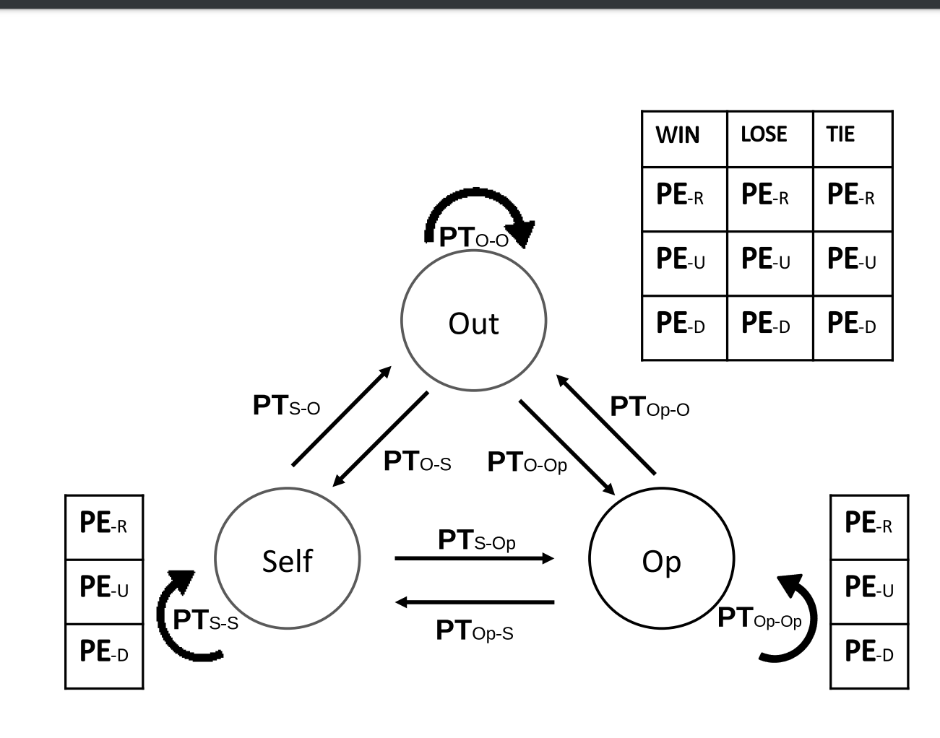
The HMM used within our project
Notes:
Mention that there are values there, pe=emission, pt= transition

Slide 25
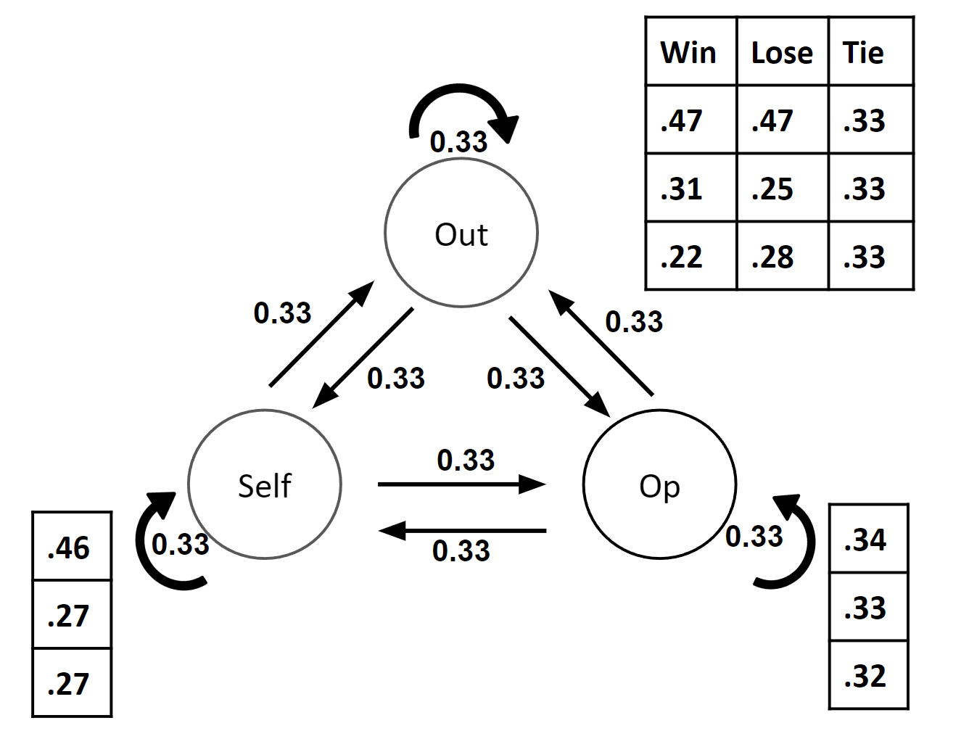
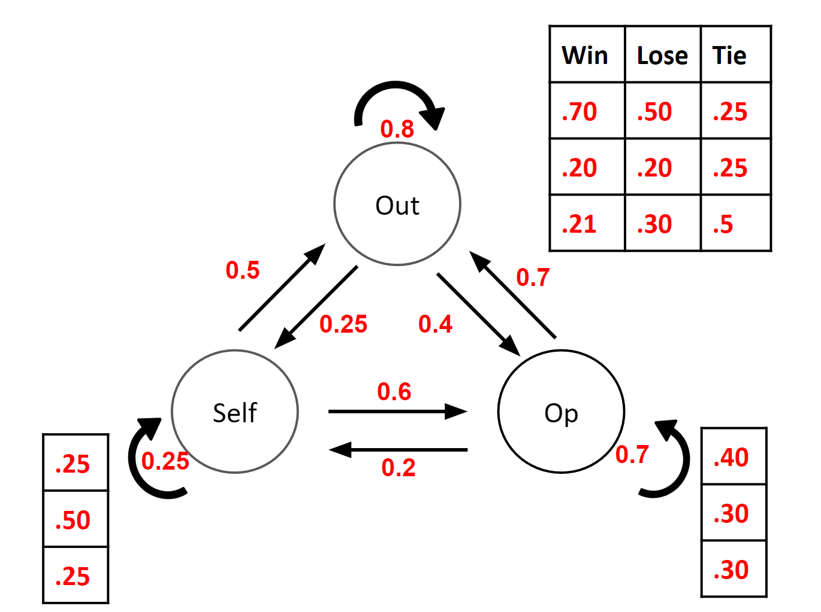
How do we use HMM
Initialization Model
Outcome of rounds used to update model
Predicted next move
Notes:
Talk about in general what changed, why they help
We input the same choices into a program using the old model and a program using the changed model. As you can see, the changed model was more successful shown by the higher win rate.

Slide 26
Challenges with using an HMM in our situation
Notes:
(say) if we directly apply HMM in this situation, it will not give us a very good-looking performance. So we must make modifications.

Slide 27
Challenge #1
Convergence speed
Better initial values→faster converge
Notes:
Additionally, our first 20 rounds we will use initialization values without chagme, collect user data, use user’s first twenty round data to recreate a personalized model for this user.
Generally speaking it will converge eventually, good starting point=fast converge
In our case, how can we choose better initialization values
What is converge

Slide 28
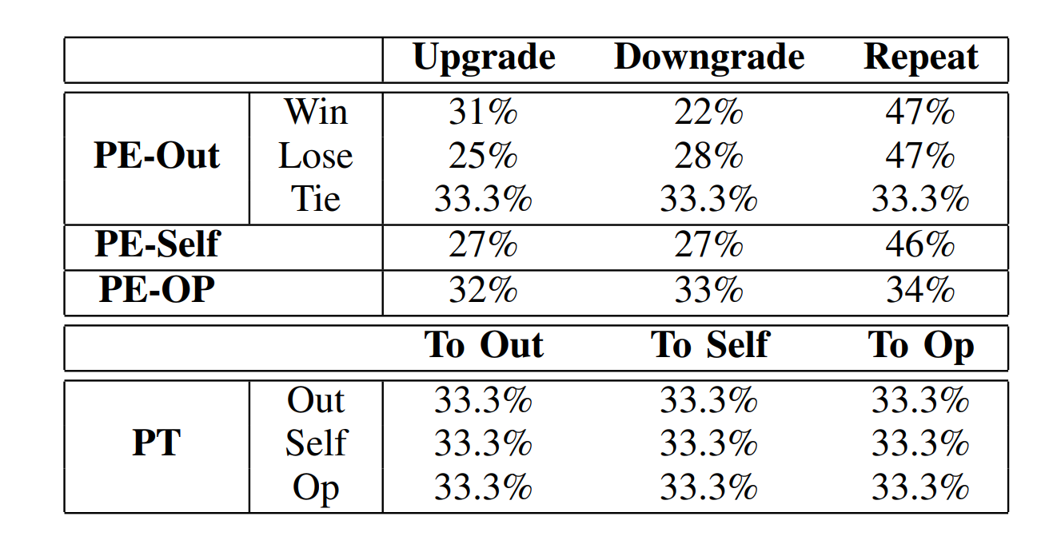
Solution to Challenge #1
Source initial values
Taken from baseline human behaviors
H. Zhang, F. Moisan, and C. Gonzalez, “Paper-rock-scissors: An exploration of the dynamics of players’ strategies,” Proceedings of the Human Factors and Ergonomics Society Annual Meeting, vol. 64, no. 1, pp. 268–272, 2021. D. Eyler, Z. Shalla, T. McDevitt, and A.Doumaux, “Winning at RockPaper-Scissors.” The College Mathematics Journal, vol. 40, no. 2, pp. 125–28. 2009. [45] D. Batzilis, S. Jaffe, S. Levitt, J. A. List, and J. Picel, “Behavior in strategic settings: Evidence from a million rock-paper-scissors games,” Games, vol. 10, no. 2, p. 18, 2019. S. Sadaghiani and A. Kleinschmidt, “Functional interactions between intrinsic brain activity and behavior,” NeuroImage, vol. 80, pp. 379–386, 2013.
Notes:
Additionally, our first 20 rounds we will use initialization values without chagme, collect user data, use user’s first twenty round data to recreate a personalized model for this user.

Slide 29
Challenge #2
Using entire observation history
Lacks dynamism
Notes:
HMM will consider the entire history, in our case people’s mood are changing, therefore unreflective of current rounds (say)

Slide 30
Solution #2
Sliding window based data restructure
With a sliding window of size s, the set of rounds being taken into account after n rounds are played is: {R_{n−s+1},R_{n−s+2},R_{n−s+3}, ... ,R_{n}}, to replace the entire history data {R₁, R₂, ..., R_{n}}.

Slide 31
Diagram of the sliding window modification
Total Data
Set of data
Set of data
Slided over by same amount each new set
Notes:
This is an example of taking sets of data instead of using the total data set as one chink. As you can see the sets of data are moved over by a set amount each time, but remain the same size.

Slide 32
Challenge #3
Need for sub-optimal convergence
Notes:
If HMM is applied totally based on personal history, then this model will be trained to overfit current player. Must also consider general human baseline behaviors/values (say).

Slide 33
Solution #3
HMM with restart
Calculation for the HMMR: k_{n} denotes the sets of parameters for the n-th rounds and k₀ is the initial parameters of the model:
k_{n} = m ∗ (k_{n−1}) + (1 − m) ∗ k₀

Slide 34
Combination Model with Partial Reset Modification
Initial model
Final Model becomes model used to make next updated model
Current iterations model
Updated model
(not used)
Combo
Initial model
Final model used for next iteration
Behavioural Profile

Slide 35
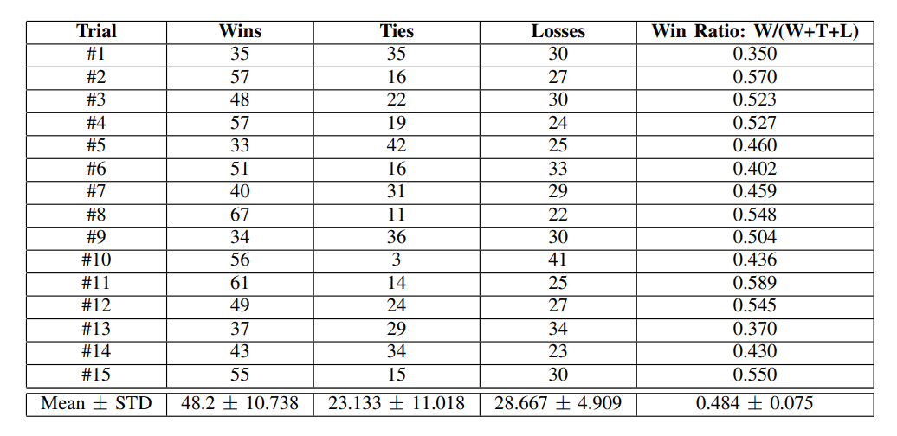
Performance
Notes:
Because of IRB cannot do any human trials, authors just did some. .33 for each by defauylt, .48 indicates that it is more accurate. Statsitcally, we can read players mind for next choice which indicates that we have idenfitifeid their current mood type as our prediction is correct and could be used as a reference for psychiatrist. Predict their current mood state which will indicate their next move. Mood indicates next move.

Slide 36
Outcome of our application
Notes:
result…

Slide 37
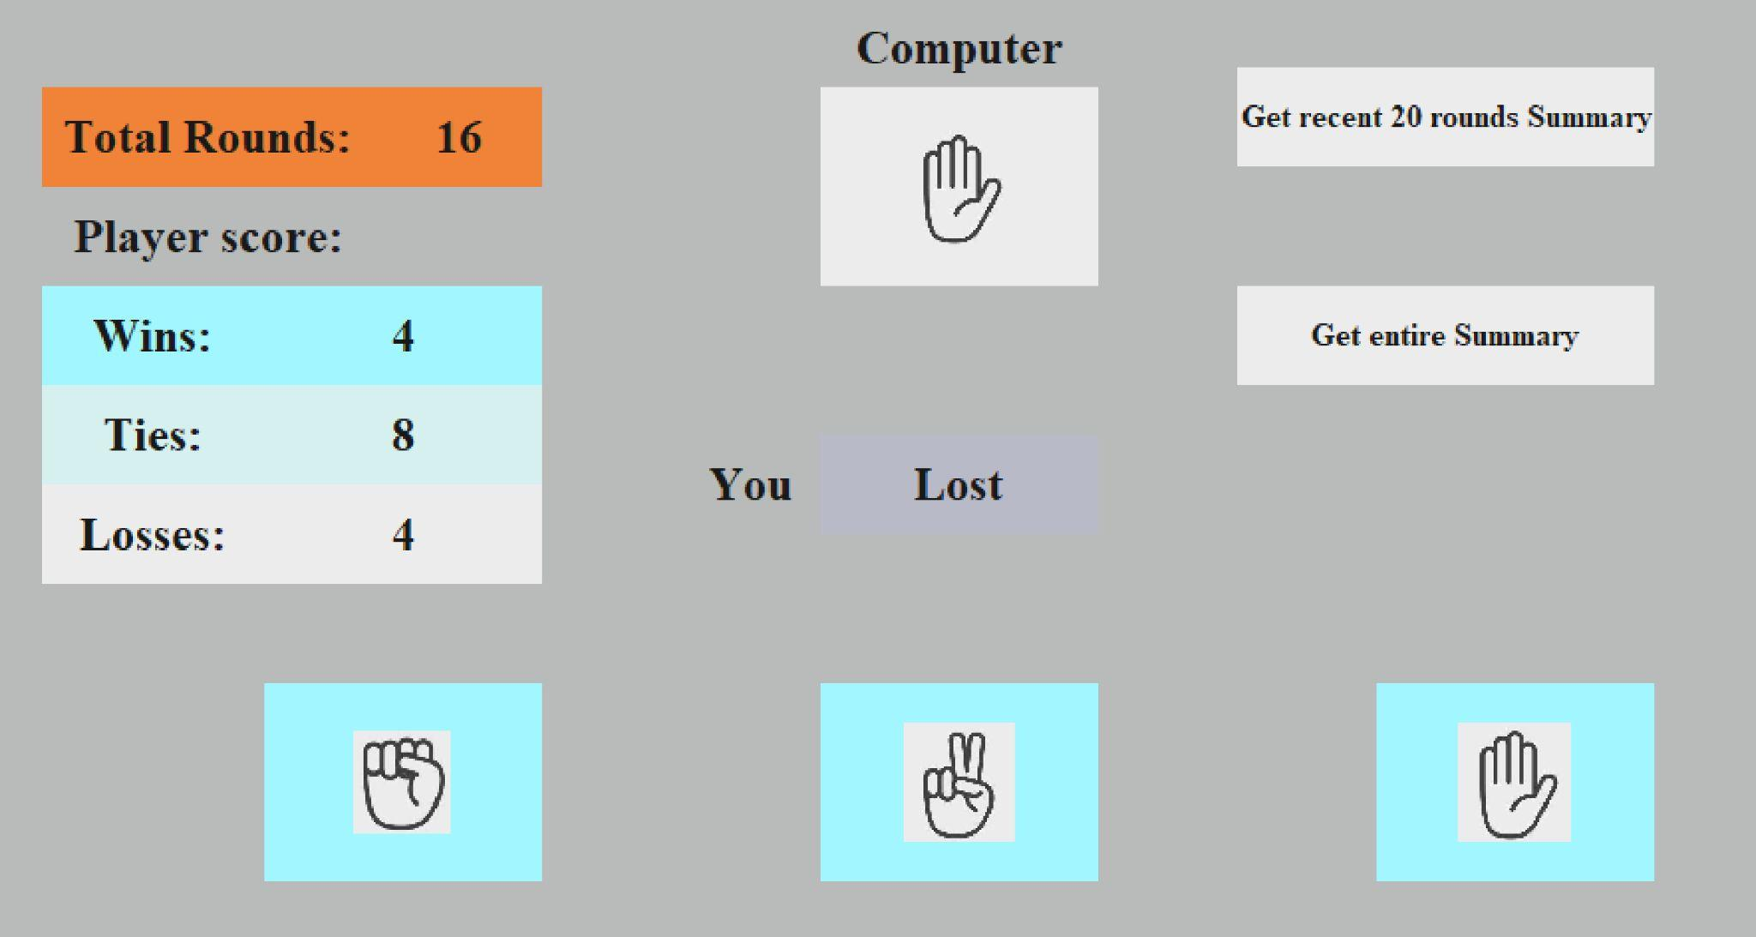
Our Application

Slide 38
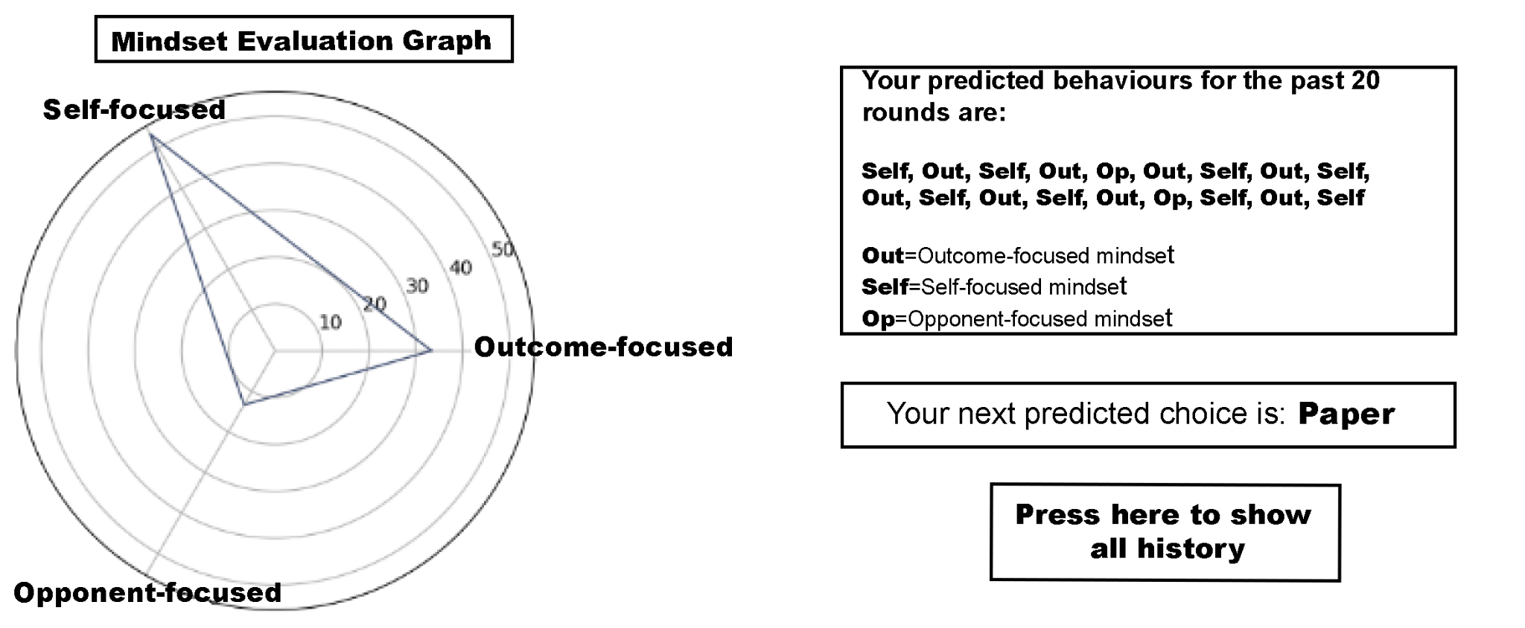
Recent 20 rounds summary

Slide 39
Future work
Human trials (with IRB approval)
Narrower identification of worrying behavior patterns
Notes:
Human trials (with IRB approval) to create a more practical platform
Ask psychiatrists to help the identification of behavior patterns that are associated with mental illnesses
Whichever is more worriable

Slide 40
Thank you for listening to our presentation

Slide 41
Computational psychology
Monte carlo way to outlier pick adhd
PSO algo
Used x algorithim to psychopathic group
Reference at bottom, spend 20 seconds talk more technical

Slide 42
Initial parameters within our HMM for RPS Player Behaviour
Out – Emission:
Win Lose Tie
Repeat 0.7 0.1 0.2
Upgrade 0.1 0.5 0.4
Downgrade 0.2 0.4 0.4
0.4
Out
0.3
0.2
0.3
0.3
Self
Op
0.2
0.5
Self – Emission:
Repeat 0.5
Upgrade 0.2
Downgrade 0.3
0.3
Op – Emission:
Repeat 0.3
Upgrade 0.5
Downgrade 0.2
0.5

Slide 43
Demo

Slide 44
Final initial parameters within our HMM for RPS Player Behaviour
Out – Emission:
Win Lose Tie
Repeat 0.47 0.47 0.33
Upgrade 0.31 0.25 0.33
Downgrade 0.22 0.28 0.33
0.4
Out
0.3
0.2
0.3
0.3
Self
Op
0.2
0.5
0.3
Self – Emission:
Repeat 0.33
Upgrade 0.33
Downgrade 0.33
Op – Emission:
Repeat 0.33
Upgrade 0.33
Downgrade 0.33
0.5

Slide 45
Implementation within project
HMM combines with RPS application
Viterbi Algorithm used to predict player’s behaviour
Detects most likely string of behaviour based on HMM
Works from the last round backwards to find best string

Slide 46
The Viterbi Algorithm
Out
Out
Out
T(0,0)
T(1,0)
Self
Self
Self
T(2,0)
Op
Op
Op
N
N+1
N+2

Slide 47
#2
#3
#4

Slide 48
Performance of Model with and without modifications
Updating without restart
Previous iterations model
Previous iterations model
Updated model (not used)
Combo
Initial model
Updated model used in next iteration
Final Used Model for Next Iteration
Updated model then becomes model used to make next updated model
Notes:
Talk about in general what changed, why they help
We input the same choices into a program using the old model and a program using the changed model. As you can see, the changed model was more successful shown by the higher win rate.

Slide 49
How do we use HMM
Initialization model
Model created
Predict next move
New outcome to update model

Slide 50
Slides to add onto end
Dynamic programing formulas
Detailed hmm example dice for viterbi algorithm.
Math, viterbi algorithm
Add more detailed stuff about slide contents, looks decent cuz well prepared

Slide 51
Example of Dynamic Programming
I have to pick from a list of numbers, with the restriction that I can’t pick two numbers that are next to each other:
3
4
1
7
2
10
6
5

Slide 52
3
4
1
7
2
10
6
5
Max at pos 1 = Item 1
Max at pos 2 = Max of (Item 1 and Item 2)
Max at pos 3 = Max of (Item 3 + Max at pos 1) and (Max at pos 2)
Max at pos 4 = Max of (Item 4 + Max at pos 2) and (Max at pos 3)
ETC
Notes:
Explai

Slide 53
Dynamic programming example
I am to pick from a list of numbers, with the restriction that I can’t pick two numbers that are next to each other:
3
4
1
7
2
10
6
5
Max at pos 2 = Max of (Item 1 and Item 2)

Slide 54
Dynamic programming example
I am to pick from a list of numbers, with the restriction that I can’t pick two numbers that are next to each other:
3
4
1
7
2
10
6
5
Max at pos 3 = Max of (Item 3 + Max at pos 1) and (Max at pos 2)

Slide 55
Dynamic programming example
I am to pick from a list of numbers, with the restriction that I can’t pick two numbers that are next to each other:
3
4
1
7
2
10
6
5
Max at pos 3 = Max of (Item 4 + Max at pos 2) and (Max at pos 3)

Slide 56
Dynamic programming example
I am to pick from a list of numbers, with the restriction that I can’t pick two numbers that are next to each other:
3
4
1
7
2
10
6
5
Max at pos 3 = Max of (Item 5 + mas at pos 3)and (max at pos 4)

Slide 57
Dynamic programming example
I am to pick from a list of numbers, with the restriction that I can’t pick two numbers that are next to each other:
3
4
1
7
2
10
6
5
Max at pos 3 = Max of (Item 6 + mas at pos 4)and (max at pos 5)

Slide 58
Dynamic programming example
I am to pick from a list of numbers, with the restriction that I can’t pick two numbers that are next to each other:
3
4
1
7
2
10
6
5
Max at pos 3 = Max of (Item 7 + mas at pos 5)and (max at pos 6)

Slide 59
Dynamic programming example
I am to pick from a list of numbers, with the restriction that I can’t pick two numbers that are next to each other:
3
4
1
7
2
10
6
5
Max at pos 8 = Max of (Item 8 + mas at pos 6)and (max at pos 7)

Slide 60
How a similar way of problem solving is used here

Slide 61
P_{rr}
E_{same-R} E_{upgrade-R} E_{downgrade-R}
Risk
P_{sr}
P_{re}
E_{same-E-win} E_{upgrade-E-win} E_{downgrade-E-win}
E_{same-E-tie} E_{upgrade-E-tie} E_{downgrade-E-tie}
E_{same-S} E_{upgrade-S} E_{downgrade-S}
P_{rs}
P_{er}
E_{same-E-lose} E_{upgrade-E-lose} E_{downgrade-E-lose}
stubborn
P_{se}
evidence
P_{es}
P_{ss}
P_{ee}

Slide 62
P_{rr}
Risk
P_{sr}
P_{re}
P_{rs}
P_{er}
stubborn
P_{se}
evidence
P_{es}
P_{ss}
P_{ee}

Slide 63
Possible paths
Risk
Risk
Risk
Stub
Stub
Stub
Evid
Evid
Evid

Slide 64
Cache the 3 value at pos 1
Max for row 1 at pos 1
Max for row 2 at pos 1
Max for row 3 at pos 1
Risk
Risk
Risk
Stub
Stub
Stub
Evid
Evid
Evid

Slide 65
Track the temporary max at pos 2
Max for row 1 at pos 2
Max for row 2 at pos 2
Max for row 3 at pos 2
Risk
Risk
Risk
Stub
Stub
Stub
Evid
Evid
Evid

Slide 66
Find the max at the final position and trace back
Risk
Risk
Max 1
Stub
Stub
Max2(final)
Evid
Evid
Max 3

Slide 67
The Viterbi Algorithm
Max for row 1 at pos 1
Max for row 2 at pos 1
Max for row 3 at pos 1
Out
Out
Out
T(0,0)
T(1,0)
Self
Self
Self
T(2,0)
Op
Op
Op
N

Slide 68
The Viterbi Algorithm
Max for row 1 at pos 2
Max for row 2 at pos 2
Max for row 3 at pos 2
Out
Out
Out
T(0,0)
T(1,0)
Self
Self
Self
T(2,0)
Op
Op
Op
N
N+1

Slide 69
The Viterbi Algorithm
Out
Out
Max 1
T(0,0)
T(1,0)
Self
Self
Max 2
T(2,0)
Op
Op
Max 3
N
N+1
N+2

