Slide 1
In a zombie apocalypse, what stuff would you store?
G**s
K****s
B*****s

Slide 2
In a zombie apocalypse, what stuff would you store?
G**s
K****s
B*****s
Water
Pasta
Toilet paper

Slide 3
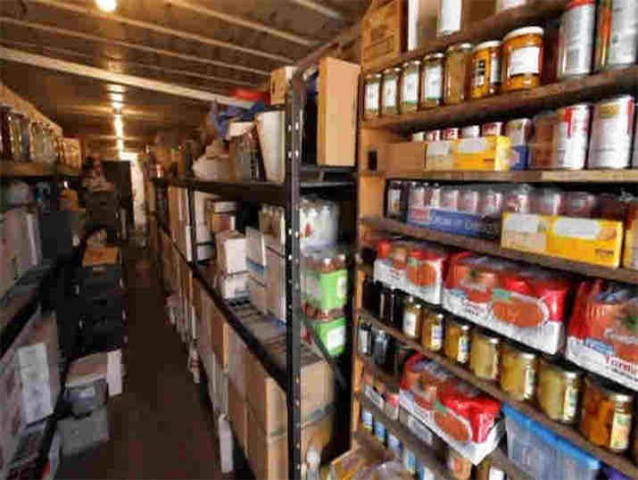

Slide 4
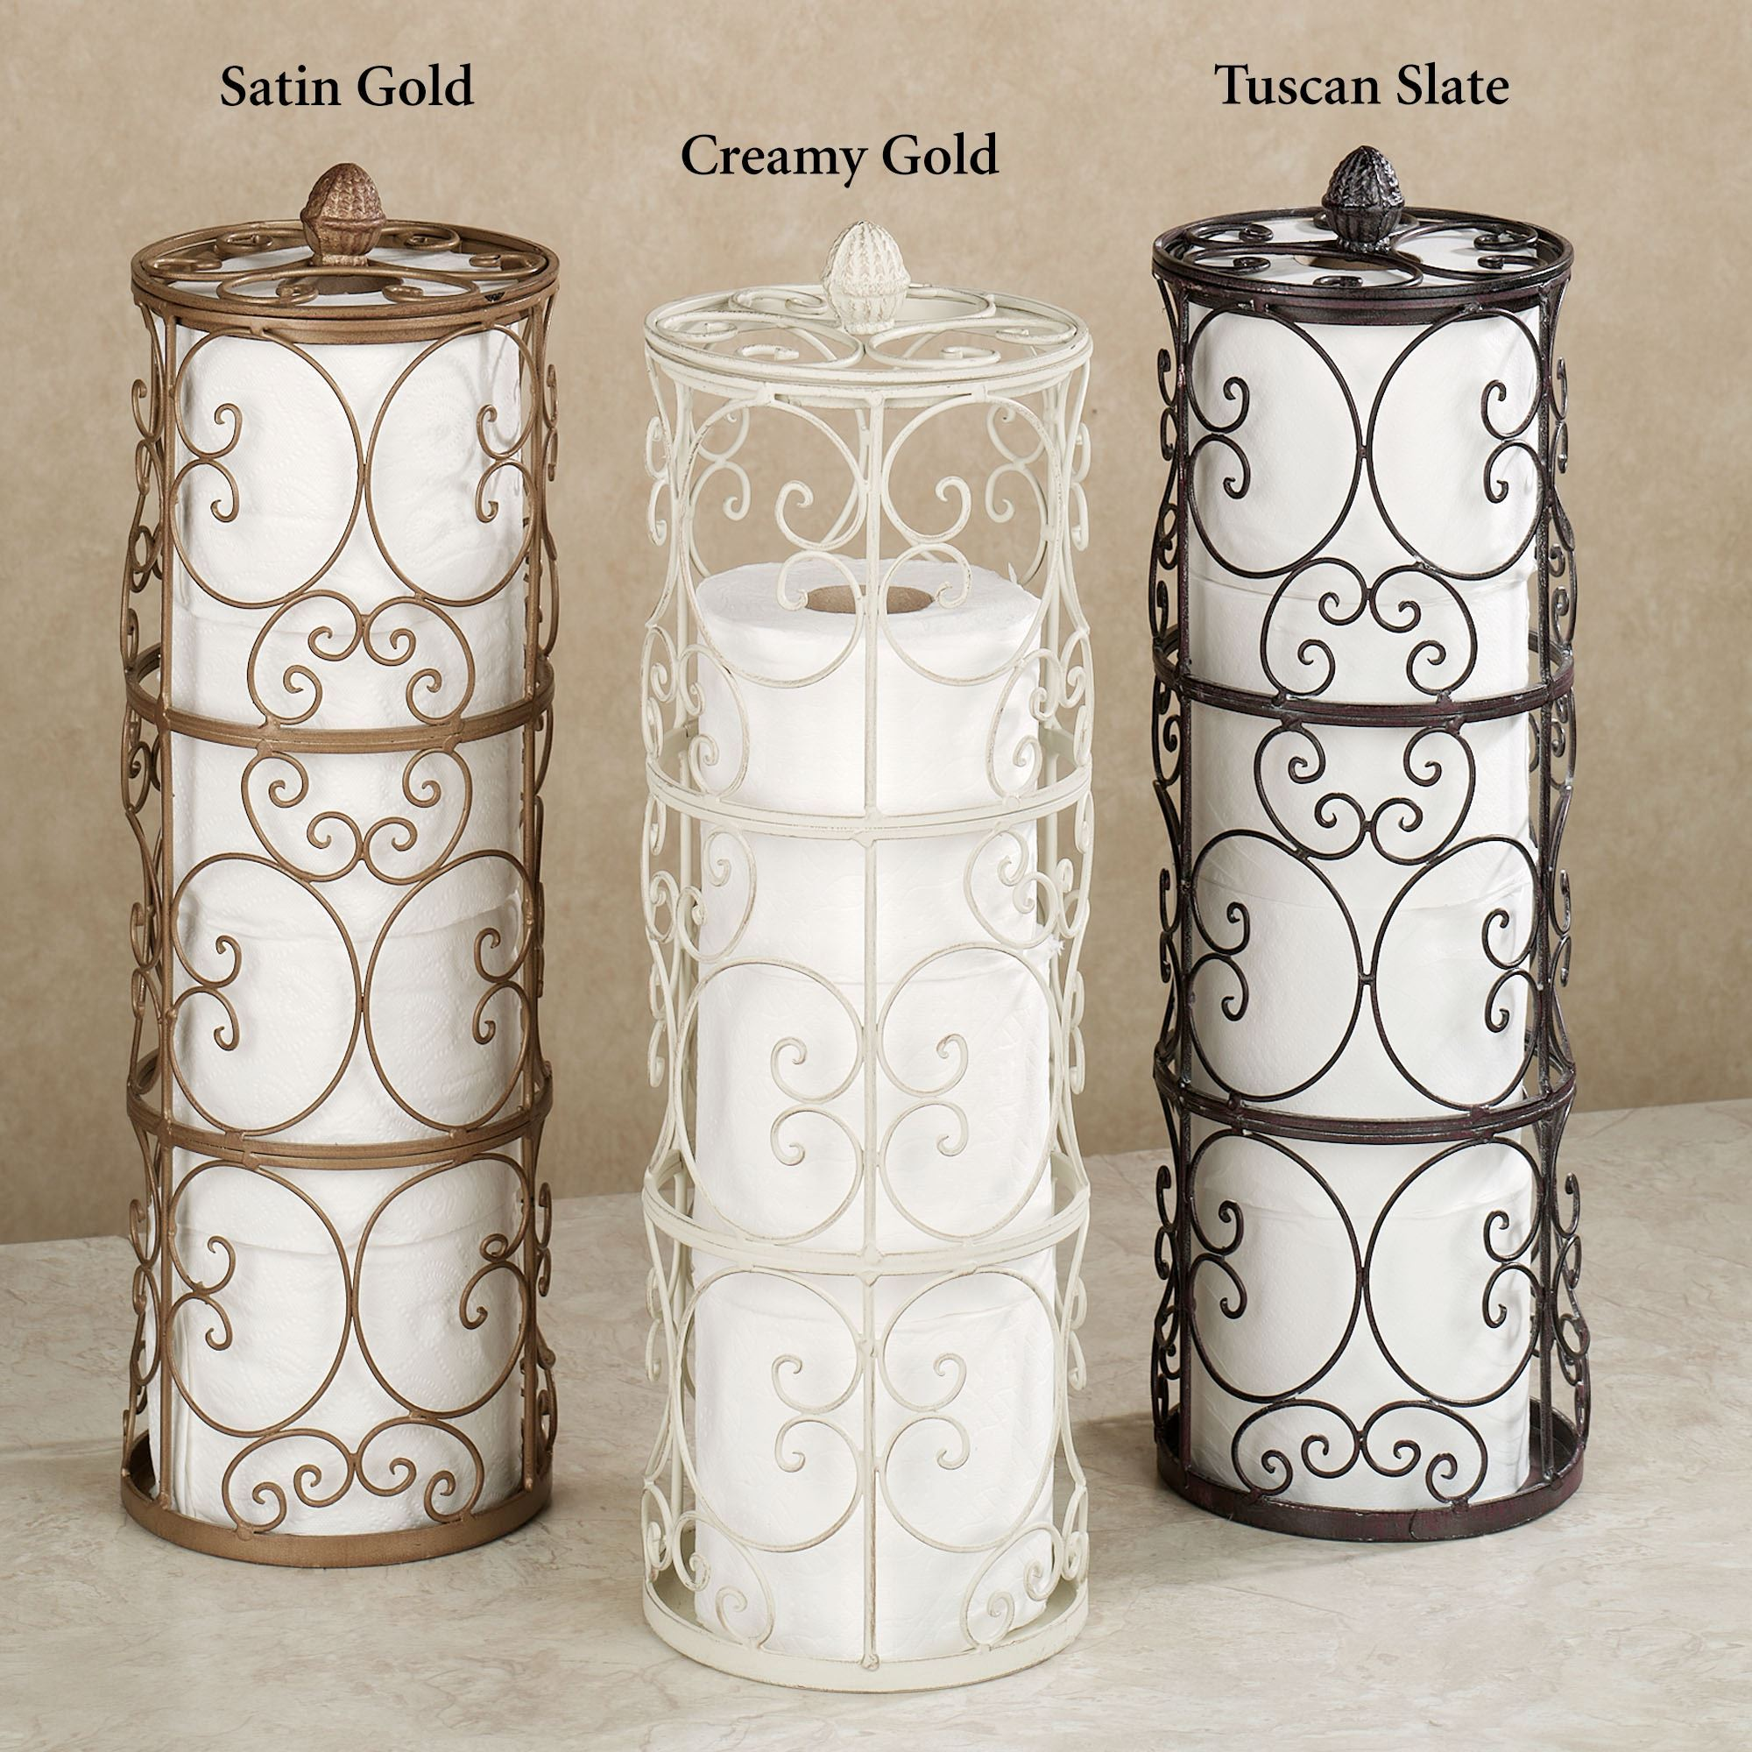

Slide 5
What is the difference?
We eat old pasta first (exp date)
We grab the top one first (we are lazy)

Slide 6
What is the difference?
We eat old pasta first (exp date)
  First In First Out (FIFO)
We grab the top one first (we are lazy)
  Last In First Out (LIFO)

