Slide 1
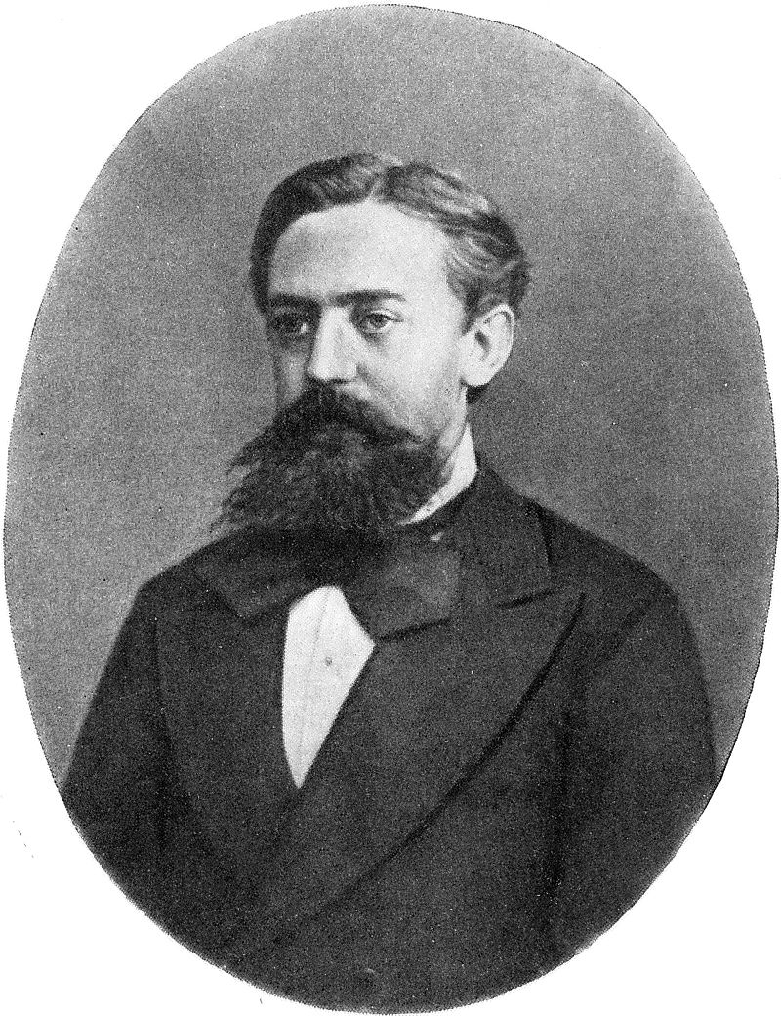
History
Markov studied Markov processes in the early 20th century, publishing his first paper on the topic in 1906.
Markov processes in continuous time were discovered long before Andrey Markov's work in the early 20th centuryin the form of the Poisson process.
Markov was interested in studying an extension of independent random sequences, motivated by a disagreement with Pavel Nekrasov who claimed independence was necessary for the weak law of large numbers to hold.

Slide 2
A Markov process is a stochastic process that satisfies the Markov property (sometimes characterized as "memorylessness").
In simpler terms, a Markov process is a process for which one can make predictions for its future based solely on its present state just as well as one could knowing the process's full history.In other words, conditional on the present state of the system, its future and past states are independent.

Slide 3
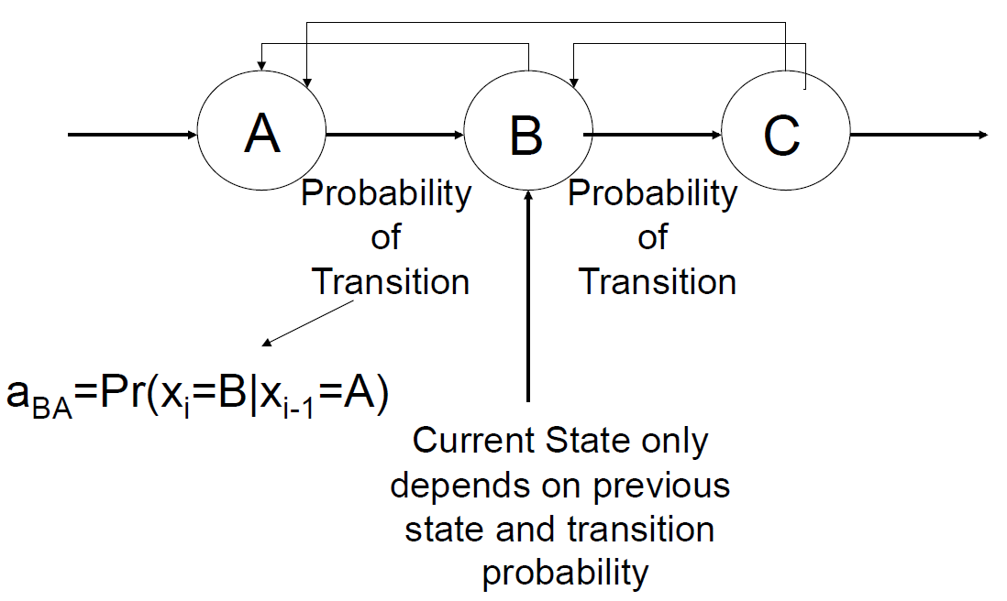
Markov Chains
A Markov chain is a stochastic model describing a sequence of possible events in which the probability of each event depends only on the state attained in the previous event.

