Slide 1
Matrix formulation
Matrix M has one row and one column for each node
Suppose page j has n outlinks
  If j ! i, then M_{ij}=1/n
  Else M_{ij}=0
M is a column stochastic matrix
  Columns sum to 1
Suppose r is a vector with one entry per node
  r_{i} is the importance score of page i
  |r| = 1

Slide 2
Example
Suppose page j links to 3 pages, including i
j
i
i
=
1/3
M
r
r

Slide 3
Eigenvector formulation
The flow equations can be written
r = Mr
So the vector is an eigenvector of the stochastic matrix
  In fact, its first or principal eigenvector, with corresponding eigenvalue 1

Slide 4
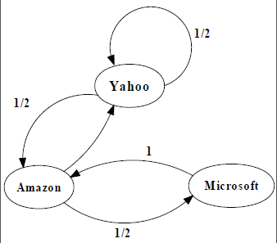
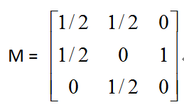
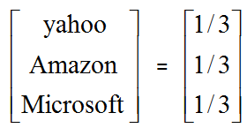
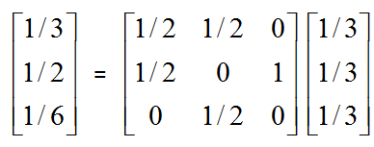
An example of Simplified Graph
first iteration

Slide 5
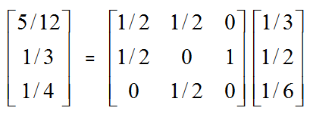
An example of Simplified Graph
second iteration

Slide 6
Power Iteration Example
Yahoo
y a m
y 1/2 1/2 0
a 1/2 0 1
m 0 1/2 0
Amazon
M’soft
y
a =
m
1/3
1/3
1/3
1/3
1/2
1/6
5/12
1/3
1/4
3/8
11/24
1/6
2/5
2/5
1/5
. . .

