Slide 1
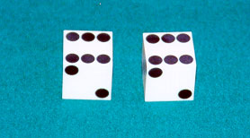
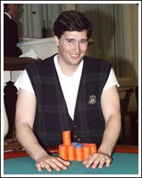
HMM for the Dishonest Casino
A casino has two dice:
Fair die
P(1) = P(2) = P(3) = P(4) = P(5) = P(6) = 1/6
Loaded die
P(1) = P(2) = P(3) = P(4) = P(5) = 1/10
P(6) = 1/2
Casino player switches back and forth between fair and loaded die once in a while

Slide 2
Simple scenario
You don’t know the probabilities
The casino player lets you observe which die he/she uses every time
  The “state” of each roll is known
Training (parameter estimation)
  How often the casino player switches dice?
  How “loaded” is the loaded die?
  Simply count the frequency that each face appeared and the frequency of die switching
  May add pseudo-counts if number of observations is small

Slide 3
More complex scenarios
The “state” of each roll is unknown:
  You are given the results of a series of rolls
  You don’t know which number is generated by which die
You may or may not know the parameters
  How “loaded” is the loaded die
  How frequently the casino player switches dice

Slide 4
Training (parameter estimation)
How often the casino player switches dice?
How “loaded” is the loaded die?

Slide 5
The dishonest casino model
a_{FF} = 0.95
a_{FL} = 0.05
a_{LL} = 0.95
Fair
LOADED
e_{F}(1) = 1/6
e_{F}(2) = 1/6
e_{F}(3) = 1/6
e_{F}(4) = 1/6
e_{F}(5) = 1/6
e_{F}(6) = 1/6
e_{L}(1) = 1/10
e_{L}(2) = 1/10
e_{L}(3) = 1/10
e_{L}(4) = 1/10
e_{L}(5) = 1/10
e_{L}(6) = 1/2
a_{LF} = 0.05
Transition probability
Emission probability

