Slide 1
Big Data Event
Dr. Chengwei Lei
CEECS
California State University, Bakersfield

Slide 2
What is Big Data
No single standard definition…
“Big Data” is data whose scale, diversity, and complexity require new architecture, techniques, algorithms, and analytics to manage it and extract value and hidden knowledge from it…

Slide 3

How much data?

Slide 4
How much data?
640K ought to be enough for anybody.

Slide 5
How much data?
Google processes 20 PB a day (2008)
Wayback Machine has 3 PB + 100 TB/month (3/2009)
Facebook has 2.5 PB of user data + 15 TB/day (4/2009)
eBay has 6.5 PB of user data + 50 TB/day (5/2009)
CERN’s Large Hydron Collider (LHC) generates 15 PB a year
640K ought to be enough for anybody.

Slide 6
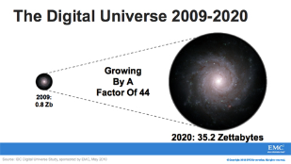
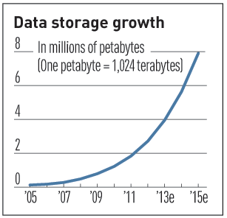

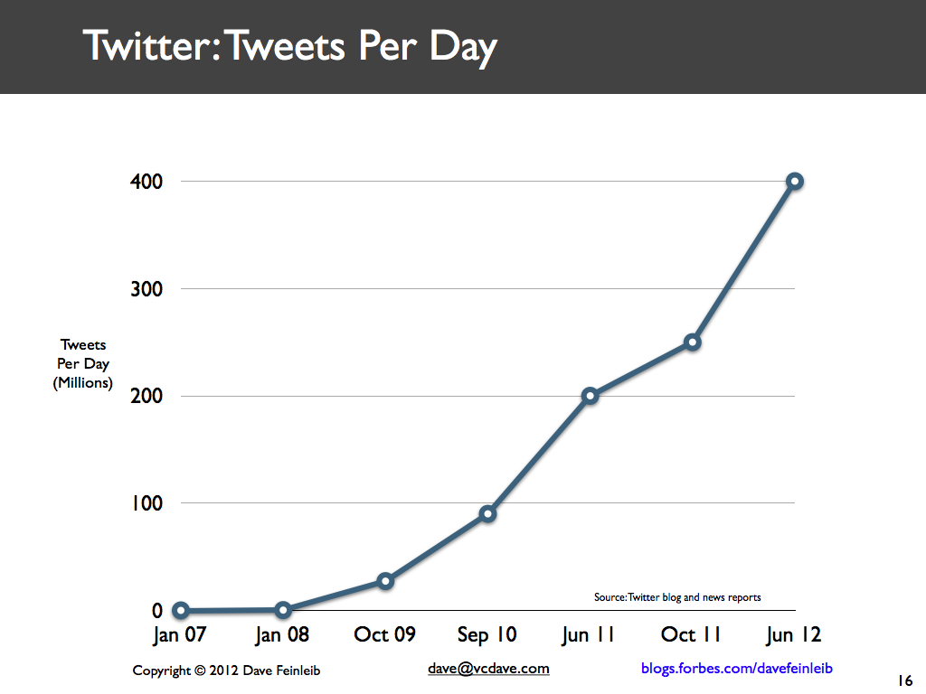
Characteristics of Big Data:
1-Scale (Volume)
Data Volume
  44x increase from 2009 2020
  From 0.8 zettabytes to 35zb
Data volume is increasing exponentially
Exponential increase in collected/generated data

Slide 7
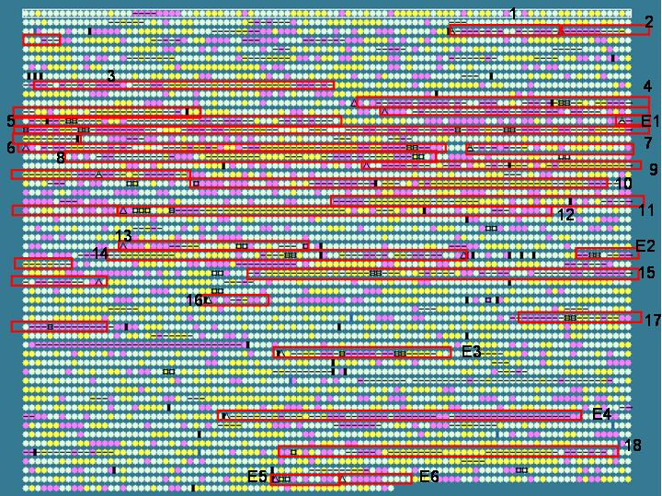
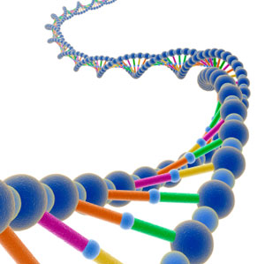
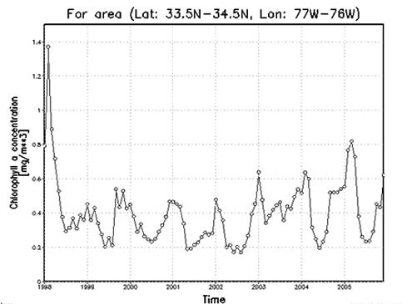
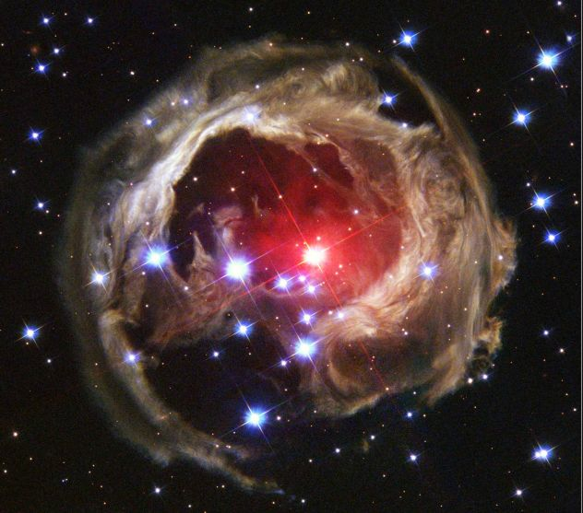
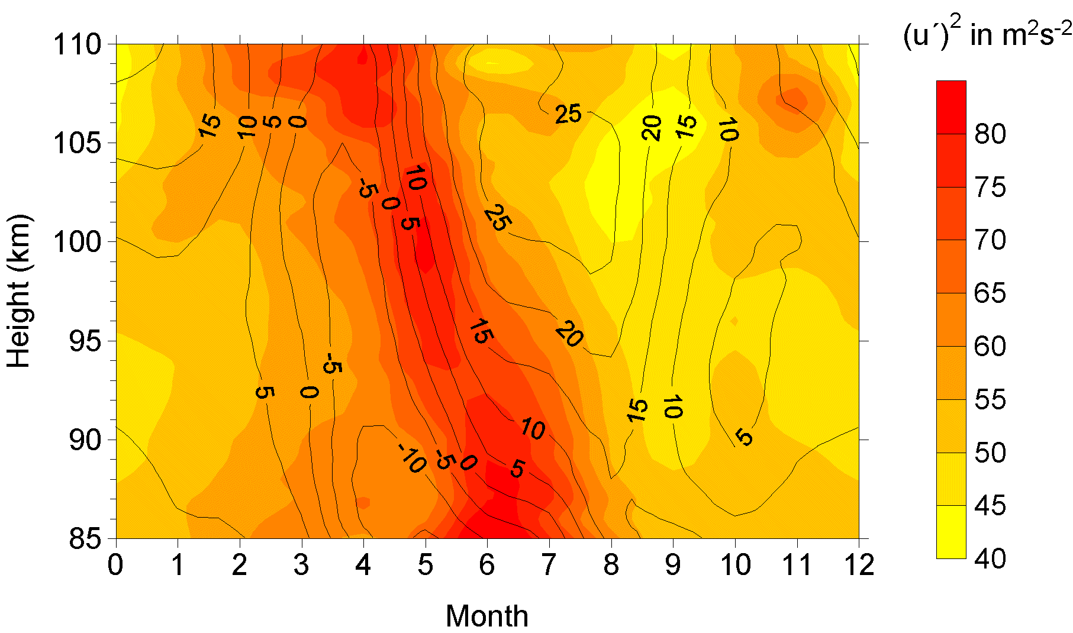
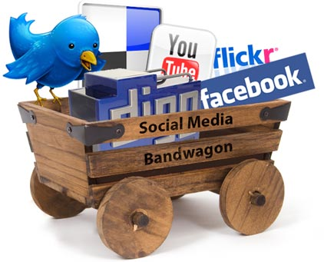
Characteristics of Big Data:
2-Complexity (Varity)
Various formats, types, and structures
Text, numerical, images, audio, video, sequences, time series, social media data, multi-dim arrays, etc…
Static data vs. streaming data
A single application can be generating/collecting many types of data
To extract knowledge➔ all these types of data need to linked together

Slide 8
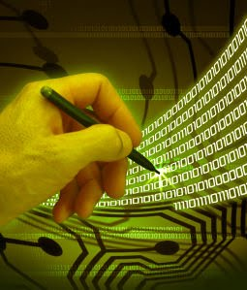
Characteristics of Big Data:
3-Speed (Velocity)
Data is begin generated fast and need to be processed fast
Online Data Analytics
Late decisions ➔ missing opportunities
Examples
  E-Promotions: Based on your current location, your purchase history, what you like ➔ send promotions right now for store next to you
  Healthcare monitoring: sensors monitoring your activities and body ➔ any abnormal measurements require immediate reaction

Slide 9
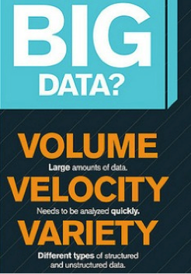
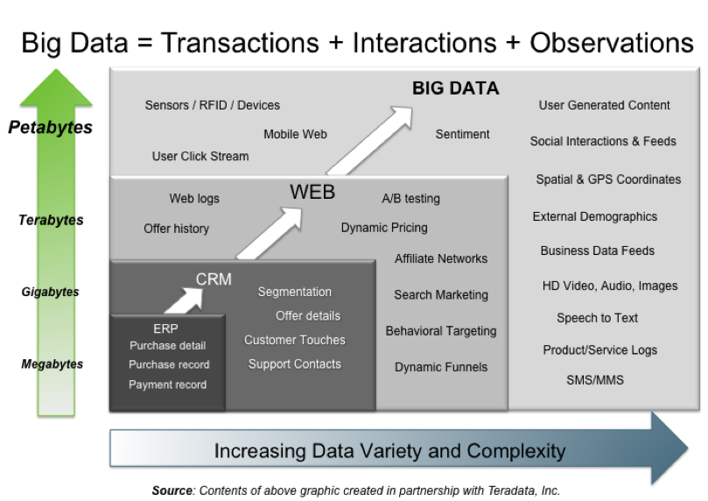
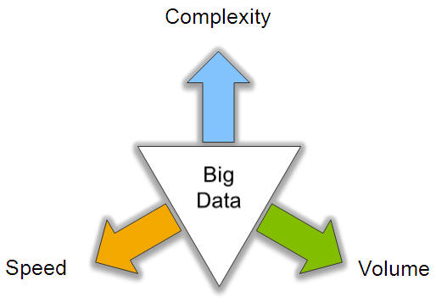
Big Data: 3V’s

Slide 10
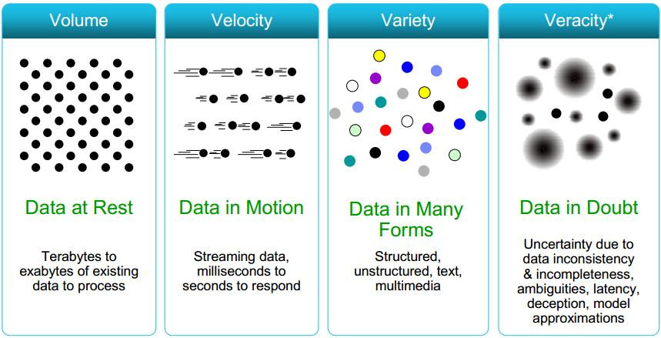
Some Make it 4V’s

Slide 11
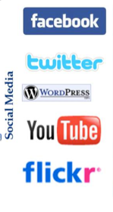
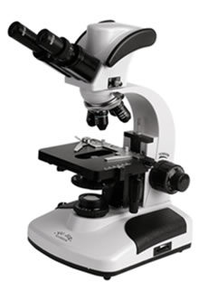
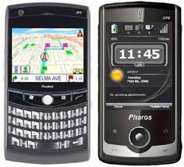
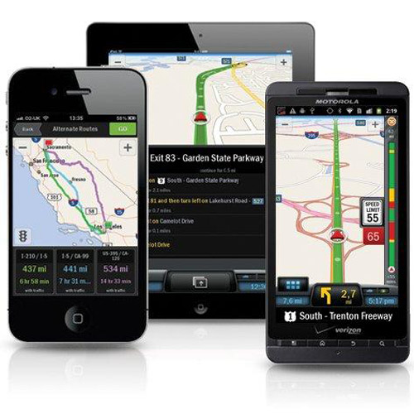
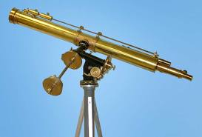
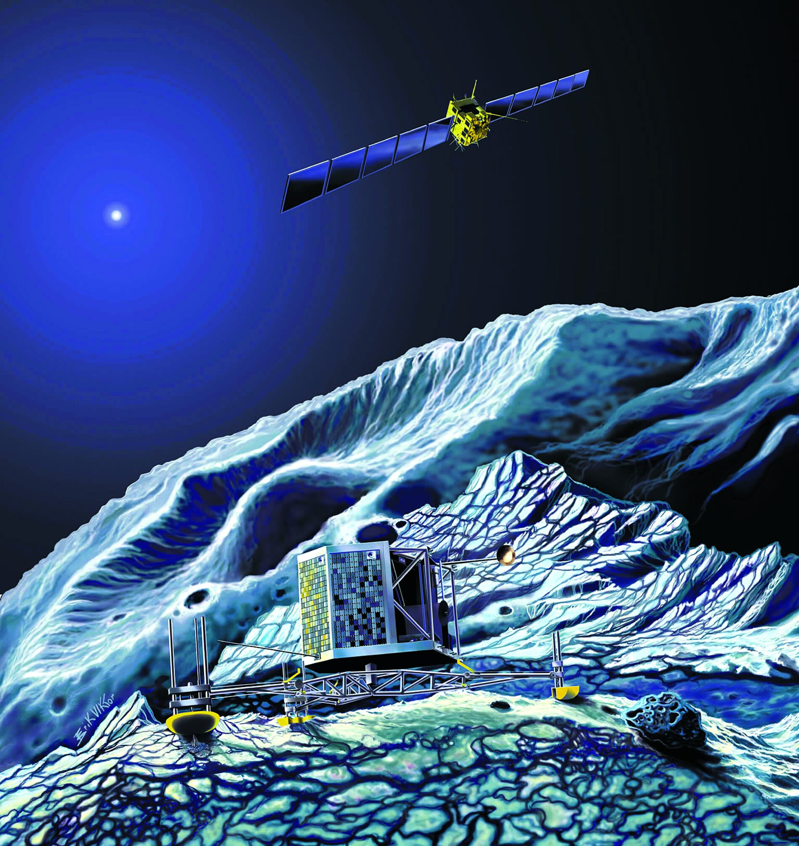
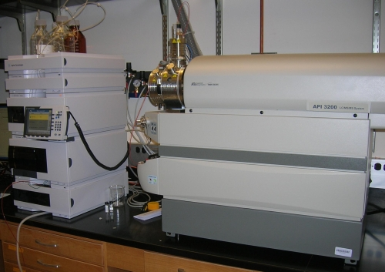
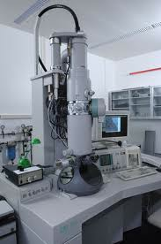
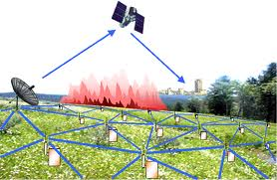
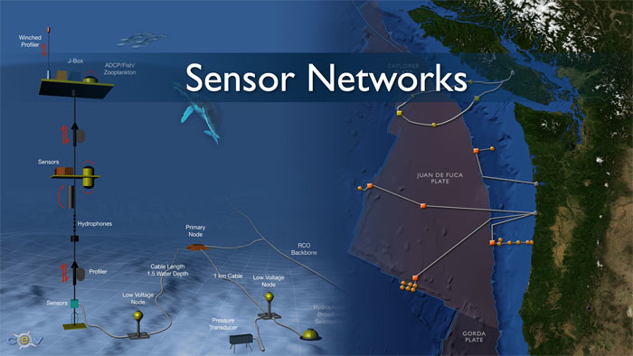
Who’s Generating Big Data
Mobile devices
(tracking all objects all the time)
Scientific instruments
(collecting all sorts of data)
Social media and networks
(all of us are generating data)
Sensor technology and networks
(measuring all kinds of data)
The progress and innovation is no longer hindered by the ability to collect data
But, by the ability to manage, analyze, summarize, visualize, and discover knowledge from the collected data in a timely manner and in a scalable fashion

Slide 12


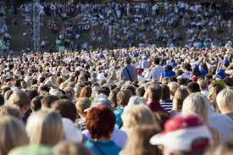

The Model Has Changed…
The Model of Generating/Consuming Data has Changed
Old Model: Few companies are generating data, all others are consuming data
New Model: all of us are generating data, and all of us are consuming data

Slide 13
Traditional Hypothesis Driven Research
Hypothesis
Design
Experiment
Data
Data analysis
Result

Slide 14

Data Driven Science
Process/Experiment
Data
No Prior Hypothesis
New Science of Data

Slide 15
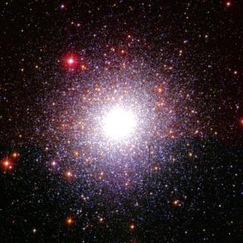
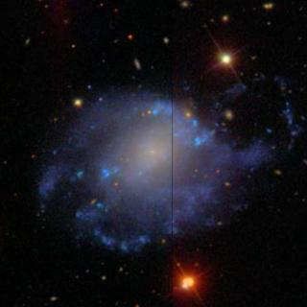
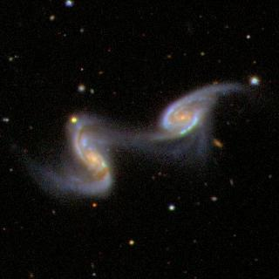
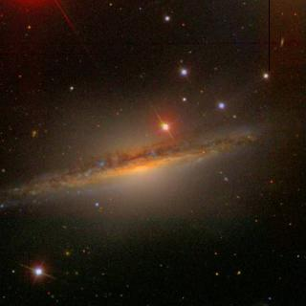
Astro-Informatics: US National Virtual Observatory (NVO)
New Astronomy
  Local vs. Distant Universe
  Rare/exotic objects
  Census of active galactic nuclei
  Search extra-solar planets
Turn anyone into an astronomer

Slide 16
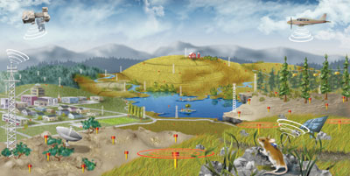

Ecological Informatics
Analyze complex ecological data from a highly-distributed set of field stations, laboratories, research sites, and individual researchers

Slide 17
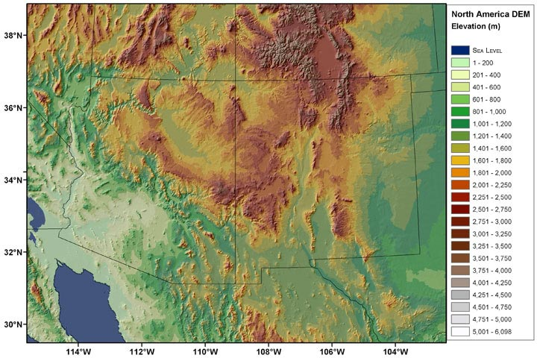
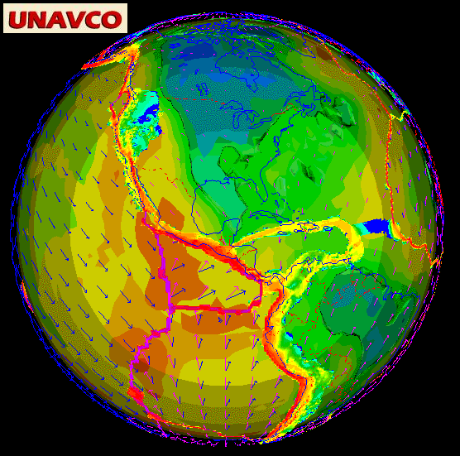
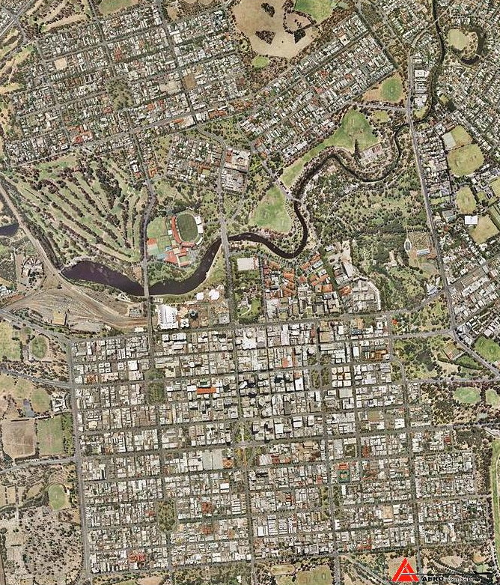
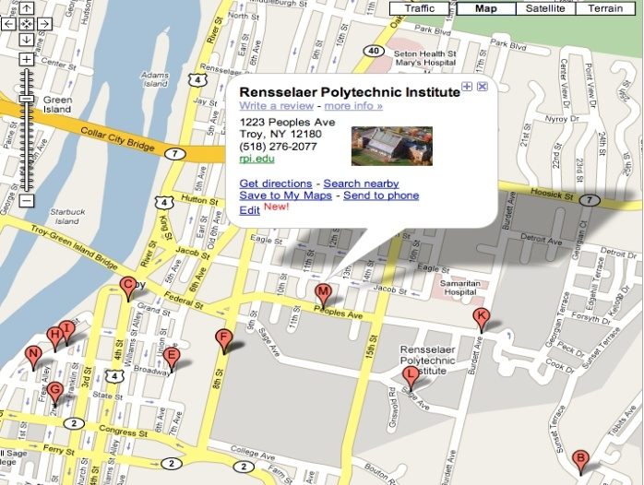
Geo-Informatics

Slide 18
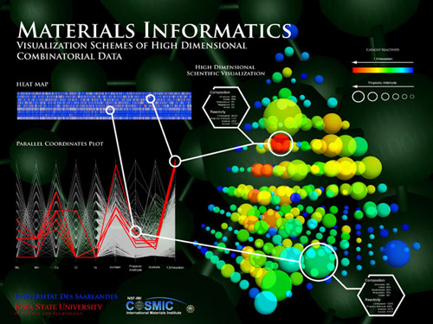
Materials Informatics

Slide 19
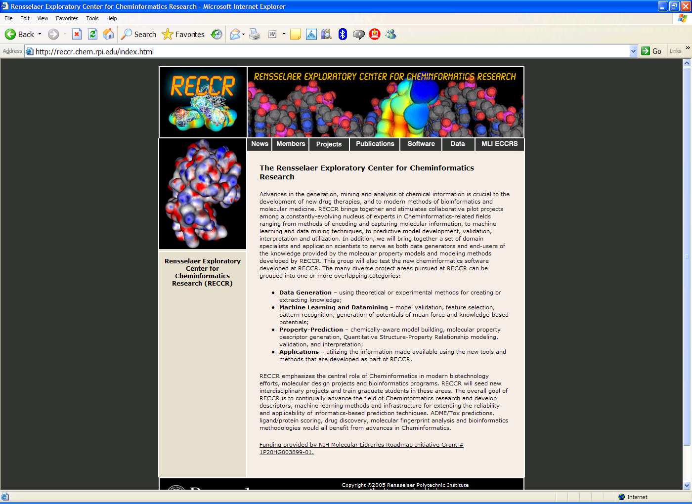

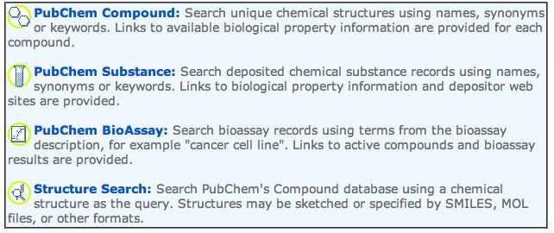
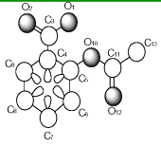
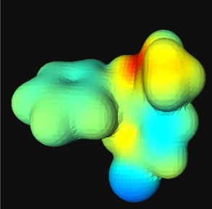
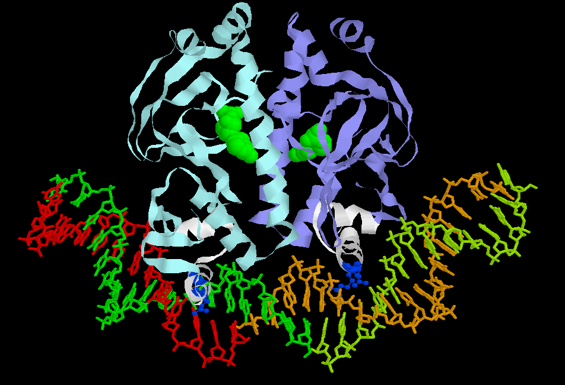
Cheminformatics
Structural Descriptors
Physiochemical Descriptors
Topological Descriptors
Geometrical Descriptors
AAACCTCATAGGAAGCATACCAGGAATTACATCA…

Slide 20
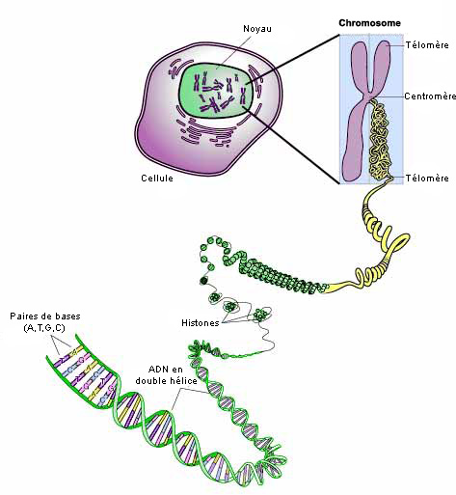
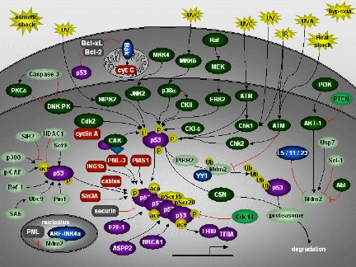
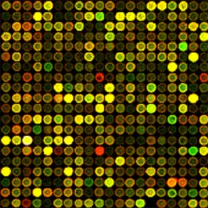
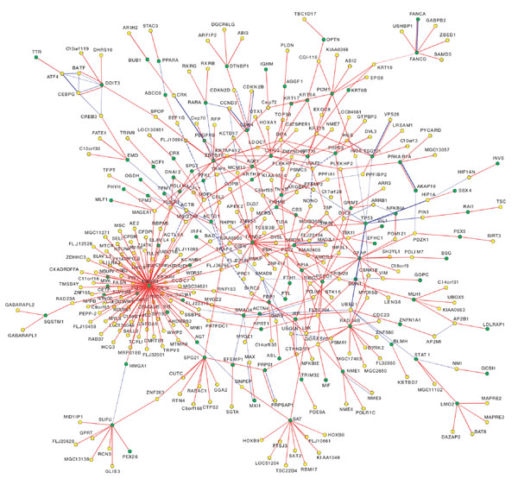
Bioinformatics
Datasets:
  Genomes
  Protein structure
  DNA/Protein arrays
  Interaction Networks
  Pathways
  Metagenomics
Integrative Science
  Systems Biology
  Network Biology

Slide 21
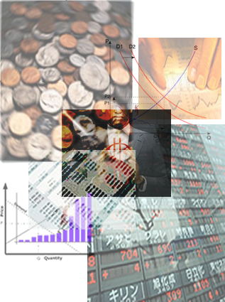
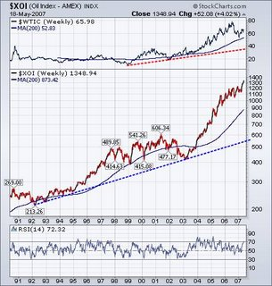
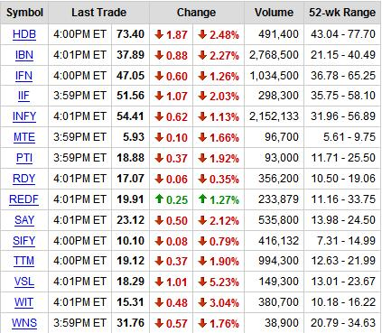
Economics & Finance

Slide 22
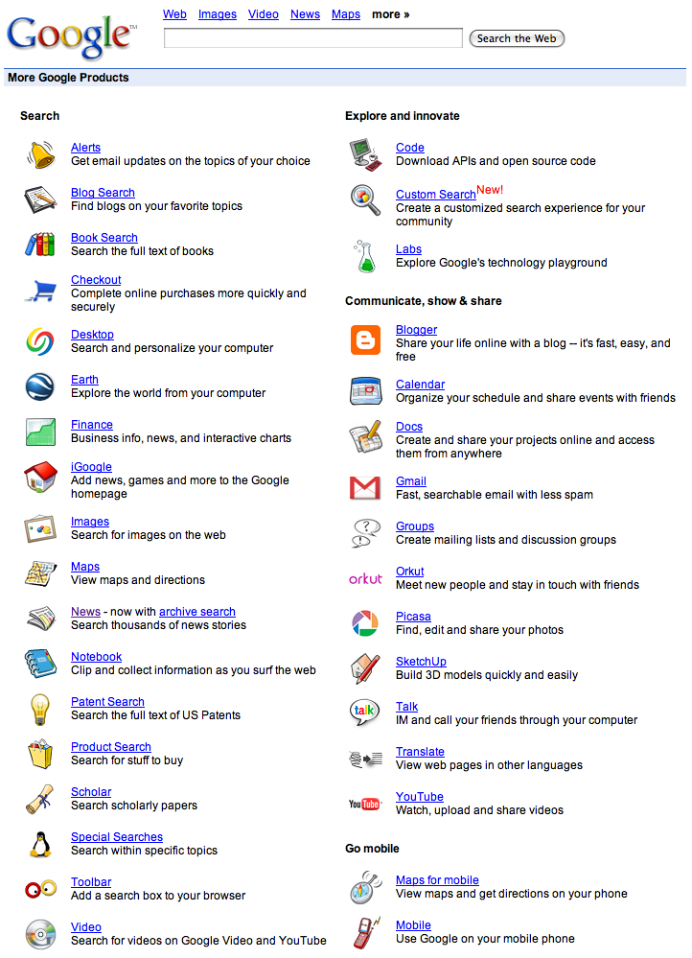

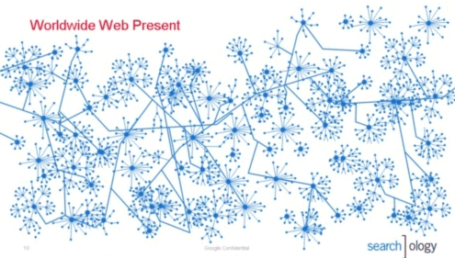
World Wide Web

Slide 23
What is Data Mining?
The iterative and interactive process of discovering valid, novel, useful, and understandable patterns or models in Massive databases

Slide 24
Supervised Learning
VS
Unsupervised Learning

Slide 25
Supervised Learning

Slide 26
Basic concepts
Supervised learning is the machine learning task of inferring a function from supervised training data.
The training data consist of a set of training examples.

Slide 27
An example application
An emergency room in a hospital measures 17 variables (e.g., blood pressure, age, etc) of newly admitted patients.
A decision is needed: whether to put a new patient in an intensive-care unit.
Due to the high cost of ICU, those patients who may survive less than a month are given higher priority.
Problem: to predict high-risk patients and discriminate them from low-risk patients.

Slide 28
Another application
A credit card company receives thousands of applications for new cards. Each application contains information about an applicant,
  age
  Marital status
  annual salary
  outstanding debts
  credit rating
  etc.
Problem: to decide whether an application should approved, or to classify applications into two categories, approved and not approved.

Slide 29
Unsupervised Learning

Slide 30
Here we focus on unsupervised learning, we where observe only the features X1;X2; ……;Xp.
We are not interested in prediction, because we do not have an associated response variable Y .

Slide 31
The goal is to discover interesting things about the measurements:
  Is there an informative way to visualize the data?
  Can we discover subgroups among the variables or among the observations?
We discuss two methods:
  principal components analysis, a tool used for data visualization or data pre-processing before supervised techniques are applied, and
  clustering, a broad class of methods for discovering unknown subgroups in data.

Slide 32
What is Cluster Analysis?
Finding groups of objects such that the objects in a group will be similar (or related) to one another and different from (or unrelated to) the objects in other groups
Inter-cluster distances are maximized
Intra-cluster distances are minimized

Slide 33
Notion of a Cluster can be Ambiguous
How many clusters?
Six Clusters
Two Clusters
Four Clusters

Slide 35
Example
K- Means

Slide 36
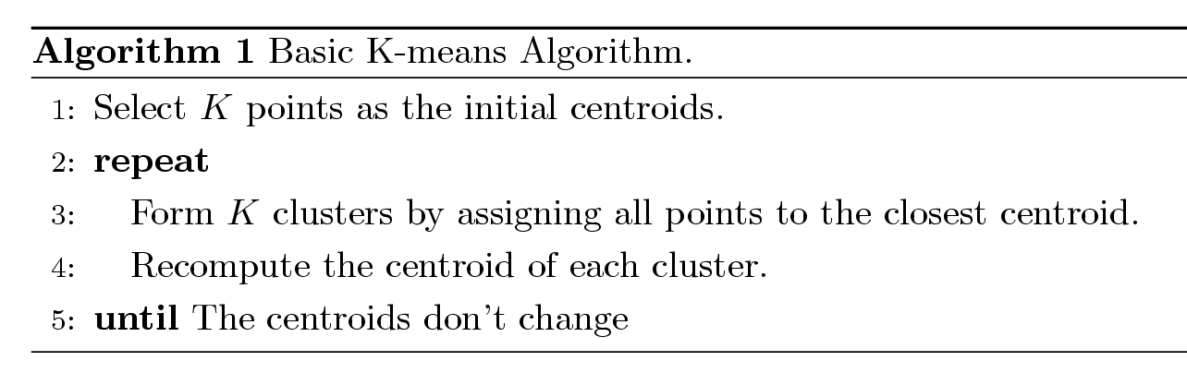
K-means Clustering
Partitional clustering approach
Each cluster is associated with a centroid (center point)
Each point is assigned to the cluster with the closest centroid
Number of clusters, K, must be specified
The basic algorithm is very simple

Slide 37
K-means Clustering – Details
Initial centroids are often chosen randomly. Clusters produced vary from one run to another.
The centroid is (typically) the mean of the points in the cluster.
‘Closeness’ is measured by Euclidean distance, cosine similarity, correlation, etc.
K-means will converge for common similarity measures mentioned above.
Most of the convergence happens in the first few iterations.
Often the stopping condition is changed to ‘Until relatively few points change clusters’
Complexity is O( n * K * I * d )
    n = number of points, K = number of clusters,
    I = number of iterations, d = number of attributes

Slide 38
Importance of Choosing Initial Centroids

Slide 39
Importance of Choosing Initial Centroids

Slide 40
Evaluating K-means Clusters
Most common measure is Sum of Squared Error (SSE)
  For each point, the error is the distance to the nearest cluster
  To get SSE, we square these errors and sum them.
  x is a data point in cluster C_{i} and m_{i} is the representative point for cluster C_{i}
    can show that m_{i} corresponds to the center (mean) of the cluster
  Given two clusters, we can choose the one with the smallest error
  One easy way to reduce SSE is to increase K, the number of clusters
    A good clustering with smaller K can have a lower SSE than a poor clustering with higher K

Slide 41
10 Clusters Example
Starting with two initial centroids in one cluster of each pair of clusters

Slide 42
10 Clusters Example
Starting with two initial centroids in one cluster of each pair of clusters

