Slide 1
CMPS 3120
Algorithm Analysis
Dr. Chengwei Lei
CEECS
California State University, Bakersfield

Slide 2
The course
Instructor: Dr. Chengwei Lei
Office: Science III 338
Phone: (661) 654-2102
E-mail: clei@csub.edu

Slide 3
About Me
LEI, Chengwei (雷程炜) received his Ph.D. in July 2014 from the Department of Computer Science in The University of Texas at San Antonio
His research interests lie in the broad area of bioinformatics, large scale data mining, network topology analysis, and clustering problems.

Slide 4
Course Description
Analysis of the performance of algorithms;
discussion of programming techniques and data structures used in the writing of effective algorithms.

Slide 5
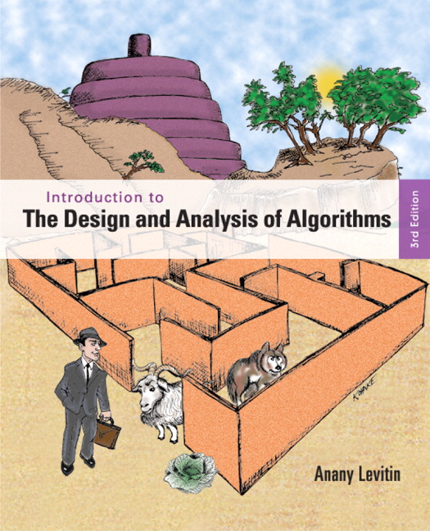
Textbook
Introduction to the Design and Analysis of Algorithms 3rd Edition,
Anany Levitin, Pearson, 2011.

Slide 6
Method of Instruction
Lecture; Demonstration; Lab

Slide 7
Semester Grade
Average of Regular Semester Exams | 30% | Exams
Homework & Labs | 50% | As determined by instructor
Comprehensive Final Exam | 20% | Comprehensive Exam

Slide 8
Late homework submissions
Each assignment is due at the specified date at the specified time. Late submissions will be accepted at a penalty of 20% for each day the assignment is late.

Slide 9
Cheating
You are not allowed to read, copy, or rewrite the solutions written by others (in this or previous terms). Copying materials from websites, books or any other sources is considered equivalent to copying from another student.
If two people are caught sharing solutions, then both the copier and copiee will be held equally responsible, which will result in zero point in homework.
Cheating on an exam will result in failing the course.

Slide 10
Getting answers from the internet is
CHEATING
Getting answers from your friends is
CHEATING
I will send it to the Dean!
You will be nailed!

Slide 11
Do NOT get answers from others!
Discuss ideas verbally at a high-level but write up on your own.

Slide 12
To do well you should:
Study with pen and paper
Ask for help immediately
Practice, practice, practice…
Follow along in class rather than take notes
Ask questions in class
Keep up with the class
Read the book, not just the slides

Slide 13
Please feel free
to ask questions!
Help me know what people are not understanding
We do have a lot of material
It’s your job to slow me down

