Slide 1
What is an algorithm?

Slide 2
What is an algorithm?
An algorithm is a sequence of unambiguous instructions for solving a problem, i.e., for obtaining a required output for any legitimate input in a finite amount of time.
problem
algorithm
“computer”
input
output

Slide 3
What is an algorithm?
Algorithms are the ideas behind computer programs.
An algorithm is the thing that stays the same regardless of programming language and the computing hardware

Slide 4
What is an algorithm? (cont’)
An algorithm is a precise and unambiguous specification of a sequence of steps that can be carried out to solve a given problem or to achieve a given condition.
An algorithm accepts some value or set of values as input and produces a value or set of values as output.
Algorithms are closely intertwined with the nature of the data structure of the input and output values

Slide 5
How to express algorithms?
Increasing precision
Nature language (e.g. English)
Pseudocode
Real programming languages
Ease of expression
Describe the ideas of an algorithm in nature language.
Use pseudocode to clarify sufficiently tricky details of the algorithm.

Slide 6
How to express algorithms?
Increasing precision
Nature language (e.g. English)
Pseudocode
Real programming languages
Ease of expression
To understand / describe an algorithm:
Get the big idea first.
Use pseudocode to clarify sufficiently tricky details

Slide 7
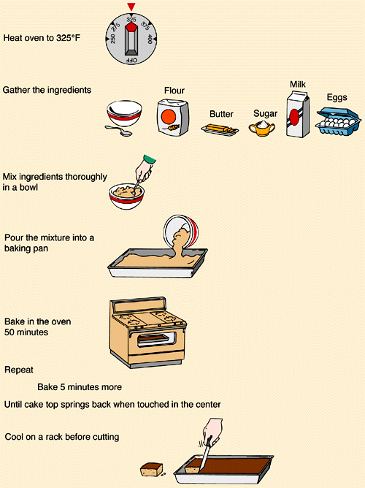
What is a program?
How to cook?
The algorithm
Are you a programmer?

Slide 8
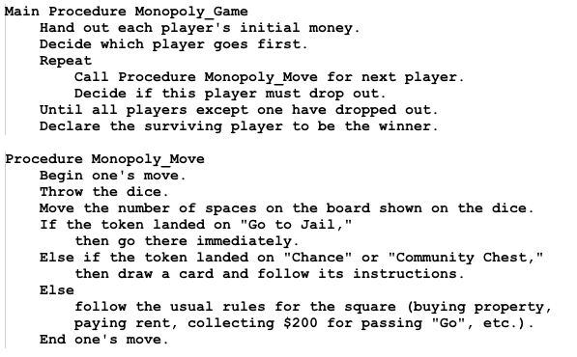
Pseudocode
This is the pseudocode for a game of Monopoly

Slide 9
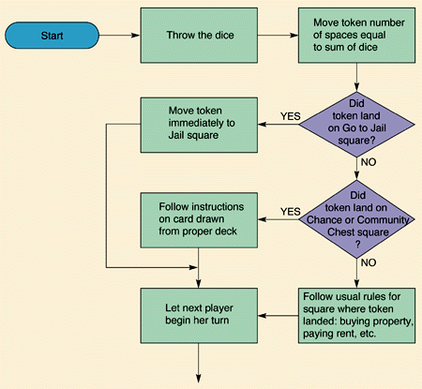
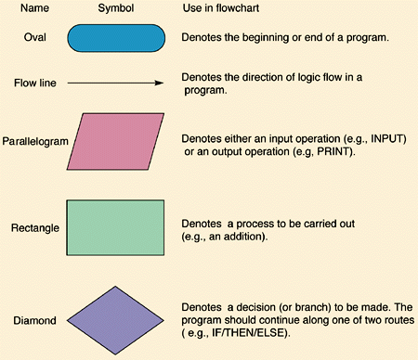
Flowcharts

Slide 10
Hey Jude
"Hey Jude" is a song by the English rock band the Beatles, written by Paul McCartney and credited to Lennon–McCartney.

Slide 11
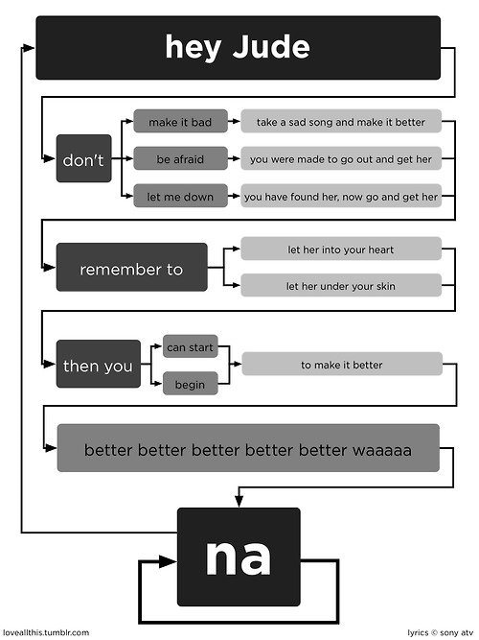

Slide 12
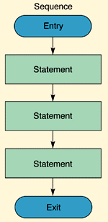
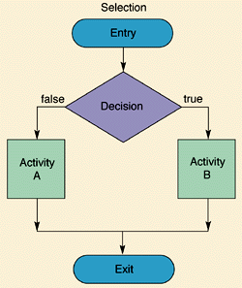
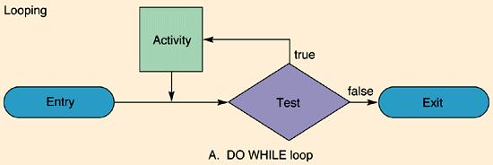
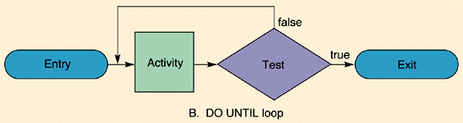
Flowcharts details

