Slide 1
Analyzing the complexity of an algorithm

Slide 2
Kinds of analyses
Worst case
  Provides an upper bound on running time
Best case – not very useful, can always cheat
Average case
  Provides the expected running time
  Very useful, but treat with care: what is “average”?

Slide 3
General plan for analyzing time efficiency of a non-recursive algorithm
Decide parameter (input size)
Identify most executed line (basic operation)
worst-case = average-case?
T(n) = ∑_{i} t_{i}
T(n) = Θ (f(n))

Slide 4
Useful summation formulas and rules
Σ_{l≤i≤u}1 = 1+1+ ⋯ +1 = u - l + 1
In particular, Σ_{l≤i≤u}1 = n - 1 + 1 = n ∈ Θ(n)
Σ_{1≤i≤n} i = 1+2+ ⋯ +n = n(n+1)/2 ≈ n²/2 ∈ Θ(n²)
Σ_{1≤i≤n} i² = 1²+2²+ ⋯ +n² = n(n+1)(2n+1)/6 ≈ n³/3 ∈ Θ(n³)
Σ_{0≤i≤n} a^{i} = 1 + a + ⋯ + a^{n} = (a^{n+1} - 1)/(a - 1) for any a ≠ 1
In particular, Σ_{0≤i≤n} 2^{i} = 2⁰ + 2¹ + ⋯ + 2^{n} = 2^{n+1} - 1 ∈ Θ(2^{n} )
Σ(a_{i} ± b_{i} ) = Σa_{i} ± Σb_{i} Σca_{i} = cΣa_{i} Σ_{l≤i≤u}a_{i} = Σ_{l≤i≤m}a_{i} + Σ_{m+1≤i≤u}a_{i}

Slide 5
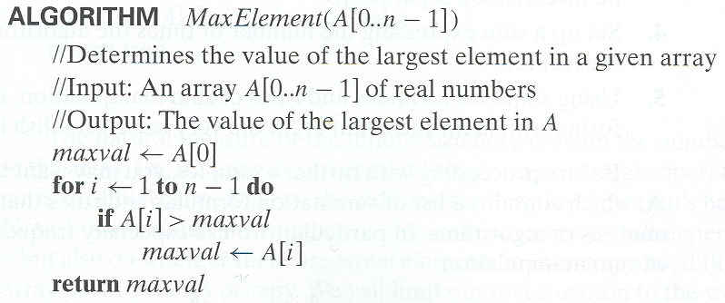
Example 1: Maximum element

Slide 6
Time efficiency of nonrecursive algorithms
General Plan for Analysis
Decide on parameter n indicating input size
Identify algorithm’s basic operation
Determine worst, average, and best cases for input of size n
Set up a sum for the number of times the basic operation is executed
Simplify the sum using standard formulas and rules (see Appendix A)

Slide 7
Example 1: Maximum element

Slide 8
Time efficiency of nonrecursive algorithms
General Plan for Analysis
input size the number of elements in the array
basic operation: comparison (>)
worst, average, best
  all cases are 1 operation for each iteration
A sum for the number of times the basic operation is executed
  all n-1 times
Simplify the sum using standard formulas and rules
  Θ(n)

Slide 9
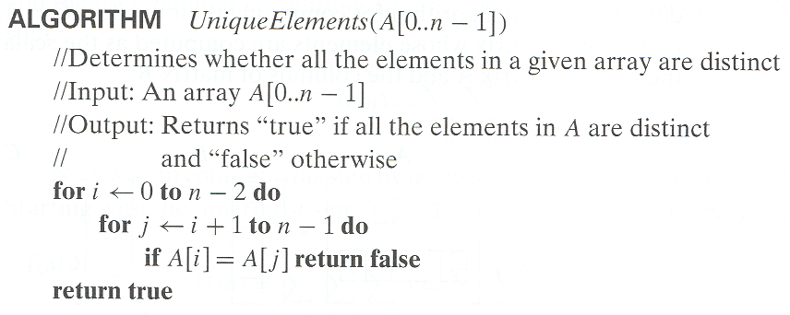
Example 2: Element uniqueness problem

Slide 10
Time efficiency of nonrecursive algorithms
General Plan for Analysis
input size ?
basic operation: ?
worst, average, best
  ?
A sum for the number of times the basic operation is executed
  ?
Simplify the sum using standard formulas and rules
  ?

Slide 11
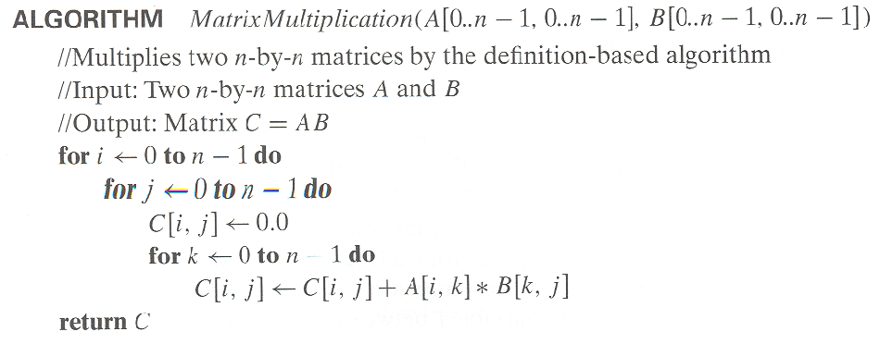
Example 3: Matrix multiplication

Slide 12
Time efficiency of nonrecursive algorithms
General Plan for Analysis
input size ?
basic operation: ?
worst, average, best
  ?
A sum for the number of times the basic operation is executed
  ?
Simplify the sum using standard formulas and rules
  ?

Slide 13
Example 4: Gaussian elimination
Algorithm GaussianElimination(A[0..n-1,0..n])
//Implements Gaussian elimination of an n-by-(n+1) matrix A
for i ← 0 to n - 2 do
for j ← i + 1 to n - 1 do
for k ← i to n do
A[j,k] ← A[j,k] - A[i,k] ∗ A[j,i] / A[i,i]
Find the efficiency class and a constant factor improvement.

Slide 14
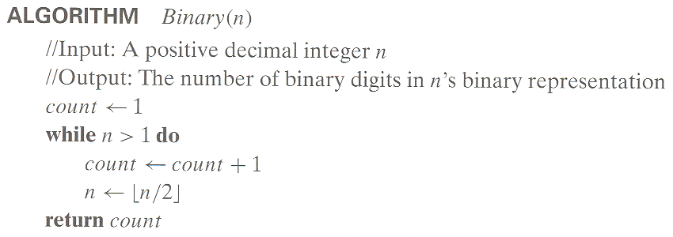
Example 5: Counting binary digits
It cannot be investigated the way the previous examples are.

