Slide 1
Plan for Analysis of Recursive Algorithms
Decide on a parameter indicating an input’s size.
Identify the algorithm’s basic operation.
Check whether the number of times the basic op. is executed may vary on different inputs of the same size. (If it may, the worst, average, and best cases must be investigated separately.)
Set up a recurrence relation with an appropriate initial condition expressing the number of times the basic op. is executed.
Solve the recurrence (or, at the very least, establish its solution’s order of growth) by backward substitutions or another method.

Slide 2
Recursive definition of sum of series
T (n) = ∑_{i=0..n} i is equivalent to:
T(n) = T(n-1) + n
T(0) = 0
T(n) = ∑_{i=0..n} a^{i} is equivalent to:
T(n) = T(n-1) + a^{n}
T(0) = 1
Recurrence relation
Boundary condition
Recursive definition is often intuitive and easy to obtain. It is very useful in analyzing recursive algorithms, and some non-recursive algorithms too.

Slide 3
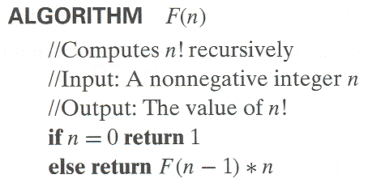
Example 1: Recursive evaluation of n!
Definition: n ! = 1 ⋅ 2 ⋅ … ⋅ (n-1) ⋅ n for n ≥ 1 and 0! = 1
Recursive definition of n!: F(n) = F(n-1) ⋅ n for n ≥ 1 and
F(0) = 1
Size:
Basic operation:
Recurrence relation:
Notes:
Note the difference between the two recurrences. Students often confuse these!
F(n) = F(n-1) n
F(0) = 1
for the values of n!
------------
M(n) =M(n-1) + 1
M(0) = 0
for the number of multiplications made by this algorithm

Slide 4
Solving the recurrence for M(n)
M(n) = M(n-1) + 1, M(0) = 0

Slide 5
Example 2: The Tower of Hanoi Puzzle
Recurrence for number of moves:

Slide 6
Solving recurrence for number of moves
M(n) = 2M(n-1) + 1, M(1) = 1

Slide 7
Tree of calls for the Tower of Hanoi Puzzle

Slide 8
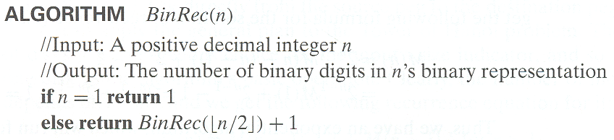
Example 3: Counting #bits

Slide 9
Recursive algorithms
Why? How?

Slide 10
Problem of the day
Write the Pseudo code to compute b^{n}

Slide 11
Problem of the day
How many multiplications do you need to compute 3¹⁶?
3¹⁶ =3 x 3 x 3 …. x 3
Answer: 15
3¹⁶ =3⁸ x 3⁸
3⁸ =3⁴ x 3⁴
Answer: 4
3⁴ =3² x 3²
3² =3 x 3

Slide 12
Pseudo code
int pow (b, n)
m = n >> 1;
p = pow (b, m);
p = p * p;
if (n % 2)
return p * b;
else
return p;
int pow (b, n)
m = n >> 1;
p = pow(b,m) * pow(b,m);
if (n % 2)
return p * b;
else
return p;

Slide 13
Recurrence for computing power
int pow (b, n)
m = n >> 1;
p = pow (b, m);
p = p * p;
if (n % 2)
return p * b;
else
return p;
int pow (b, n)
m = n >> 1;
p=pow(b,m)*pow(b,m);
if (n % 2)
return p * b;
else
return p;
T(n) = ?
T(n) = ?

Slide 14
Recurrence for computing power
int pow (b, n)
m = n >> 1;
p = pow (b, m);
p = p * p;
if (n % 2)
return p * b;
else
return p;
int pow (b, n)
m = n >> 1;
p=pow(b,m)*pow(b,m);
if (n % 2)
return p * b;
else
return p;
T(n) = T(n/2)+Θ(1)
T(n) = 2T(n/2)+Θ(1)

Slide 15
Recurrence for computing power
int pow (b, n)
m = n >> 1;
p = pow (b, m);
p = p * p;
if (n % 2)
return p * b;
else
return p;
int pow (b, n)
m = n >> 1;
p=pow(b,m)*pow(b,m);
if (n % 2)
return p * b;
else
return p;
T(n) = T(n/2)+Θ(1)
T(n) = 2T(n/2)+Θ(1)
Which algorithm is more efficient asymptotically?

Slide 16
Time complexity for Alg1
Solve T(n) = T(n/2) + 1
T(n) = T(n/2) + 1
= T(n/4) + 1 + 1
= T(n/8) + 1 + 1 + 1
= T(1) + 1 + 1 + … + 1
= Θ (log(n))
log(n)
Iteration method

Slide 17
Time complexity for Alg2
Solve T(n) = 2T(n/2) + 1.

Slide 18
Time complexity for Alg2
Solve T(n) = 2T(n/2) + 1.
T(n)

Slide 19
Time complexity for Alg2
Solve T(n) = 2T(n/2) + 1.
1
T(n/2)
T(n/2)

Slide 20
Time complexity for Alg2
Solve T(n) = 2T(n/2) + 1.
1
1
1
T(n/4)
T(n/4)
T(n/4)
T(n/4)

Slide 21
Time complexity for Alg2
Solve T(n) = 2T(n/2) + 1.
1
1
1
1
1
1
1
…
Θ(1)

Slide 22
Time complexity for Alg2
Solve T(n) = 2T(n/2) + 1.
1
1
1
h = log n
1
1
1
1
…
Θ(1)

Slide 23
Time complexity for Alg2
Solve T(n) = 2T(n/2) + 1.
1
1
1
1
h = log n
1
1
1
1
…
Θ(1)

Slide 24
Time complexity for Alg2
Solve T(n) = 2T(n/2) + 1.
1
1
1
1
2
h = log n
1
1
1
1
…
Θ(1)

Slide 25
Time complexity for Alg2
Solve T(n) = 2T(n/2) + 1.
1
1
1
1
2
h = log n
1
1
1
1
4
…
…
Θ(1)

Slide 26
Time complexity for Alg2
Solve T(n) = 2T(n/2) + 1.
1
1
1
1
2
h = log n
1
1
1
1
4
…
…
Θ(1)
#leaves = n
Θ(n)

Slide 27
Time complexity for Alg2
Solve T(n) = 2T(n/2) + 1.
1
1
1
1
2
h = log n
1
1
1
1
4
…
…
Θ(1)
#leaves = n
Θ(n)
Total Θ(n)

