Slide 1
CMPS 3120
Algorithm Analysis
Dr. Chengwei Lei
CEECS
California State University, Bakersfield

Slide 2
Example: sorting
Input: A sequence of N numbers a₁…a_{n}
Output: the permutation (reordering) of the input sequence such that a₁ ≤ a₂ … ≤ a_{n}.

Slide 3


Slide 4


Slide 5


Slide 6


Slide 7


Slide 8


Slide 9
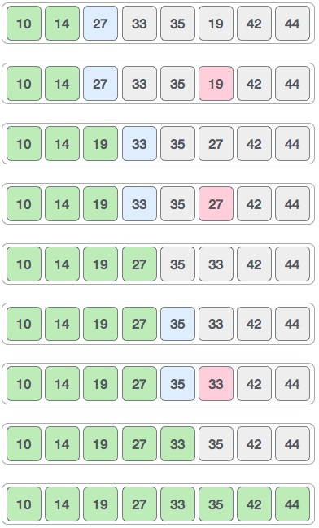

Slide 10
Brute Force
A straightforward approach, usually based directly on the problem’s statement and definitions of the concepts involved

Slide 11
Brute-Force Sorting Algorithm
Selection Sort Scan the array to find its smallest element and swap it with the first element. Then, starting with the second element, scan the elements to the right of it to find the smallest among them and swap it with the second elements. Generally, on pass i (0 ≤ i ≤ n-2), find the smallest element in A[i..n-1] and swap it with A[i]:
A[0] ≤ . . . ≤ A[i-1] | A[i], . . . , A[min], . . ., A[n-1]
in their final positions

Slide 12
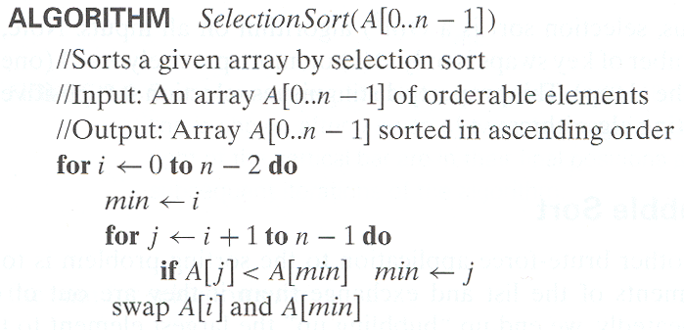
Analysis of Selection Sort
Time efficiency:
Space efficiency:
Stability:

Slide 13
Bubble Sort
5 1 4 2 8

Slide 14
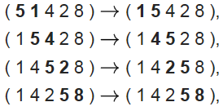

Slide 15
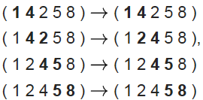

Slide 16
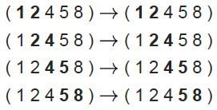

Slide 17
Brute Force
A straightforward approach, usually based directly on the problem’s statement and definitions of the concepts involved
Examples:
Computing a^{n} (a > 0, n a nonnegative integer)
Computing n!
Multiplying two matrices
Searching for a key of a given value in a list

