Slide 1
CMPS 3120
Algorithm Analysis
Dr. Chengwei Lei
CEECS
California State University, Bakersfield

Slide 2
Graph Traversal Algorithms
Many problems require processing all graph vertices (and edges) in systematic fashion
Graph traversal algorithms:
  Depth-first search (DFS)
  Breadth-first search (BFS)

Slide 3
Depth-First Search (DFS)
Visits graph’s vertices by always moving away from last
visited vertex to unvisited one, backtracks if no adjacent
unvisited vertex is available.
Uses a stack
  a vertex is pushed onto the stack when it’s reached for the first time
  a vertex is popped off the stack when it becomes a dead end, i.e., when there is no adjacent unvisited vertex
“Redraws” graph in tree-like fashion (with tree edges and
back edges for undirected graph)

Slide 4
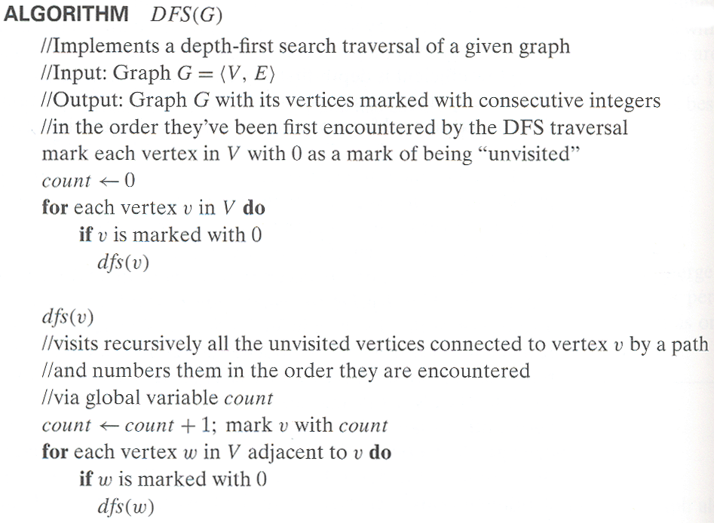
Pseudocode of DFS

Slide 5
Example: DFS traversal of undirected graph
a
b
c
d
e
f
g
h
DFS traversal stack:
DFS tree:
Notes:
Traversal using alphabetical order of vertices. Work through this example in detail,
showing the traversal by highlighting edges on the graph and showing how the stack
evolves:
8 h 3
7 d 4 stack shown growing upwards
4 e 1 6 c 5 number on left is order that vertex was pushed onto stack
3 f 2 5 g 6 number on right is order that vertex was popped from stack
2 b 7 overlap is because after e, f are popped off stack, g and c
1 a 8 are pushed onto stack in their former locations.
order pushed onto stack: a b f e g c d h
order popped from stack: e f h d c g b a
* show dfs tree as it gets constructed, back edges

Slide 6
Notes on DFS
DFS can be implemented with graphs represented as:
  adjacency matrices: Θ(V²)
  adjacency lists: Θ(|V|+|E|)
Yields two distinct ordering of vertices:
  order in which vertices are first encountered (pushed onto stack)
  order in which vertices become dead-ends (popped off stack)
Applications:
  checking connectivity, finding connected components
  checking acyclicity
  finding articulation points and biconnected components
  searching state-space of problems for solution (AI)

Slide 7
Breadth-first search (BFS)
Visits graph vertices by moving across to all the neighbors of last visited vertex
Instead of a stack, BFS uses a queue
Similar to level-by-level tree traversal
“Redraws” graph in tree-like fashion (with tree edges and cross edges for undirected graph)

Slide 8
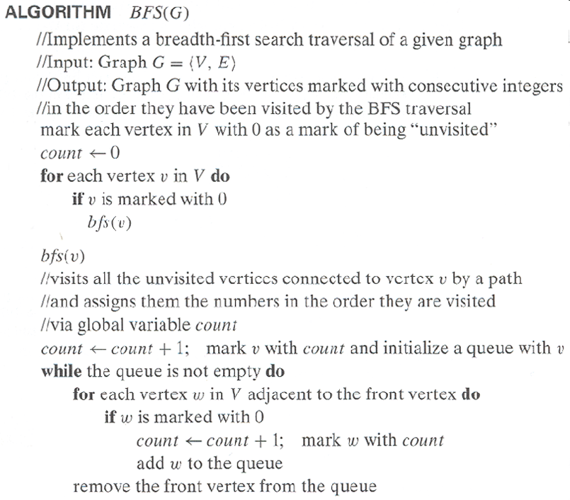
Pseudocode of BFS

Slide 9
Example of BFS traversal of undirected graph
a
b
c
d
e
f
g
h
BFS traversal queue:
BFS tree:

Slide 10
Notes on BFS
BFS has same efficiency as DFS and can be implemented with graphs represented as:
  adjacency matrices: Θ(V²)
  adjacency lists: Θ(|V|+|E|)
Yields single ordering of vertices (order added/deleted from queue is the same)
Applications: same as DFS, but can also find paths from a vertex to all other vertices with the smallest number of edges

