Slide 1
CMPS 3120
Algorithm Analysis
Dr. Chengwei Lei
CEECS
California State University, Bakersfield

Slide 2
Brute-Force Polynomial Evaluation
Problem: Find the value of polynomial
p(x) = a_{n}x^{n} + a_{n-1}x^{n-1} +… + a₁x¹ + a₀
at a point x = x₀
Brute-force algorithm
Efficiency:
p ← 0.0
for i ← n downto 0 do
power ← 1
  for j ← 1 to i do //compute x^{i}
  power ← power ∗ x
  p ← p + a[i] ∗ power
return p

Slide 3
Polynomial Evaluation: Improvement
We can do better by evaluating from right to left:
Better brute-force algorithm
Efficiency:
p ← a[0]
power ← 1
for i ← 1 to n do
    power ← power ∗ x
  p ← p + a[i] ∗ power
  return p

Slide 4
Closest-Pair Problem
Find the two closest points in a set of n points (in the two-dimensional Cartesian plane).
Brute-force algorithm
Compute the distance between every pair of distinct points
and return the indexes of the points for which the distance is the smallest.
Notes:
Draw example.

Slide 5
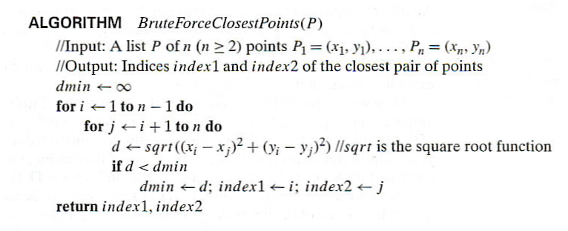
Closest-Pair Brute-Force Algorithm (cont.)
Efficiency:
How to make it faster?
Notes:
The basic operation of the algorithm is computing the Euclidean distance between two points.
The square root is a complex operation who’s result is often irrational, therefore the results
can be found only approximately. Computing such operations are not trivial. One can avoid
computing square roots by comparing distance squares instead.

Slide 6
Brute-Force Strengths and Weaknesses
Strengths
  wide applicability
  simplicity
  yields reasonable algorithms for some important problems
  (e.g., matrix multiplication, sorting, searching, string matching)
Weaknesses
  rarely yields efficient algorithms
  some brute-force algorithms are unacceptably slow
  not as constructive as some other design techniques

Slide 7
Exhaustive Search
A brute force solution to a problem involving search for an element with a special property, usually among combinatorial objects such as permutations, combinations, or subsets of a set.
Method:
  generate a list of all potential solutions to the problem in a systematic manner (see algorithms in Sec. 5.4)
  evaluate potential solutions one by one, disqualifying infeasible ones and, for an optimization problem, keeping track of the best one found so far
  when search ends, announce the solution(s) found

Slide 8
Example 1: Traveling Salesman Problem
Given n cities with known distances between each pair, find the shortest tour that passes through all the cities exactly once before returning to the starting city
Alternatively: Find shortest Hamiltonian circuit in a weighted connected graph
Example:
2
a
b
5
3
8
4
c
d
7

Slide 9
TSP by Exhaustive Search
Tour Cost
a→b→c→d→a 2+3+7+5 = 17
a→b→d→c→a 2+4+7+8 = 21
a→c→b→d→a 8+3+4+5 = 20
a→c→d→b→a 8+7+4+2 = 21
a→d→b→c→a 5+4+3+8 = 20
a→d→c→b→a 5+7+3+2 = 17
More tours?
Less tours?
Efficiency:

Slide 10
Example 2: Knapsack Problem
Given n items:
  weights: w₁ w₂ … w_{n}
  values: v₁ v₂ … v_{n}
  a knapsack of capacity W
Find most valuable subset of the items that fit into the knapsack
Example: Knapsack capacity W=16
item weight value
2 $20
5 $30
10 $50
5 $10

Slide 11
Knapsack Problem by Exhaustive Search
Subset Total weight Total value
{1} 2 $20
{2} 5 $30
{3} 10 $50
{4} 5 $10
{1,2} 7 $50
{1,3} 12 $70
{1,4} 7 $30
{2,3} 15 $80
{2,4} 10 $40
{3,4} 15 $60
{1,2,3} 17 not feasible
{1,2,4} 12 $60
{1,3,4} 17 not feasible
{2,3,4} 20 not feasible
{1,2,3,4} 22 not feasible
Efficiency:

Slide 12
Example 3: The Assignment Problem
There are n people who need to be assigned to n jobs, one person per job. The cost of assigning person i to job j is C[i,j]. Find an assignment that minimizes the total cost.
Job 0 Job 1 Job 2 Job 3
Person 0 9 2 7 8
Person 1 6 4 3 7
Person 2 5 8 1 8
Person 3 7 6 9 4
Algorithmic Plan: Generate all legitimate assignments, compute
their costs, and select the cheapest one.
How many assignments are there?
Pose the problem as the one about a cost matrix:

Slide 13
Assignment Problem by Exhaustive Search
9 2 7 8
6 4 3 7
5 8 1 8
7 6 9 4
Assignment (col.#s) Total Cost
1, 2, 3, 4 9+4+1+4=18
1, 2, 4, 3 9+4+8+9=30
1, 3, 2, 4 9+3+8+4=24
1, 3, 4, 2 9+3+8+6=26
1, 4, 2, 3 9+7+8+9=33
1, 4, 3, 2 9+7+1+6=23
etc.
(For this particular instance, the optimal assignment can be found by exploiting the specific features of the number given. It is: )
C =

Slide 14
Final Comments on Exhaustive Search
Exhaustive-search algorithms run in a realistic amount of time only on very small instances
In some cases, there are much better alternatives!
  Euler circuits
  shortest paths
  minimum spanning tree
  assignment problem
In many cases, exhaustive search or its variation is the only known way to get exact solution

