Slide 1
Mergesort
Split array A[0..n-1] in two about equal halves and make copies of each half in arrays B and C
Sort arrays B and C recursively
Merge sorted arrays B and C into array A as follows:
  Repeat the following until no elements remain in one of the arrays:
    compare the first elements in the remaining unprocessed portions of the arrays
    copy the smaller of the two into A, while incrementing the index indicating the unprocessed portion of that array
  Once all elements in one of the arrays are processed, copy the remaining unprocessed elements from the other array into A.

Slide 2
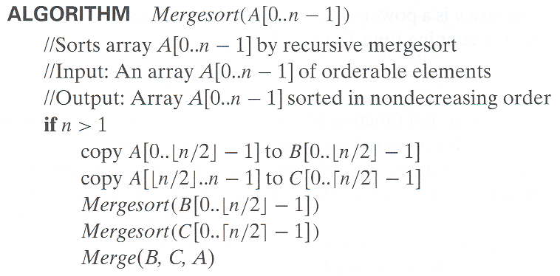
Pseudocode of Mergesort

Slide 3
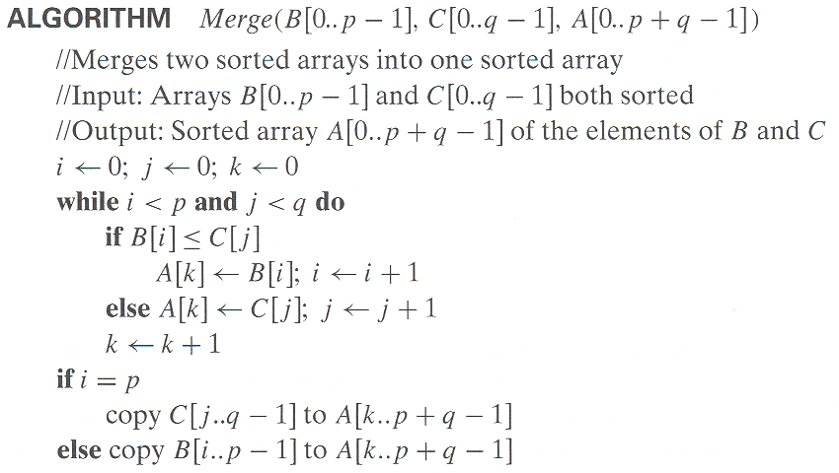
Pseudocode of Merge

Slide 4
Mergesort Example
Notes:
Go over this example in detail, then do another example of merging, something like:
(1 2 5 7 9)
(3 4 6)

Slide 5
Analysis of Mergesort
All cases have same efficiency: Θ(n log n)
Number of comparisons in the worst case is close to theoretical minimum for comparison-based sorting:
  ⎡log₂ n!⎤ ≈ n log₂ n - 1.44n
Space requirement: Θ(n) (not in-place)
Can be implemented without recursion (bottom-up)
Notes:
even if not analyzing in detail, show the recurrence for mergesort in worst case:
T(n) = 2 T(n/2) + (n-1)
worst case comparisons for merge

Slide 7
Quicksort
Select a pivot (partitioning element) – here, the first element
Rearrange the list so that all the elements in the first s positions are smaller than or equal to the pivot and all the elements in the remaining n-s positions are larger than or equal to the pivot (see next slide for an algorithm)
Exchange the pivot with the last element in the first (i.e., ≤) subarray — the pivot is now in its final position
Sort the two subarrays recursively
p
A[i]≤p
A[i]≥p

Slide 8
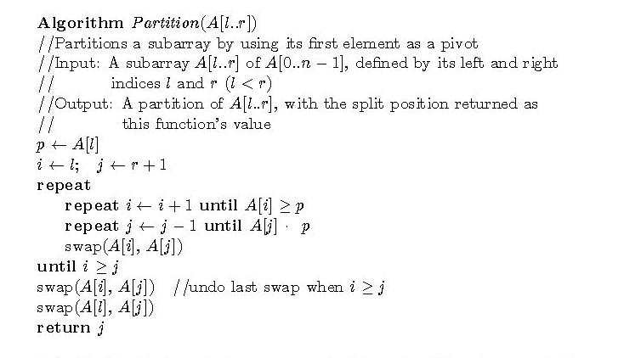
Hoare’s Partitioning Algorithm

Slide 9
Quicksort Example
3 7 8 5 2 1 9 5 4

Slide 10
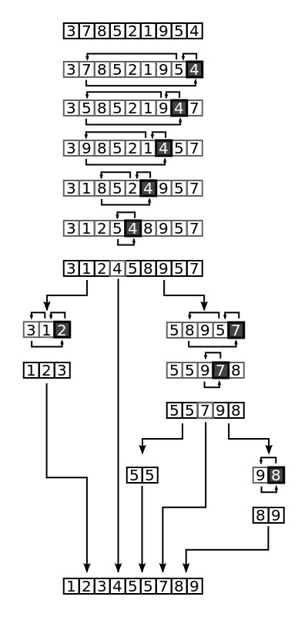

Slide 11
Analysis of Quicksort
Best case: split in the middle — Θ(n log n)
Worst case: sorted array! — Θ(n²)
Average case: random arrays — Θ(n log n)
Improvements:
  better pivot selection: median of three partitioning
  switch to insertion sort on small subfiles
  elimination of recursion
  These combine to 20-25% improvement
Considered the method of choice for internal sorting of large files (n ≥ 10000)

