Slide 1
CMPS 3120
Algorithm Analysis
Dr. Chengwei Lei
CEECS
California State University, Bakersfield

Slide 2
Searching Problem
Problem: Given a (multi)set S of keys and a search
key K, find an occurrence of K in S, if any
Searching must be considered in the context of:
  file size (internal vs. external)
  dynamics of data (static vs. dynamic)
Dictionary operations (dynamic data):
  find (search)
  insert
  delete

Slide 3
Taxonomy of Searching Algorithms
List searching
  sequential search
  binary search
  interpolation search
Tree searching
  binary search tree
  binary balanced trees: AVL trees, red-black trees
  multiway balanced trees: 2-3 trees, 2-3-4 trees, B trees
Hashing
  open hashing (separate chaining)
  closed hashing (open addressing)

Slide 4
Binary Search Tree
Arrange keys in a binary tree with the binary search tree property:
K
<K
>K
Example: 5, 3, 1, 10, 12, 7, 9

Slide 5
Dictionary Operations on Binary Search Trees
  Searching – straightforward
  Insertion – search for key, insert at leaf where search terminated
  Deletion – 3 cases:
    deleting key at a leaf
    deleting key at node with single child
    deleting key at node with two children
Efficiency depends of the tree’s height: ⎣log₂ n⎦ ≤ h ≤ n-1,
with height average (random files) be about 3log₂ n
Thus all three operations have
  worst case efficiency: Θ(n)
  average case efficiency: Θ(log n)
Bonus: inorder traversal produces sorted list
Notes:
1.41 lg n = 2 ln n

Slide 6
Balanced Search Trees
Attractiveness of binary search tree is marred by the bad (linear) worst-case efficiency. Two ideas to overcome it are:
to rebalance binary search tree when a new insertion
makes the tree “too unbalanced”
  AVL trees
  red-black trees
to allow more than one key per node of a search tree
  2-3 trees
  2-3-4 trees
  B-trees

Slide 7
Balanced trees: AVL trees
Definition An AVL tree is a binary search tree in which, for every node, the difference between the heights of its left and right subtrees, called the balance factor, is at most 1 (with the height of an empty tree defined as -1)
Tree (a) is an AVL tree; tree (b) is not an AVL tree

Slide 8
Rotations
If a key insertion violates the balance requirement at some node, the subtree rooted at that node is transformed via one of the four rotations. (The rotation is always performed for a subtree rooted at an “unbalanced” node closest to the new leaf.)
Single R-rotation
Double LR-rotation

Slide 9
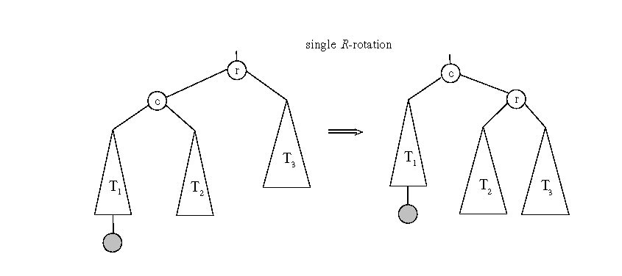
General case: Single R-rotation

Slide 10
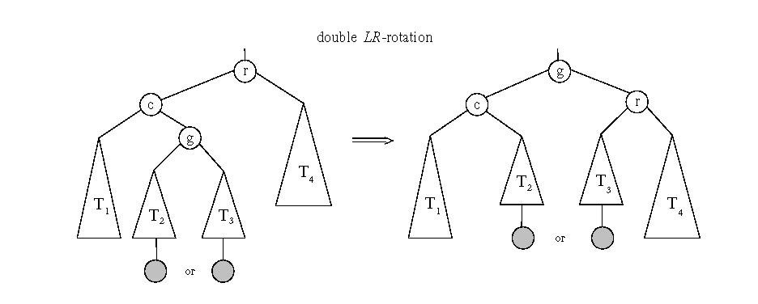
General case: Double LR-rotation

Slide 11
AVL tree construction - an example
Construct an AVL tree for the list 5, 6, 8, 3, 2, 4, 7

Slide 12
AVL tree construction - an example (cont.)

Slide 13
Analysis of AVL trees
h ≤ 1.4404 log₂ (n + 2) - 1.3277
average height: 1.01 log₂n + 0.1 for large n (found empirically)
Search and insertion are O(log n)
Deletion is more complicated but is also O(log n)
Disadvantages:
  frequent rotations
  complexity
A similar idea: red-black trees (height of subtrees is allowed to differ by up to a factor of 2)

