Slide 1
CMPS 3120
Algorithm Analysis
Dr. Chengwei Lei
CEECS
California State University, Bakersfield

Slide 2
What is the “best” binary tree?

Slide 3
Heaps and Heapsort
Definition A heap is a binary tree with keys at its nodes (one key per node) such that:
It is essentially complete, i.e., all its levels are full except possibly the last level, where only some rightmost keys may be missing
The key at each node is ≥ keys at its children

Slide 4
Illustration of the heap’s definition

Slide 5
Illustration of the heap’s definition
a heap
not a heap
not a heap
Note: Heap’s elements are ordered top down (along any path
down from its root), but they are not ordered left to right

Slide 6
Some Important Properties of a Heap
Given n, there exists a unique binary tree with n nodes that
is essentially complete, with h = ⎣log₂ n⎦
The root contains the largest key
The subtree rooted at any node of a heap is also a heap
A heap can be represented as an array

Slide 7
Heap’s Array Representation
Store heap’s elements in an array (whose elements indexed, for convenience, 1 to n) in top-down left-to-right order
Example:
Left child of node j is at 2j
Right child of node j is at 2j+1
Parent of node j is at ⎣j/2⎦
Parental nodes are represented in the first ⎣n/2⎦ locations
9
1 2 3 4 5 6
5
3
9 5 3 1 4 2
1
4
2

Slide 8
Heap Construction (bottom-up)
Step 0: Initialize the structure with keys in the order given
Step 1: Starting with the last (rightmost) parental node, fix the heap rooted at it, if it doesn’t satisfy the heap condition: keep exchanging it with its largest child until the heap condition holds
Step 2: Repeat Step 1 for the preceding parental node

Slide 9
Example of Heap Construction
Construct a heap for the list 2, 9, 7, 6, 5, 8

Slide 10
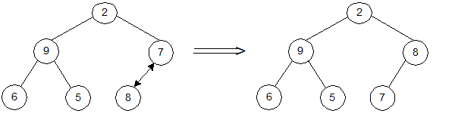
Example of Heap Construction
Construct a heap for the list 2, 9, 7, 6, 5, 8

Slide 11
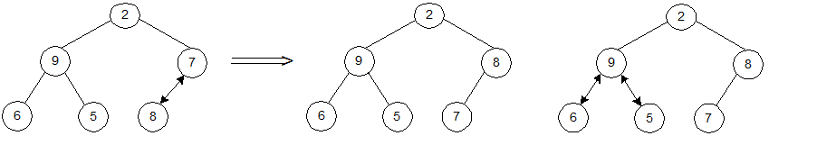
Example of Heap Construction
Construct a heap for the list 2, 9, 7, 6, 5, 8

Slide 12
Example of Heap Construction
Construct a heap for the list 2, 9, 7, 6, 5, 8

Slide 13
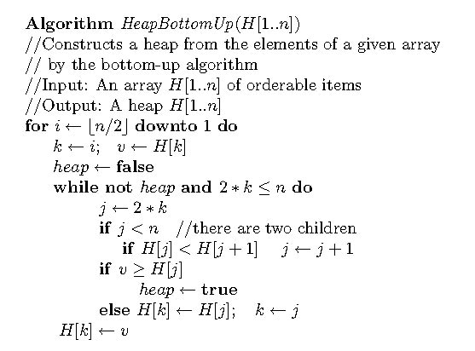
Pseudopodia of bottom-up heap construction

Slide 14
Heapsort
Stage 1: Construct a heap for a given list of n keys
Stage 2: Repeat operation of root removal n-1 times:
    Exchange keys in the root and in the last (rightmost) leaf
    Decrease heap size by 1
    If necessary, swap new root with larger child until the heap condition holds

Slide 15
Example of Sorting by Heapsort
Sort the list 2, 9, 7, 6, 5, 8 by heapsort
Stage 1 (heap construction) Stage 2 (root/max removal)
2 9 7 6 5 8 9 6 8 2 5 7
2 9 8 6 5 7 7 6 8 2 5 | 9
2 9 8 6 5 7 8 6 7 2 5 | 9
9 2 8 6 5 7 5 6 7 2 | 8 9
9 6 8 2 5 7 7 6 5 2 | 8 9
2 6 5 | 7 8 9
6 2 5 | 7 8 9
5 2 | 6 7 8 9
5 2 | 6 7 8 9
2 | 5 6 7 8 9

Slide 16
Analysis of Heapsort
Stage 1: Build heap for a given list of n keys
worst-case
C(n) =
Stage 2: Repeat operation of root removal n-1 times (fix heap)
worst-case
C(n) =
Both worst-case and average-case efficiency: Θ(nlogn)
In-place: yes
Stability: no (e.g., 1 1)
h-1
Σ
2(h-i) 2^{i} = 2 ( n – log₂(n + 1)) ∈ Θ(n)
i=0
# nodes at level i
n-1
Σ
2log₂ i ∈ Θ(nlogn)
i=1

Slide 17
Insertion of a New Element into a Heap
Insert the new element at last position in heap.
Compare it with its parent and, if it violates heap condition,
exchange them
Continue comparing the new element with nodes up the tree until the heap condition is satisfied
Example: Insert key 10
Efficiency: O(log n)

