Slide 1
Suffix Tree

Slide 2
Motivation
DNA sequences and protein sequences are too large to search by traditional algorithms
Text search
  Need fast searching algorithm(with low space cost)
Credit to Brain Chen & Pluto Chang

Slide 3
Exact Matching Problem
Find ‘ssi’ in ‘mississippi’

Slide 4
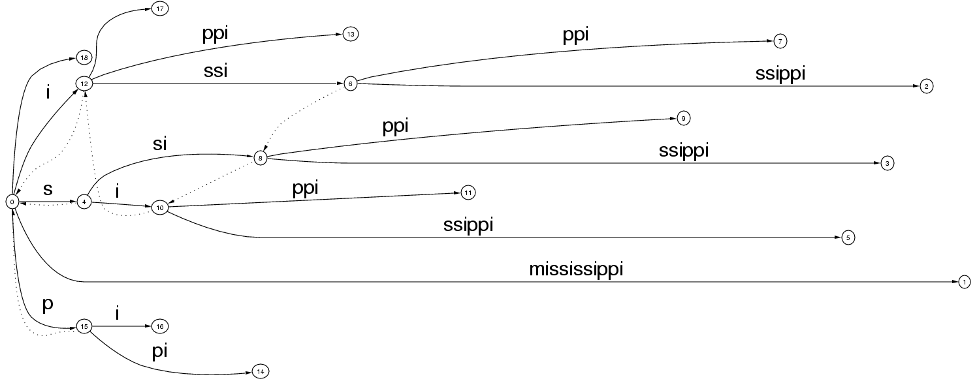
Exact Matching Problem
Find ‘ssi’ in ‘mississippi’

Slide 5
Exact Matching Problem
Find ‘ssi’ in ‘mississippi’
si
s

Slide 6
Exact Matching Problem
Find ‘ssi’ in ‘mississippi’
ssippi
si
s
Every leaf below this point
in the tree marks the starting
location of ‘ssi’ in ‘mississippi’.
(ie. ‘ssissippi’ and ‘ssippi’)

Slide 7
Exact Matching Problem
Find ‘sissy’ in ‘mississippi’

Slide 8
Exact Matching Problem
Find ‘sissy’ in ‘mississippi’

Slide 9
Exact Matching Problem
Find ‘sissy’ in ‘mississippi’
s
i
ss

Slide 10
Exact Matching Problem
Find ‘sissy’ in ‘mississippi’
s
i
ss

Slide 11
Exact Matching Problem
So what? Knuth-Morris-Pratt and Boyer-Moore both achieve this worst case bound.
  O(m+n) when the text and pattern are presented together.
Suffix trees are much faster when the text is fixed and known first while the patterns vary.
  O(m) for single time processing the text, then only O(n) for each new pattern.

Slide 12
Boyer-Moore Algorithm
For string matching(exact matching problem)
Time complexity O(m+n) for worst case and O(n/m) for absense
Method: backward matching with 2 jumping arrays(bad character table and good suffix table)

Slide 13
What are suffix arrays and trees?
Text indexing data structures
not word based
allow search for patterns or
computation of statistics
Important Properties
Size
Speed of exact matching
Space required for construction
Time required for construction

Slide 14
Suffix Tree

Slide 15
Properties of a Suffix Tree
Each tree edge is labeled by a substring of S.
Each internal node has at least 2 children.
Each S_{(i)} has its corresponding labeled path from root to a leaf, for 1≤ i ≤ n .
There are n leaves.
No edges branching out from the same internal node can start with the same character.

Slide 16
Building the Suffix Tree
How do we build a suffix tree?
while suffixes remain:
  add next shortest suffix to the tree

Slide 17
Building the Suffix Tree
papua

Slide 18
Building the Suffix Tree
papua
papua

Slide 19
Building the Suffix Tree
papua
apua
papua

Slide 20
Building the Suffix Tree
papua
apua
p
apua
ua

Slide 21
Building the Suffix Tree
papua
apua
p
apua
ua
ua

Slide 22
Building the Suffix Tree
papua
a
pua
p
apua
ua
ua

Slide 23
Building the Suffix Tree
papua
a
pua
p
apua
ua
ua

Slide 24
Building the Suffix Tree
How do we build a suffix tree?
while suffixes remain:
  add next shortest suffix to the tree
Naïve method - O(m²) (m = text size)

Slide 25
Building the Suffix Tree in O(m) Time
In the previous example, we assumed that the tree can be built in O(m) time.
Weiner showed original O(m) algorithm (Knuth is claimed to have called it “the algorithm of 1973”)
More space efficient algorithm by McCreight in 1976
Simpler ‘on-line’ algorithm by Ukkonen in 1995

Slide 26
Ukkonen’s Algorithm
Build suffix tree T for string S[1..m]
  Build the tree in m phases, one for each character. At the end of phase i, we will have tree T_{i}, which is the tree representing the prefix S[1..i].
    In each phase i, we have i extensions, one for each character in the current prefix. At the end of extension j, we will have ensured that S[j..i] is in the tree T_{i}.

Slide 27
Ukkonen’s Algorithm
3 possible ways to extend S[j..i] with character i+1.
S[j..i] ends at a leaf. Add the character i+1 to the end of the leaf edge.
There is a path through S[j..i], but no match for the i+1 character. Split the edge and create a new node if necessary, then add a new leaf with character i+1.
There is already a path through S[j..i+1]. Do nothing.

Slide 28
Ukkonen’s Algorithm - mississippi

Slide 29

Ukkonen’s Algorithm - mississippi

Slide 30
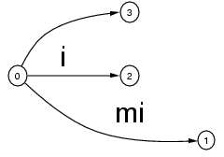
Ukkonen’s Algorithm - mississippi

Slide 31
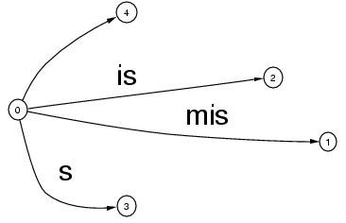
Ukkonen’s Algorithm - mississippi

Slide 32
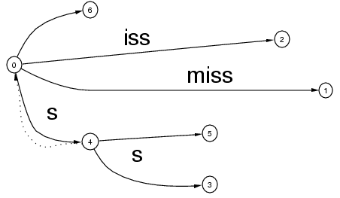
Ukkonen’s Algorithm - mississippi

Slide 33
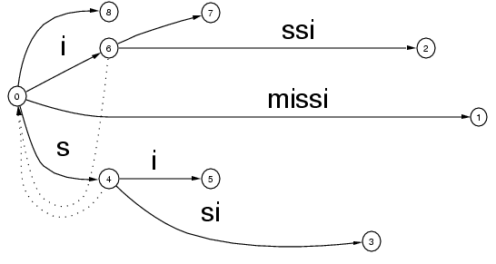
Ukkonen’s Algorithm - mississippi

Slide 34
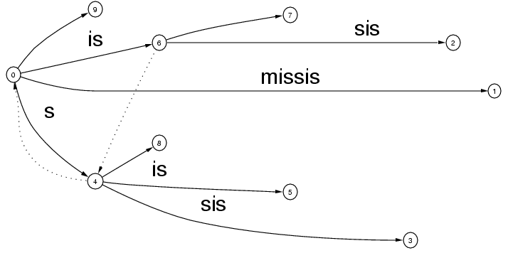
Ukkonen’s Algorithm - mississippi

Slide 35
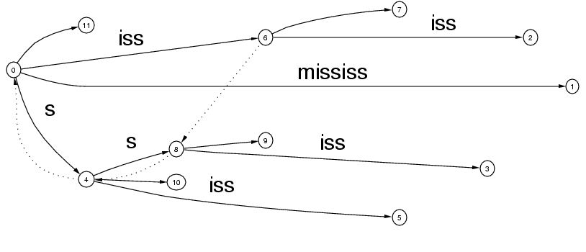
Ukkonen’s Algorithm - mississippi

Slide 36
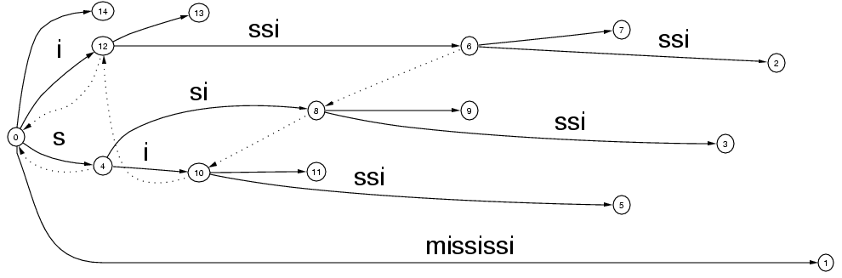
Ukkonen’s Algorithm - mississippi

Slide 37
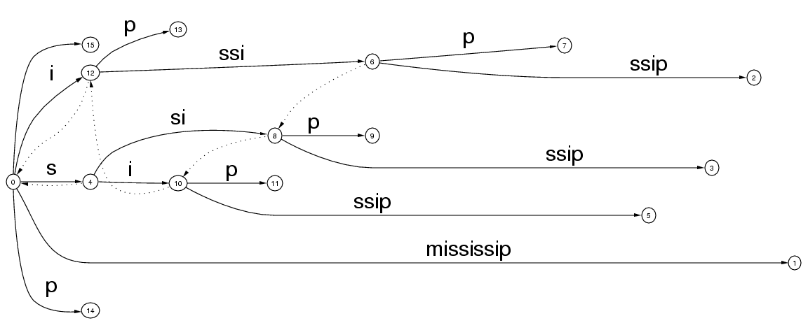
Ukkonen’s Algorithm - mississippi

Slide 38
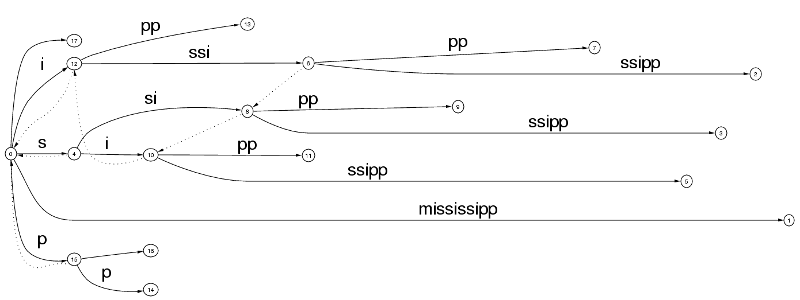
Ukkonen’s Algorithm - mississippi

Slide 39
Ukkonen’s Algorithm - mississippi

Slide 40
Ukkonen’s Algorithm
In the form just presented, this is an O(m³) time, O(m²) space algorithm.
We need a few implementation speed-ups to achieve the O(m) time and O(m) space bounds.

