Slide 1
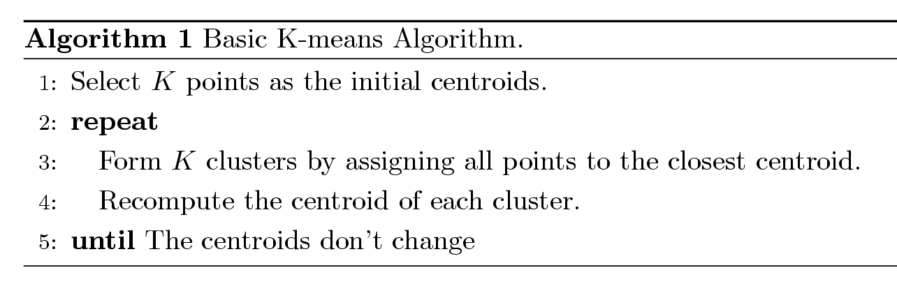
K-means Clustering
Partitional clustering approach
Each cluster is associated with a centroid (center point)
Each point is assigned to the cluster with the closest centroid
Number of clusters, K, must be specified
The basic algorithm is very simple

Slide 2
K-means Clustering – Details
Initial centroids are often chosen randomly. Clusters produced vary from one run to another.
The centroid is (typically) the mean of the points in the cluster.
‘Closeness’ is measured by Euclidean distance, cosine similarity, correlation, etc.
K-means will converge for common similarity measures mentioned above.
Most of the convergence happens in the first few iterations.
Often the stopping condition is changed to ‘Until relatively few points change clusters’
Complexity is O( n * K * I * d )
    n = number of points, K = number of clusters,
    I = number of iterations, d = number of attributes

Slide 3
Two different K-means Clusterings
Original Points
Optimal Clustering
Sub-optimal Clustering

Slide 4
Importance of Choosing Initial Centroids

Slide 5
Importance of Choosing Initial Centroids

Slide 6
Importance of Choosing Initial Centroids …

Slide 7
Importance of Choosing Initial Centroids …

Slide 8
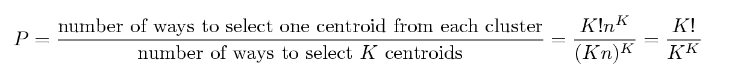
Problems with Selecting Initial Points
If there are K ‘real’ clusters then the chance of selecting one centroid from each cluster is small.
  Chance is relatively small when K is large
  If clusters are the same size, n, then
  For example, if K = 10, then probability = 10!/10¹⁰ = 0.00036
  Sometimes the initial centroids will readjust themselves in ‘right’ way, and sometimes they don’t
  Consider an example of five pairs of clusters

Slide 9
10 Clusters Example
Starting with two initial centroids in one cluster of each pair of clusters

Slide 10
10 Clusters Example
Starting with two initial centroids in one cluster of each pair of clusters

Slide 11
10 Clusters Example
Starting with some pairs of clusters having three initial centroids, while other have only one.

Slide 12
10 Clusters Example
Starting with some pairs of clusters having three initial centroids, while other have only one.

Slide 13
Solutions to Initial Centroids Problem
Multiple runs
  Helps, but probability is not on your side
Sample and use hierarchical clustering to determine initial centroids
Select more than k initial centroids and then select among these initial centroids
  Select most widely separated
Postprocessing
Bisecting K-means
  Not as susceptible to initialization issues

Slide 14
Handling Empty Clusters
Basic K-means algorithm can yield empty clusters
Several strategies
  Choose the point that contributes most to SSE
  Choose a point from the cluster with the highest SSE
  If there are several empty clusters, the above can be repeated several times.

Slide 15
Updating Centers Incrementally
In the basic K-means algorithm, centroids are updated after all points are assigned to a centroid
An alternative is to update the centroids after each assignment (incremental approach)
  Each assignment updates zero or two centroids
  More expensive
  Introduces an order dependency
  Never get an empty cluster
  Can use “weights” to change the impact

Slide 16
Pre-processing and Post-processing
Pre-processing
  Normalize the data
  Eliminate outliers
Post-processing
  Eliminate small clusters that may represent outliers
  Split ‘loose’ clusters, i.e., clusters with relatively high SSE
  Merge clusters that are ‘close’ and that have relatively low SSE
  Can use these steps during the clustering process
    ISODATA

Slide 17
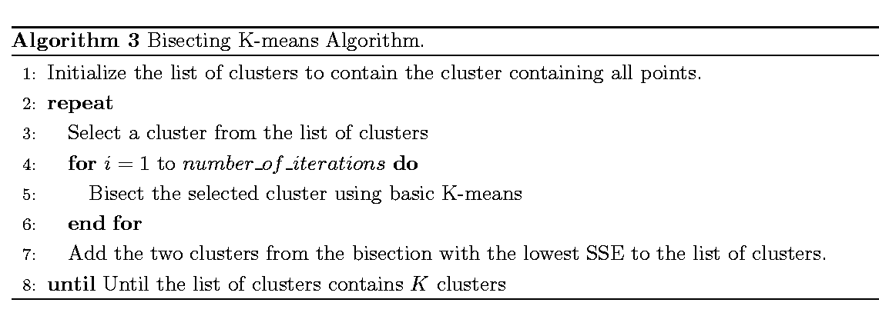
Bisecting K-means
Bisecting K-means algorithm
  Variant of K-means that can produce a partitional or a hierarchical clustering

Slide 18
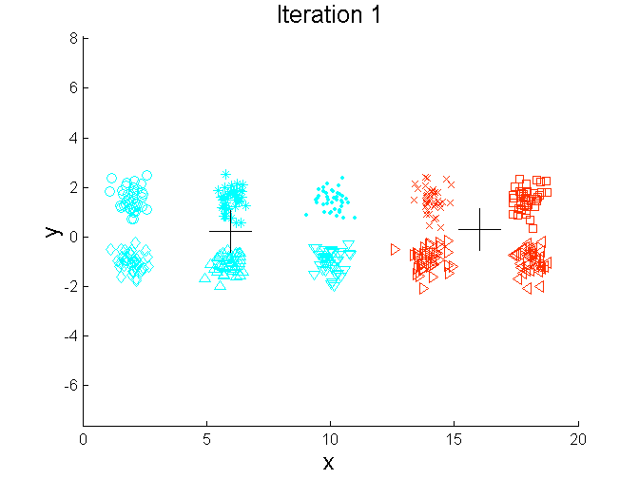
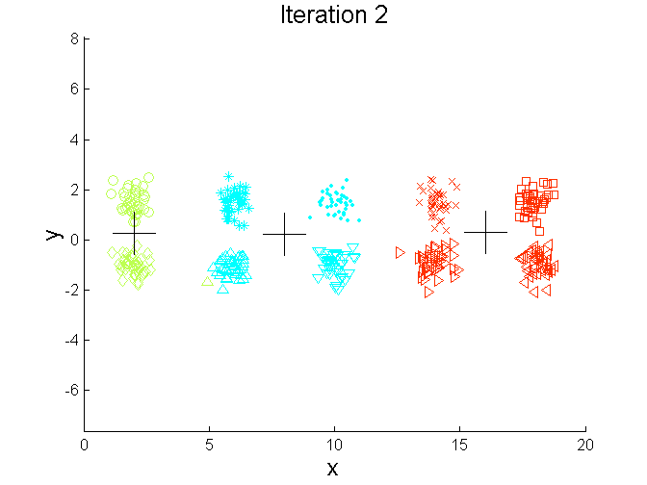
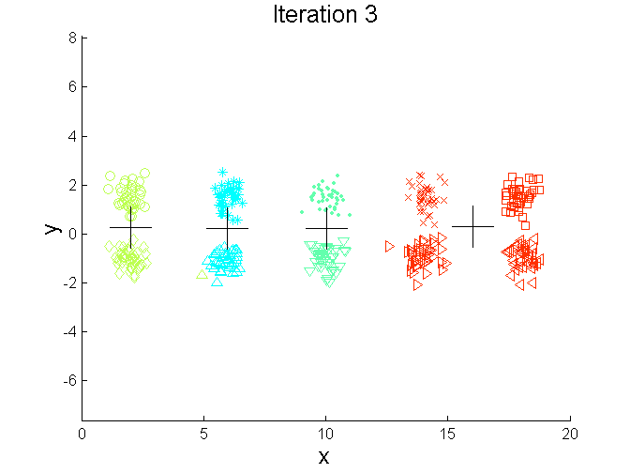
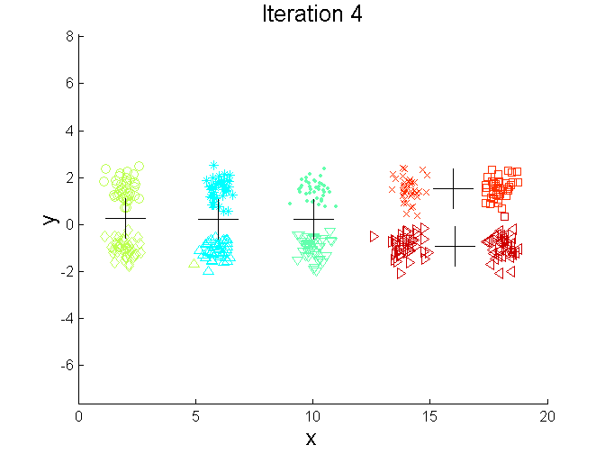
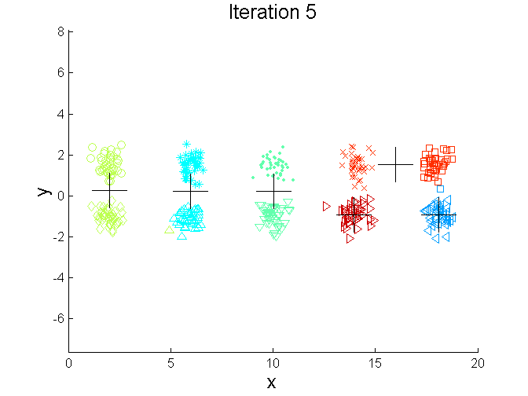
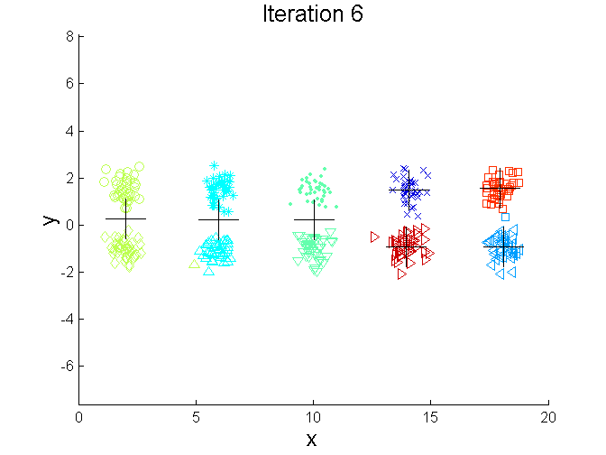
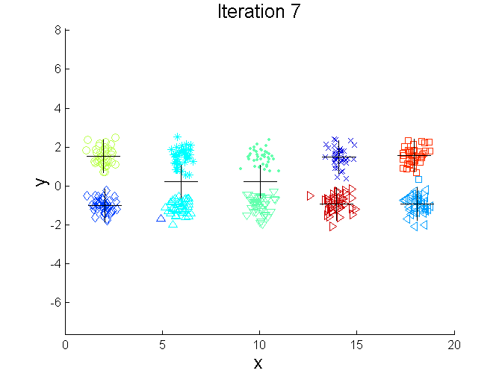
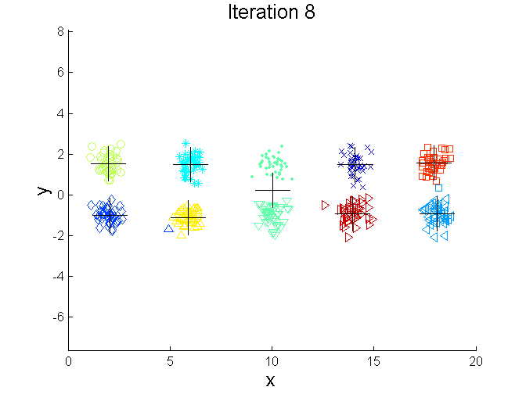
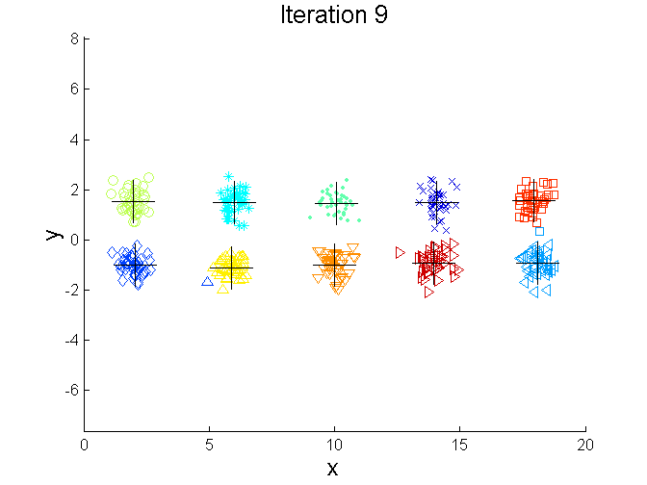
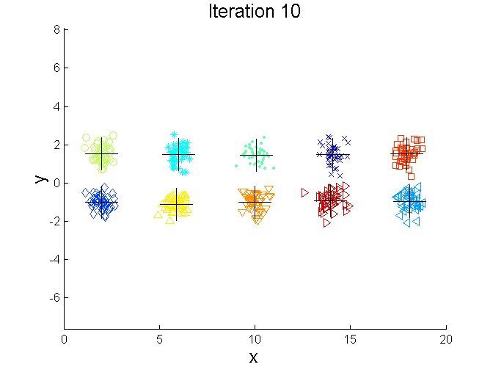
Bisecting K-means Example

