Slide 1
What is Cluster Analysis?
Finding groups of objects such that the objects in a group will be similar (or related) to one another and different from (or unrelated to) the objects in other groups
Inter-cluster distances are maximized
Intra-cluster distances are minimized

Slide 2
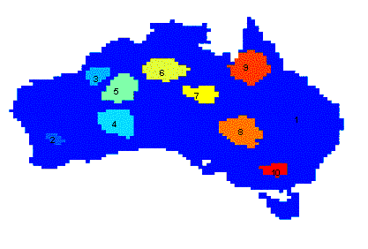
Applications of Cluster Analysis
Understanding
  Group related documents for browsing, group genes and proteins that have similar functionality, or group stocks with similar price fluctuations
Summarization
  Reduce the size of large data sets
Clustering precipitation in Australia

Slide 3
What is not Cluster Analysis?
Supervised classification
  Have class label information
Simple segmentation
  Dividing students into different registration groups alphabetically, by last name
Results of a query
  Groupings are a result of an external specification
Graph partitioning
  Some mutual relevance and synergy, but areas are not identical

Slide 4
Notion of a Cluster can be Ambiguous
How many clusters?
Six Clusters
Two Clusters
Four Clusters

Slide 5
Types of Clusterings
A clustering is a set of clusters
Important distinction between hierarchical and partitional sets of clusters
Partitional Clustering
  A division data objects into non-overlapping subsets (clusters) such that each data object is in exactly one subset
Hierarchical clustering
  A set of nested clusters organized as a hierarchical tree

Slide 6
Partitional Clustering
Original Points
A Partitional Clustering

Slide 7
Hierarchical Clustering
Traditional Hierarchical Clustering
Traditional Dendrogram
Non-traditional Hierarchical Clustering
Non-traditional Dendrogram

Slide 8
Other Distinctions Between Sets of Clusters
Exclusive versus non-exclusive
  In non-exclusive clusterings, points may belong to multiple clusters.
  Can represent multiple classes or ‘border’ points
Fuzzy versus non-fuzzy
  In fuzzy clustering, a point belongs to every cluster with some weight between 0 and 1
  Weights must sum to 1
  Probabilistic clustering has similar characteristics
Partial versus complete
  In some cases, we only want to cluster some of the data
Heterogeneous versus homogeneous
  Cluster of widely different sizes, shapes, and densities

