Slide 1
Example 1
Observation | Observation Income ($000’s) | Lot Size (000’s sq. ft.) | Owners=1, Non-owners=2
1 | 60 | 18.4 | 1
2 | 85.5 | 16.8 | 1
3 | 64.8 | 21.6 | 1
4 | 61.5 | 20.8 | 1
5 | 87 | 23.6 | 1
6 | 110.1 | 19.2 | 1
7 | 108 | 17.6 | 1
8 | 82.8 | 22.4 | 1
9 | 69 | 20 | 1
10 | 93 | 20.8 | 1
11 | 51 | 22 | 1
12 | 81 | 20 | 1
13 | 75 | 19.6 | 2
14 | 52.8 | 20.8 | 2
15 | 64.8 | 17.2 | 2
16 | 43.2 | 20.4 | 2
17 | 84 | 17.6 | 2
18 | 49.2 | 17.6 | 2
19 | 59.4 | 16 | 2
20 | 66 | 18.4 | 2
21 | 47.4 | 16.4 | 2
22 | 33 | 18.8 | 2
23 | 51 | 14 | 2
24 | 63 | 14.8 | 2
A riding-mower manufacturer would like to find a way of classifying families in a city into those that are likely to purchase a riding mower and those who are not likely to buy one. A pilot random sample of 12 owners and 12 non-owners in the city is undertaken. The data are shown in Table 1
How to calculate the distance between two families?

Slide 2
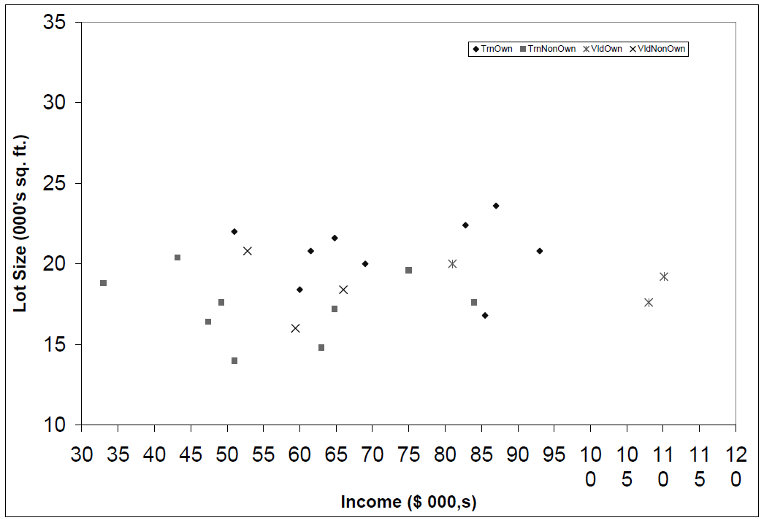

Slide 3
Example 2
Credit card application approval, based on Age and Loan
There is a new application.
  What are the distances between the new application and the known applications.

Slide 4
Distance
Age | Loan | Default | Distance
25 | $40,000 | N | 102000
35 | $60,000 | N | 82000
45 | $80,000 | N | 62000
20 | $20,000 | N | 122000
35 | $120,000 | N | 22000
52 | $18,000 | N | 124000
23 | $95,000 | Y | 47000
40 | $62,000 | Y | 80000
60 | $100,000 | Y | 42000
48 | $220,000 | Y | 78000
33 | $150,000 | Y | 8000
48 | $142,000 | ?
Euclidean Distance

Slide 5
Standardized Distance
Age | Loan | Default | Distance
0.125 | 0.11 | N | 0.7652
0.375 | 0.21 | N | 0.5200
0.625 | 0.31 | N | 0.3160
0 | 0.01 | N | 0.9245
0.375 | 0.50 | N | 0.3428
0.8 | 0.00 | N | 0.6220
0.075 | 0.38 | Y | 0.6669
0.5 | 0.22 | Y | 0.4437
1 | 0.41 | Y | 0.3650
0.7 | 1.00 | Y | 0.3861
0.325 | 0.65 | Y | 0.3771
0.7 | 0.61 | ?
Standardized Variable

