Slide 1
Learning
When the state path is known
  We’ve already done that
  Estimate parameters from labeled data
  “Supervised” learning
When the state path is unknown
  Estimate parameters without labeled data
  “unsupervised” learning

Slide 2
Basic idea
Estimate our “best guess” on the model parameters θ
Use θ to predict the unknown labels
Re-estimate a new set of θ
Repeat 2 & 3
Multiple ways

Slide 3
Viterbi training
Estimate our “best guess” on the model parameters θ
Find the Viterbi path using current θ
Re-estimate a new set of θ based on the Viterbi path
  Count transitions/emissions on those paths, getting new θ
Repeat 2 & 3 until converge

Slide 5
Posterior decoding
Viterbi finds the path with the highest probability
We want to know
  Σ_{k} = 1
In order to do posterior decoding, we need to know P(x) and P(π_{i} = k, x), since
Computing P(x) and P(x,π_{i}=k) is called the evaluation problem
The solution: Forward-backward algorithm

Slide 6
Probability of a sequence
P(X | M): prob that X can be generated by M
Sometimes simply written as P(X)
May be written as P(X | M, θ) or P(X | θ) to emphasize that we are looking for θ to optimize the likelihood (discussed later in learning)
Not equal to the probability of a path P(X, π)
  Many possible paths can generate X. Each with a probability
  P(X) = Σ_{π}P(X, π) = Σ_{π}P(X | π) P(π)
  How to compute without summing over all possible paths (exponential of them)?
    Dynamic programming

Slide 7
The forward algorithm
Define f_{k}(i) = P(x₁…x_{i}, π_{i}=k)
  Implicitly: sum over all possible paths for x₁…x_{i-1}
x_{i}
k

Slide 9
The forward algorithm
k
x_{i}

Slide 10
The forward algorithm
We can compute f_{k}(i) for all k, i, using dynamic programming!
Initialization:
f₀(0) = 1
f_{k}(0) = 0, for all k > 0
Iteration:
f_{k}(i) = e_{k}(x_{i}) Σ_{j} f_{j}(i-1) a_{jk}
Termination:
Prob(x) = Σ_{k} f_{k}(N)

Slide 11
Relation between Forward and Viterbi
VITERBI (in prob space)
Initialization:
P₀(0) = 1
P_{k}(0) = 0, for all k > 0
Iteration:
P_{k}(i) = e_{k}(x_{i}) max_{j} P_{j}(i-1) a_{jk}
Termination:
Prob(x, π*) = max_{k} P_{k}(N)
FORWARD
Initialization:
f₀(0) = 1
f_{k}(0) = 0, for all k > 0
Iteration:
f_{k}(i) = e_{k}(x_{i}) Σ_{j} f_{j}(i-1) a_{jk}
Termination:
Prob(x) = Σ_{k} f_{k}(N)

Slide 12
Posterior decoding
Viterbi finds the path with the highest probability
We want to know
  Σ_{k} = 1
In order to do posterior decoding, we need to know P(x) and P(π_{i} = k, x), since
Need to know how to compute this
Have just shown how to compute this

Slide 13
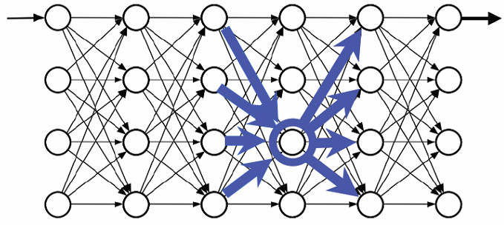
x_{i}
k

Slide 14
The backward algorithm
Define b_{k}(i) = P(x_{i+1}…x_{n} | π_{i}=k)
  Implicitly: sum over all possible paths for x_{i}…x_{n}
x_{i}
k

Slide 15
k
x_{i}
1
This does not include the emission probability of x_{i}

Slide 16
The forward-backward algorithm
Compute f_{k}(i) for each state k and position i
Compute b_{k}(i), for each state k and position i
Compute P(x) = Σ_{k}f_{k}(N)
Compute P(π_{i}=k | x) = f_{k}(i) * b_{k}(i) / P(x)

Slide 17
The prob of x, with the constraint that x_{i} was generated by state k
Sequence
state
Forward probabilities
x
Backward probabilities
/ P(X)
Space: O(KN)
Time: O(K²N)
P(π_{i}=k | x)

Slide 18
What’s P(π_{i}=k | x) good for?
For each position, you can assign a probability (in [0, 1]) to the states that the system might be in at that point – confidence level
Assign each symbol to the most-likely state according to this probability rather than the state on the most-probable path – posterior decoding
    π^_{i} = argmax_{k} P(π_{i} = k | x)

Slide 19
Posterior decoding for the dishonest casino
If P(fair) > 0.5, the roll is more likely to be generated by a fair die than a loaded die

Slide 20
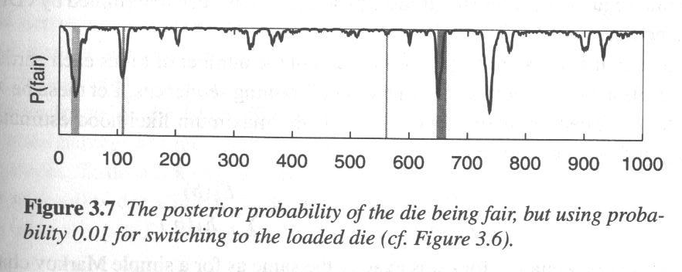
Posterior decoding for another dishonest casino
In this example, Viterbi predicts that all rolls were from the fair die.

Slide 22
Baum-Welch training
Estimate our “best guess” on the model parameters θ
Find P(π_{i}=k | x,θ) using forward-backward algorithm
Re-estimate a new set of θ based on all possible paths
  For example, according to Viterbi, pos i is in state k and pos (i+1) is in state l
    This contributes 1 count towards the frequency that transition k→ l is used
    In Baum-Welch, pos i has some prob in state k and pos (i+1) has some prob in state l. This transition is counted only partially, according to the prob of this transition
Repeat 2 & 3 until converge

Slide 23
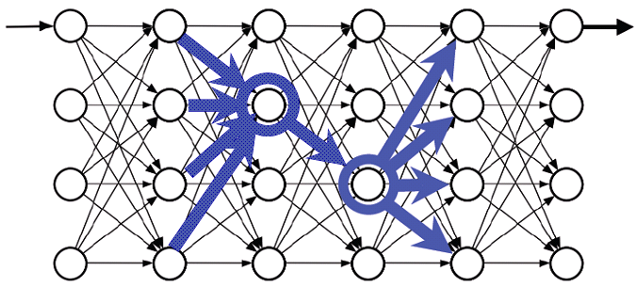
Probability that a transition is used
i
i+1
k
l

Slide 24
Estimated # of k→l transition

Slide 26
Viterbi vs Baum-Welch training
Viterbi training
  Returns a single path
  Each position labeled with a fixed state
  Each transition counts one
  Each emission also counts one
Baum-Welch training
  Does not return a single path
  Considers the prob that each transition is used and the prob that a symbol is generated by a certain state
  They only contribute partial counts

Slide 27
Viterbi vs Baum-Welch training
Both guaranteed to converges
Baum-Welch improves the likelihood of the data in each iteration: P(X)
  True EM (expectation-maximization)
Viterbi improves the probability of the most probable path in each iteration: P(X, π*)
  EM-like

Slide 28
Expectation-maximization (EM)
Baum-Welch algorithm is a special case of the expectation-maximization (EM) algorithm, a widely used technique in statistics for learning parameters from unlabeled data
E-step: compute the expectation (e.g. prob for each pos to be in a certain state)
M-step: maximum-likelihood parameter estimation
Recall: clustering

Slide 29
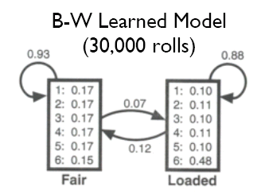

Slide 31
Summary
Viterbi – best single path
Forward – sum over all paths
Backward – similar
Baum-Welch – training via EM and forward-backward
Viterbi training – another “EM”, but Viterbi-based

