Slide 1

Ethical problems in data science
Chengwei

Slide 2
What is the correct way to present data?

Slide 3
Level 1
Generate fake data

Slide 4
How the Biggest Fabricator in Science Got Caught
In April of 2000, the journal Anesthesia & Analgesia published a letter to its editor from Peter Kranke and two colleagues that was fairly dripping with sarcasm. The trio of academic anesthesiologists took aim at an article published by a Japanese colleague named Yoshitaka Fujii, whose data on a drug to prevent nausea and vomiting after surgery were, they wrote, “incredibly nice.”
Over the next two years, it became clear that he had fabricated much of his research—most of it, in fact. Today he stands alone as the record-holder for most retractions by a single author, at a breathtaking 183, representing roughly 7 percent of all retracted papers between 1980 and 2011.
His story represents a dramatic fall from grace, but also the arrival of a new dimension to scholarly publishing: Statistical tools that can sniff out fraud, and the “cops” that are willing to use them.
Ref: https://nautil.us/how-the-biggest-fabricator-in-science-got-caught-3275/

Slide 5
Level 2
Use fake data generated by others

Slide 6
Discussion
You are a top researcher in Bioinformatic, and you are dealing with the dataset provided by a publication on a top journal, the authors are big names in this area.
  The data is fake, but you don’t know. You apply your algorithm on the data, and the result is fantastic.
  The data is fake, you notice that, but your algorithm got some fancy results on the fake data.

Slide 7
Level 3
Misleading the audience (without lying)

Slide 8
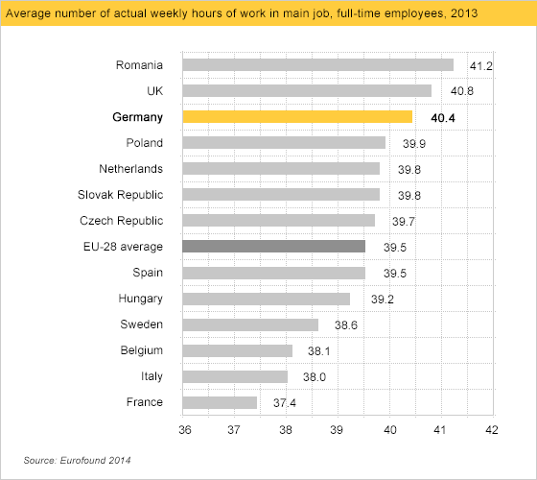

Slide 9
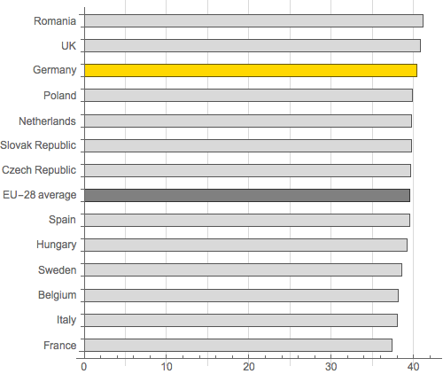
Level 3

Slide 10
Discussion
Is it okay to mislead the audience (without lying)

Slide 11
Level 4
Biased or unbiased?

Slide 12
Fair or unfair
 | Admitted | Rejected | Total
Men | 209 | 95 | 304
Women | 143 | 110 | 253

Slide 13
Numbers don't lie!!! It is unfair!!!
 | Admitted | Rejected | Total | Percentage
Men | 209 | 95 | 304 | 68.8%
Women | 143 | 110 | 253 | 56.5%

Slide 14
Someone should be responsible for this!
 | Admitted | Rejected | Total | Percentage
Men | 209 | 95 | 304 | 68.8%
Women | 143 | 110 | 253 | 56.5%
Law School
 | Admitted | Rejected | Total
Men | 8 | 45 | 53
Women | 51 | 101 | 152
Business School
 | Admitted | Rejected | Total
Men | 201 | 50 | 251
Women | 92 | 9 | 101

Slide 15
Which department?
Law School
 | Admitted | Rejected | Total | Perct.
Men | 8 | 45 | 53 | ???
Women | 51 | 101 | 152 | ???
Business School
 | Admitted | Rejected | Total | Perct.
Men | 201 | 50 | 251 | ???
Women | 92 | 9 | 101 | ???

Slide 16
Which department?
Law School
 | Admitted | Rejected | Total | Perct.
Men | 8 | 45 | 53 | 15.1%
Women | 51 | 101 | 152 | 33.6%
Business School
 | Admitted | Rejected | Total | Perct.
Men | 201 | 50 | 251 | 80.1%
Women | 92 | 9 | 101 | 91.1%

Slide 17
What is going on?
 | Admitted | Rejected | Total | Percentage
Men | 209 | 95 | 304 | 68.8%
Women | 143 | 110 | 253 | 56.5%
Law School
 | Admitted | Rejected | Total | Perct.
Men | 8 | 45 | 53 | 15.1%
Women | 51 | 101 | 152 | 33.6%
Business School
 | Admitted | Rejected | Total | Perct.
Men | 201 | 50 | 251 | 80.1%
Women | 92 | 9 | 101 | 91.1%

Slide 18
Discussion
What conclusion will you draw? Do you think it is biased or unbiased?

Slide 19
Simpson's paradox
Simpson's paradox - Wikipedia

Slide 20
Is the data real?
Is the data manipulated?
Is there any privacy problem?
How about the intelligence property rights in data science?
Is your activity / algorithm good for all humankind?

