Slide 1
An example application
An emergency room in a hospital measures 17 variables (e.g., blood pressure, age, etc) of newly admitted patients.
A decision is needed: whether to put a new patient in an intensive-care unit.
Due to the high cost of ICU, those patients who may survive less than a month are given higher priority.
Problem: to predict high-risk patients and discriminate them from low-risk patients.

Slide 2
Another application
A credit card company receives thousands of applications for new cards. Each application contains information about an applicant,
  age
  Marital status
  annual salary
  outstanding debts
  credit rating
  etc.
Problem: to decide whether an application should approved, or to classify applications into two categories, approved and not approved.

Slide 3
Machine learning and our focus
Like human learning from past experiences.
A computer does not have “experiences”.
A computer system learns from data, which represent some “past experiences” of an application domain.
Our focus: learn a target function that can be used to predict the values of a discrete class attribute, e.g., approve or not-approved, and high-risk or low risk.
The task is commonly called: Supervised learning, classification, or inductive learning.

Slide 4
The data and the goal
Data: A set of data records (also called examples, instances or cases) described by
  k attributes: A₁, A₂, … A_{k}.
  a class: Each example is labelled with a pre-defined class.
Goal: To learn a classification model from the data that can be used to predict the classes of new (future, or test) cases/instances.
Notes:
Induction is different from deduction and DBMS does not not support induction;
The result of induction is higher-level information or knowledge: general statements about data
There are many approaches. Refer to the lecture notes for CS3244 available at the Co-Op.
We focus on three approaches here, other examples:
Other approaches
Instance-based learning
other neural networks
Concept learning (Version space, Focus, Aq11, …)
Genetic algorithms
Reinforcement learning

Slide 5
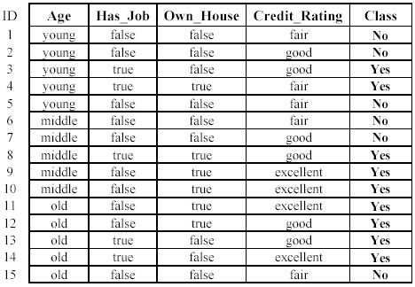
An example: data (loan application)
Approved or not

Slide 6
An example: the learning task
Learn a classification model from the data
Use the model to classify future loan applications into
  Yes (approved) and
  No (not approved)
What is the class for following case/instance?

Slide 7
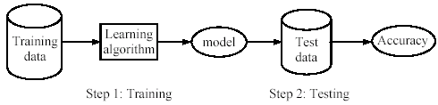
!!!Naïve!!! Supervised learning process: two steps
Learning (training): Learn a model using the training data
Testing: Test the model using unseen test data to assess the model accuracy

Slide 8
What do we mean by learning?
Given
  a data set D,
  a task T, and
  a performance measure M,
a computer system is said to learn from D to perform the task T if after learning the system’s performance on T improves as measured by M.
In other words, the learned model helps the system to perform T better as compared to no learning.

Slide 9
An example
Data: Loan application data
Task: Predict whether a loan should be approved or not.
Performance measure: accuracy.
No learning: classify all future applications (test data) to the majority class (i.e., Yes):
Accuracy = 9/15 = 60%.
We can do better than 60% with learning.

