Slide 1
NAÏVE BAYES CLASSIFIER
Abstractly, probability model for a classifier is a conditional model
P(C|F1,F2,…,Fn)
Over a dependent class variable C with a small number of outcome or classes conditional over several feature variables F1,…,Fn.
Naïve Bayes Formula:
P(C|F1,F2,…,Fn)
= argmax_{c} [P(C) x P(F1|C) x P(F2|C) x…x P(Fn|C)] / P(F1,F2,…,Fn)
Since P(F1,F2,…,Fn) is common to all probabilities, we do not need to evaluate the denominator for comparisons.

Slide 2
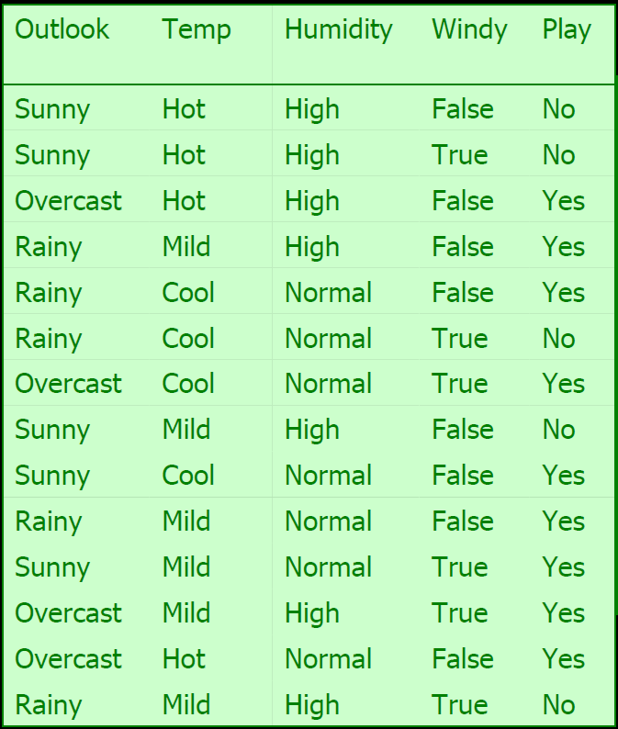

Slide 3
If today we have "sunny, cool, high, true", do you think it is a play or not?
P(yes|sunny, cool, high, true)
= P(yes) x P(sunny|yes) x P(cool|yes) x P(high|yes) x P(true|yes)
/ P (sunny, cool, high, true)
P(no|sunny, cool, high, true)
= P(no) x P(sunny|no) x P(cool|no) x P(high|no) x P(true|no)
/ P (sunny, cool, high, true)

Slide 4
P(Play=yes) = 9/14 = 0.64
P(Play=no) = 5/14 = 0.36
P(Outlook=sunny|Play=yes) = 2/9 = 0.22
P(Outlook=sunny|Play=no) = 3/5 = 0.60
P(Temperature=cool|Play=yes) = 3/9 = 0.33
P(Temperature=cool|Play=no) = 1/5 = .20
P(Humidity=high|Play=yes) = 3/9 = 0.33
P(Humidity=high|Play=no) = 4/5 = 0.80
P(Wind=true|Play=yes) = 3/9 = 0.33
P(Wind=true|Play=no) = 3/5 = 0.60

Slide 5
P(yes|sunny, cool, high, true)
= P(yes) x P(sunny|yes) x P(cool|yes) x P(high|yes) x P(true|yes)
/ P (sunny, cool, high, true)
= 0.0053 / P (sunny, cool, high, true)
P(no|sunny, cool, high, true)
= P(no) x P(sunny|no) x P(cool|no) x P(high|no) x P(true|no)
/ P (sunny, cool, high, true)
=0.0206 / P (sunny, cool, high, true)
The class for this instance will be ‘no’.
We can normalize the probability by: [0.0206]/[0.0206+0.0053] = 0.795

