Slide 1
NAÏVE BAYES CLASSIFIER
Abstractly, probability model for a classifier is a conditional model
P(C|F1,F2,…,Fn)
Over a dependent class variable C with a small number of outcome or classes conditional over several feature variables F1,…,Fn.
Naïve Bayes Formula:
P(C|F1,F2,…,Fn)
= argmax_{c} [P(C) x P(F1|C) x P(F2|C) x…x P(Fn|C)] / P(F1,F2,…,Fn)
Since P(F1,F2,…,Fn) is common to all probabilities, we do not need to evaluate the denominator for comparisons.

Slide 2
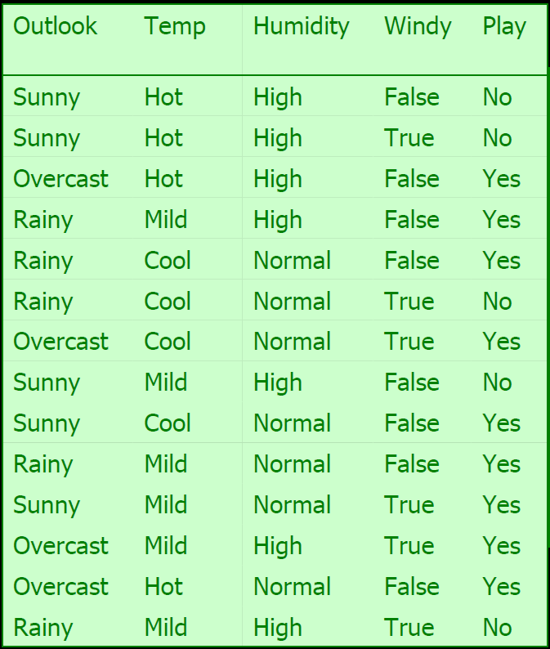

Slide 3
If today we have " overcast, cool, high, true", do you think it is a play or not?
P(yes| overcast, cool, high, true)
= P(yes) x P(overcast |yes) x P(cool|yes) x P(high|yes) x P(true|yes)
/ P (overcast, cool, high, true)
P(no| overcast, cool, high, true)
= P(no) x P(overcast |no) x P(cool|no) x P(high|no) x P(true|no)
/ P (sunny, cool, high, true)

Slide 4
P(Play=yes) = 9/14 = 0.64
P(Play=no) = 5/14 = 0.36
P(Outlook=overcast|Play=yes) = 4/9 = 0.44
P(Outlook=overcast|Play=no) = 0/5 = 0
P(Temperature=cool|Play=yes) = 3/9 = 0.33
P(Temperature=cool|Play=no) = 1/5 = .20
P(Humidity=high|Play=yes) = 3/9 = 0.33
P(Humidity=high|Play=no) = 4/5 = 0.80
P(Wind=true|Play=yes) = 3/9 = 0.33
P(Wind=true|Play=no) = 3/5 = 0.60

Slide 5
P(yes| overcast, cool, high, true)
= P(yes) x P(overcast |yes) x P(cool|yes) x P(high|yes) x P(true|yes)
/ P (overcast, cool, high, true)
= 0.0053 / P (overcast, cool, high, true)
P(no| overcast, cool, high, true)
= P(no) x P(overcast |no) x P(cool|no) x P(high|no) x P(true|no)
/ P (overcast, cool, high, true)
= 0 / P (overcast, cool, high, true)
The class for this instance will be ‘???’.

Slide 6
M-Estimate Formula:
c/n is the original probability used,
Use [c + k] / [n + m] , k=1 and m= equivalent sample size.

Slide 7
P(Play=yes) = 10/16 = 0.63
P(Play=no) = 6/16 = 0.37
P(Outlook=overcast|Play=yes) = 5/12 = 0.42
P(Outlook=overcast|Play=no) = 1/8 = .13
P(Temperature=cool|Play=yes) = 4/12 = 0.33
P(Temperature=cool|Play=no) = 2/8 = .25
P(Humidity=high|Play=yes) = 4/11 = 0.36
P(Humidity=high|Play=no) = 5/7 = 0.71
P(Wind=strong|Play=yes) = 4/11 = 0.36
P(Wind=strong|Play=no) = 4/7 = 0.57

Slide 8
P(yes| overcast, cool, high, true)
= P(yes) x P(overcast |yes) x P(cool|yes) x P(high|yes) x P(true|yes)
/ P (overcast, cool, high, true)
= 0.011 / P (overcast, cool, high, true)
P(no| overcast, cool, high, true)
= P(no) x P(overcast |no) x P(cool|no) x P(high|no) x P(true|no)
/ P (overcast, cool, high, true)
= 0.00486 / P (overcast, cool, high, true)
The class for this instance will be ‘yes’.
We can normalize the probability by: [0.011]/[0.011 + 0.00486] = 0.694

