Slide 1
Information theory: Entropy measure
The entropy formula,
Pr(c_{j}) is the probability of class c_{j} in data set D
We use entropy as a measure of impurity or disorder of data set D. (Or, a measure of information in a tree)

Slide 2
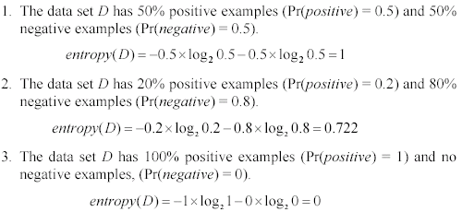
Entropy measure: let us get a feeling
As the data become purer and purer, the entropy value becomes smaller and smaller. This is useful to us!

Slide 3

Information gain
Given a set of examples D, we first compute its entropy:
If we make attribute A_{i}, with v values, the root of the current tree, this will partition D into v subsets D₁, D₂ …, D_{v} . The expected entropy if A_{i} is used as the current root:

Slide 4
Information gain (cont …)
Information gained by selecting attribute A_{i} to branch or to partition the data is
We choose the attribute with the highest gain to branch/split the current tree.

Slide 5
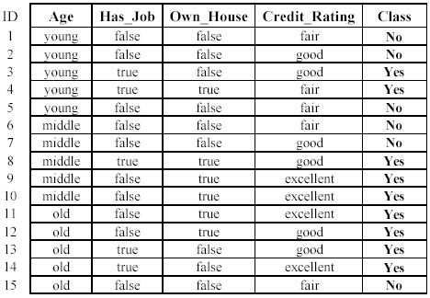
The loan data
Approved or not

Slide 6
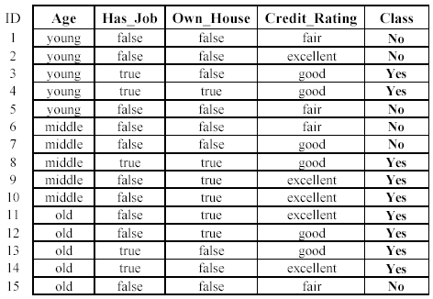

An example
Own_house is the best choice for the root.

