Slide 1
Brute-Force String Matching
pattern: a string of m characters to search for
text: a (longer) string of n characters to search in
problem: find a substring in the text that matches the pattern
Brute-force algorithm
Step 1 Align pattern at beginning of text
Step 2 Moving from left to right, compare each character of
pattern to the corresponding character in text until
    all characters are found to match (successful search); or
    a mismatch is detected
Step 3 While pattern is not found and the text is not yet
exhausted, realign pattern one position to the right and
repeat Step 2

Slide 2
Text T
Assume |T| = n and |P| = m
  Compare until a match is found. If so return the index where match occurs
  else return -1
Pattern P
Pattern P
Pattern P

Slide 3
Examples of Brute-Force String Matching
Text: 10010101101001100101111010
Pattern: 001011
Text: It is never too late to have a happy childhood.
Pattern: happy

Slide 4
Examples of Brute-Force String Matching
Text: 100101011010011001011110
Pattern: 001011

Slide 5
1 | 0 | 0 | 1 | 0 | 1 | 0 | 1 | 1 | 0 | 1 | 0 | 0 | 1 | 1 | 0 | 0 | 0 | 1 | 0 | 1 | 1 | 1 | 1 | 0
0 | 0 | 1 | 0 | 1 | 1

Slide 6
1 | 0 | 0 | 1 | 0 | 1 | 0 | 1 | 1 | 0 | 1 | 0 | 0 | 1 | 1 | 0 | 0 | 0 | 1 | 0 | 1 | 1 | 1 | 1 | 0
0 | 0 | 1 | 0 | 1 | 1
 | 0 | 0 | 1 | 0 | 1 | 1

Slide 7
1 | 0 | 0 | 1 | 0 | 1 | 0 | 1 | 1 | 0 | 1 | 0 | 0 | 1 | 1 | 0 | 0 | 0 | 1 | 0 | 1 | 1 | 1 | 1 | 0
0 | 0 | 1 | 0 | 1 | 1
 | 0 | 0 | 1 | 0 | 1 | 1
 |  | 0 | 0 | 1 | 0 | 1 | 1

Slide 8
1 | 0 | 0 | 1 | 0 | 1 | 0 | 1 | 1 | 0 | 1 | 0 | 0 | 1 | 1 | 0 | 0 | 0 | 1 | 0 | 1 | 1 | 1 | 1 | 0
0 | 0 | 1 | 0 | 1 | 1
 | 0 | 0 | 1 | 0 | 1 | 1
 |  | 0 | 0 | 1 | 0 | 1 | 1
 |  |  | 0 | 0 | 1 | 0 | 1 | 1

Slide 9
1 | 0 | 0 | 1 | 0 | 1 | 0 | 1 | 1 | 0 | 1 | 0 | 0 | 1 | 1 | 0 | 0 | 0 | 1 | 0 | 1 | 1 | 1 | 1 | 0
0 | 0 | 1 | 0 | 1 | 1
 | 0 | 0 | 1 | 0 | 1 | 1
 |  | 0 | 0 | 1 | 0 | 1 | 1
 |  |  | 0 | 0 | 1 | 0 | 1 | 1
 |  |  |  | 0 | 0 | 1 | 0 | 1 | 1

Slide 10
1 | 0 | 0 | 1 | 0 | 1 | 0 | 1 | 1 | 0 | 1 | 0 | 0 | 1 | 1 | 0 | 0 | 0 | 1 | 0 | 1 | 1 | 1 | 1 | 0
0 | 0 | 1 | 0 | 1 | 1
 | 0 | 0 | 1 | 0 | 1 | 1
 |  | 0 | 0 | 1 | 0 | 1 | 1
 |  |  | 0 | 0 | 1 | 0 | 1 | 1
 |  |  |  | 0 | 0 | 1 | 0 | 1 | 1
 |  |  |  |  | 0 | 0 | 1 | 0 | 1 | 1

Slide 11
1 | 0 | 0 | 1 | 0 | 1 | 0 | 1 | 1 | 0 | 1 | 0 | 0 | 1 | 1 | 0 | 0 | 0 | 1 | 0 | 1 | 1 | 1 | 1 | 0
0 | 0 | 1 | 0 | 1 | 1
 | 0 | 0 | 1 | 0 | 1 | 1
 |  | 0 | 0 | 1 | 0 | 1 | 1
 |  |  | 0 | 0 | 1 | 0 | 1 | 1
 |  |  |  | 0 | 0 | 1 | 0 | 1 | 1
 |  |  |  |  | 0 | 0 | 1 | 0 | 1 | 1
 |  |  |  |  |  | 0 | 0 | 1 | 0 | 1 | 1

Slide 12
1 | 0 | 0 | 1 | 0 | 1 | 0 | 1 | 1 | 0 | 1 | 0 | 0 | 1 | 1 | 0 | 0 | 0 | 1 | 0 | 1 | 1 | 1 | 1 | 0
0 | 0 | 1 | 0 | 1 | 1
 | 0 | 0 | 1 | 0 | 1 | 1
 |  | 0 | 0 | 1 | 0 | 1 | 1
 |  |  | 0 | 0 | 1 | 0 | 1 | 1
 |  |  |  | 0 | 0 | 1 | 0 | 1 | 1
 |  |  |  |  | 0 | 0 | 1 | 0 | 1 | 1
 |  |  |  |  |  | 0 | 0 | 1 | 0 | 1 | 1
 |  |  |  |  |  |  | 0 | 0 | 1 | 0 | 1 | 1
 |  |  |  |  |  |  |  | 0 | 0 | 1 | 0 | 1 | 1
 |  |  |  |  |  |  |  |  | 0 | 0 | 1 | 0 | 1 | 1
 |  |  |  |  |  |  |  |  |  | 0 | 0 | 1 | 0 | 1 | 1
 |  |  |  |  |  |  |  |  |  |  | 0 | 0 | 1 | 0 | 1 | 1
 |  |  |  |  |  |  |  |  |  |  |  | 0 | 0 | 1 | 0 | 1 | 1
 |  |  |  |  |  |  |  |  |  |  |  |  | 0 | 0 | 1 | 0 | 1 | 1
 |  |  |  |  |  |  |  |  |  |  |  |  |  | 0 | 0 | 1 | 0 | 1 | 1
 |  |  |  |  |  |  |  |  |  |  |  |  |  |  | 0 | 0 | 1 | 0 | 1 | 1
 |  |  |  |  |  |  |  |  |  |  |  |  |  |  |  | 0 | 0 | 1 | 0 | 1 | 1

Slide 13
String Matching
abacaabaccabacabaabb
abacab

Slide 14
String Matching
abacaabaccabacabaabb
abacab
abacab
abacab
abacab
abacab
abacab
abacab
abacab
abacab
abacab
abacab
The brute force algorithm
22+6=28 comparisons.

Slide 15
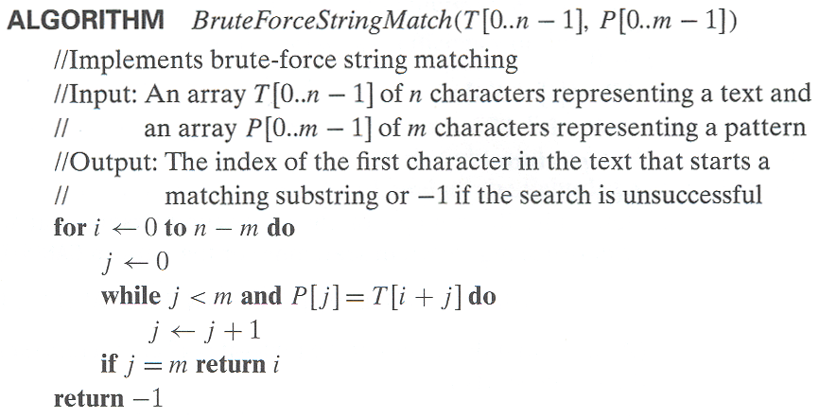
Pseudocode and Efficiency
Efficiency:

