Slide 1
CLASSROOM INFORMATION DELIVERY PROGRAM BASED ON
BLUETOOTH LOW ENERGY BEACONS AND
KOTLIN MOBILE APPS
Eddie Ekpo, Edwin Hernandez, Nicholas Kalar

Slide 2
Who is Team Lighthouse?
Eddie Ekpo
CS Major
Java/C++
Spring
REST
Kotlin
Teen Heart Throb
Edwin Hernandez
CIS MAJOR
Python
C/C++
Taller on the inside
PHP
HTML/CSS
Nicholas Kalar
CIS Major
Frontend Web Design
HTML/CSS/JavaScript
Backend Server
PHP/SQL
Capricorn
C/C++/Python
Kotlin Mobile

Slide 3
Abstract/Problem
College is a stressful time for most students.
How to get classroom information:
Physical
Professor’s Websites
Moodle
Blackboard
Canvas
Solution?
BLE Beacons
Verify and Push
Mobile Application
Download and View
Easy Web Portal
Create and Edit

Slide 4
Definition of terms
JVM
Virtual Machine Container
Load, verify, execute
Kotlin
New JVM Programming Language
Android / Backend
Spring
Development Ecosystem
Integrates
Web, Android, Backend
Spring Data, Spring Web, Android
Kotlin Support

Slide 5
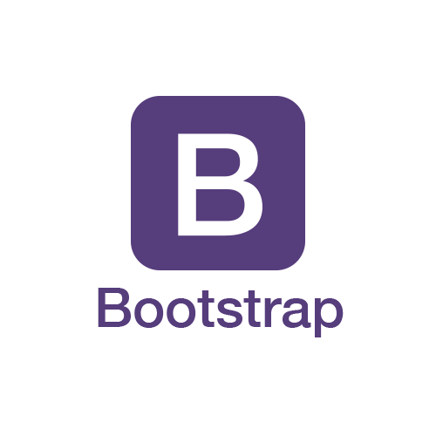
Definition of Terms cont’
Bootstrap
Open source frontend framework
Bluetooth beacon
Proximity based devices to update users
Eddystone
open beacon format by google
SQL
Database language for backend

Slide 6
Purpose of Project
Simplify the lives of students/professors
One source for classroom material
Easy to update database
automated syllabus updates

Slide 7
Significance Of the project
Project scope limited
Teachers
Students
Project can be Scalable
Apply to CSU system
Integrate with csub app
Concept can be applied to other fields
Notifying foresters of animal activity
Notifying employees of a business regarding:
Policy changes
Workflow altering events
Road closure / flood

Slide 8
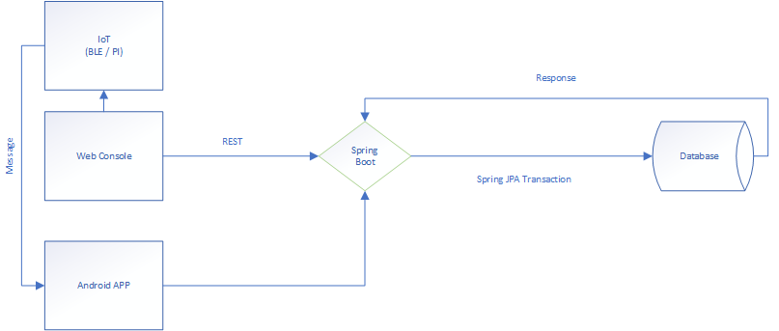

Slide 9
Future Roadmap
iOS Application
Increase in the type of files supported
Desktop client for more file storage
Automatic class creation
Automatic roster upload

