Slide 1
Team Lighthouse Project: WhatsDue
Eddie Ekpo, Edwin Hernandez, Nick Kalar

Slide 2
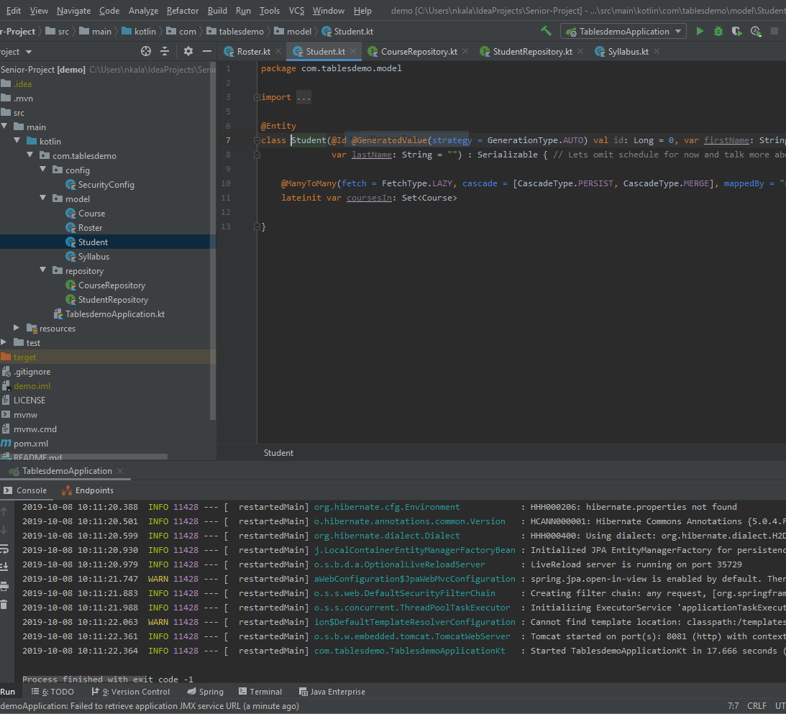
IntelliJ IDEA 2019.2.3
IDE built for JVM languages
Can be used for HTML, JavaScript, and SQL
Built in version control with Git

Slide 3
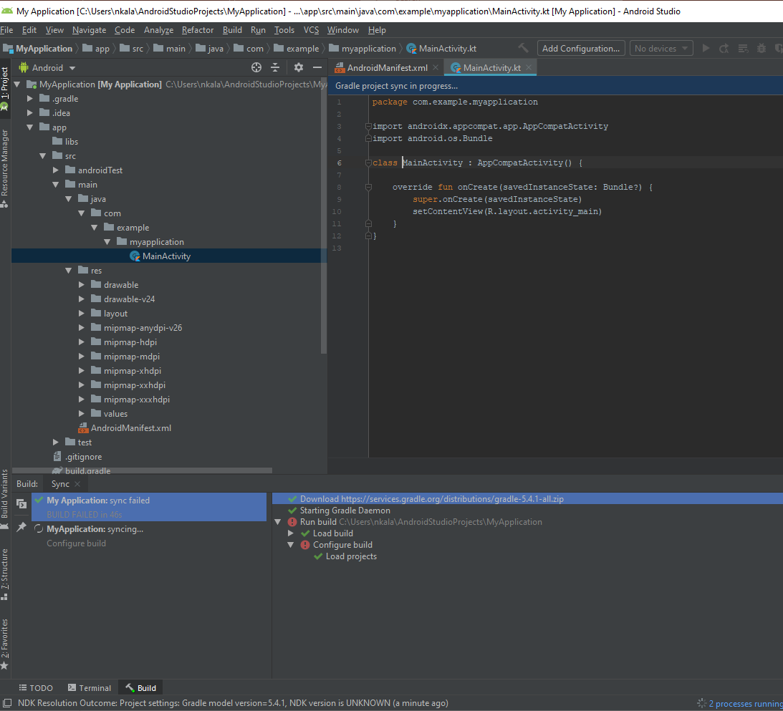
Android Studio IDE
IDE built for Android development
Emulates Android phones on desktop
Built in version control with Git
Basically IntelliJ IDEA, but meant for just Android

Slide 4
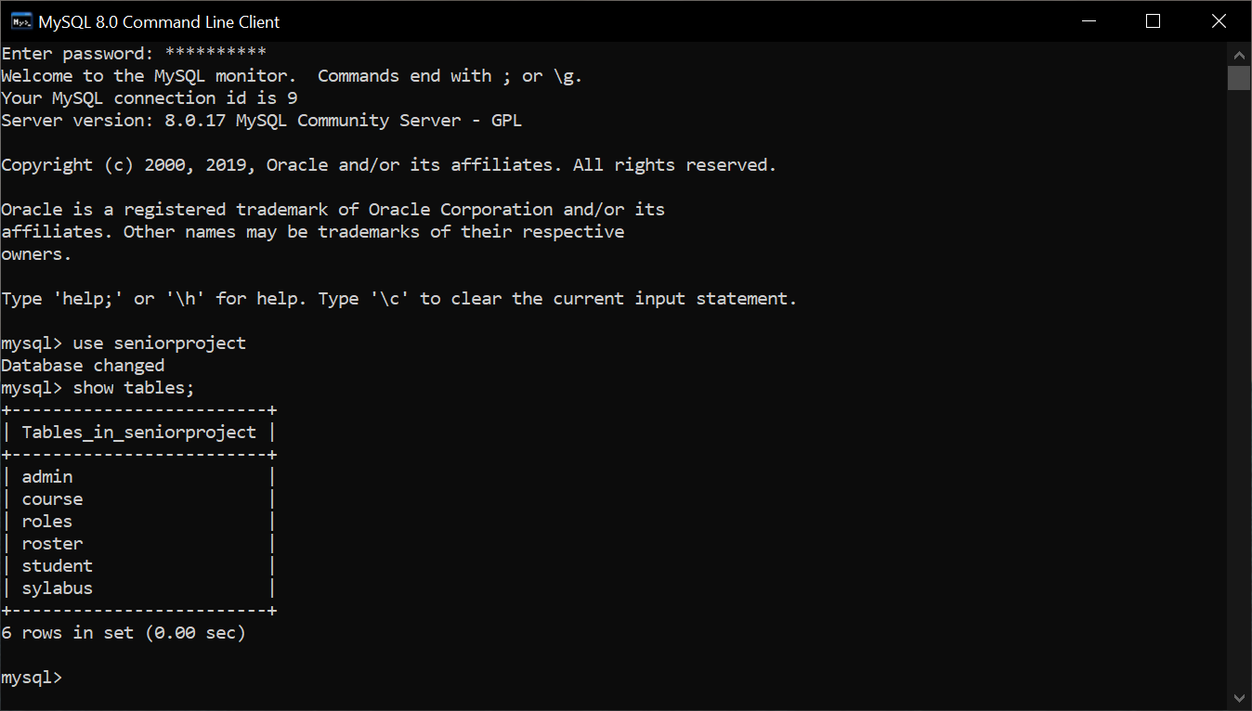
MySQL Server 8.0
Database language by Oracle
Great tool for building our backend for Professor, student, and course information

Slide 5
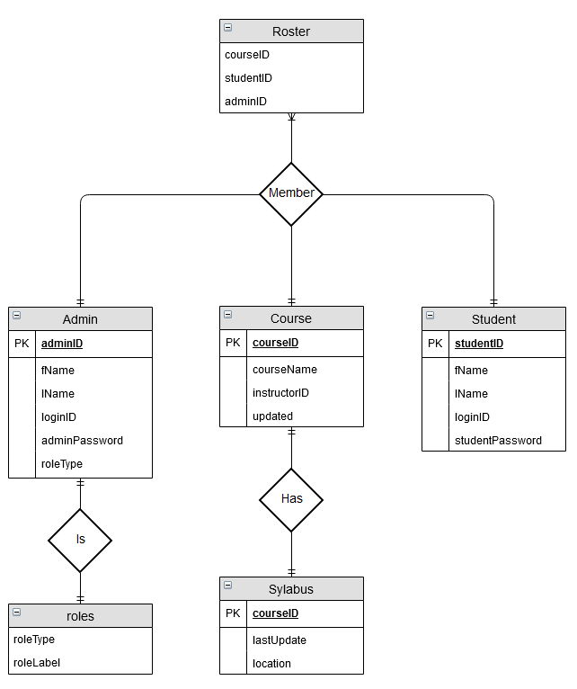
ER Model
Simple relationships
Subject to change
Easy addition for additional course files

Slide 6
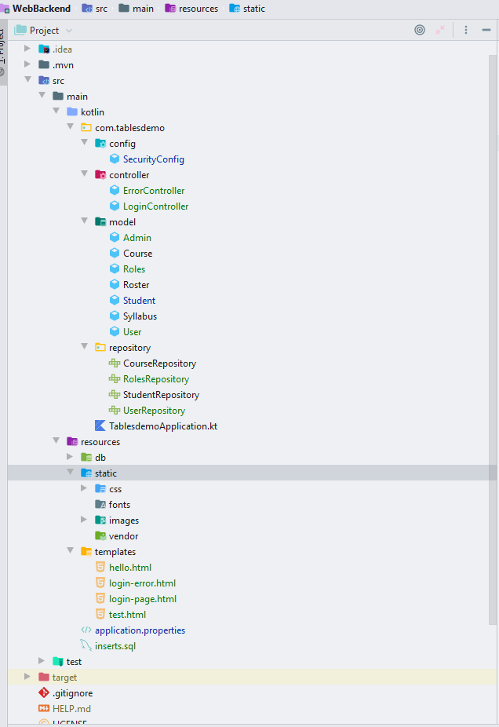
Spring Boot
Brings the components together
Android
IoT
Web
Comes with a webserver
Handles our REST Repositories
Makes working as a group easier

Slide 7
Spring Boot

Slide 8
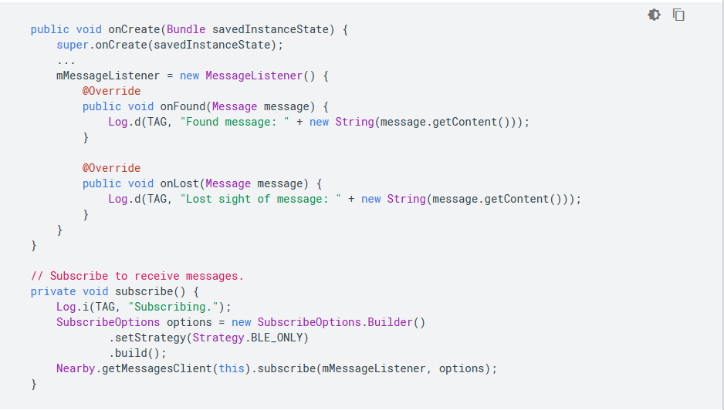
Eddystone and Google Beacon
Assigned a unique identifier by registration with google
Allows communication with a mobile application
Delivers information from backend to mobile app
Does so using foreground and background subscription

Slide 9
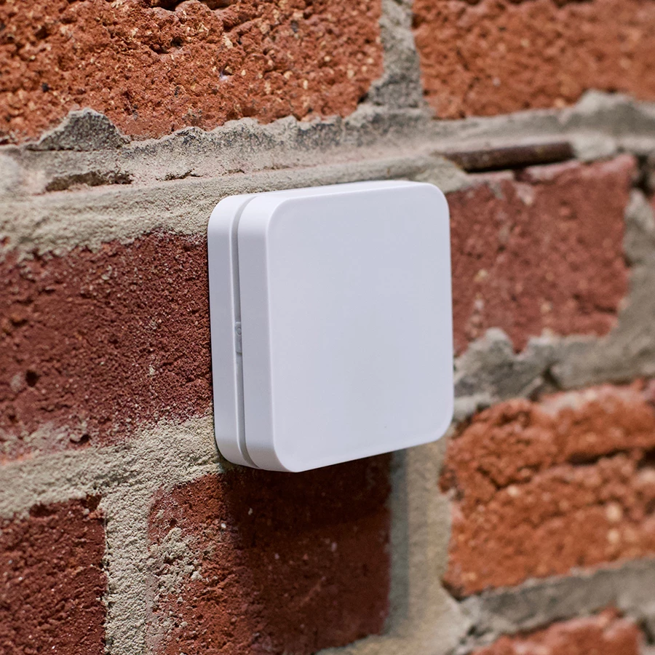
Radius Network E4 Beacon
Bluetooth Low Energy Beacon
Can be used for both Android and iOS devices
Up to 300-meter range (variable range)
Up to 127 months of power with replaceable AA batteries

Slide 10
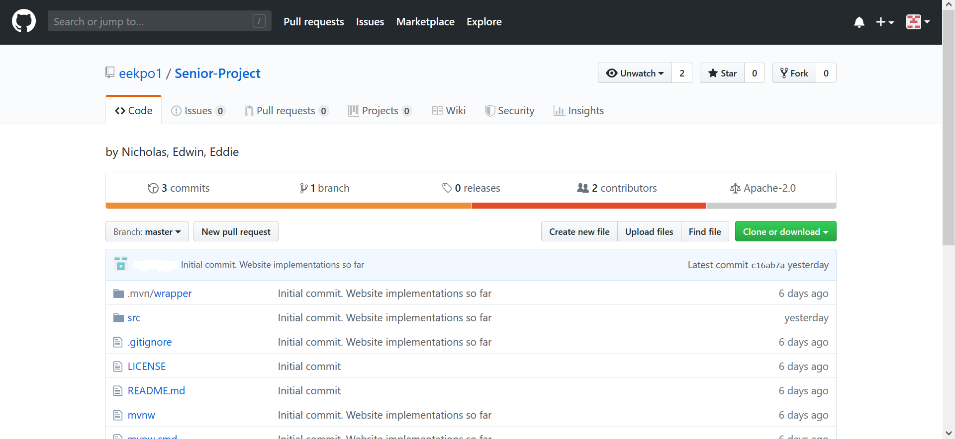
Git and GitHub
Used for source code management
Branching, merging
Pulling, Pushing
GitHub
Owned by Microsoft
Easy to use and integrated with many IDEs

Slide 11
Demo Website
Shows basic SQL queries
Not the finished project. Just a prototype.
Currently written using PHP for the SQL calls
Database is being hosted by Odin

Slide 12
Timeline

