Slide 1
3D Tracking Simulation of Orbiting Satellites
TEAM INNER ELLIPSE

Slide 2
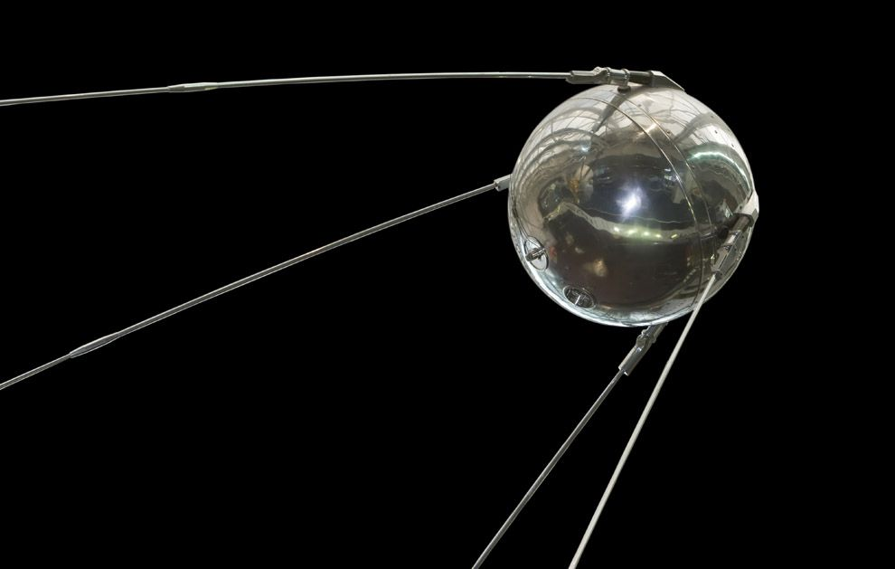
Background
On October 4th, 1957, The Soviet Union launched Sputnik
According to the UNOOSA, there are 4,987 satellites orbiting the Earth, 1,957 of these satellites currently remain active

Slide 3
Project Goals
Satellite tracking web application
Simulation of satellites orbiting the Earth
Lookup actual real time data from satellites in orbit around Earth
Show user what satellites are currently passing over his/her location
Ability to display a particular satellite or constellations of satellite networks (Ex. Iridium project)

Slide 4
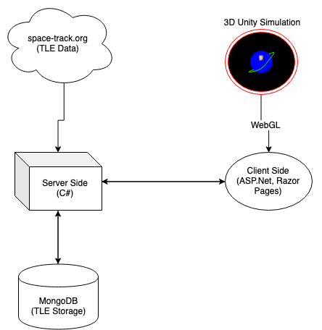
Core Components
Unity to create simulation experience
Space-Track.org data TLE Repository
MongoDB for Persisted TLE data
Microsoft stack for Server-Client side application.

Slide 5
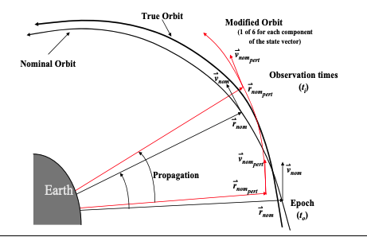
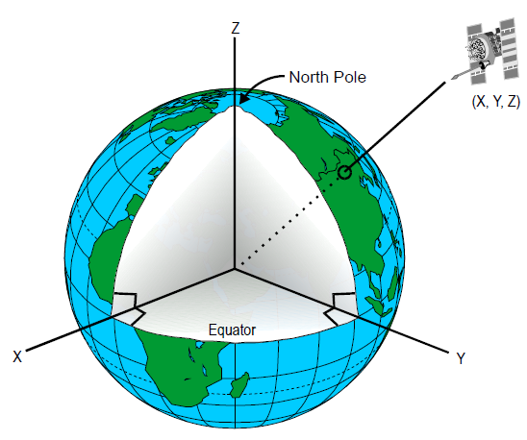
Two-Line Element Sets
List of orbital elements of an Earth-orbiting object.
Generated using SGP (Simplified General Perturbation) Model.
Data can be translated into ECI(Earth Centered Inertial) coordinates.
Courtesy of David Vallo & Paul Crawford

Slide 6
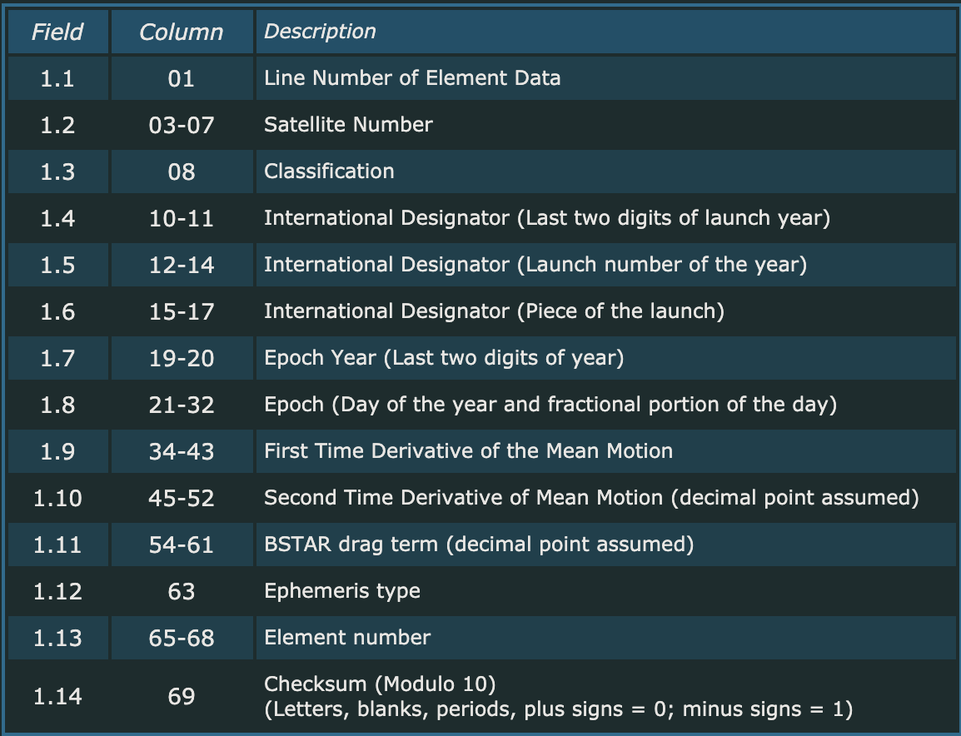
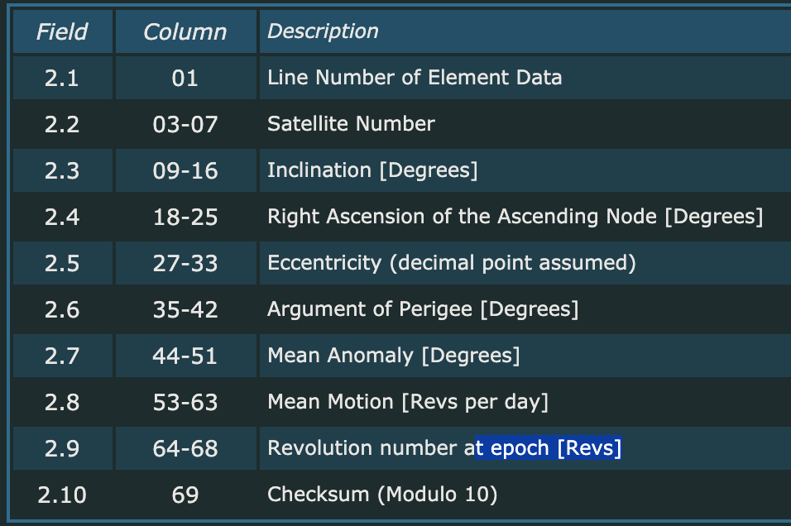
Two-Line Element Sets

Slide 7
3D Rendering
C#
WebGL, Javascript API for web browser.
Unity - Popular 3D cross platform development engine.
Compatibility(With Constraint).

Slide 8
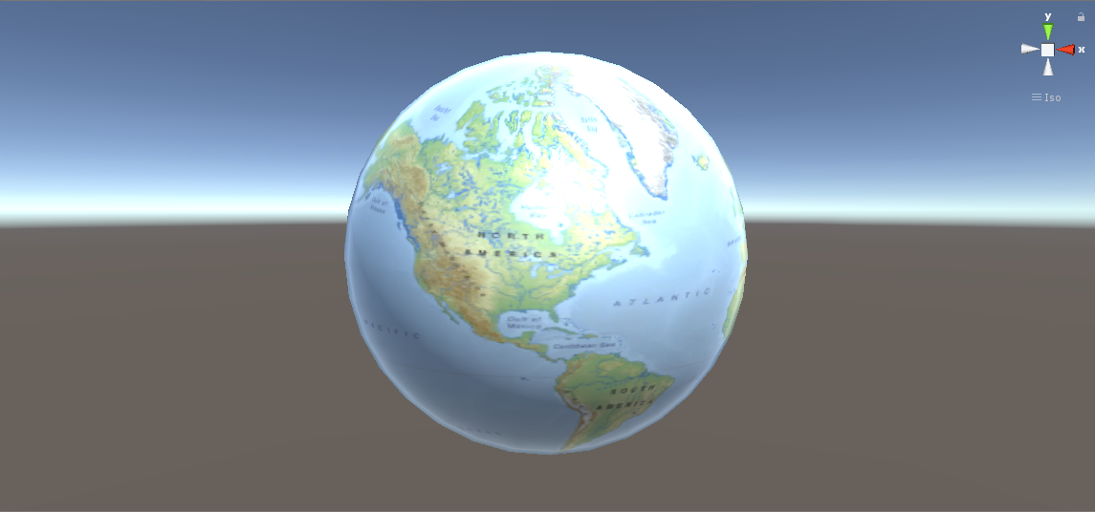

Slide 9
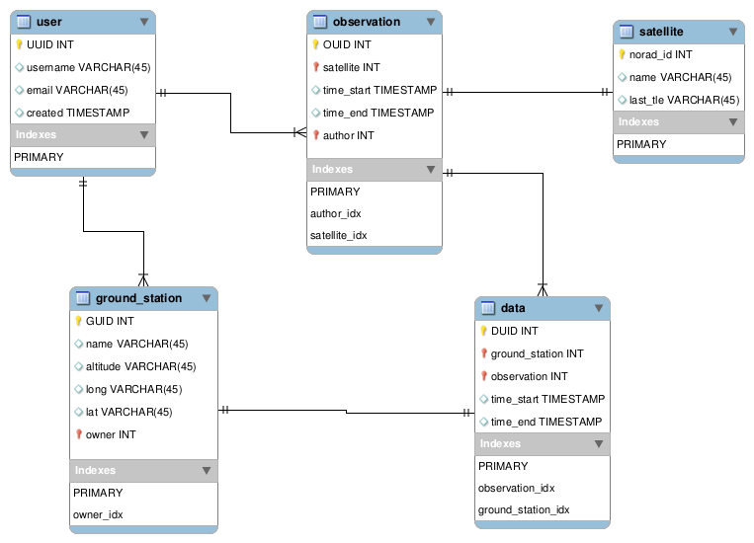
MongoDB
Utilization of an open source DBMS to store TLE data
Ensure reliability and accessibility of large amounts of data

Slide 10
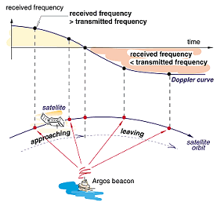
Project Challenges
Scaling of simulation (Unit and measurements)
Accurate mathematical calculations
Time constraints, depending on complexity of project
Utilization of new frameworks

Slide 11
Estimated Timeline
-> Gathering Data/ R&D
-> Test implementations
-> Proof of concept with a single satellite
Project completion
10/24*
02/22*
05/20*
12/05*
04/20*
-Project Infrastructure Design/ Delegate Tasks
-> Data Gathering Completed
-> Begin final modifications
-> Maintenance/Consumer Review
* Subject to change

