Slide 1
3D Tracking Simulation of Orbiting Satellites
TEAM INNER ELLIPSE

Slide 2
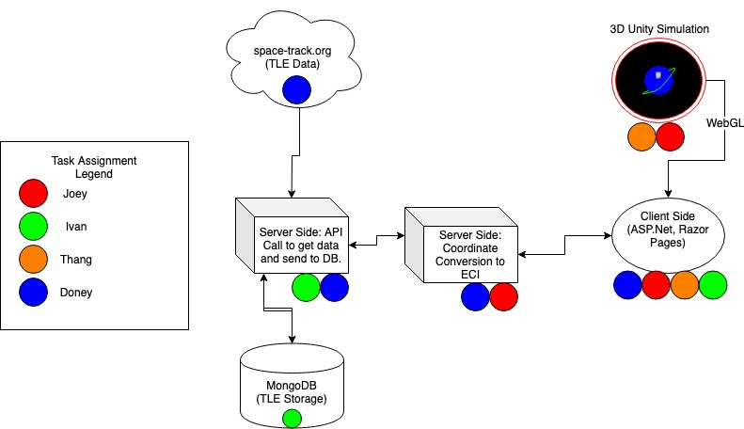
Project Assignments
Unity to create simulation experience
Space-Track.org data TLE Repository
MongoDB for Persisted TLE data
Microsoft stack for Server-Client side application.

Slide 3
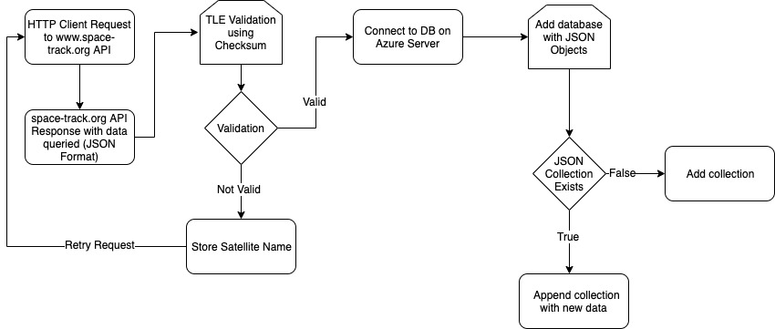
Data Retrieval and Storage Flowchart

Slide 4
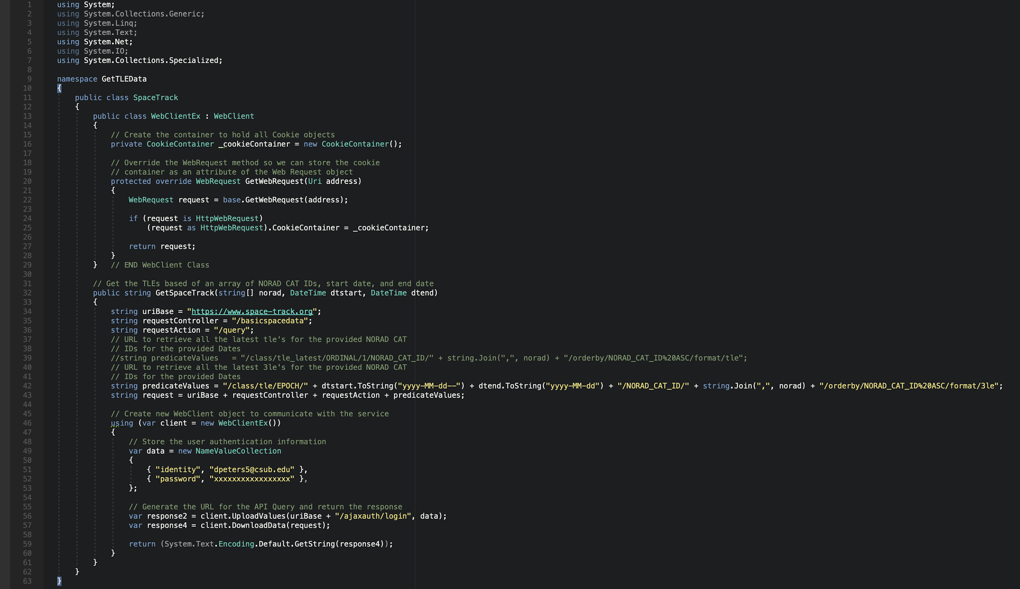
Two-Line Element Set API Retrieval Code

Slide 5
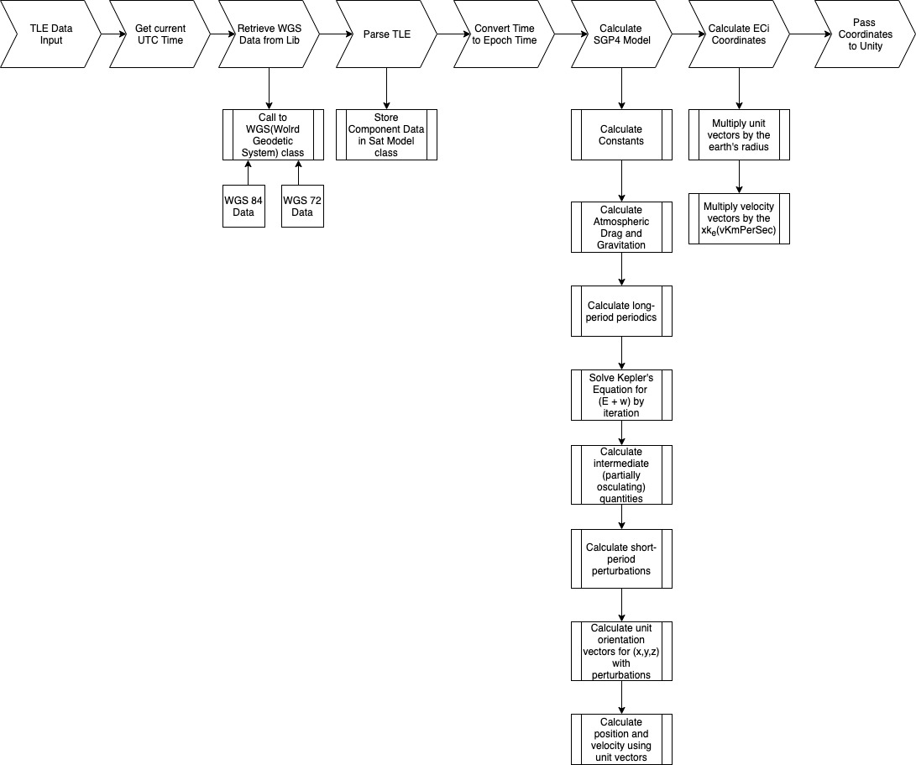
Two-Line Element Conversion Flow Chart

Slide 6
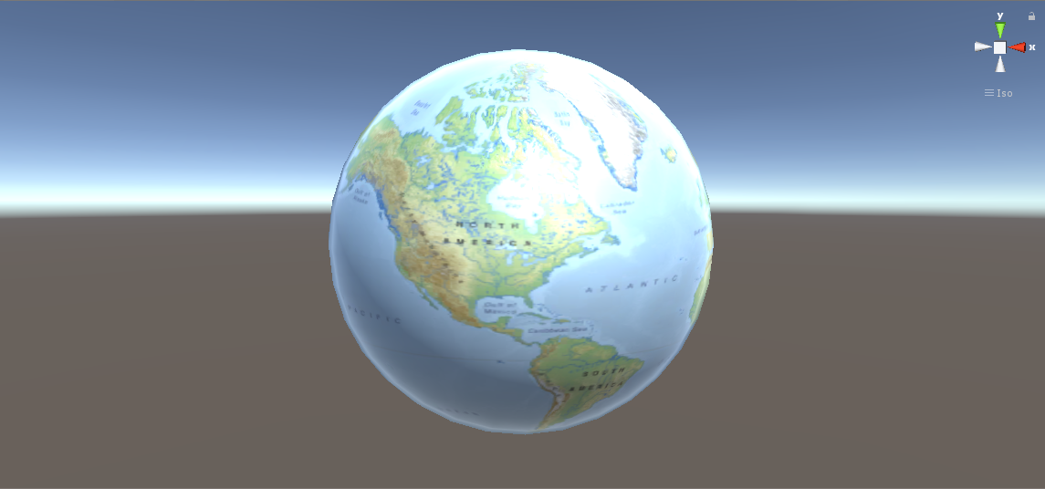

Slide 7
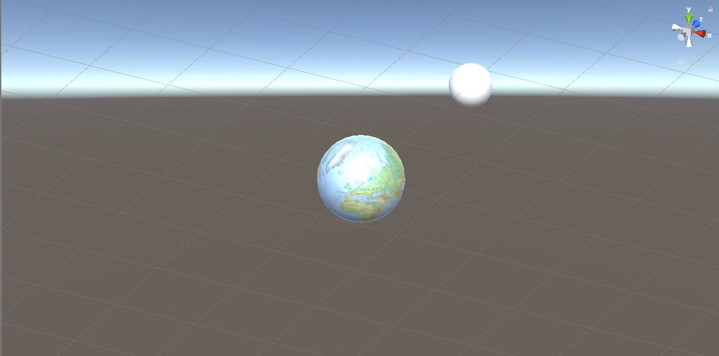

Slide 8
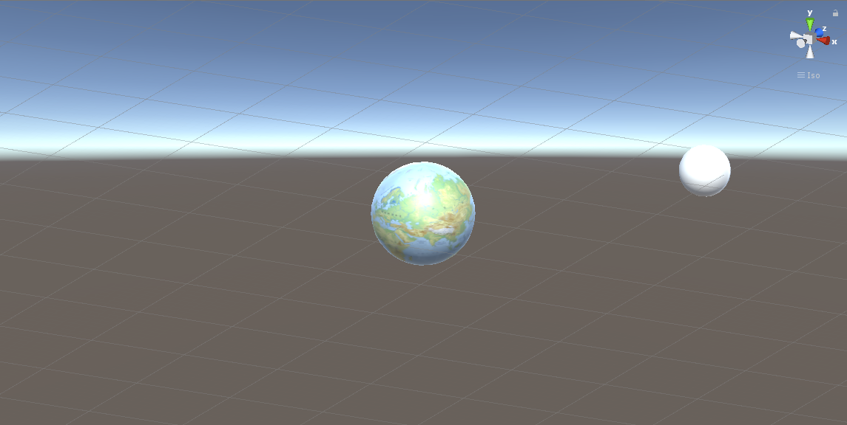

Slide 9
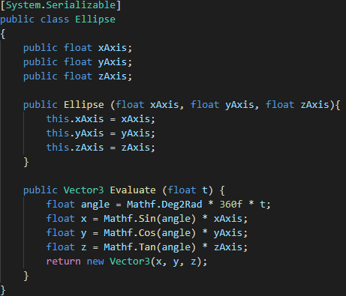

Slide 10
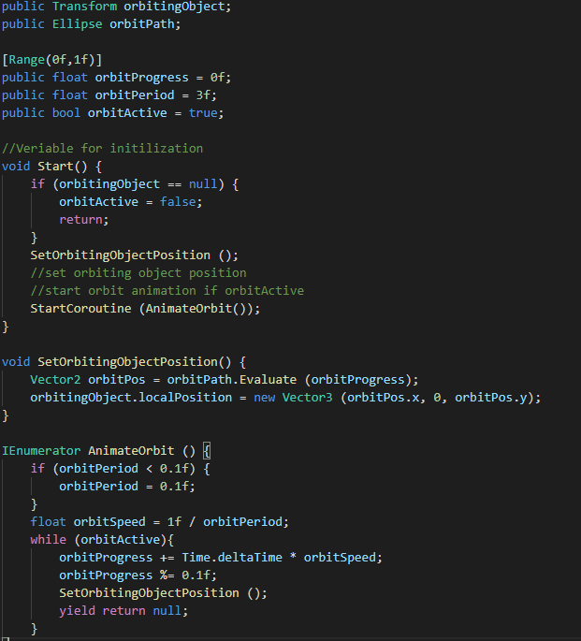

Slide 11
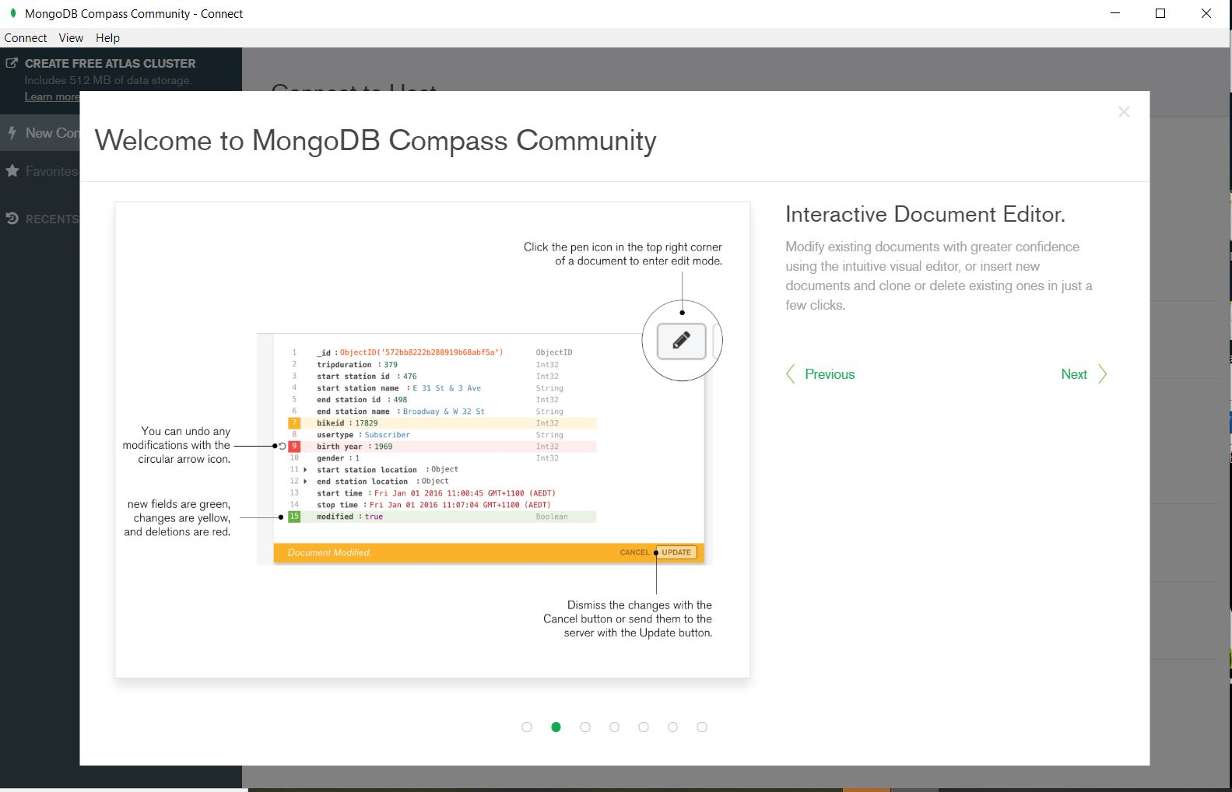
MongoDB

Slide 12

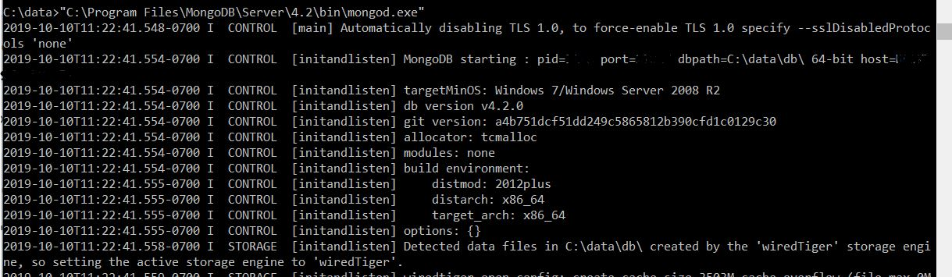

Slide 13
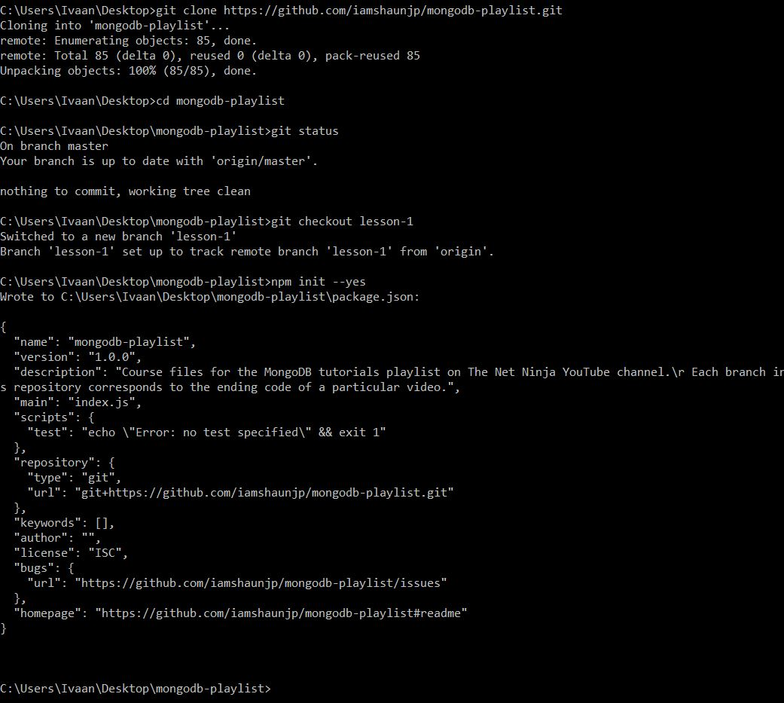
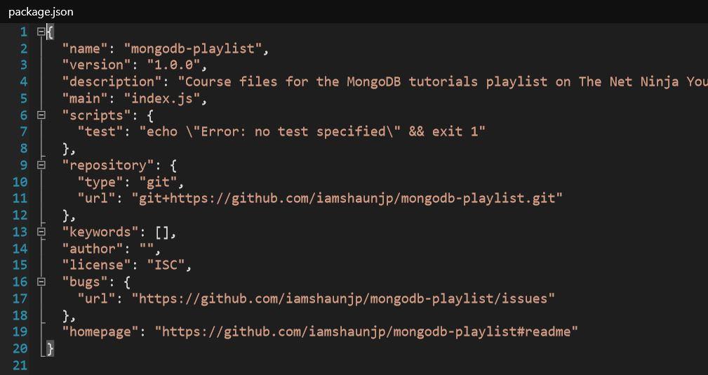
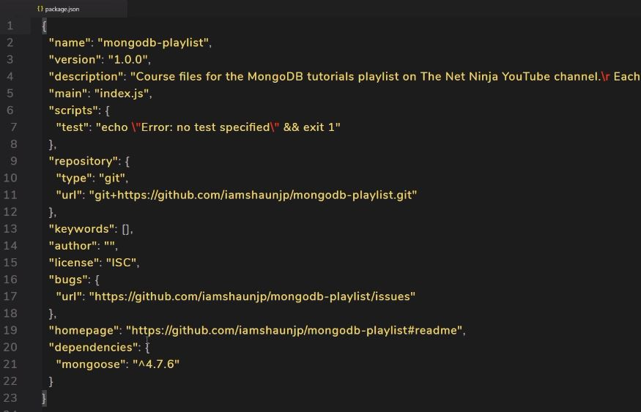

Slide 14
