Slide 1
CAMPUS DATA FOR
GEO-LOCATION BASED AUGMENTED REALITY
By
Cesar Aleman
Spencer Austin
Andrew Burt
Rodrigo Ortiz

Slide 2
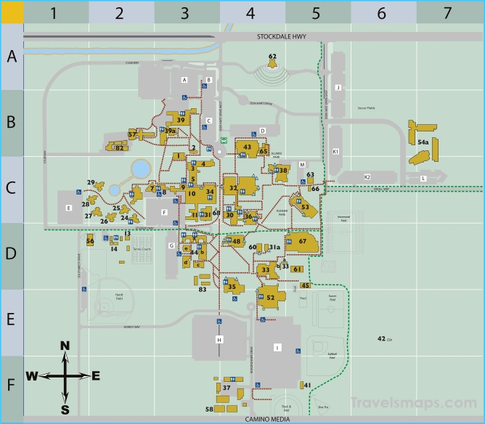
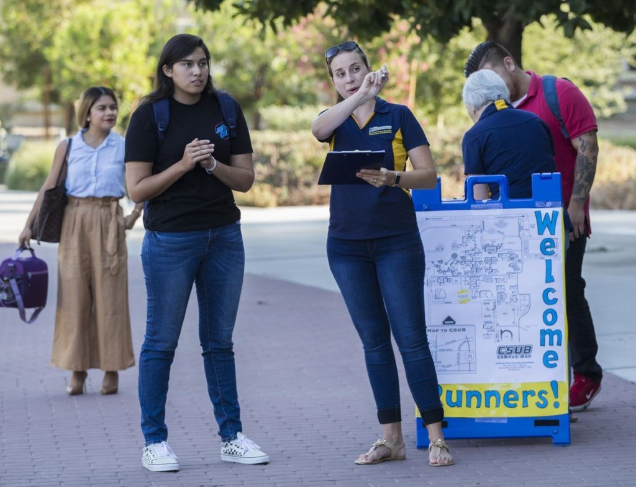
The Problem
Currently students and guests of the CUSB campus can only navigate around campus based on antiquated maps which may be inaccurate or lead to confusion.
There is no true way of navigating around CSUB without consulting the help of someone who is familiar with the ins and outs of CSUB.

Slide 3
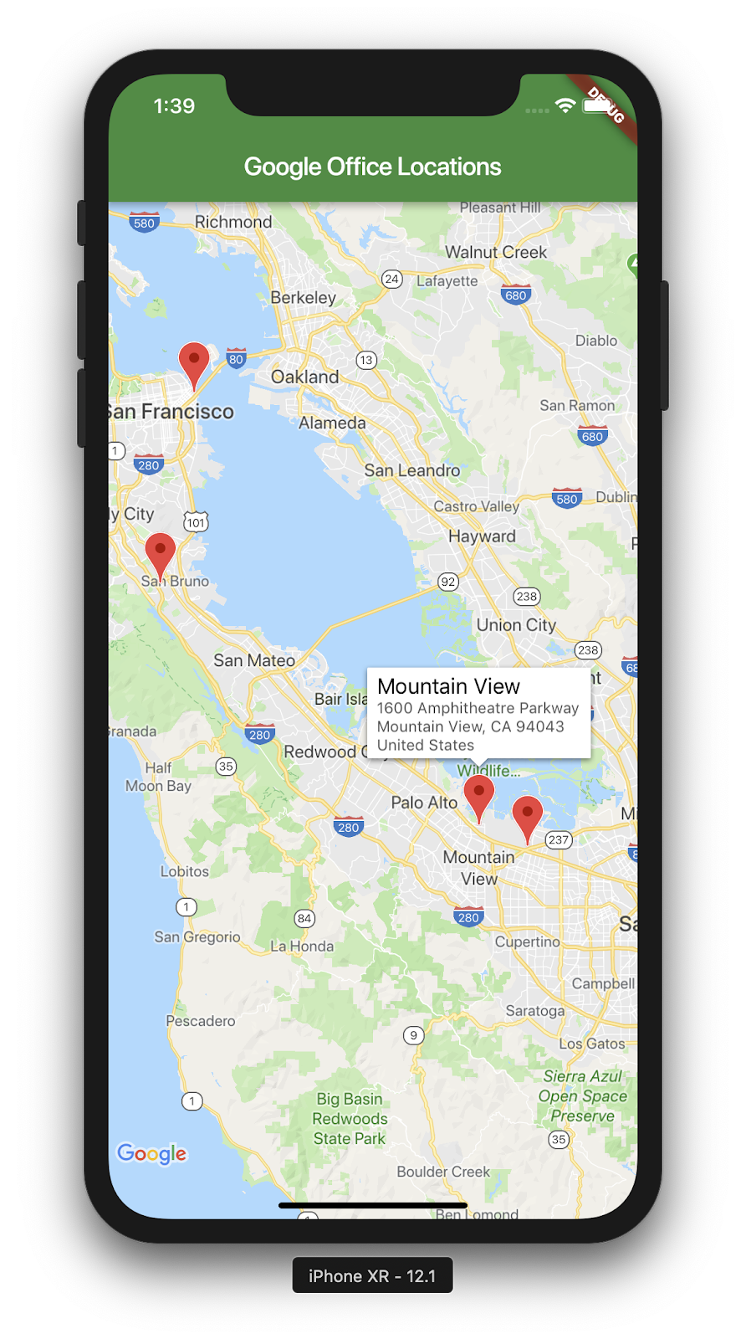
Possible Solutions
"Outdoor Mapping" - allows a student to open up their “go to” mobile mapping application, such as Google Maps to navigate to a desired location on campus.
Great in a general sense, however when it comes to distinct mapping of CSUB, where a student is trying to find the name of a building, or a specific landmark on campus, not a street address, the technology isn’t exact.

Slide 4
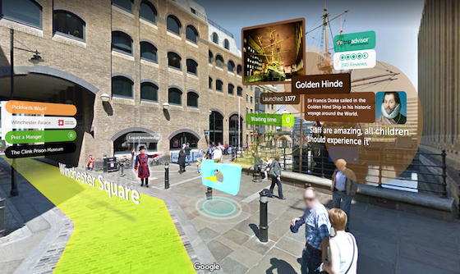
Possible Solutions
"Augmented Reality using Geo-Based Location"
Augmented Reality is a technology that falls under the Artificial Intelligence umbrella and is used to insert graphically made objects into the real-world using a medium.

Slide 5
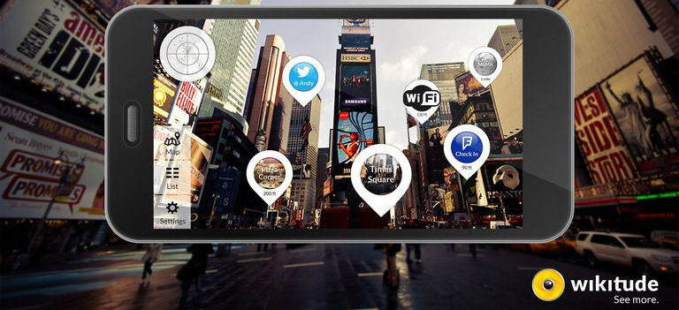
Wikitude
Wikitude is based on image recognition of landmarks coupled with GPS coordinates to provide an accurate representation of what is on the screen.
With Wikitude, the user would point their phone to a land mark and relevant information of the land mark would be displayed.

Slide 6
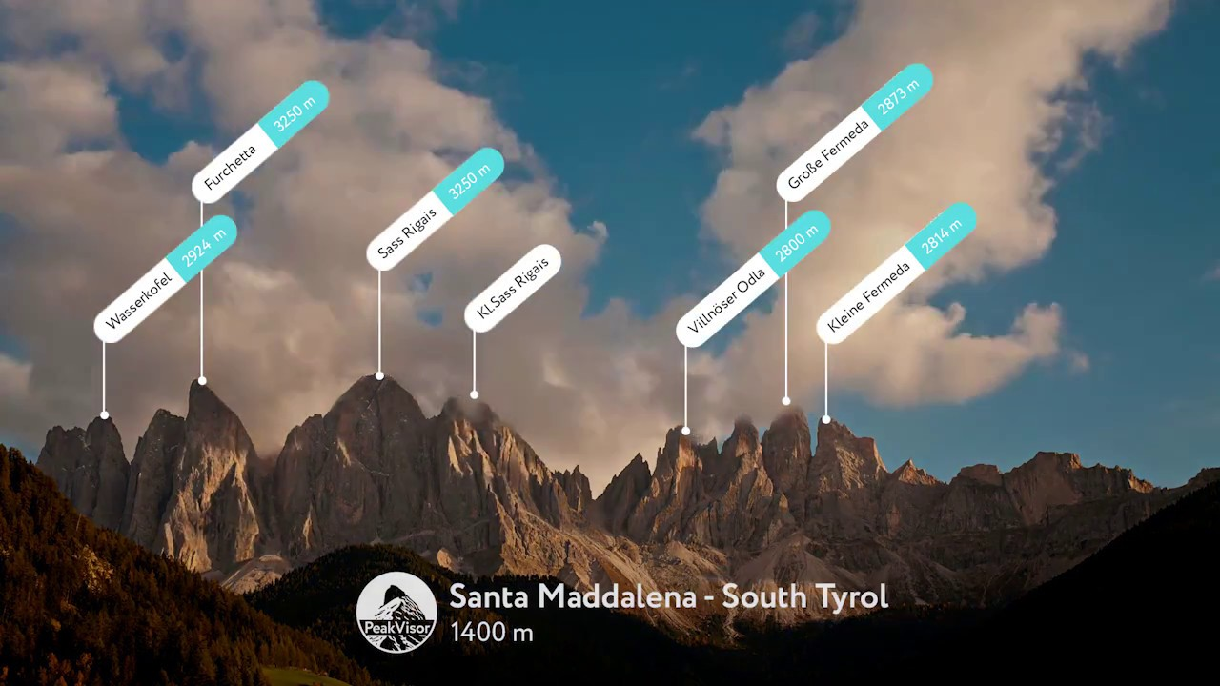
PeakVisor
PeakVisor is an application that allows the user to point there phones around them and they will see nearby mountains/peaks.
The medium in the case of Peak Visor is a cell phone camera.
Uses built in sensors that come with the phone such as the barometer and gyroscope.

Slide 7
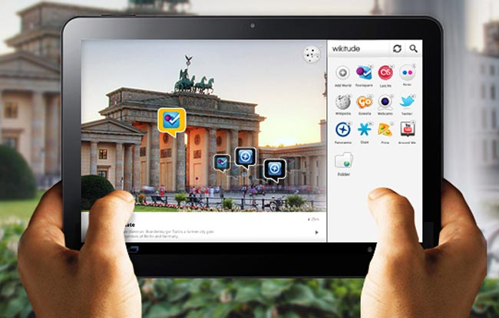
The Solution
Wikitude's SDK will be used as our base for a Geo-Based Augmented Reality Mobile Application.
An example phone app showcases the functionality of displaying points of interests along with descriptions of that interest.

Slide 8
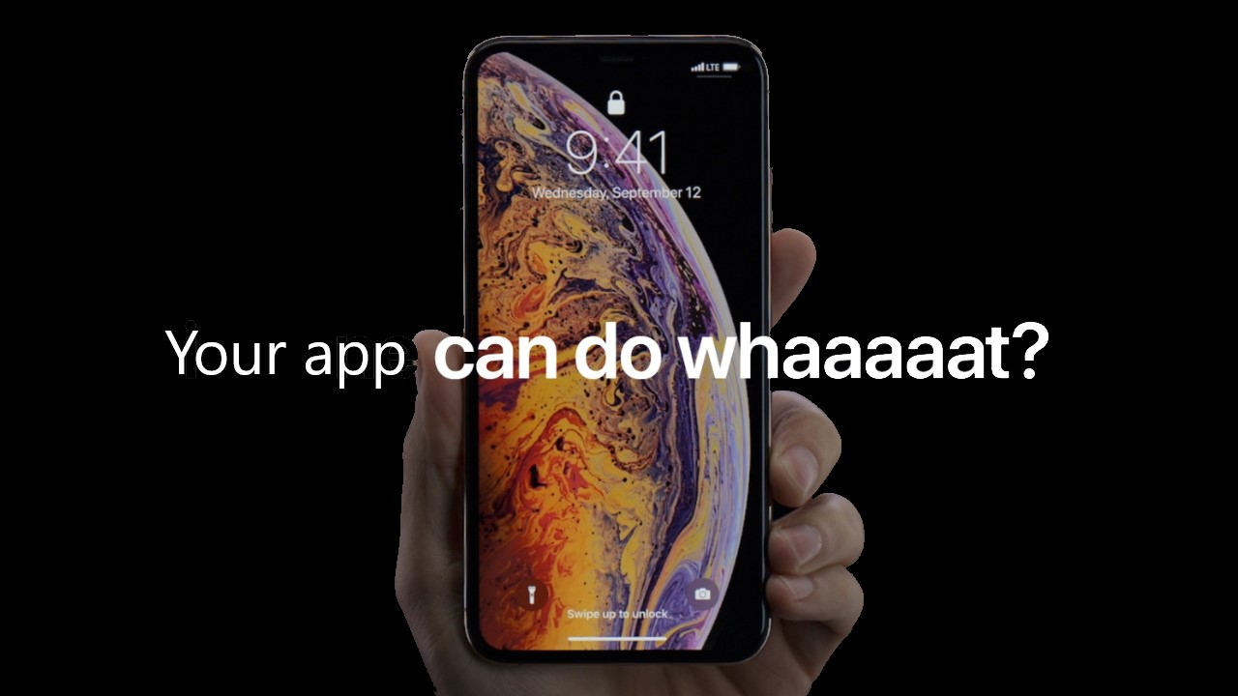
Features
Selecting a building name would present relevant information.
View instructors whose offices are in these particular buildings.
What classrooms are located in the building.
Which department(s) the building houses such as Math, Biology, etc.
Input instructor's name or classroom the user will be given navigation instructions using outdoor mapping techniques.

Slide 9
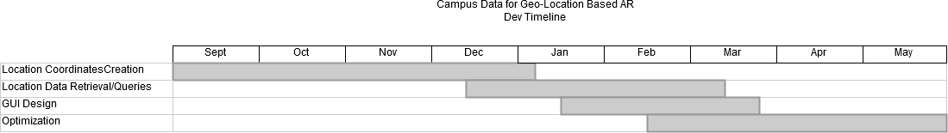
Implementation
Software tools
  Android Studio
  Wikitude Javascript SDK
  SQLite4
  *MapBox SDK
Languages
  JavaScript
  Java
  SQL or JSON
  Node.js
    Library (GeoLib for calcuations)
Timeline

