Slide 1
Resources and Environment
For
Campus Data For Geo-Location Based Augmented Reality
By
Cesar Aleman
Spencer Austin
Andrew Burt
Rodrigo Ortiz

Slide 2
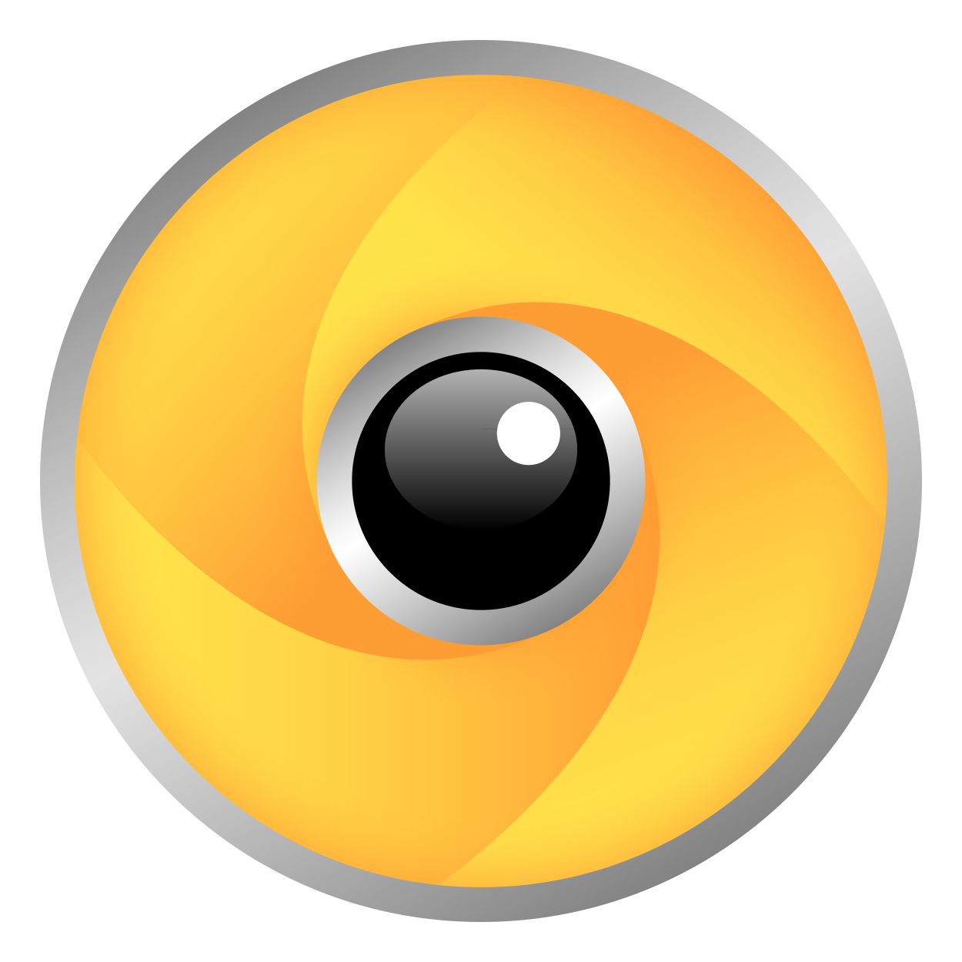
Wikitude SDK
Location-based augmented reality.
Very well documented.
Works great with Android Studio.
Original use of wikitude was very similar to our idea.

Slide 3
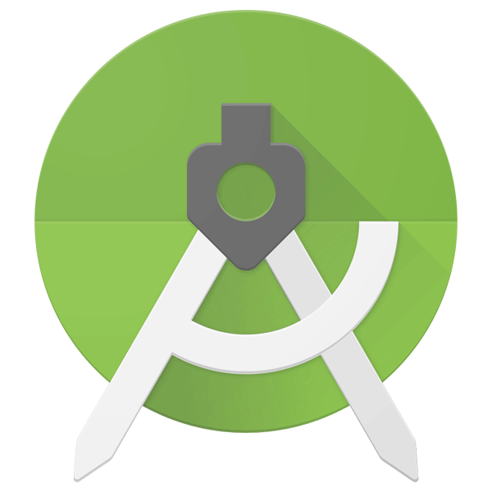
Android Studio
Great IDE to build Android Apps.
Prior experience.
Easy to use UI and great project management tools.
Using Java, JavaScript, JSON, xml, etc.

Slide 4
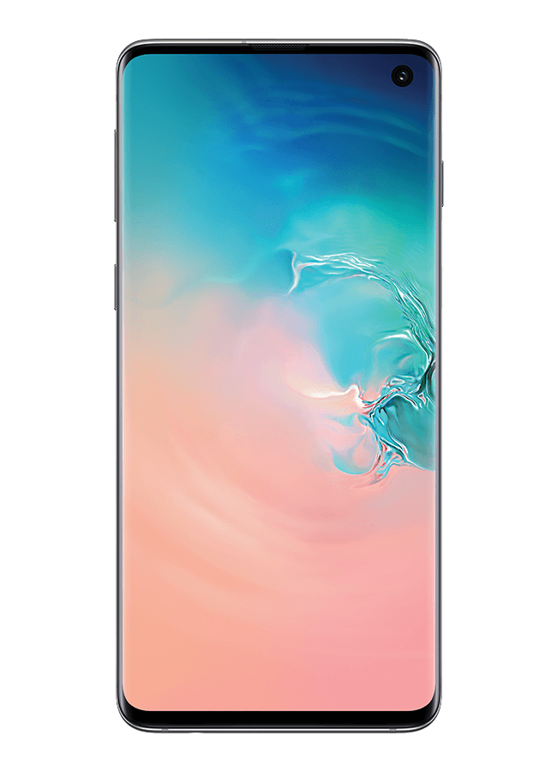
Android Device
Easy to Navigate(*opinion)
Necessary for Android Studio
Necessary for testing/debugging
2.5 billion Android Devices in use

Slide 5

GitHub
Version control system using Git.
Built in support for use with Android Studio
Quickly push changes and pull most recent version of project.
Reset button if needed.

Slide 6

PHP
Allows a web interface for managing data to keep track of all data of project.
Allows us to manipulate JSON files on the go and from any device.

Slide 7
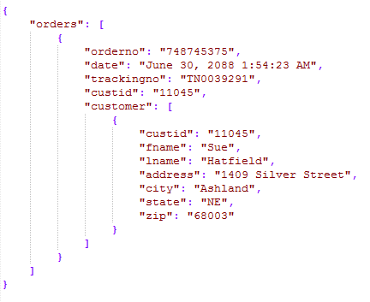
JSON
JavaScript Object Notation.
Wikitude SDK is built on JavaScript, so this allows easy manipulation and reading via the Wikitude SDK.
Allows for a database type feel that does not need to be hosted but instead packaged with the application.

Slide 8
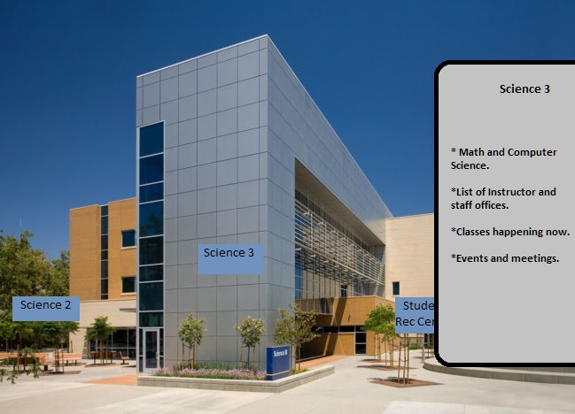
Concept
Pop-up boxes around labeling buildings
Boxes can be clicked to show relevant information.

