Slide 1
Resources and Environment
For
Campus Data For Geo-Location Based Augmented Reality
By
Cesar Aleman
Spencer Austin
Andrew Burt
Rodrigo Ortiz

Slide 2
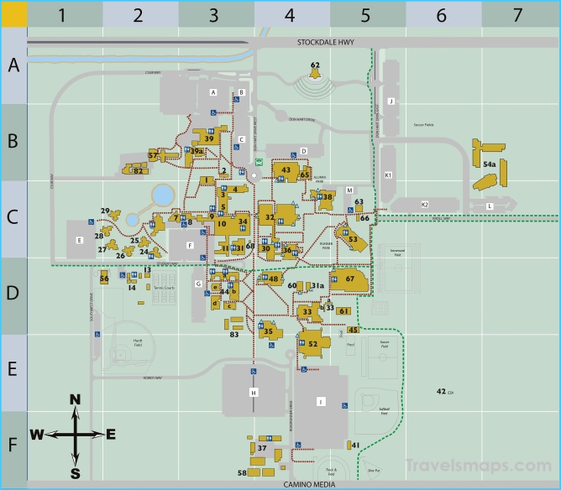
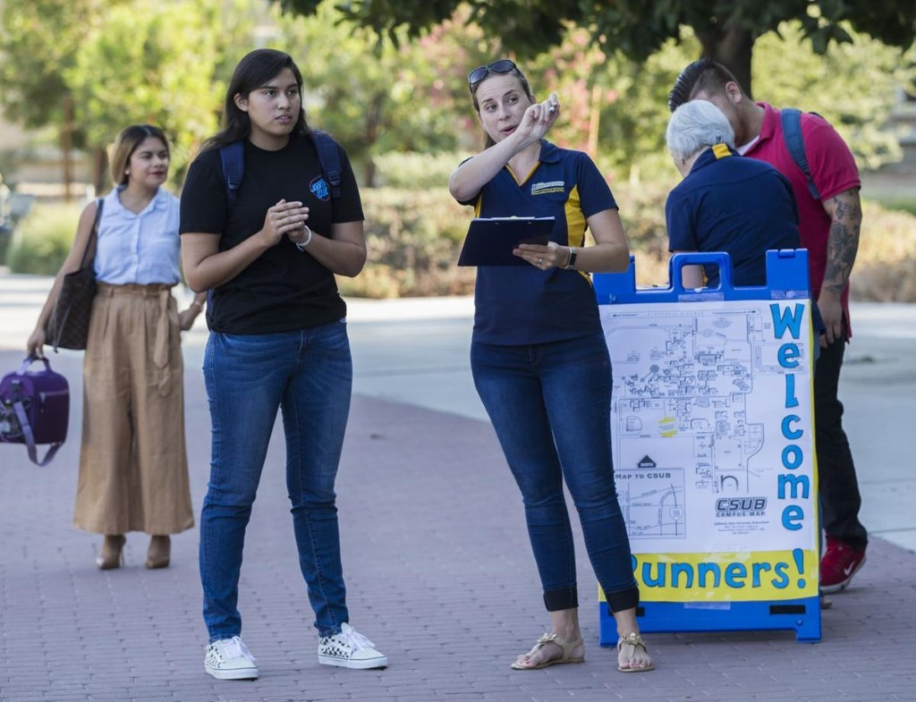
The Problem
Currently students and guests of the CUSB campus can only navigate around campus based on antiquated maps which may be inaccurate or lead to confusion.
There is no true way of navigating around CSUB without consulting the help of someone who is familiar with the ins and outs of CSUB.

Slide 3
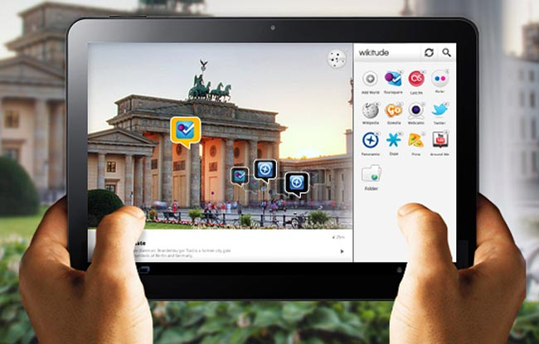
The Solution
Wikitude's SDK will be used as our base for a Geo-Based Augmented Reality Mobile Application.
An example phone app showcases the functionality of displaying points of interests along with descriptions of that interest.

Slide 4
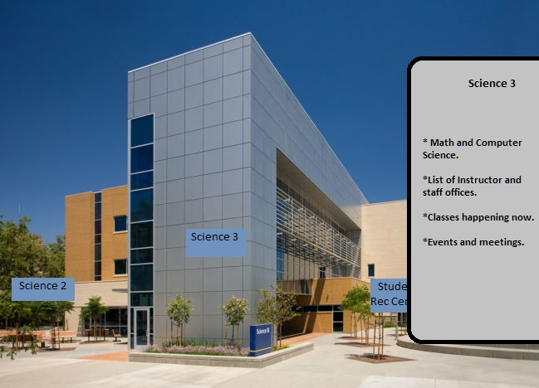
Concept
Pop-up boxes around labeling buildings
Boxes can be clicked to show relevant information.

Slide 5
Week 1-4
Coming up with the problem we wanted to solve.
Choosing the different tools we want to put to use.
Finding a group.
Looking at different tools that we could use to implement our solution to the problem.

Slide 6
Week 5 & 6
The focus for us here was to set up our environment on android studio using the license that we were able to obtain to use the SDK.
Licensing was the most time consuming part for these two weeks.
Began researching the accuracy of GPS coordinates and looked to see if it was a viable solution.

Slide 7
Week 7-10
Setting up the base up to use the primary source of feedback, the camera.
Putting all location data into a file
Running through parser.
Makers appear with data from a JSON file.
Adjustment of marker locations.
Geo-Fences for indoor navigation

Slide 8

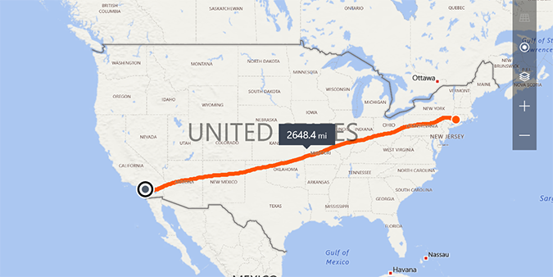
Week 10-12
Worked on range and putting distance between two points onto the marker.
Also the altitude of the user to later consider for indoor navigation.

Slide 9
What's Next?
The next steps for us would be to continue to work on the accuracy of the distances between two objects.
Also the altitude.
Geo-Fences that will be needed to navigate indoors.

Slide 10
Demonstration
https://bigpapaburt.com/data/

