Slide 1
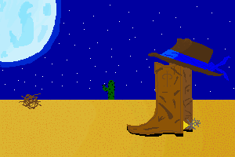
Typing-Teaching System for Beginning Programmers
1PM Section
Andres Zamora
Josh Chavez
D’Angelo Felix
Juan Orozco

Slide 2

Future Goals
Adding more lessons to C++ with its corresponding quizzes.
Being able to add one more language during the next semester.
Having more minigames added.
Getting a proper score system implemented for the typing game.
Implementation of audio software tools is still on the table.
Still planning on adding an avatar character for the user to play as.

Slide 3
What we learned
That our original idea was more than we bargained for.
  We were all new to Unity ,so learning it took most of our time.

