Slide 1
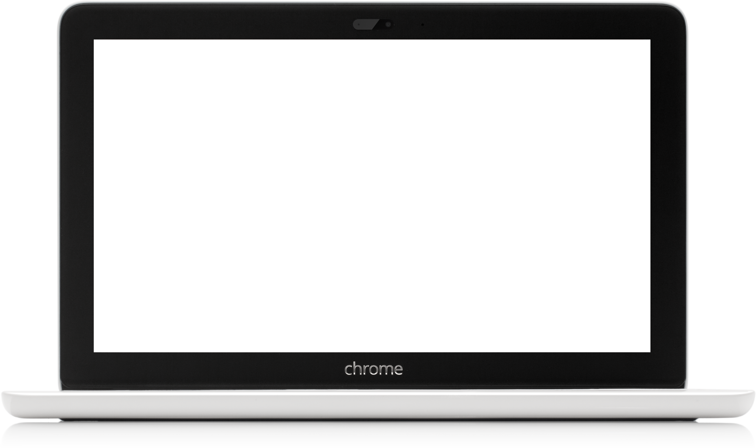
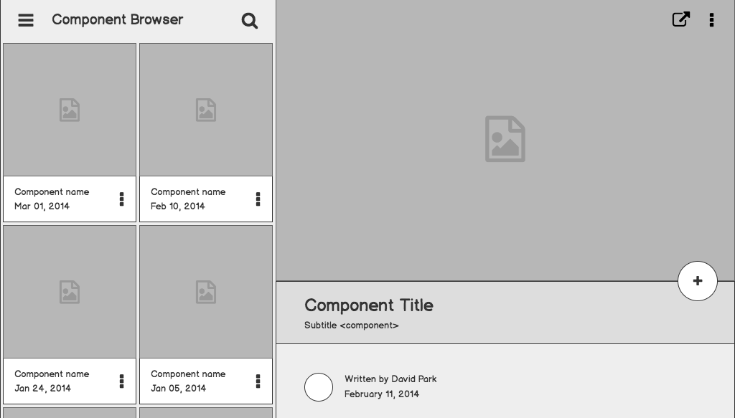
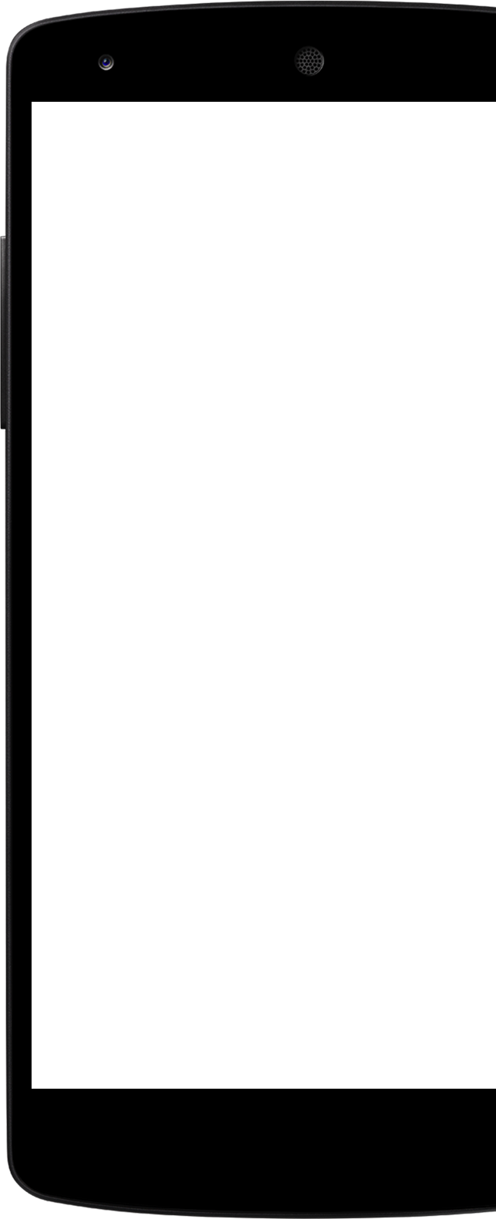
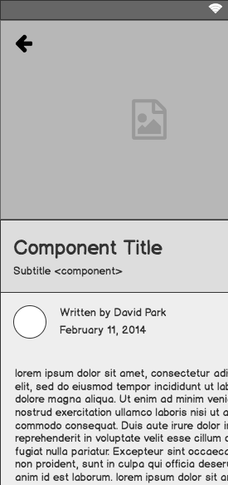
MusicFriend
APPLICATION TO MAKE MUSICAL RECOMMENDATIONS BASED ON USERS’ PERSONAL PREFERENCES
Anahi Vargas Bryan Gutierrez Francisco Ulloa Gracelove Simons

Slide 2
Outline
Front End
Anahi
Francisco
Backend
Bryan
Gracelove
Timeline

Slide 3
Frontend

Slide 4
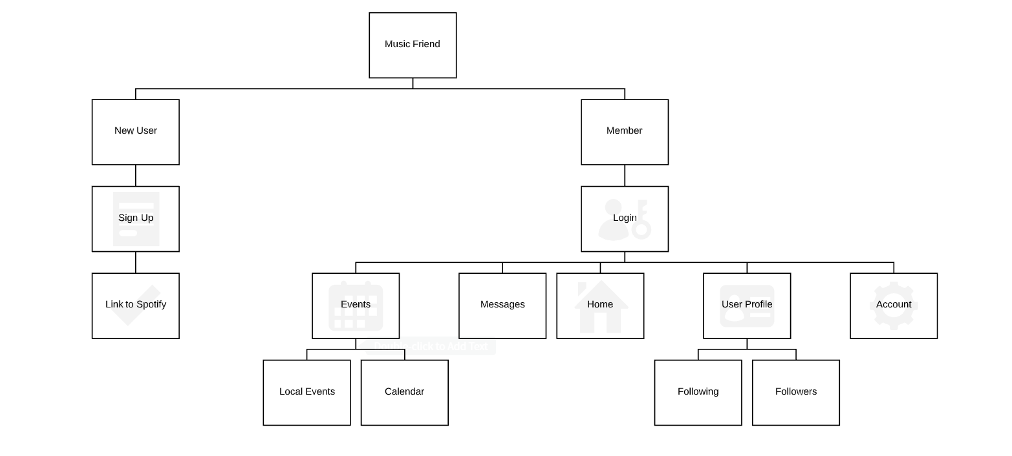

Slide 5
Frontend Technologies
Languages
  HTML
  CSS
  JavaScript
Frameworks and Libraries
  React JS
    A widely used client-side JavaScript library for building web apps
  Material UI
    A React based UI library

Slide 6
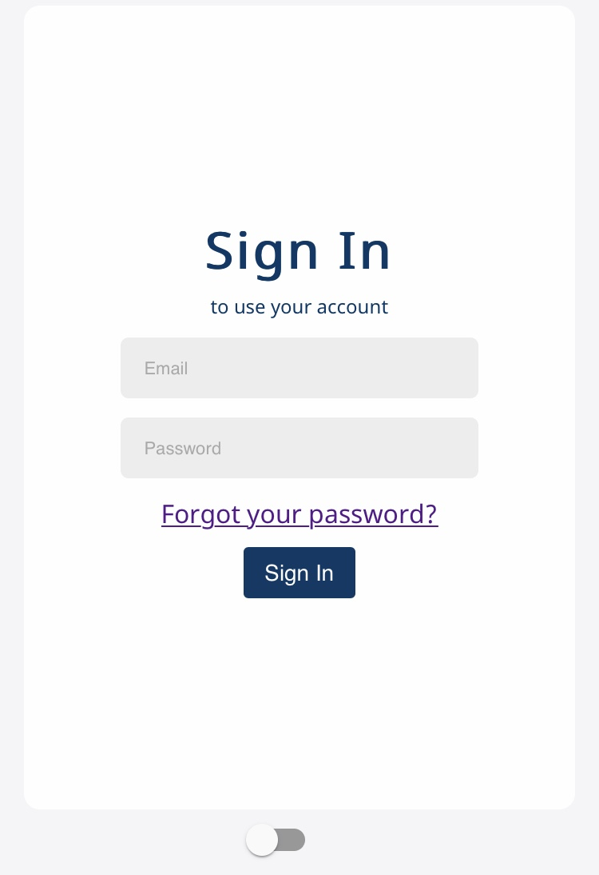
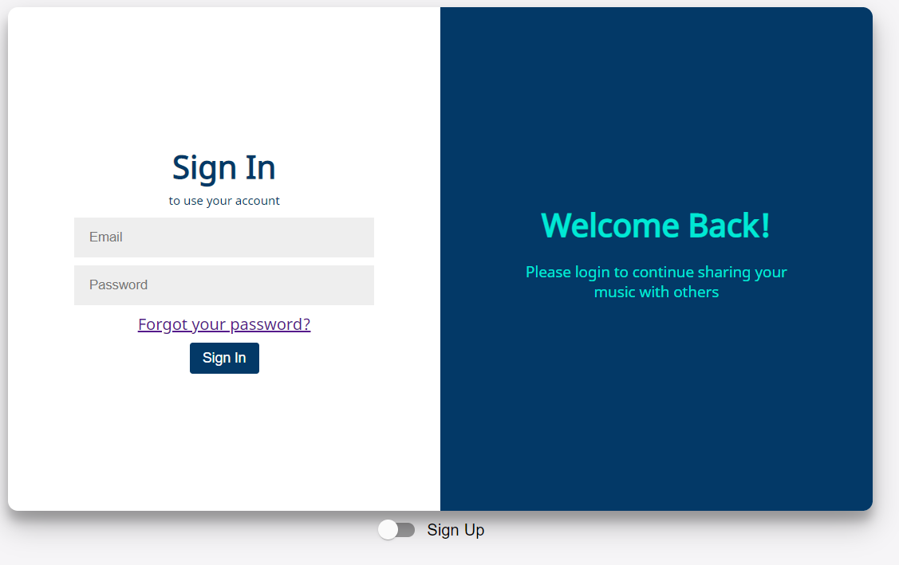
Login

Slide 7
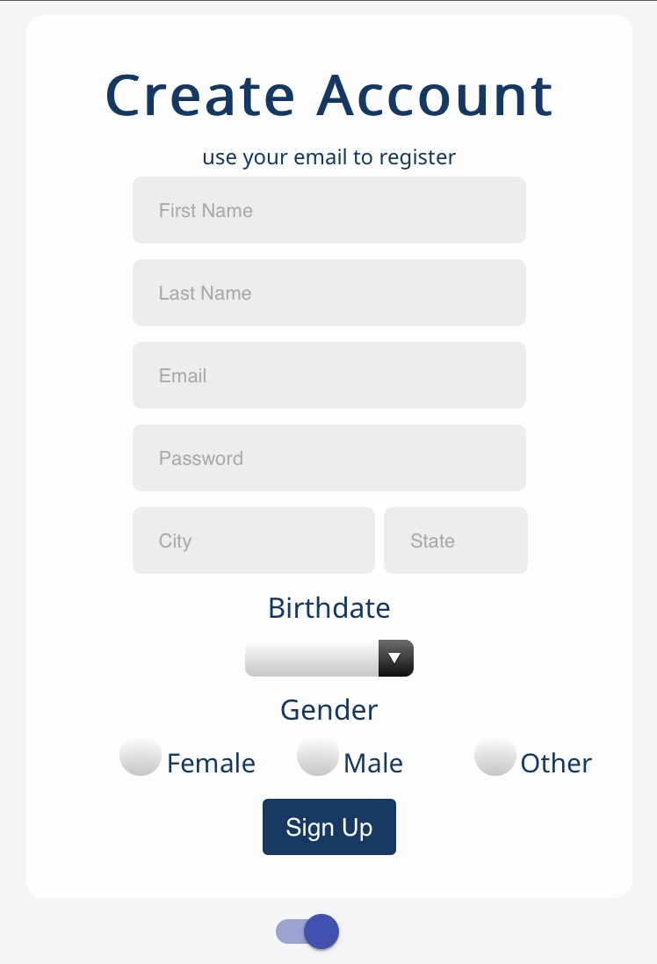
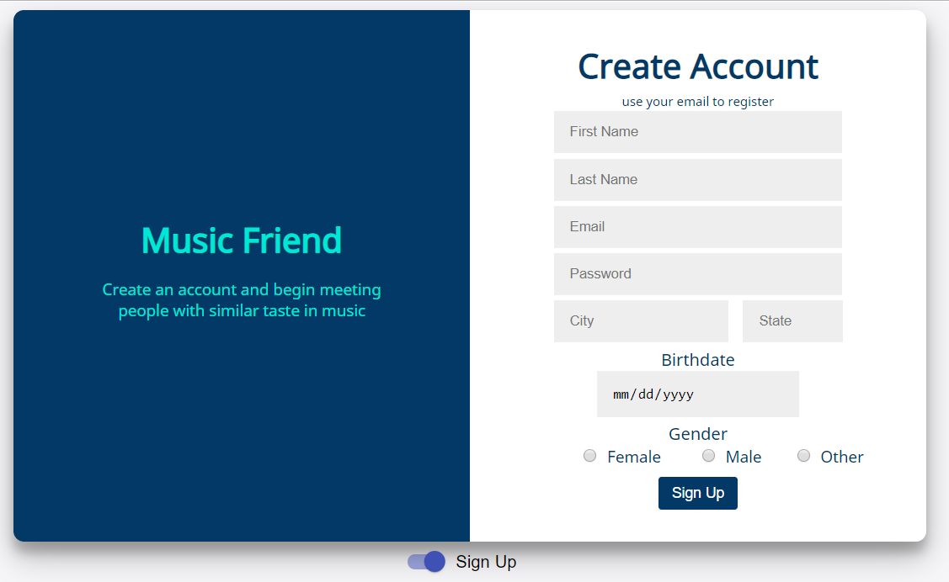
Sign Up

Slide 8
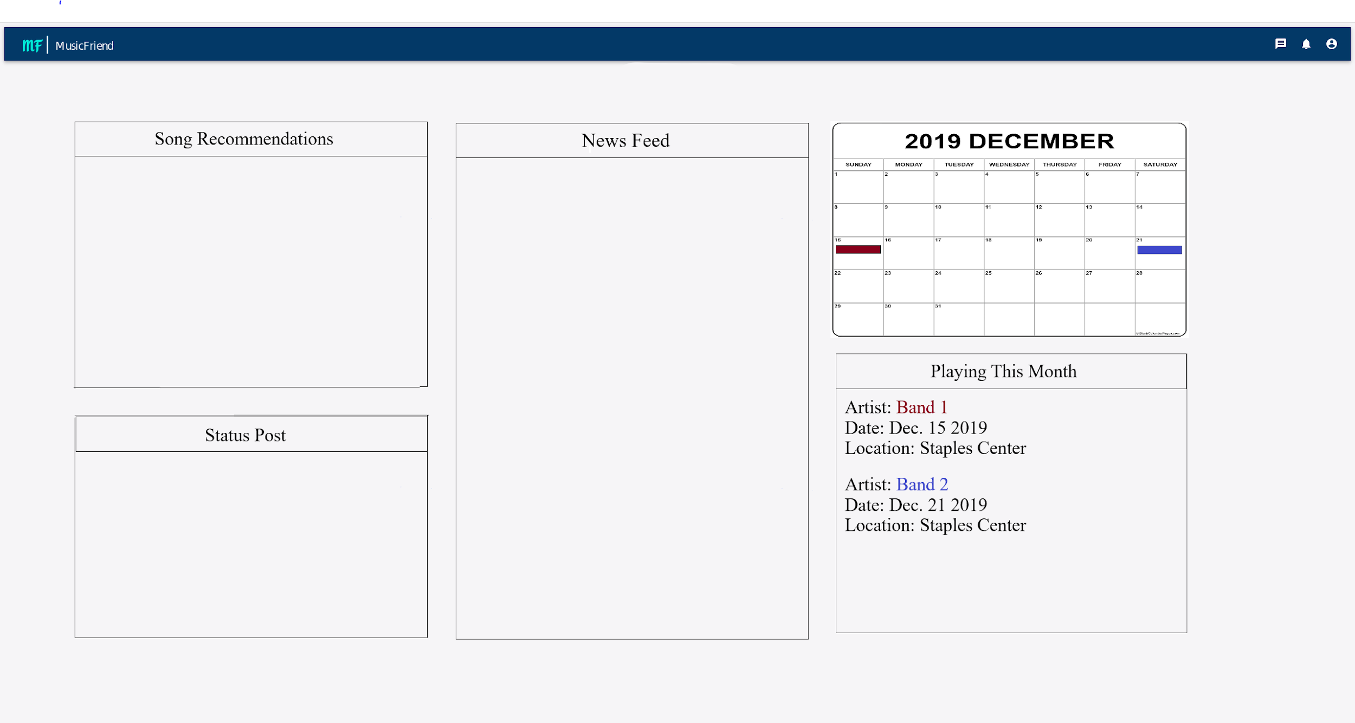
Home Page

Slide 9
Backend

Slide 10
Building the Database
Collections, which are similar to tables, hold the documents, or the data for that said collection.
The collections in our database are:
Artists
Events
Followers
Following
Messages_relation
Messages_text
Top
User

Slide 11
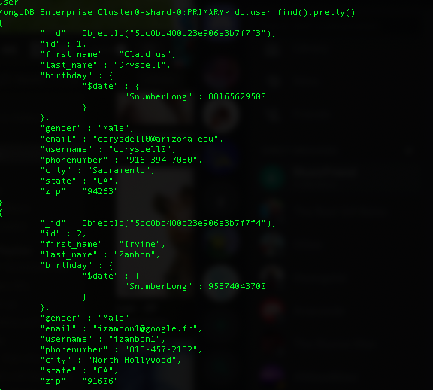
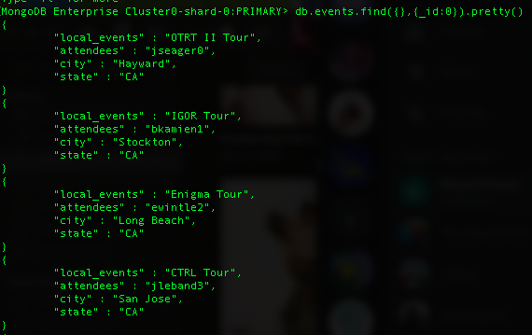
Screenshots of the Database

Slide 12
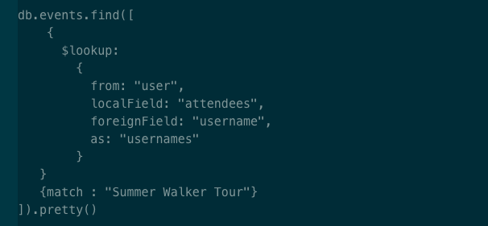
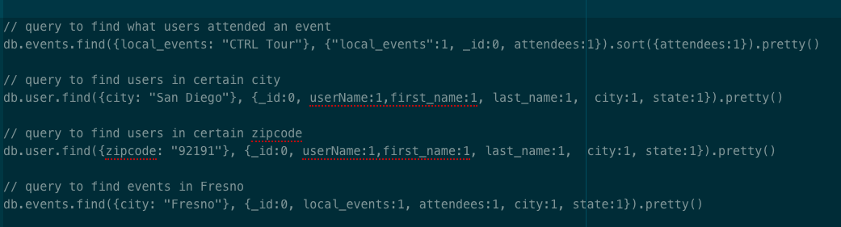
Screenshots of the Queries

Slide 13
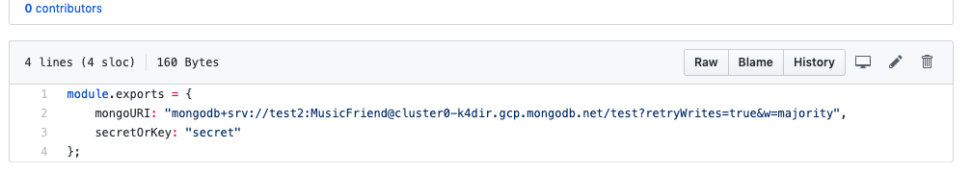
Accessing the Database

Slide 14
Timeline
Gathering More Information:
Research more about the Spotify and Bands in Town (By Jan. 11th, 2020)
Implementing:
Have homepage and user profile done (By January 2020)
Display people and events in the surrounding area of the user (By February 2020)
Display artist information (By February 2020)
Have messaging functionality working (By March 2020)
Have Spotify and Bands in Town APIs working (By April 2020)
Final touches (By May 2020)

