Slide 1
Senior-project proposal
By:
Moath nafjan, fahad alqahtani, rayan alsabr

Slide 2
Introduction:
. Why we choose this project.
. An IOS and Android application base.
. Designed to help sever and chronic patients.

Slide 3


method:
React Native
-to create an IOS and Android application.
JavaScript.
DBMS:
-PostgreSQL

Slide 4

Method continued
GitHub:
-to share the progress of the work.

Slide 5
User Interface:
PATIENTS UI :
Participants/ volunteers:
Account profile
Direct messaging
Recommendations
Payment method.
Account profile
Direct messaging
Requests

Slide 6
Setting:
Initializing privileges for sub-account.
Users can toggle whether they view a paid participants, volunteers, or both.

Slide 7
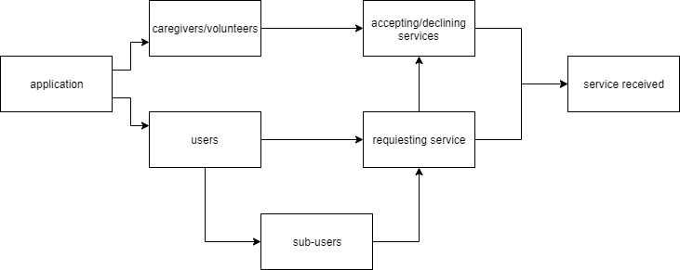
FLOW-CHART

Slide 8
Potential problems:
Using new language.
Connecting to database.
Creating a sub-account.
Recommendation's algorithm.

Slide 9
solutions
Learning through tutorial.
Helping each other.
Get help from different sources (internet)
Working daily to finish our goals.

Slide 10
conclusion
Goals by the end of the semester (Fall 2019):
A functional application for IOS and Android to download.
Goals by the end of the semester(Spring 2020):
More improvements.
Possible website.
A well functional application.

