Slide 1
Project 8
Resources & Environment
RAYAN ALSABR
MOATH NAFJAN
FAHAD ALQAHTANI

Slide 2
Quick recap
- we are making an application to provide users with caregivers to accompany them during their medical treatment
- this can help many patient to have a better choices picking their personal caregivers

Slide 3
Method to setup the database
DMBS:
-Postgressql
-pgadmin4
-draw.io
To create the E-R diagram

Slide 4
Entity-relationship diagram

Slide 5
Tables
Example of the tables
Patient table
Caregivers table
Medical history

Slide 6
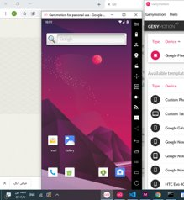
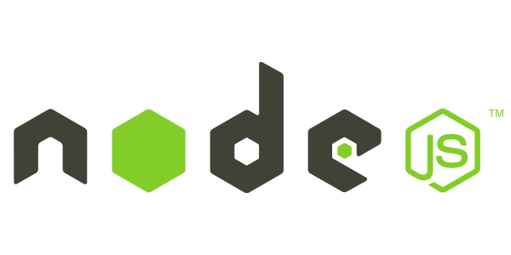
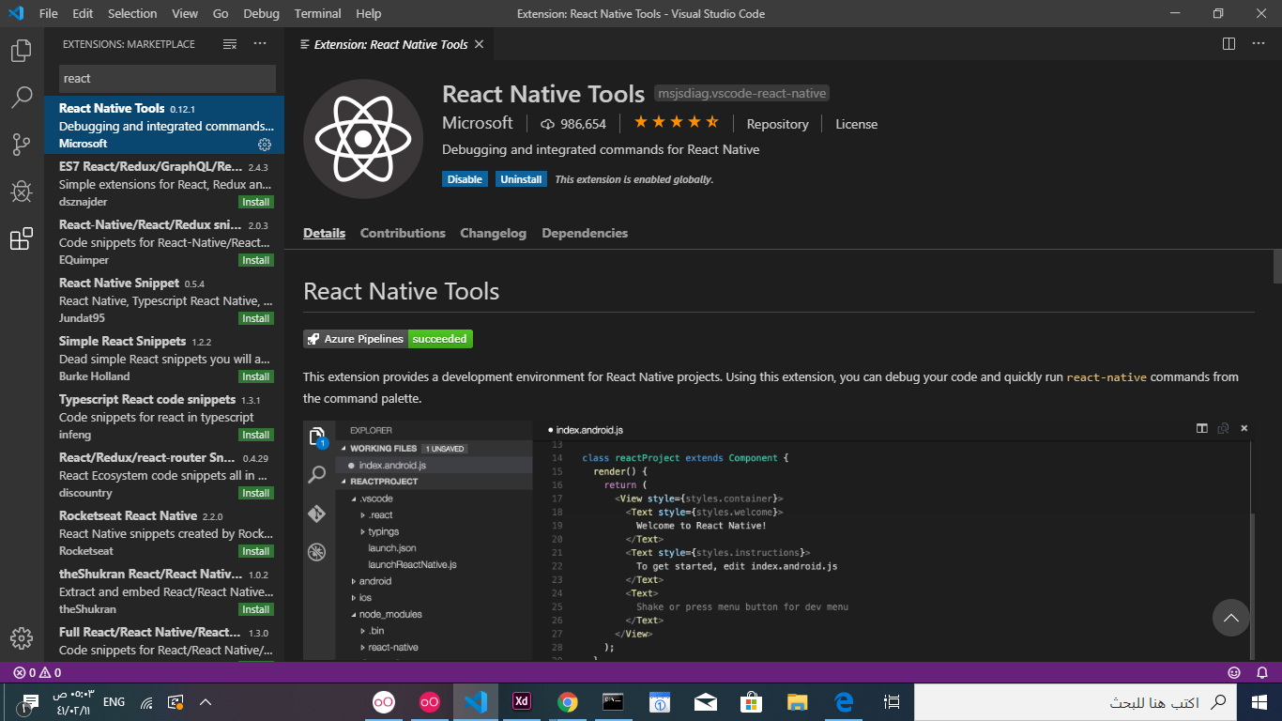
Methods to design the app UI
visual studios
React Native tools
-designing the UI
Genymotion
Andriod/ios emulator
Node.js

Slide 7
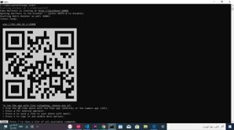
Method continue
Git
Expo-cli (NPM)

Slide 8
Method to design the backend
Express js
a minimal and flexible Node.js web application framework
Visual staduio code
Appolo & GraphQL

Slide 9
Other tools
Github
- a git reposotory hosting system(DVC)

