Slide 1
Resources and Environments
Code Name: NULL

Slide 2
Overview
Peer to Peer Network
Data Structures
User Interface

Slide 3
Peer to Peer
Python 3.7
Socket
Struct
threading/AsyncIO
Hashlib/picryptodomex
SQlite 3

Slide 4
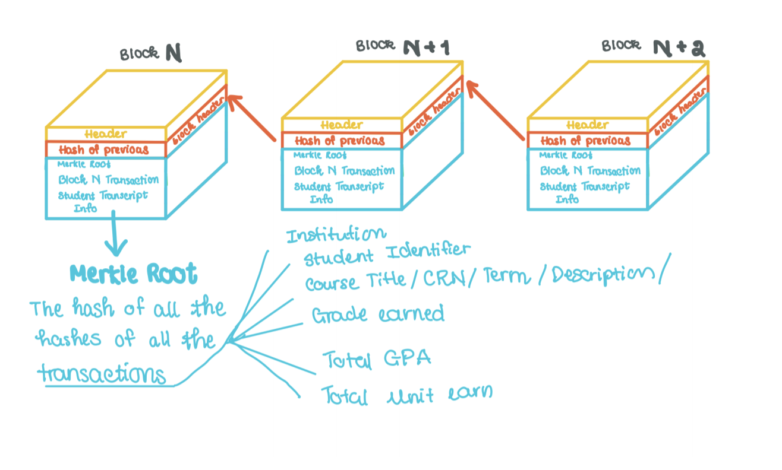
Data Structures

Slide 5
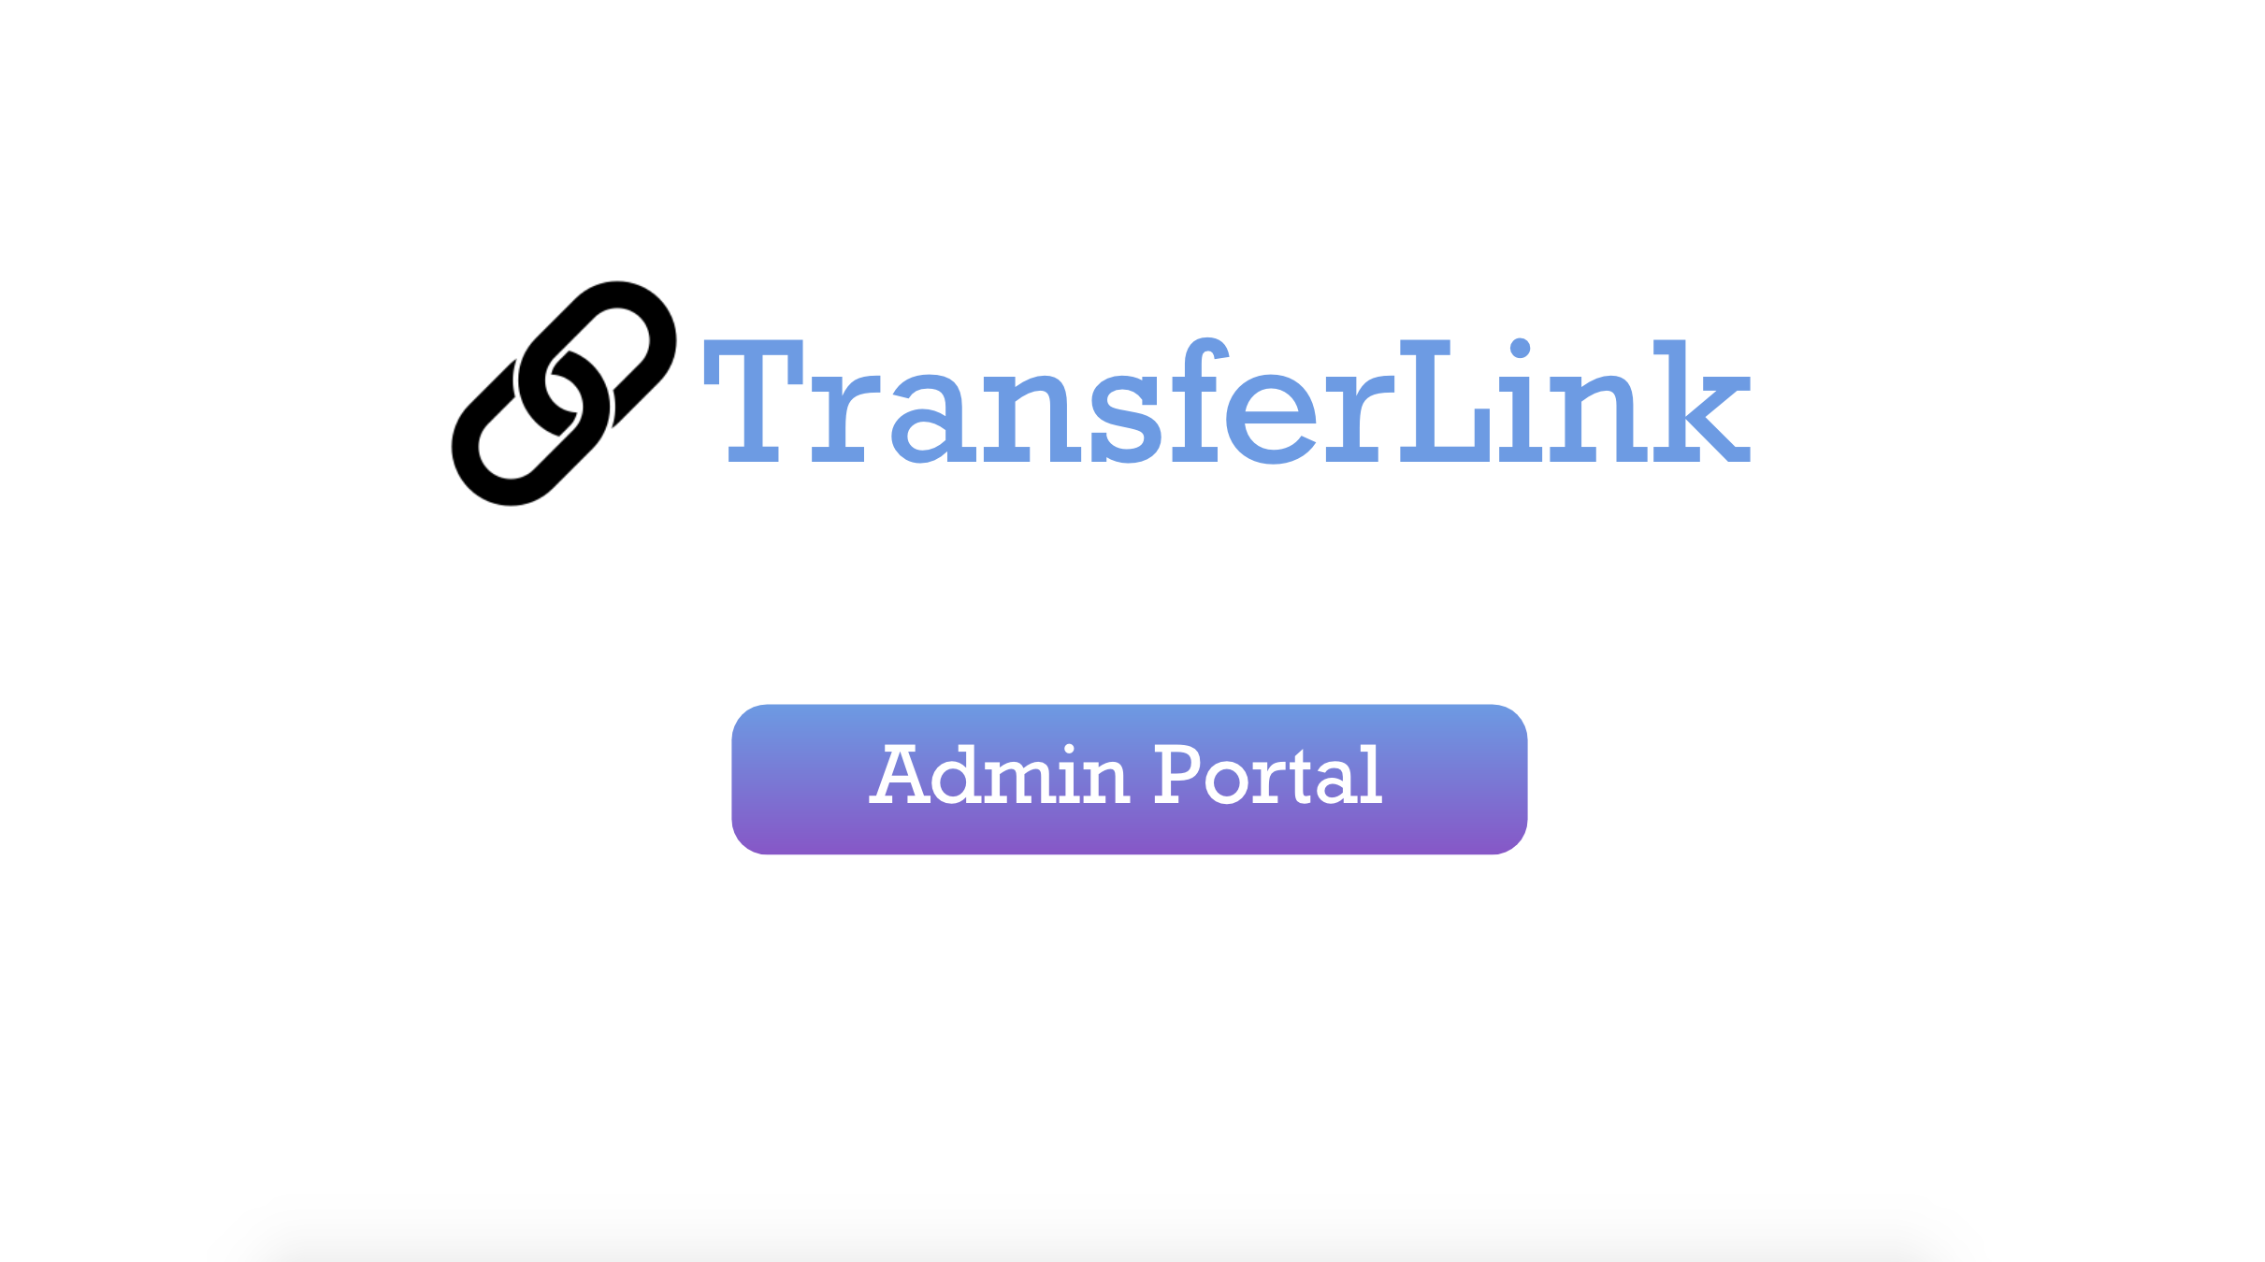
User Interface

Slide 6
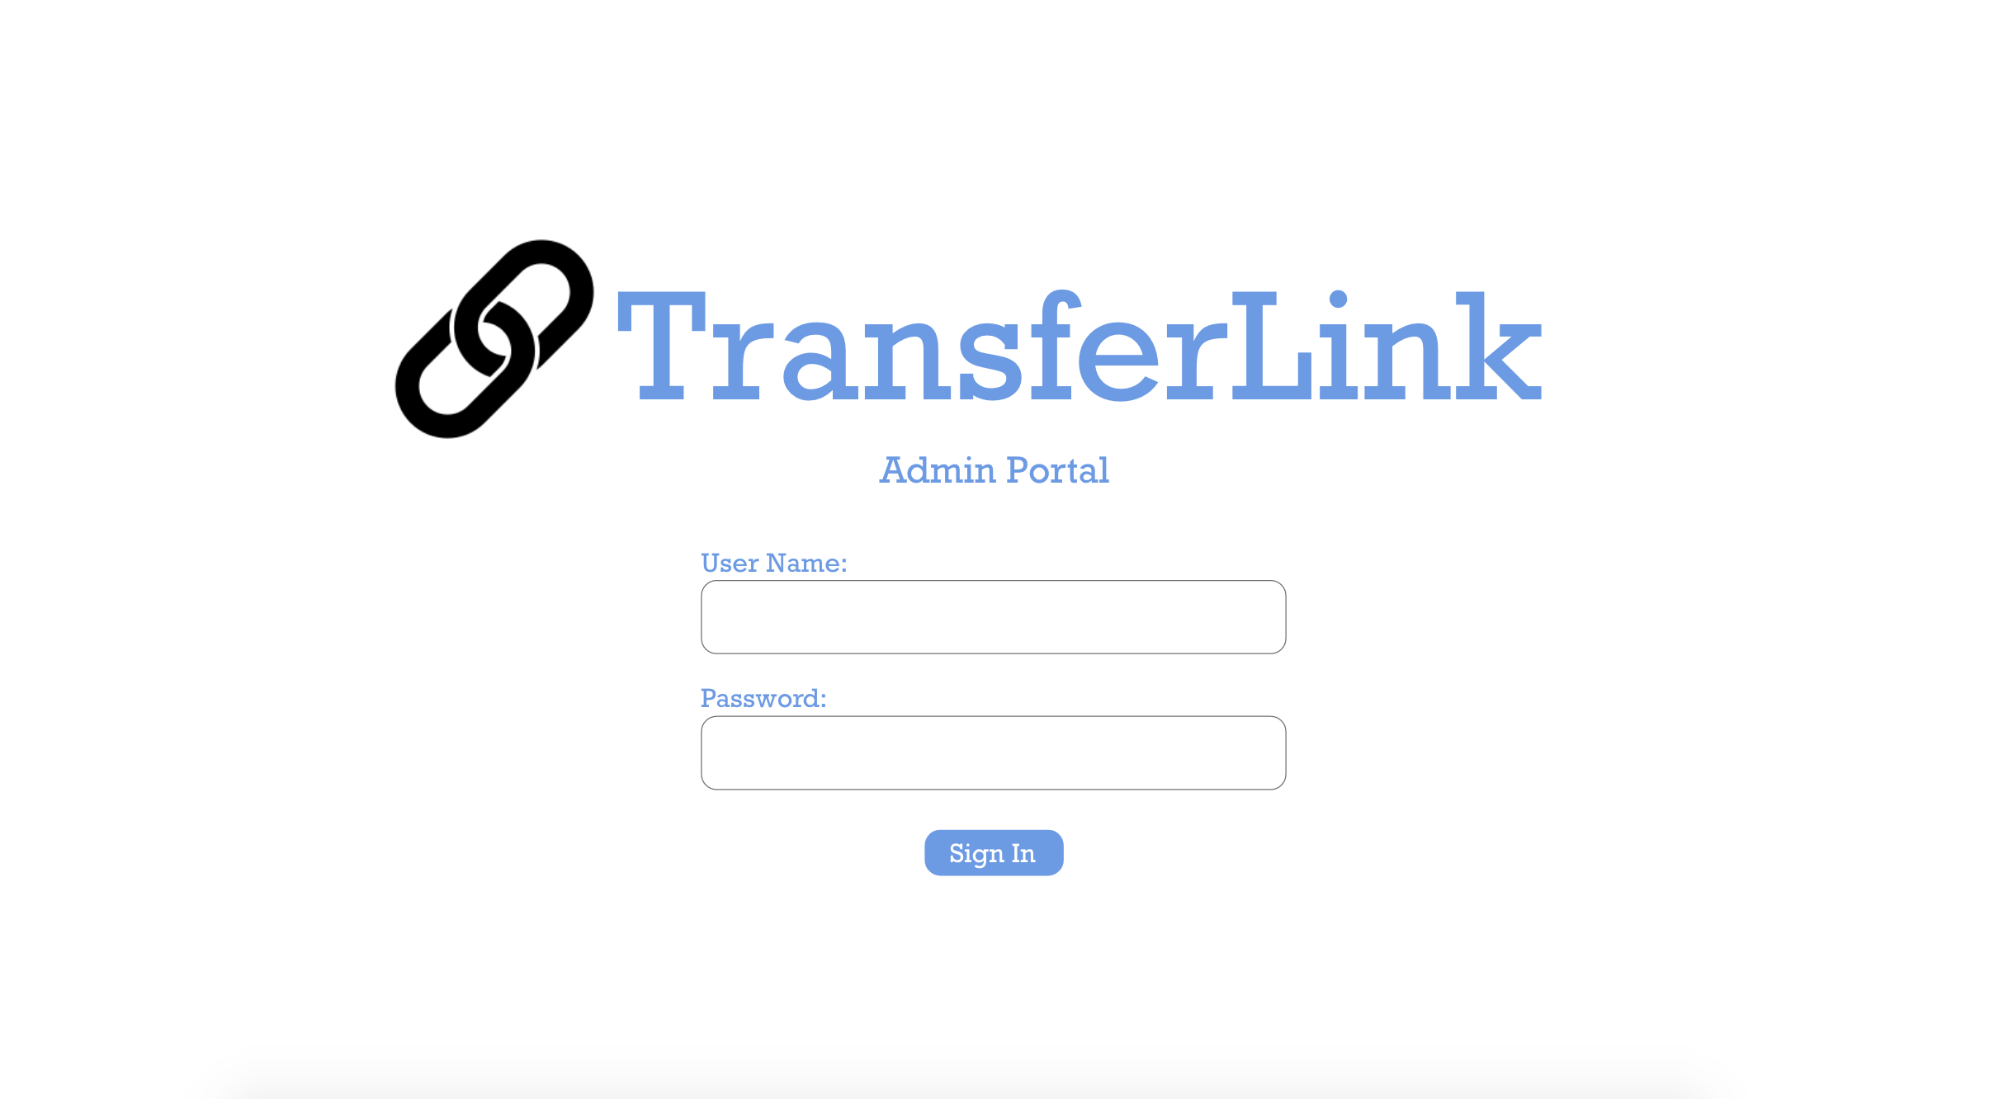

Slide 8
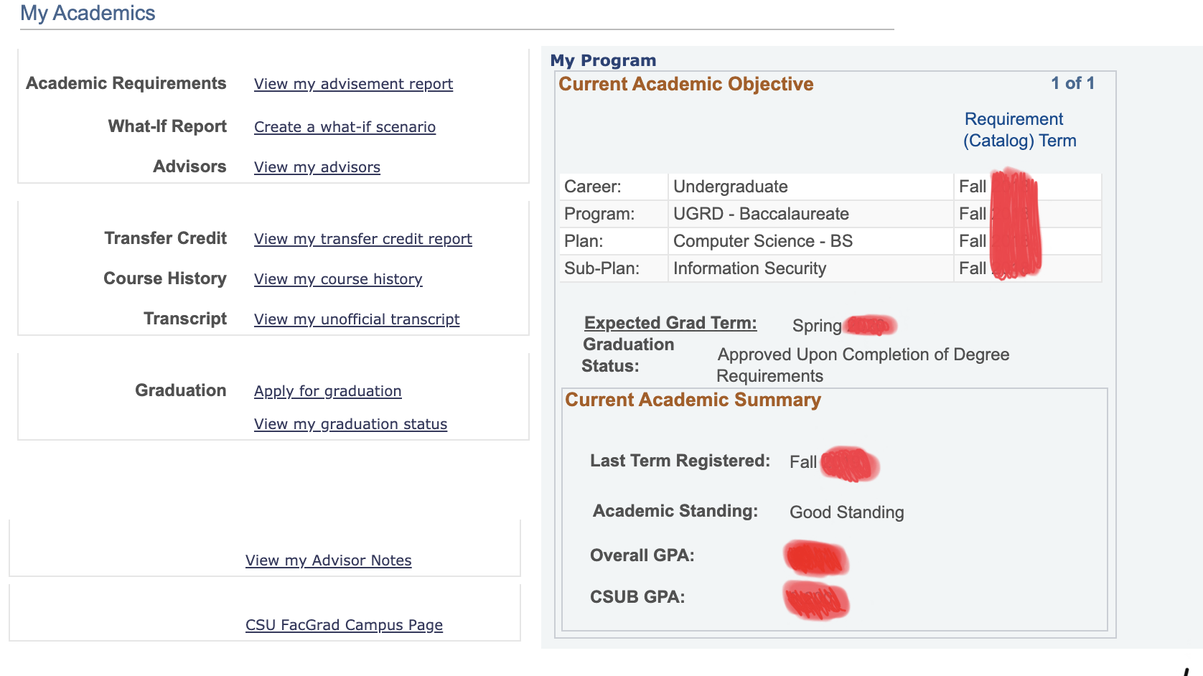

Slide 9
Our Timeline
Implement P2P Network
Testing Node Interactions
Front End Development
Basic request/response functions
Merge P2P and Blockchain Structures and begin tests
Design UI for blockchain client
Step 2
Step 4
Step 6
Step 1
Step 3
Step 5
Data Gathering
Implement Fundamental Structures
Multiple Nodes
Student Record Requirements
How records are maintained
Scale upwards to test functionality

