Slide 1
Web Crawling and Community Review to Prevent Misleading Links
Adam Arreguin, Adrian Gutierrez, Joel Staggs, Kenny Taylor

Slide 2

The Problem
Low quality webpages manipulating web users.
Intentionally create an unpleasant web experience to maximize clicks.
Article duplication causing unwanted advertisement spam.

Slide 3
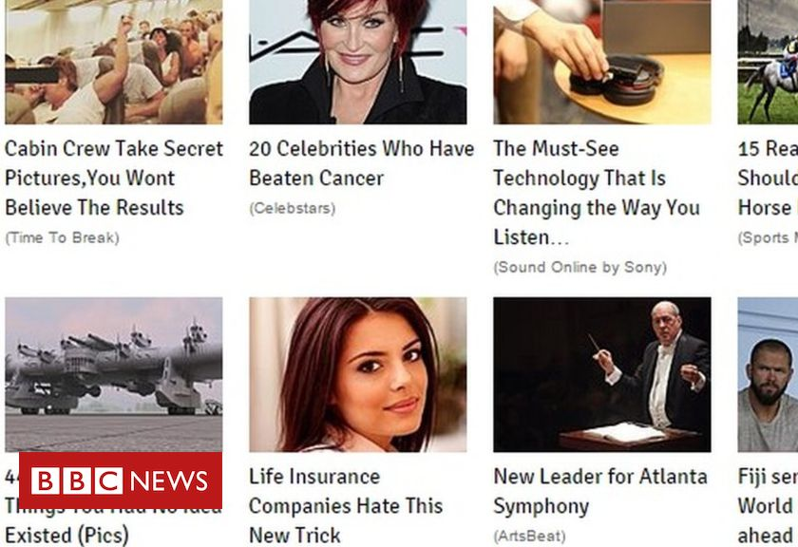
Types of Manipulation
Overhyping and Underdelivering
Claiming to subvert expectations
Presents mundane content as novel

Slide 4
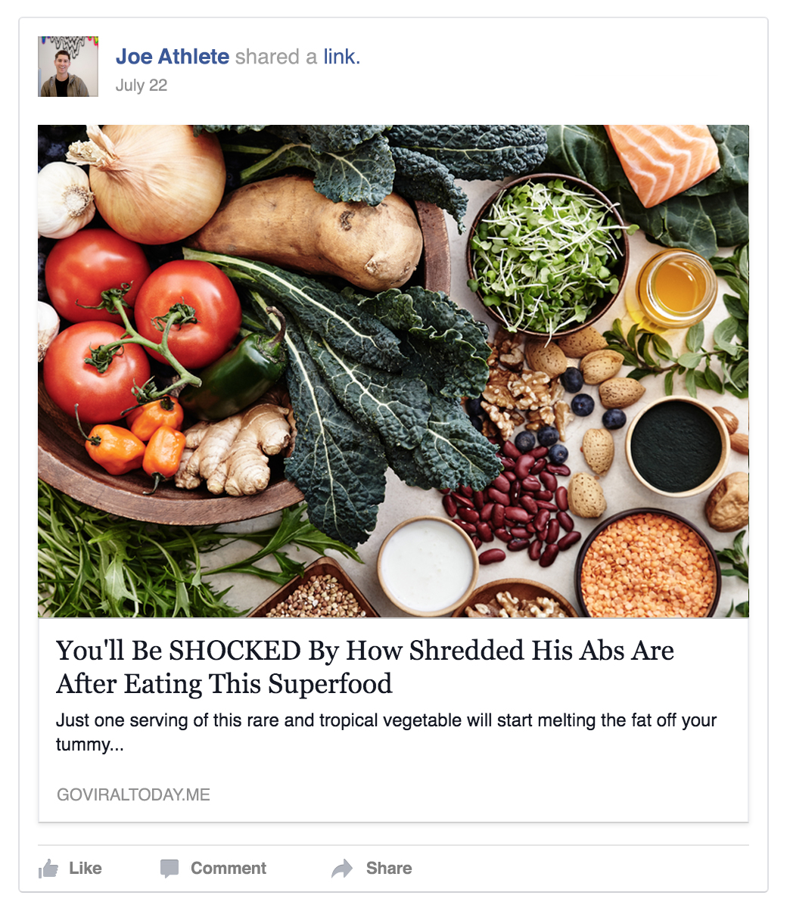
Hiding the Topic

Slide 5
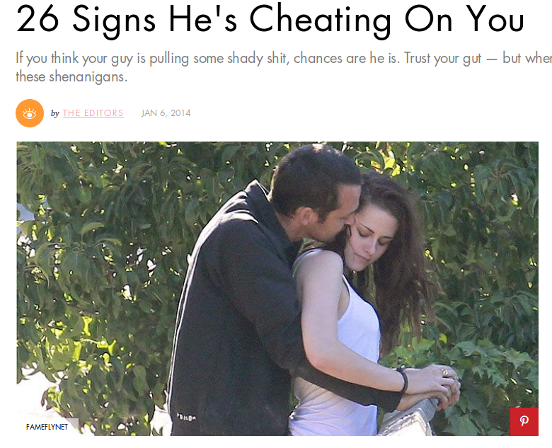
Creating Fear

Slide 6
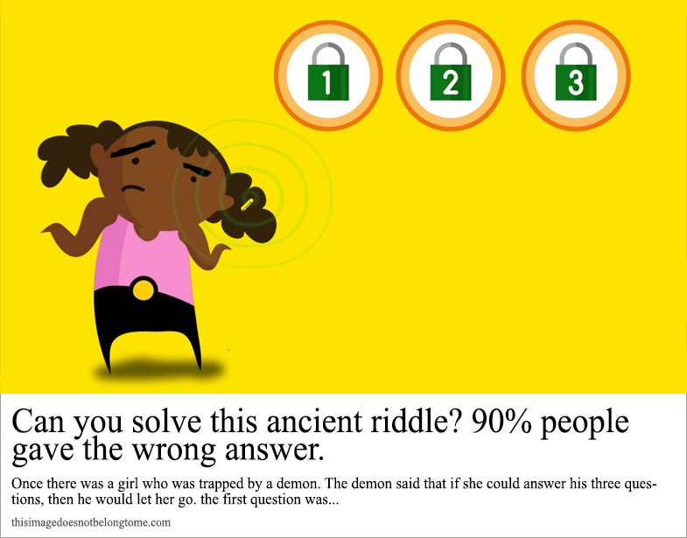
Challenging your Intellect

Slide 7
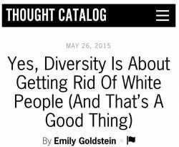
Using Controversy

Slide 8
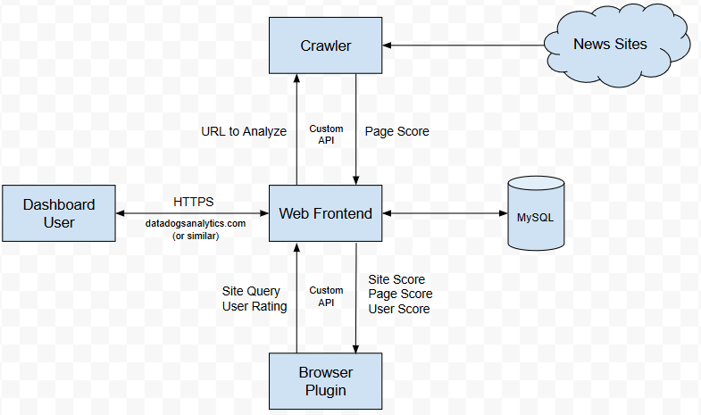
Our System
Crawler
Analyzer
User Review System
Browser Extension

Slide 9
Crawler
Is a scheduled task run on a server
Attempts to simulate a real user and avoid conspicuous traffic
Stores relevant data into a large database of webpage information
Written in C++, PHP, or Python
Honors the Robots Exclusion Standard

Slide 10
Analyzer
Uses several techniques to generate webpage scores
Provides several metrics (Author, Website, Article)
Runs in tandem with the Crawler

Slide 11
User Review System
Meant for addressing issues not picked up in automated review
Is a remote website using user accounts
User comments will be viewable on extension

Slide 12

Browser Extension
Browser extension will automatically prepare score of all links on page
If webpage review has not been performed, it will be performed automatically
User will be able to view review and comments when hovering over a link

Slide 13

Significance of Our Project
Helps users understand possible manipulation
Encourages thoughtful content
Prevent misrepresentative journalism and advertising

