Slide 1
Application of Voxel-Based Physics across a Multi-user Network
Group Purify

Slide 2
The problem, proposed solution, and purpose
The problem:
  Polygons
    “The currently dominant 3D graphics and simulation paradigm, based on polygon meshes, is fundamentally flawed...volumetric geometry presents a simpler and more granular representation of a scene, which makes most of these issues simply go away” - Dan Tabar
Our solution:
  Utilization of algorithmic techniques (octree, perlin noise, greedy meshing, etc.)
  Separation of tasks across network
What can be gained from solving this problem:
  Could help in changing future of physics-based simulations
Notes:
Today’s Graphics limit possibilities, can’t be communicated over a network well
https://venturebeat.com/2018/04/05/atomontage-reveals-voxel-3d-simulation-technology-for-games/

Slide 3
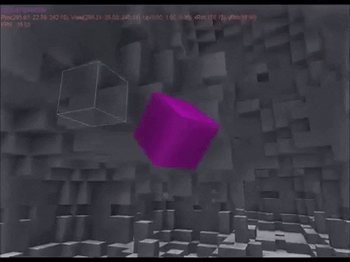
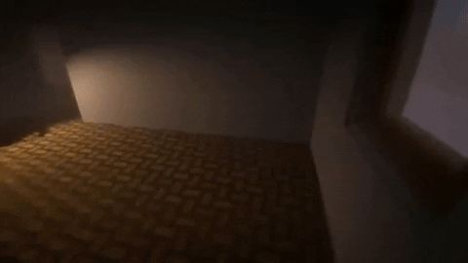
Voxel Engines

Slide 4
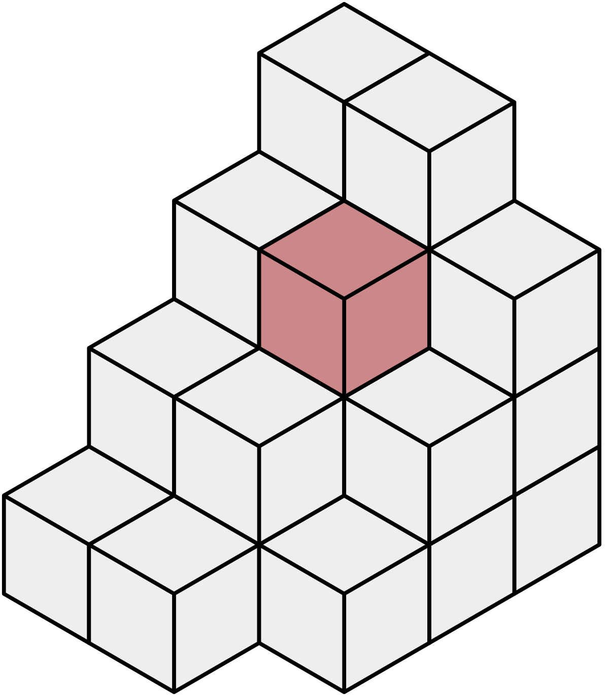
Graphics
What is a Voxel?
  Volumetric Pixel
Pros
  Interpolation
  Accurate manipulation of environment
Cons
  Can be taxing on client and server when used in large quantities
Algorithms
  Perlin Noise
  Marching Cube
  Octrees/Quadtrees

Slide 5
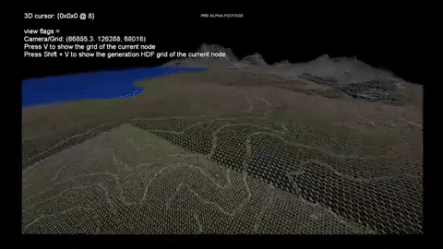
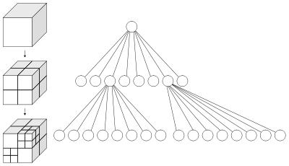
Octrees

Slide 6
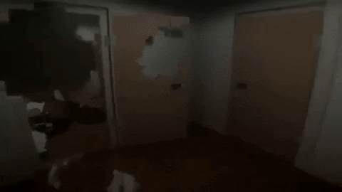
Construction of Physics Engine
Purpose of Physics Engine
  Volume
  Destruction
Basic Physics
  Collision Detection + Impulse Resolution
    Axis-Aligned Bounding Boxes
  Laws of Motion
Notes:
State we’re implementing the math of Rigid Bodies through use of Kinetics and Lagrangian Mechanics (derivative form)

Slide 7
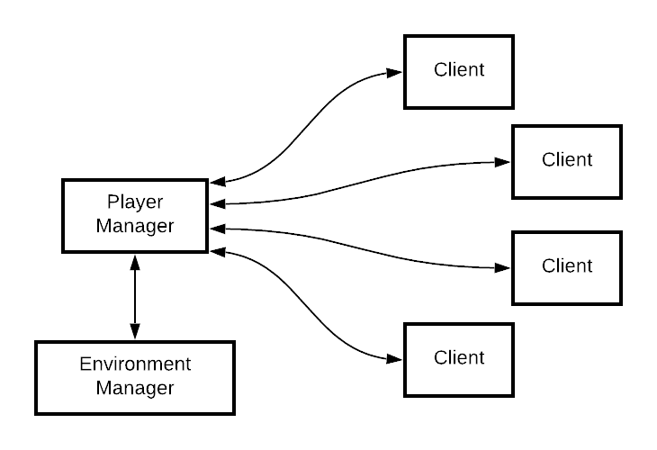
Two Backend Servers
Notes:
Synchronization throughout all systems may be an issue. To reduce it, mask lag issues and use prediction information to reduce latency.
TCP connection
Authoritative system
C++

Slide 8
Player Manager
Players
Projectiles/Physics
  Trajectory, Speed and Force
  Collision with player
Potential Issue
  Network Traffic/Packet Size
QuadTrees(Zoning)
  Snapshots vs Single Movements to reduce size of network messages
Osmium
CPU
Intel Core i7 (3rd Gen) 3520M / 2.9 GHz
96 CUDA Cores
Primary Memory
8GB DDR3 SDRAM 1600 MHz
Secondary Memory
240GB SATA III SSD
Notes:
Quad tree initialized through connection with environment manager

Slide 9
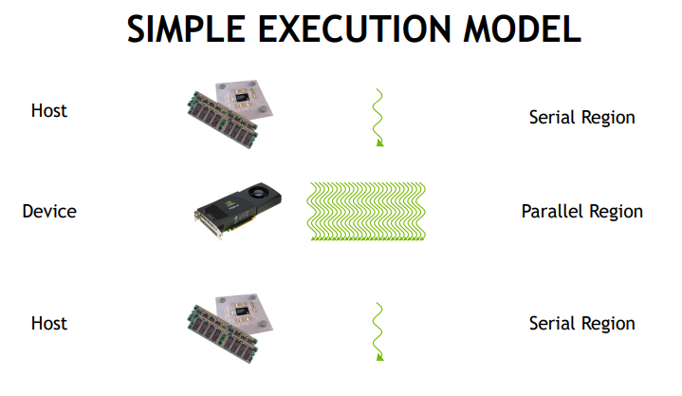
Environment Manager
Iridium
CPU
Intel Core i5 (2nd Gen) 3570K / 3.4 GHz
1344 CUDA Cores
Primary Memory
24GB DDR3 SDRAM 1600 MHz
Secondary Memory
480GB SATA III SSD RAID-0
Determines how the collision affects the environment
  QuadTrees to optimize finding where the projectile collides
Keep record of environment destruction/changes
Runs Physics Engine
  CUDA Parallel Processing
Notes:
The environment manager uses projectile information from player manager to determine how the collision affects the environment. One issue we can foresee is the long environment update message turn-around. This can cause environment collision lag so we are using QuadTrees to optimize determining the point of impact of projectiles. The ruble from the destruction of the environment is saved as changes in the environment so that it can be transferred to new players. Fallen buildings and other damages saved as well so that every player can see the changes. Most calculations run on the GPU using its CUDA cores. This allows us to parallel process the information and at the same time, reduce the load on the processor. Therefore, it is not necessary to have a high performance processor.

Slide 10
Tools and Languages
MagicaVoxel
  Building models
Blender
  User/Equipment models
OpenGL
  Rendering
Unity
  Client-side physics/rendering

Slide 11
2 Term Time Frame
Stage 1 - done by 10/31/19
Create basic graphics engine
Client/server communication
Stage 2 - done by 11/30/19
Start basic physics engine
Allow for multiple-user access
Stage 3 - done by 12/31/19
Apply Physics to environment manager
Finalize graphics & physics engine
Stage 4 - done by 2/29/20
Optimization of project
Finalization of all tasks
Stage 5 - done by 5/31/20
Time accomodation
**Dates subject to change through the course of the school year**
Notes:
Stage 1 - Rendering voxels to the screen, terrain generation through use of perlin noise, etc.
- Communication of construction of voxels between client and server
Stage 2 - Begin to implement basics of physics engine now (collision detection, Impulse resolution, movement)
- Implement multi-user connection and communication across servers (connecting user to both servers)
Stage 3 - Implement basic physics on environment manager
- Implement necessary optimization algorithms (marching cubes, octrees, etc.)
Stage 4 - Optimization of communication, physics and rendering
- Add finishing functionality (potentially adding fluid-body and soft-body dynamics in physics)
Stage 5 - Release to public (verify server strength, unforseen graphical issues)

