Slide 1
Application of Voxel-Based Physics across a Multi-user Network
Team Purify
October 10th, 2019
5 P.M.
Presentation 2

Slide 2
Tools We Used
Unity
For Rendering and Physics implementation
Visual Studio / Visual Studio Code
IDE used for coding as a group
Github
Used for version control

Slide 3
What We’ve Accomplished
Built and Rendered an octree
Implementation of Level of detail
Working client/server communication
Sending and Receiving messages

Slide 4
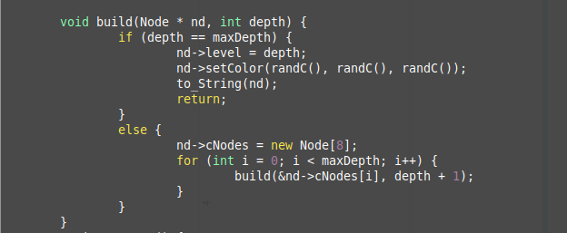
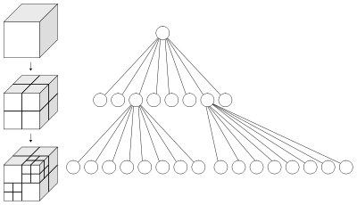
Octree Data Structure

Slide 5
Network
Working:
Servers (Ubuntu Server)
Osmium - player server
Iridium - environment server
Client-Server connections
Currently working on:
Client management on Server
Multi-threading clients
Message types and parsing
//////////////////create threads here ////////////////////////
do {
clilen = sizeof(cli_addr);
newsockfd = accept(sockfd,
(struct sockaddr *) &cli_addr, &clilen);
if (newsockfd < 0)
error("ERROR on accept");
//check hashtable for empty slots
if (pthread_create(&cli_id,NULL,cli,(void *)&tid)<0) {
perror("ERROR creating thread");
} else {
if (pthread_join(&cli_id,NULL,cli,NULL)<0) {
perror("ERROR joining thread");
} else {
//if thread join, then add unused cli_id to hashtable
}
}
} while (1);

Slide 6
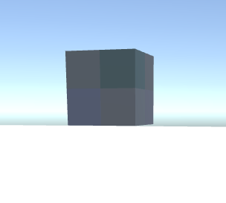
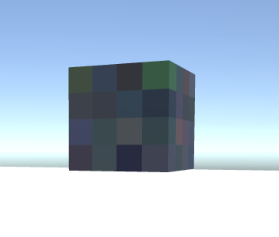
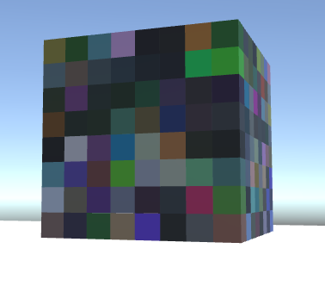
Demonstration

