Slide 1
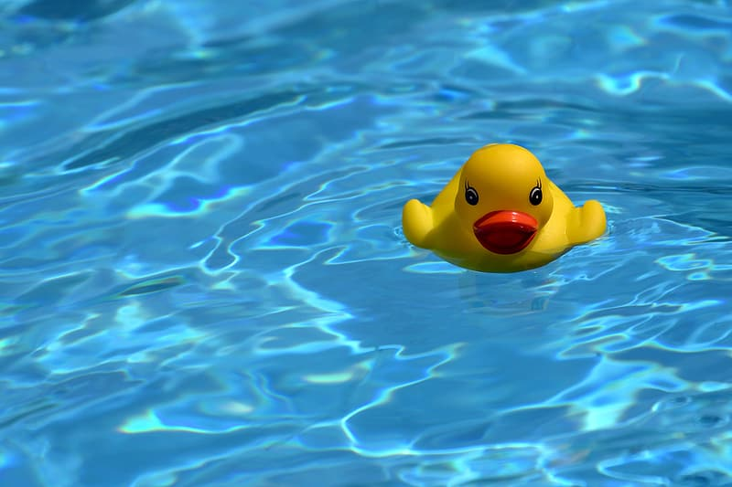
Social Media Platform via Blockchain Technology
RubberDuckys
Tawfic Jobah,
Dylan Gonzalez,
Aldair Martinez

Slide 2
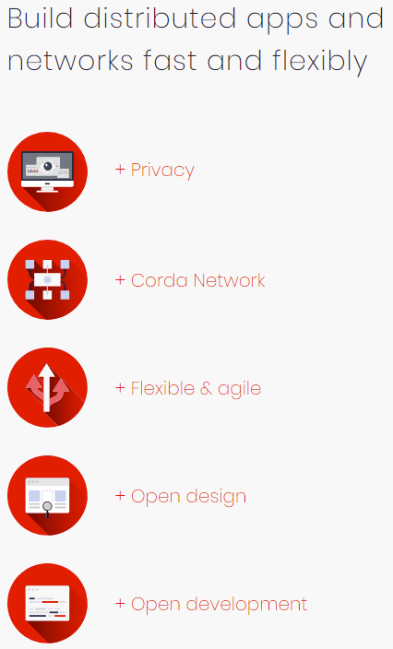
Our Network Structure: Blockchain
A blockchain is a data structure that divides data into “blocks” that are linked together using a peer-to-peer network.
It is difficult to modify the data in a blockchain, as it would require modifying every other linked block.
This makes a blockchain network highly secure.

Slide 3
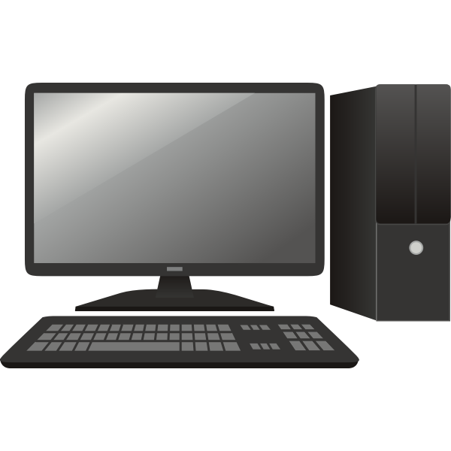
Local Machine
Cloned repository and set up environment
Found many issues, we will spend time making sure the program is ready for deployment

Slide 4
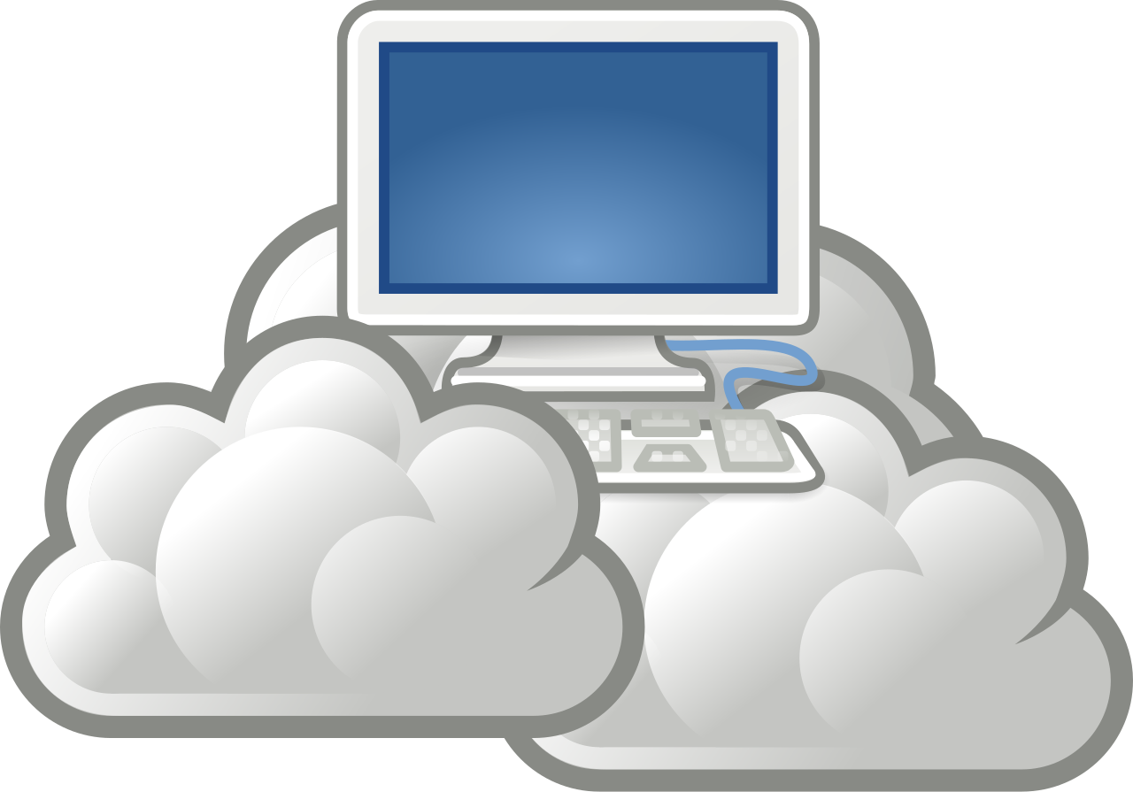
VM on the cloud
Prototype for running multiple instances online
Google Cloud Compute Engine

Slide 5
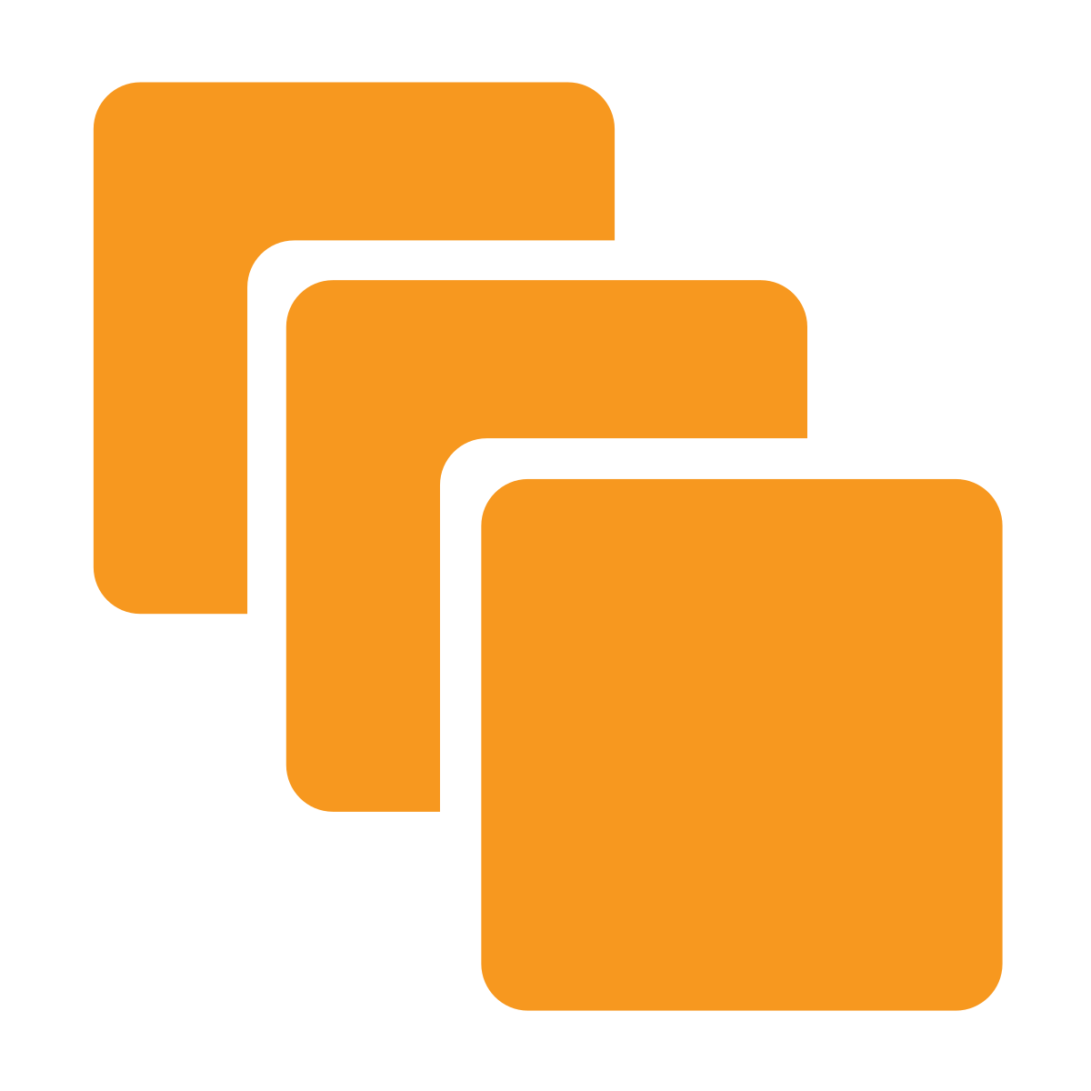
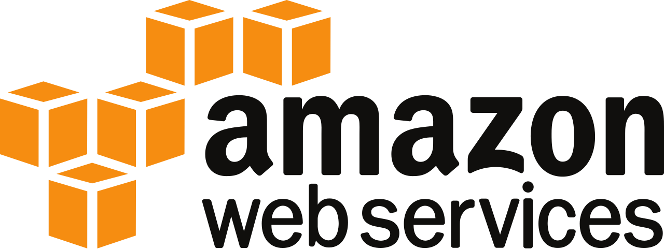
Instances
Move the program to a service like AWS for scalability, reliability and security.
More efficient than running on a VM
End goal for Aquifer injection monitoring tool

Slide 6
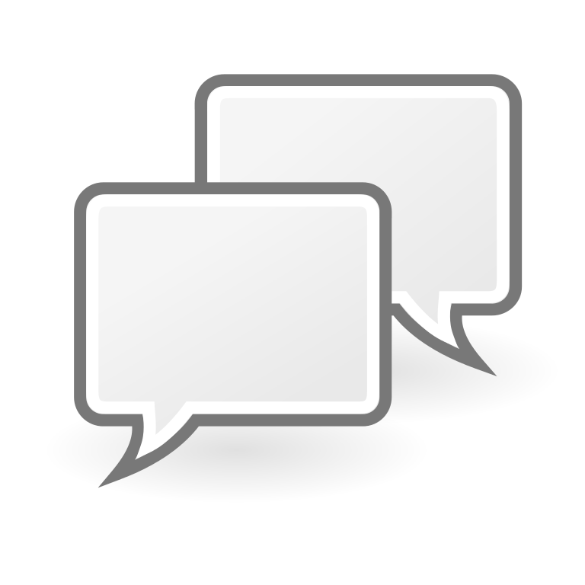
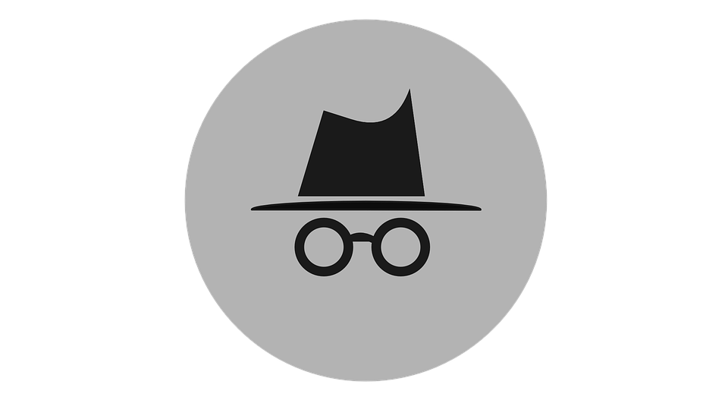
Social Media Platform
Anonymous communication
We will be using a similar environment to the Aquifer Injection program.
Using Corda (Blockchain API)
Using React Native for cross-platform development (web, mobile web, native mobile)

