Slide 1
Customizable Translation Platform for Special Needs
By: Dat Pham, Jamie Nukepese, Kenneth Wood, Dominic Fanucchi

Slide 2
World Problem
Communication issues
Blind people can’t see text/ gestures
Deaf people can’t hear words
ADHD people have short attention spans

Slide 3
Modern Day Solutions
speech recognition technologies
Text-to-speech
Blind people can hear/listen to what other people are writing (newspapers, books, etc.)
Speech-to-text
Deaf people can read what other people are saying
ADHD people can document down conversations so that they can refer back for later review
Accommodates for short attention spans and being easily distracted
Take conversations down like notes
Text to sign-language translator technology
Deaf people can see text in gestures (sign language)

Slide 4
Issues with Modern Day Solutions
Speech recognition technology is a bit inaccurate, around 80% accuracy (Palmer, n.d.)
Although numerous speech recognition libraries exist already, programmed by developers, these libraries are disorganized and unorderly
Requires users to switch between applications if they want to use a different set of speech recognition library
Ex: adults, kids - speech recognition libraries
These libraries cannot be used together because they are too different in speaking manner and patterns, so users would have to change to an entirely different app.

Slide 5
Solutions to Issues with Modern Day Solutions
Accuracy
Improve speech recognition accuracy by modifying the training sets to be tailored towards a specific audience
Disorganized and unorderly libraries
Design an application that would…
take every distinct set of related speech recognition libraries (kids, adults, English, Spanish, etc.) to be categorized as their own individual, separate module
The module would then be able to be interchangeable by the user in the program
Makes process of trying and changing to new libraries way simpler (no swapping between applications needed)
Customizable and adaptable to new information and terminology
Combine speech-to-text with text-to-sign language too to further help deaf people with communication

Slide 6
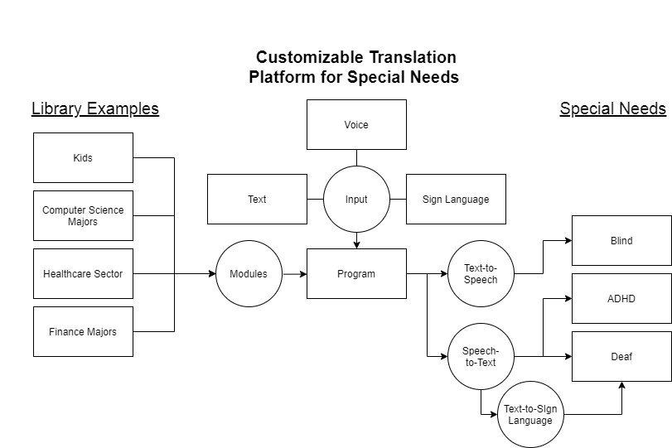
Application Diagram

Slide 7
References
Palmer, Sam. “How to make a speech recognition system.” DevTeam.Space. www.devteam.space/blog/how-to-make-a-speech-recognition-system. Accessed 12 Sept. 2021.

