Slide 1
Customizable Translation Platform for Special Needs
(Part 2 - Requirements Resources & Development Environment)
By: Dat Pham, Jamie Nukepese, Kenneth Wood, Dominic Fanucchi

Slide 2
Overview
Application
Speech-to-text
  With multiple different speech recognition libraries as modules
Text-to-speech
Sign Language-to-text
Text-to-Sign Language

Slide 3

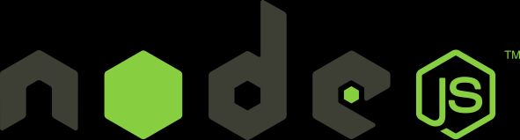

Application
Python
Nodejs or kivy (GUI)

Slide 4
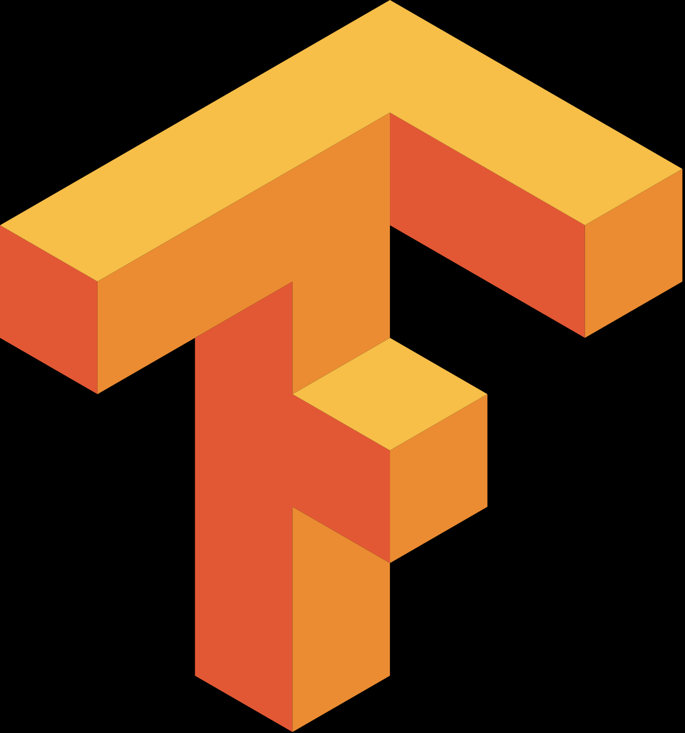
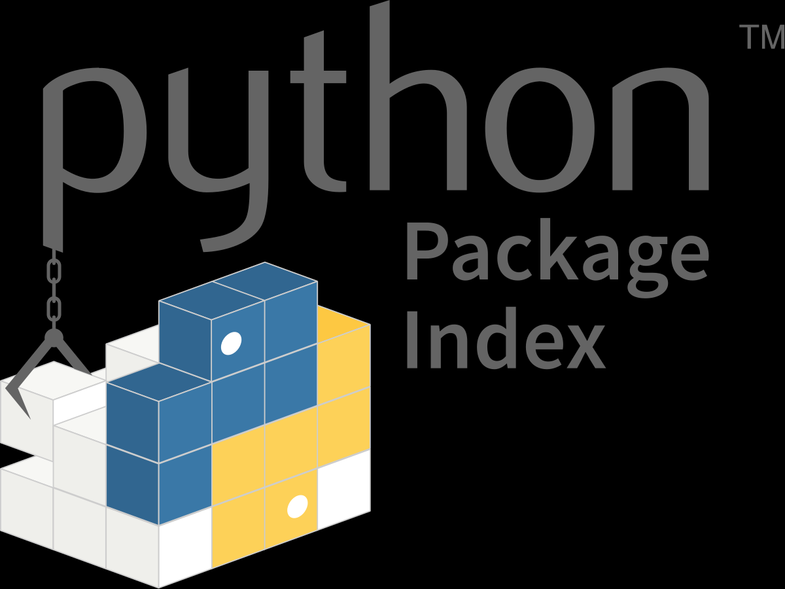
Speech-to-text
PyPI (speech recognition package/library)
  py.audio
  Google API
TensorFlow model
  To train sets for a specific audience

Slide 5
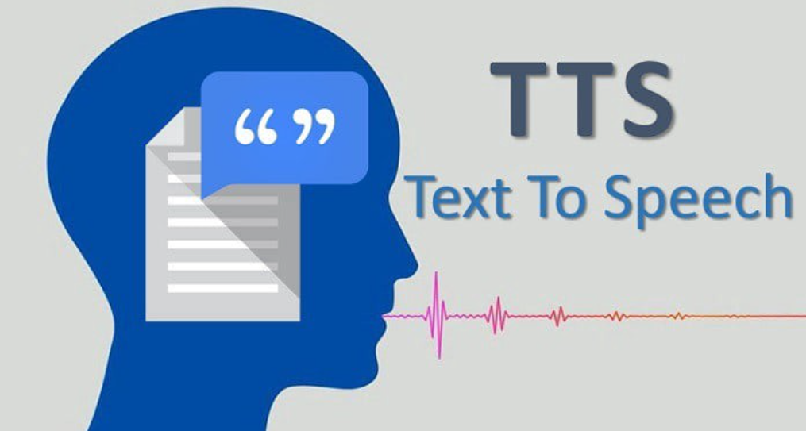
Text-to-Speech
gtts (google text-to-speech)

Slide 6
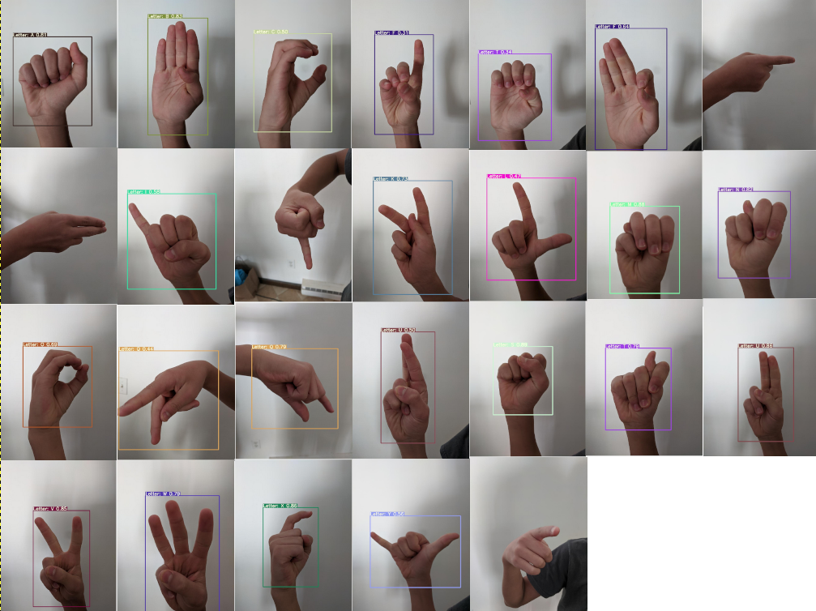
Sign Language-to-text
TensorFlow
  Library for machine learning and artificial intelligence. Particular focus on training of deep neural networks.
OpenCV
  Library aimed at real-time computer vision
Picture credit: Joseph Nelson @ https://blog.roboflow.com/computer-vision-american-sign-language/

Slide 7
Text-to-Sign Language
Fun Translations API? (https://api.funtranslations.com/translate/)
  Converts text to pictures of sign language
  Example:
Text: “Hello, you are all poor.”
Sign Language Translation:

Slide 8
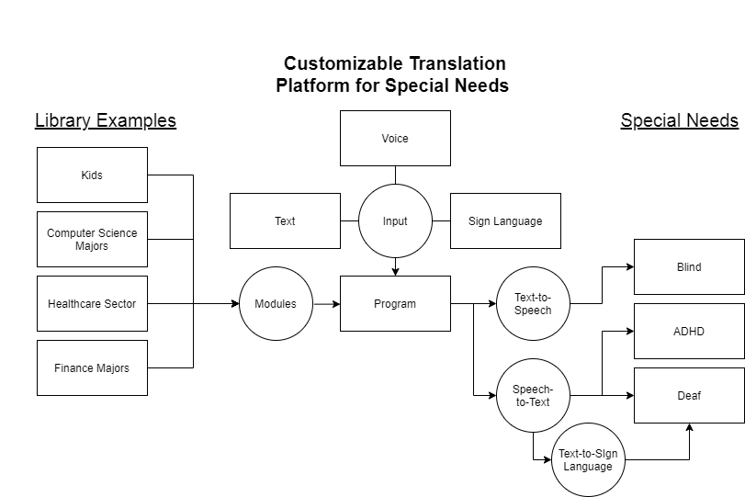
Model

Slide 9
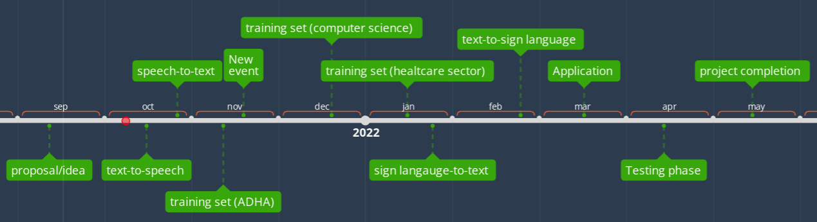
Timeline

Slide 10
Project Progress
Basic speech-to-text (English) completed.
Text-to-speech completed.
Still researching training sets

Slide 11
References
Nelson, Joseph. Test set sign language image examples from my child's hand. 9 Oct. 2020. Roboflow, https://blog.roboflow.com/computer-vision-american-sign-language. Accessed 8 Oct. 2021.

