Slide 1
Customizable Translation Platform for Special Needs
Part 3: Project Progress Report
Member(s): Dat Pham, Jamie Nukepese, Kenneth Wood, Dominic Fanucchi

Slide 2
Overview
Application (python)
GUI
Kivy
Text-to-Speech
gtts (google text-to-speech)
vlc player/library to play mp3 files (still exploring other options too)
Speech-to-Text
PyPI (speech recognition package/library)
Py.audio
Google API
TensorFlow model (to train sets)
Sign language-to-text
Tensorflow model
OpenCV
Text-to-Sign language
Still researching...

Slide 3
Kivy (GUI)
What is kivy?
“Open source Python library for rapid development of applications that make use of innovative user interfaces, such as multi-touch apps” (“Cross-platform python framework for Nui,” n.d.)
Uses the concepts of classes and widgets with roots to build apps
Can code in .py file or .kv file
More efficient to code in .kv because shortens code, but more difficult in the sense that there is not as much information to learn
Why use kivy?
Most modern translators are used on phones
Ex: More than than 500 million people use Google translate, and Google translate more than 100 billion words per day (Books, 2016)
Still allow for PC development if necessary
Disadvantages
Kivy is a small community
Although there are tutorials available to learn the framework, it is still difficult to find certain information and fix errors.

Slide 4
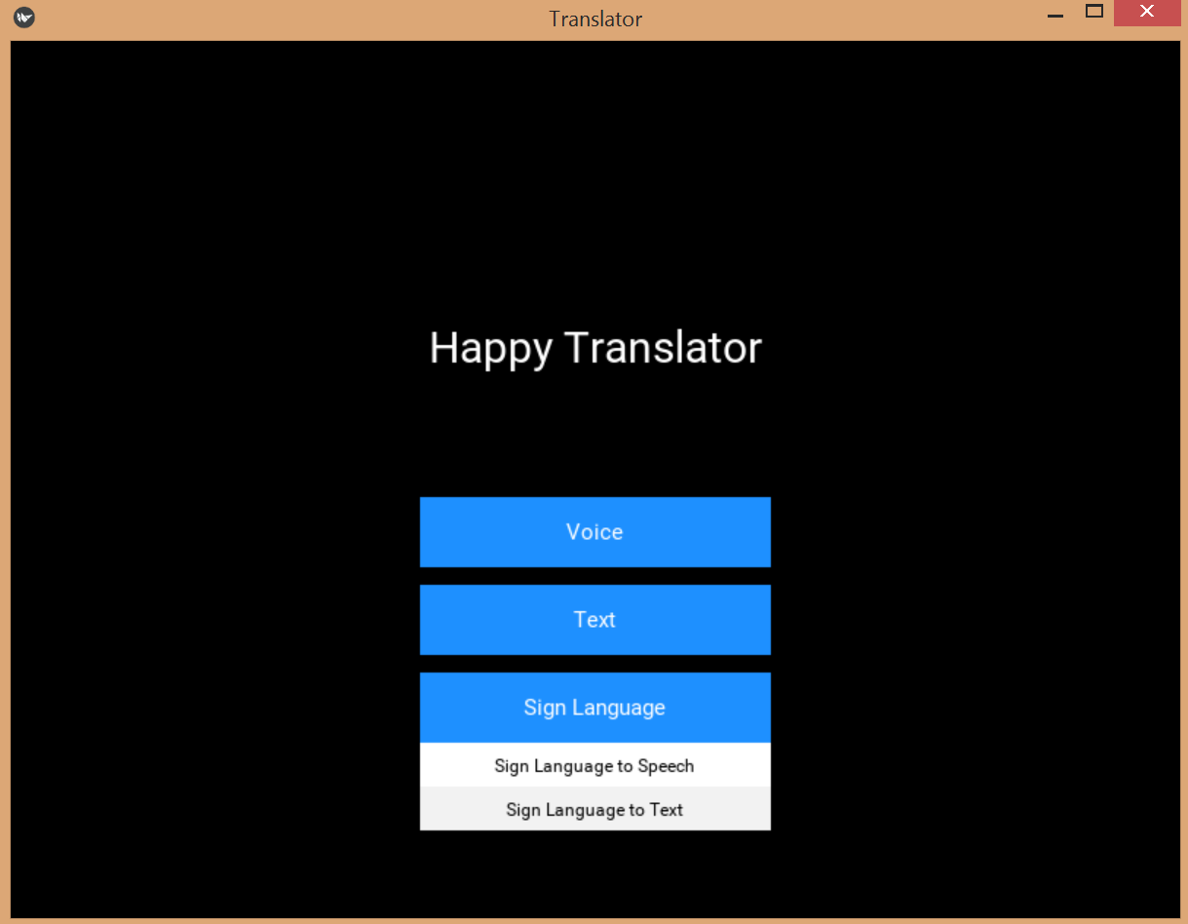
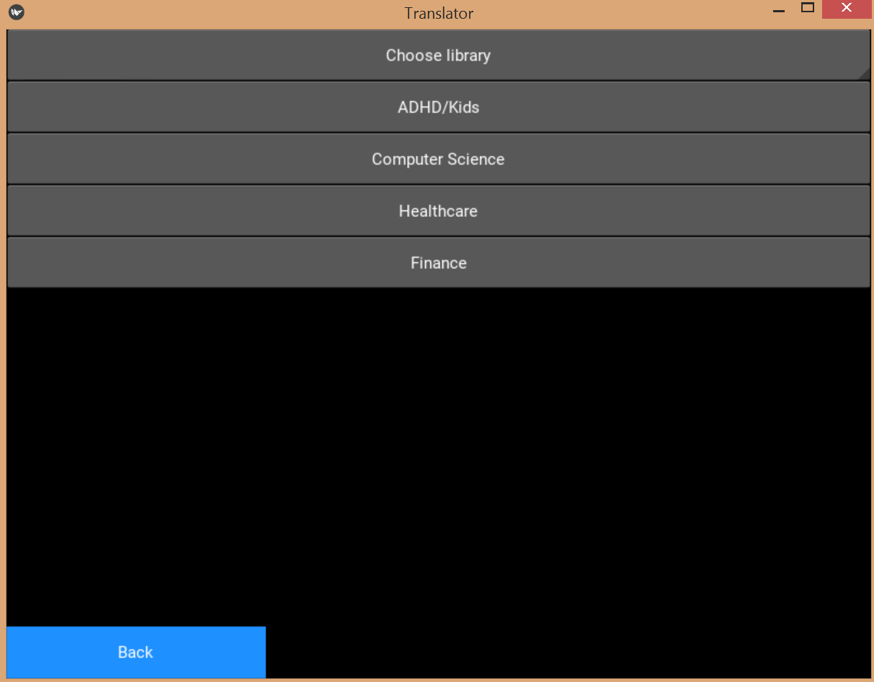
Kivy (Progress)
Menu
User can choose which input they want on the front page
On button click/press, a dropdown inner menu appears, further presenting the available types of translators
(format) Options:
Voice
Speech-to-Text
Speech-to-Sign Language
Text
Text-to-speech
Speech-to-Sign Language
Sign Language
Sign Language to Speech
Sign Language to Text
The chosen translator would then direct the user to its own page
All pages have back button
most pages are currently empty right now except for the text-to-speech page
Speech-to-text/Speech-to-Sign language page both have a spinner menu that allows user to pick between different speech recognition libraries/training sets (ADHD/Kids, Computer Science, Healthcare, Finance, etc.)
Issues
Dropdown menu (status: fixed)
On button press, it would close it instantly
Some parts of the menu would show even though they are supposed to be hidden
Text-to-Speech page (status: in progress...)
Not working properly (certain elements are not pointing to the right root)
On any click, application crashes
Seperate test program could not translate well

Slide 5
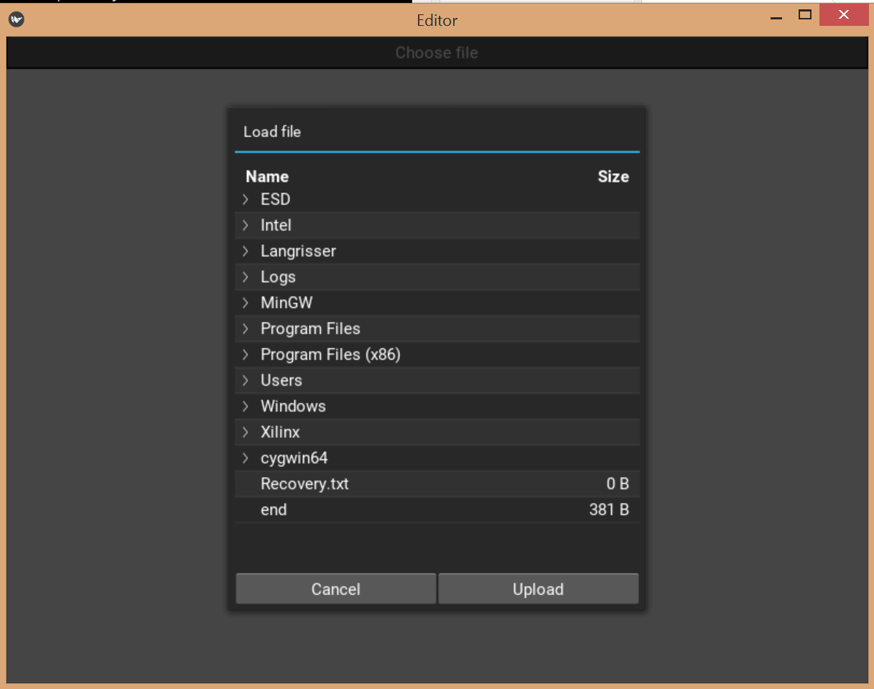
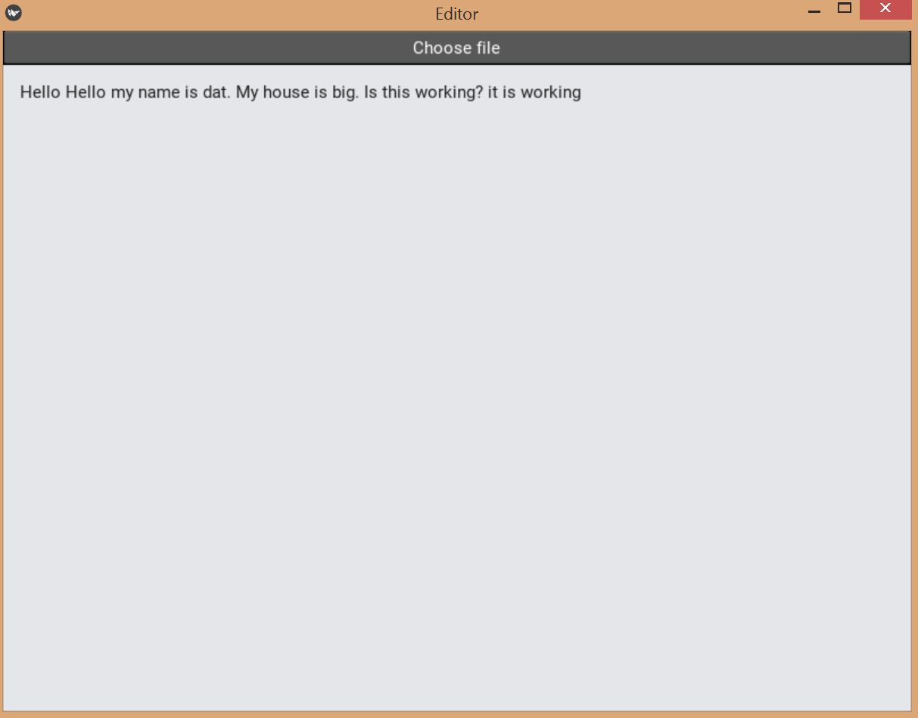
Kivy (Progress continued)
Text-to-Speech Test program
User kivy Filechooser library to select and upload a text file
Once selected, translate the file from text to speech
Plays speech mp3 file
Prints text out to screen
Issues
Mp3 file would not play (status: fixed)
gtts does not come with its own packages/libraries to play sound, it is only used for translating text
Had to download exterior audio libraries (playsound, vlc, etc.)
Allows speech to play in the app instead of doing a system call
VLC player cuts off (status: in progress..)
In a separate smaller program, the audio fully plays, but after transferring it to kivy, it cuts off towards the end of the audio file
Goals
Make text-to-speech work with pdf file (currently only works on text file)

Slide 6
TensorFlow
Training Set: Data is currently trained using a google published open source data set, designed for use in speech command recognition. A small batch of words is being used currently to keep training time low as large data sets can take multiple hours or days.
These consist of folders separated by word with multiple pronunciations of the word within the folder
which are broken down by the file interpreter and used as data in the tensorflow training program.
Ref: https://ai.googleblog.com/2017/08/launching-speech-commands-dataset.html

Slide 7
Tensorflow terminology
Tensor- data structure, matrix of
n dimensions, generally used to create graphs
Of interactions between values. These are objects in python as well as nodes.
Epoch- An epoch is one training iteration, so in one iteration all samples are iterated once.
Loss- the penalty for a bad prediction- a number indicating how bad the model's prediction was on a single example. If the model's prediction is perfect, the loss is zero; otherwise, the loss is greater.
Accuracy - The measurement used to determine which model is best at identifying relationships and patterns between variables in a dataset based on the input, or training, data.

Slide 8
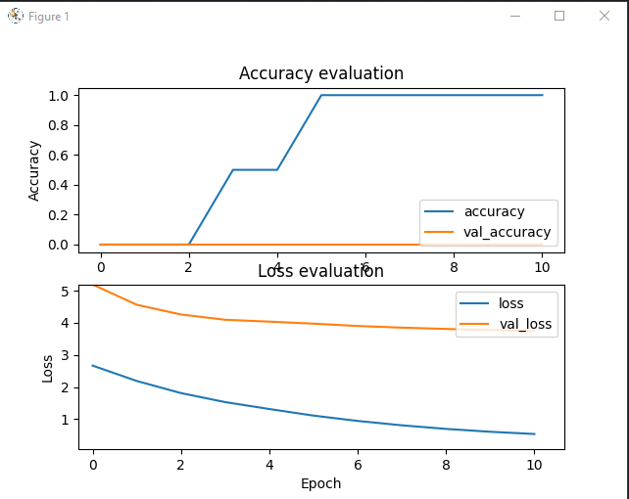
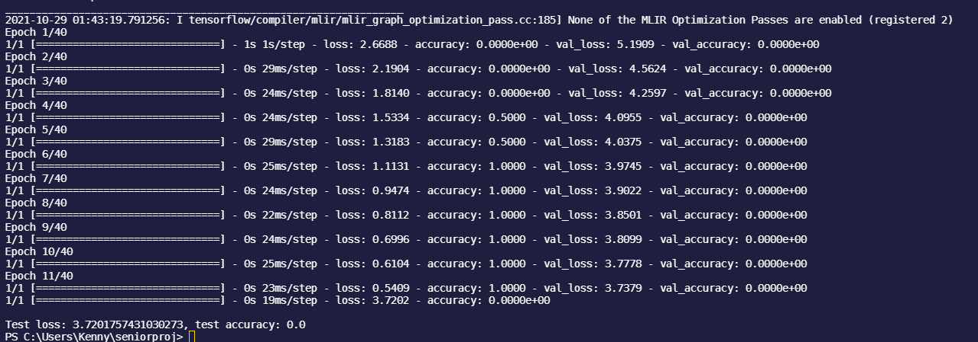
Results from training set build
A successful run of the training model results in a network being created, and the next step is to evaluate the network and allow it to make predictions based on its training.

Slide 9
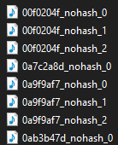
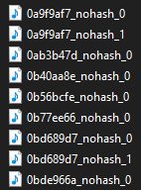
TensorFlow(continued)
Each audio file with its own unique pronunciation of the word “yes”
------>
Each audio file with its own unique pronunciation of the word “no”
------>

Slide 10
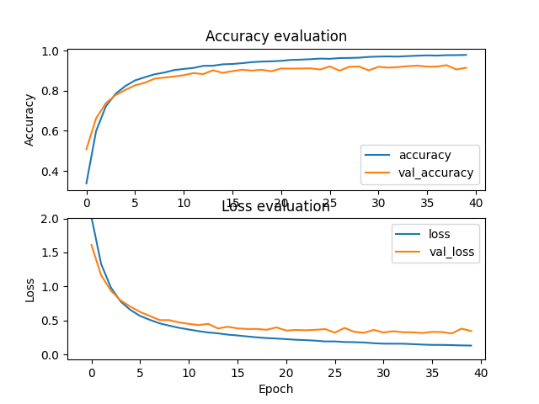
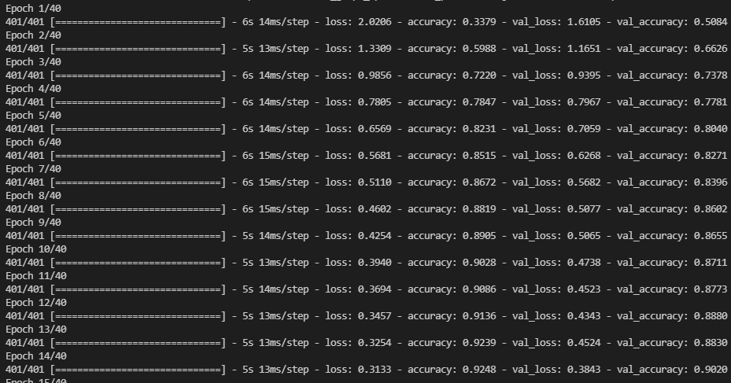
Results from Training Set(pt. 2)

Slide 11
Sign Language-to-Text Overview
For each static sign, images are collected using webcam. 15 images are collected, which 13 are used to train on, and 2 are for testing.
Each image is given a unique ID.
Use LabelImg package to label each image which will be used for Object Detection.
On each image, you draw a box around each sign, which then the Object Detection Model learns to train on.
We are utilizing Transfer Learning, which is a research problem in machine learning (ML) that focuses on storing knowledge gained while solving one problem and applying it to a different but related problem. For example, knowledge gained while learning to recognize cars could apply when trying to recognize trucks.
ref: https://en.wikipedia.org/wiki/Transfer_learning

Slide 12
Sign Language-to-Text Overview cont.
Training is dependent on hardware available. Computers with dedicated GPU’s train much faster than computers with CPU/GPU chips.
Training to about 10,000 steps provides lower loss metrics.
Future development will lead us to Action Detection which will allow for more complex signs to be accurately detected.

Slide 13
References
Cross-platform python framework for Nui. Kivy. (n.d.). Retrieved October 26, 2021, from https://kivy.org/#home.
Brooks, R. (2016, May 2). 11 google translate facts you should know. K International. Retrieved October 26, 2021, from https://www.k-international.com/blog/google-translate-facts/.
https://en.wikipedia.org/wiki/Transfer_learning. Accessed October 29, 2021.

