Slide 1
A WEB-INTERFACE TO IDENTIFY
SEO SUCESS FACTORS FOR SMEs
Daisy Alondra Cortez, Nathaly Taiz Leon, Sydney Taylor Jue, Tiara Francis Smith

Slide 2
New technologies
Selenium
  Used for web crawling the webpages
Chromedriver
  Make an instance of chrome that is compatible with selenium to make it scrape dynamic webpages

Slide 3
Progress
The webdriver goes to google ads inputs a word that is manually put into the program
Gets 50 keywords instead of 100 because the web-based API cannot handle 100 words
The web crawler inputs the words into the web-based API and downloads the table to get the URLs

Slide 4
Problems faced
Initially running the code through a Virtual Machine worked, but when the code was transferred to the ec2 instance it had a lot of issues
  Mainly one is running headless and the other is not
Google Sign In loaded old webpage instead of the updated one
Google verification in headless mode

Slide 5
Problems fixed
Used a user agent to make the updated Google Sign In show
Created two separate files so Google Chrome will not crash
Kept getting screenshots, made it to where the web crawling click to call one of us and have us manually input the code to sign in

Slide 6
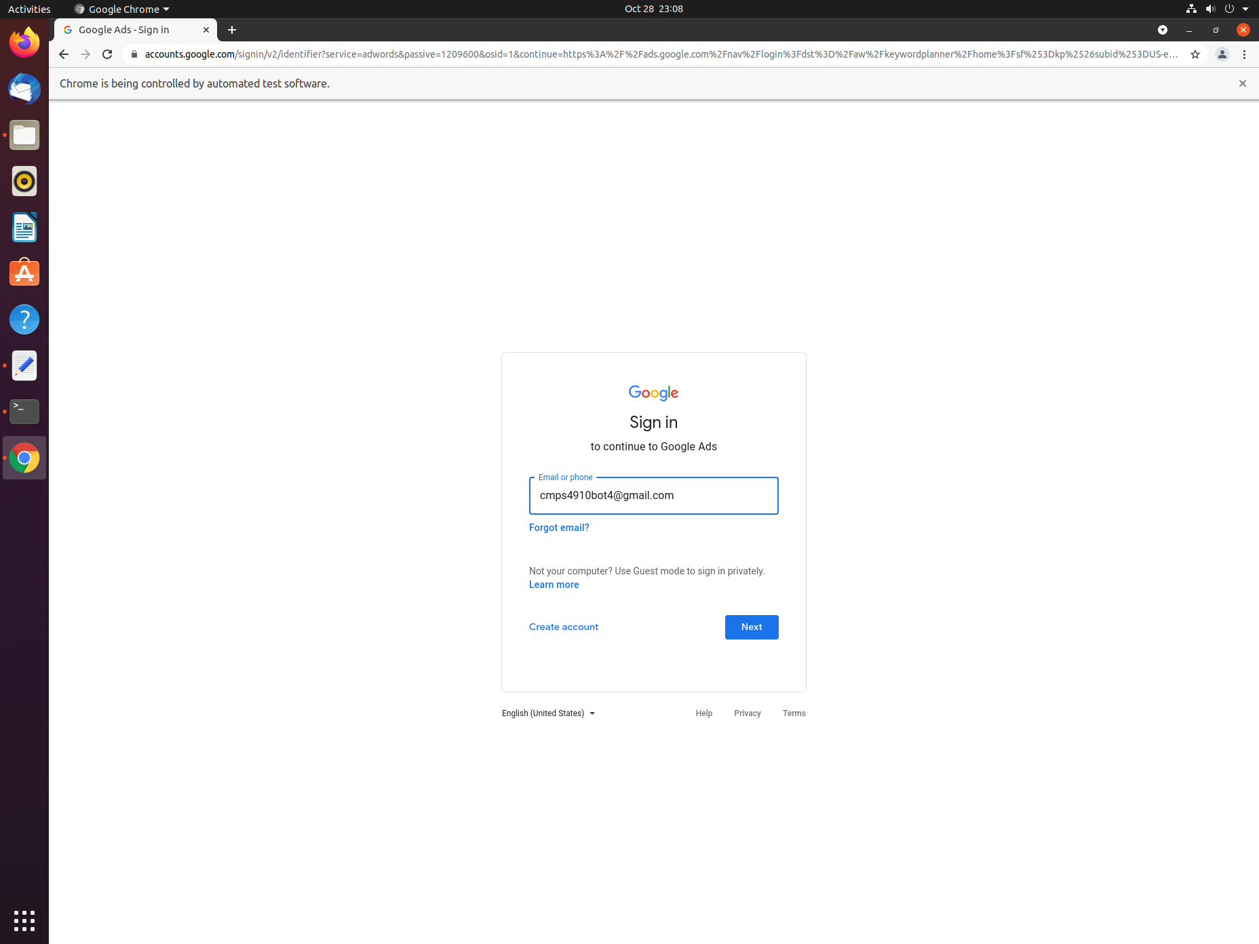

Slide 7
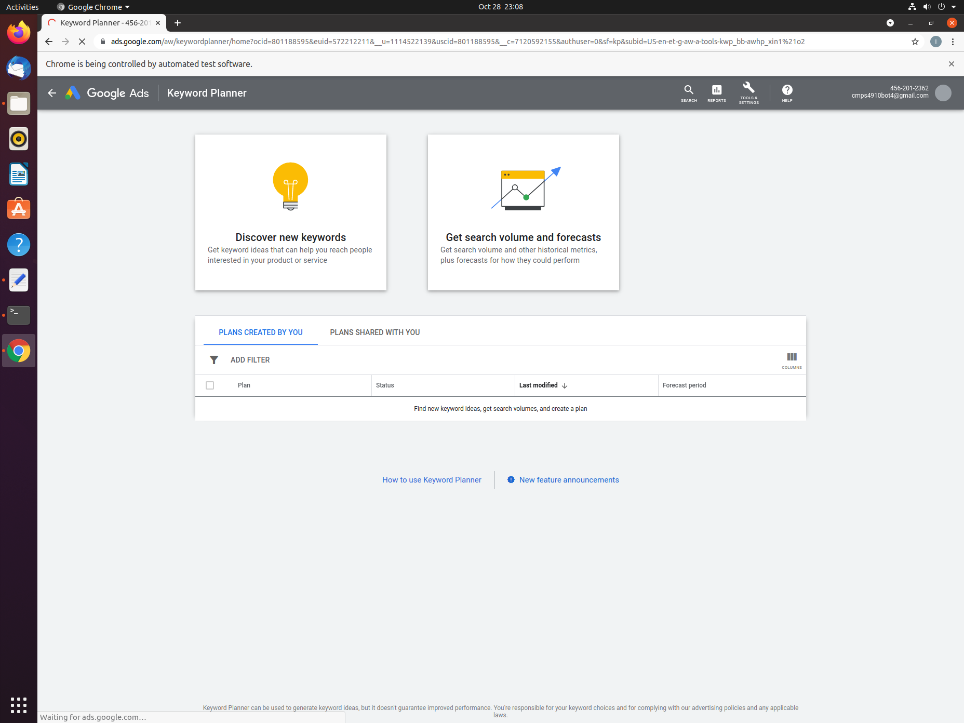

Slide 8
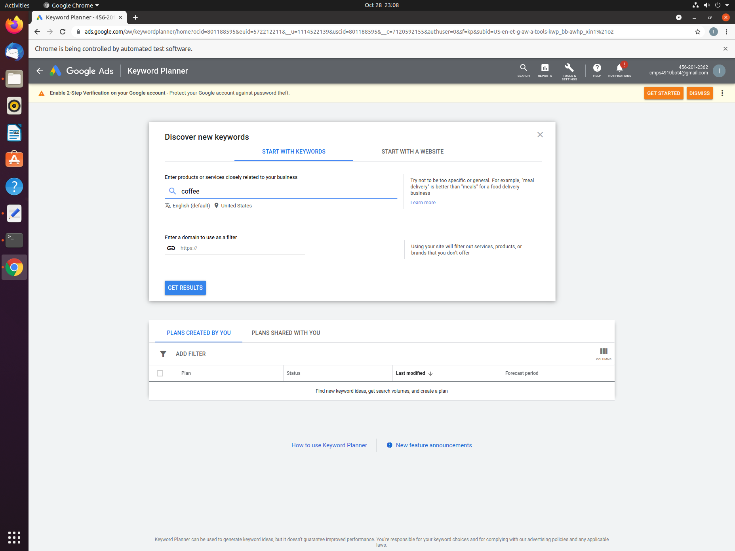

Slide 9
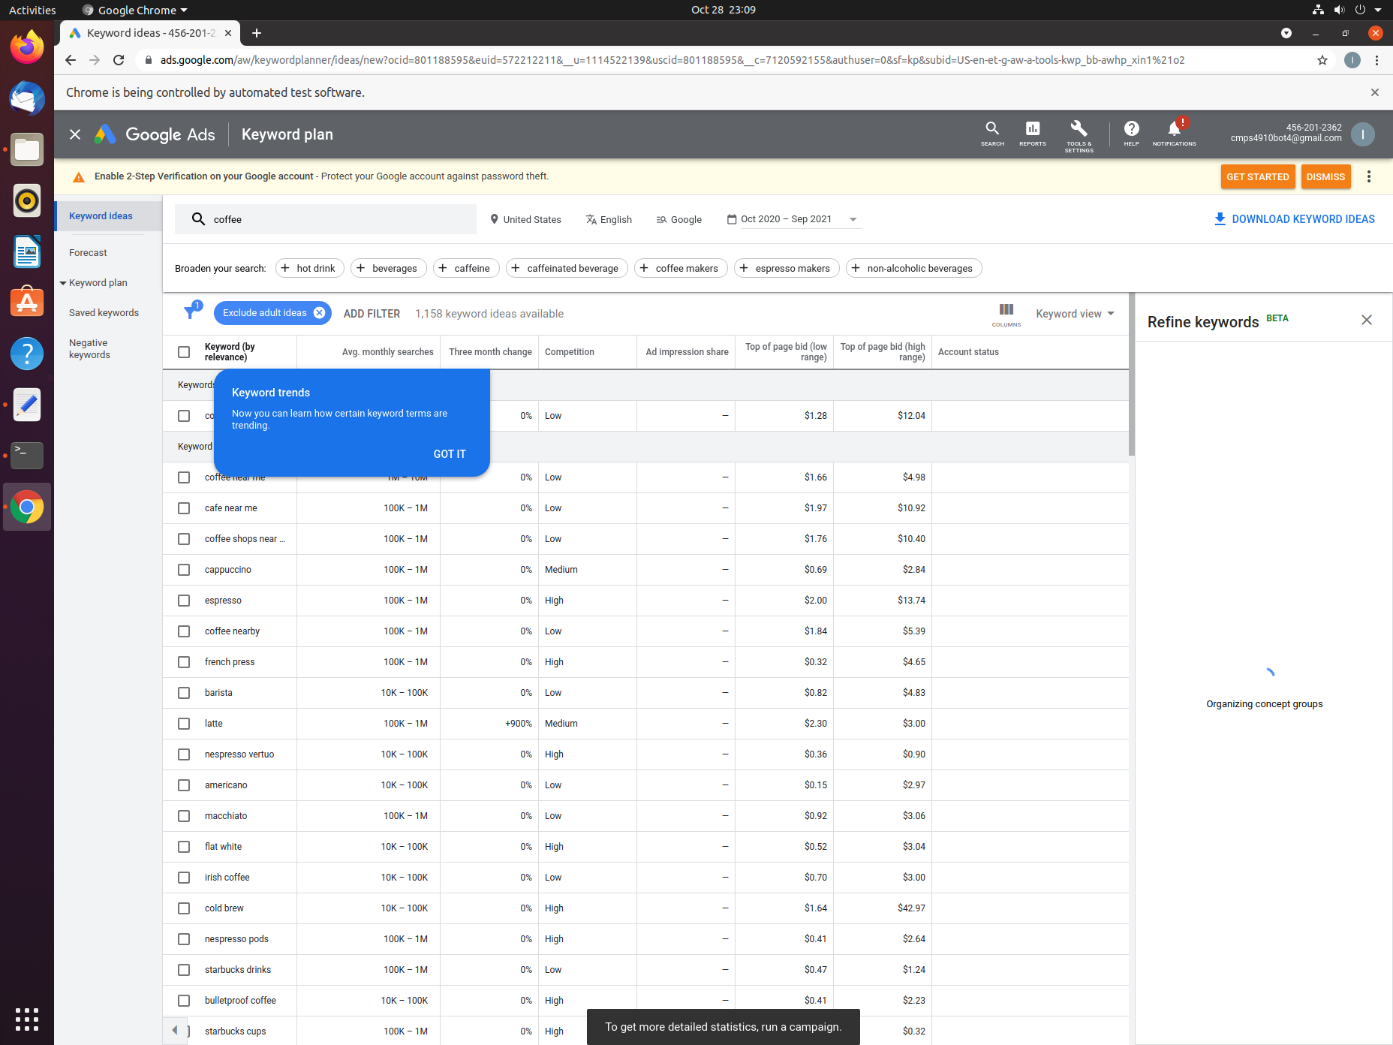

Slide 10
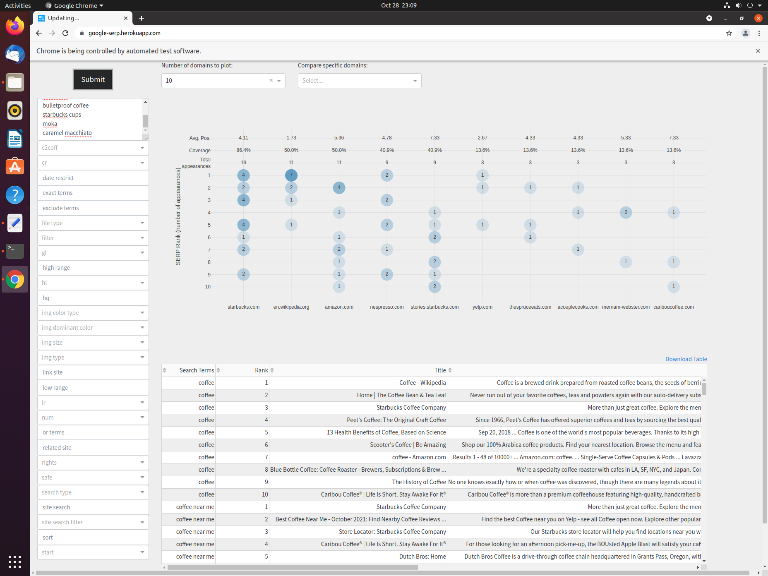

Slide 11
