Slide 1

Utilizing Data Mining Technologies to Analyze the Physical and Cognitive Benefits of Golf Therapy on Seniors
By
Steven Merino
Clemente Rodriguez
McKay Russell
Zachary Scholefield

Slide 2


USC Golf for Healthy Aging Study
George Salem, PhD and Andrea Du Bois, PhD
Institute for Senior Golf Science
USC Division of Biokinesiology and Physical Therapy
Golf for Healthy Aging Study (GHA)

Slide 3
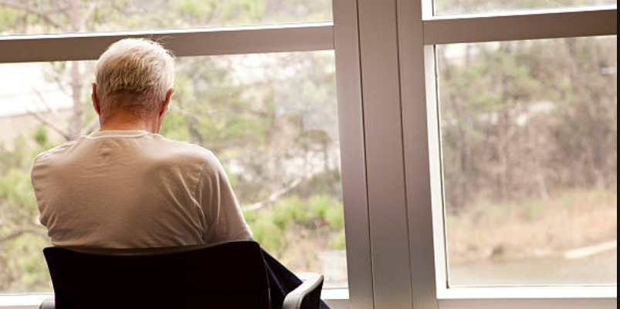
Physical and Cognitive Declination
As we age, our physical and cognitive abilities begin to decline.
Pain in joints and muscles make the problem worse.
Lack of social activities is detrimental for maintaining mental wellness.

Slide 4
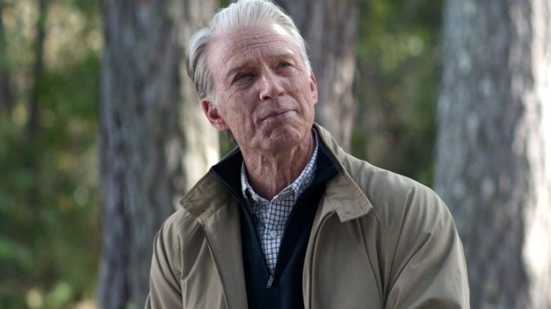
Studies Show
Article: Late-Life Social Activity and Cognitive Decline in Old Age published by Cambridge University Press
Found that social interaction lead to:
Higher Cognition
Less disability
Fewer depressive symptoms

Slide 5
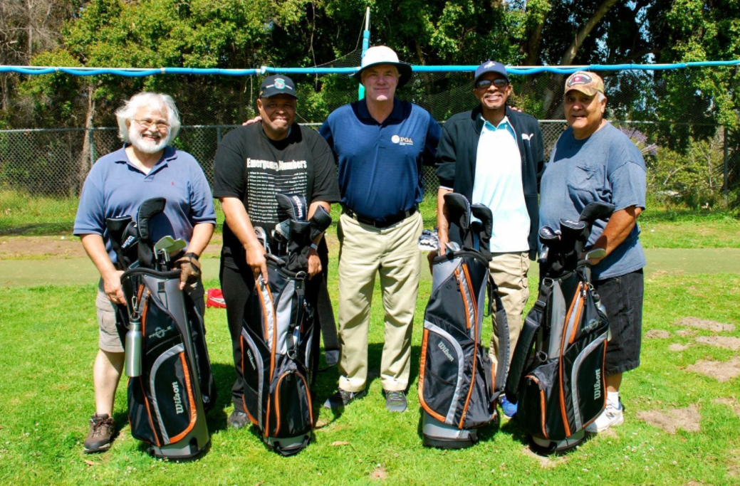
Why Golf?
Socialization
Light Cardio
Balance
Not physically demanding
Critical thinking

Slide 6
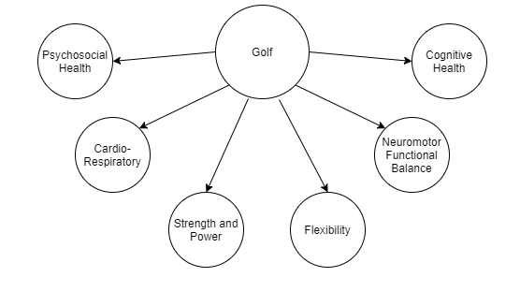
Our Solution
Looking for marked improvements.
Performing data analysis to find links in data that could show these improvements.

Slide 7
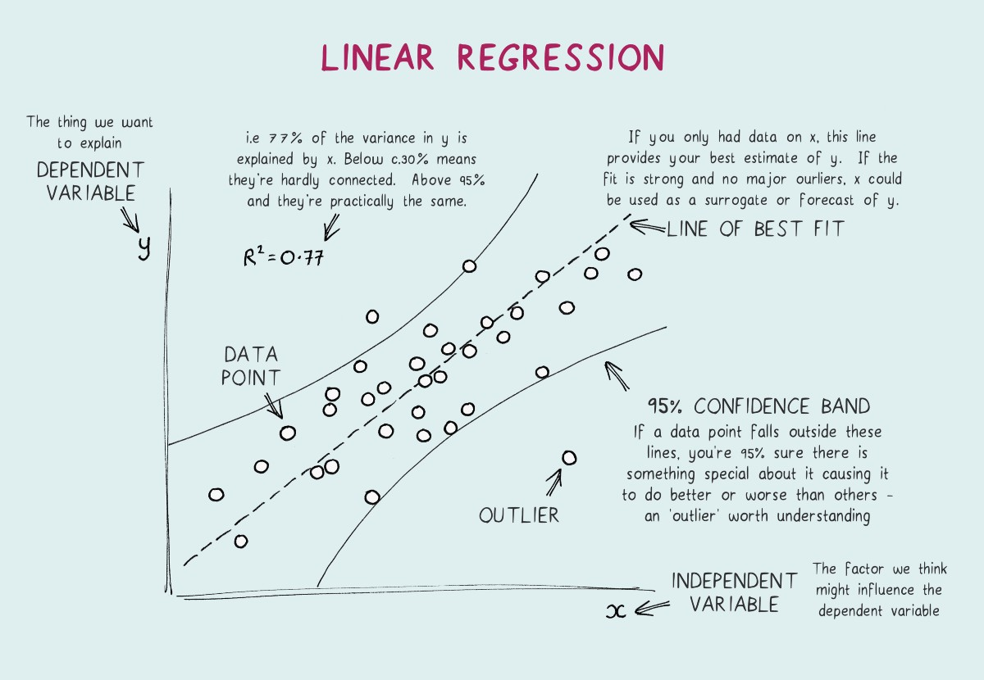
Our Method
Data mining algorithm used on data from the GHA study.
Using linear regression to find correlations in data points.

Slide 8
Moving Forward
Once we have access to data we’ll look into specific measurements of improvement.
Look for and report on signs of improvement in things like cardiovascular and cognitive performance

Slide 9
References:
Late-Life Social Activity and Cognitive Decline in Old Age: https://www.cambridge.org/core/journals/journal-of-the-international-neuropsychological-society/article/abs/latelife-social-activity-and-cognitive-decline-in-old-age/91C0CD4DF1817938EB16E3179567D76E

