Slide 1

Project Required Resources & Development Environment
For: Utilizing Data Mining Technologies to Analyze the Physical and Cognitive Benefits of Golf Therapy on Seniors
By
Steven Merino
Clemente Rodriguez
McKay Russell
Zachary Scholefield

Slide 2
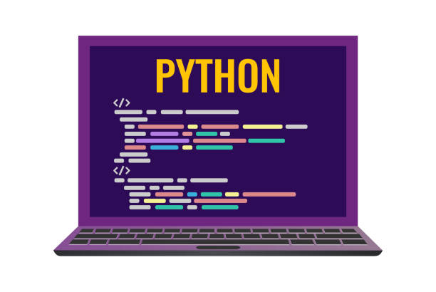
Python and CSVs
Easy to import data from CSVs to Python code
Multitude of libraries
Offers various tools for data analysis
Great for handling large datasets

Slide 3

Visual Code Studio
Utilizing VS Code as our development environment.

Slide 4
Using Odin / Delphi to host a website
We can use Odin to host a webpage where we can display our findings
If we find that we need database capabilities we can potentially take advantage of Delphi
Additionally, if we decide to or need to host the web page somewhere else we can do so

Slide 5
Clustering Algorithm
A machine learning algorithm that groups data unsupervised
Cluster algorithms we’re looking at:
  Agglomerative
  Mean Shift

Slide 6
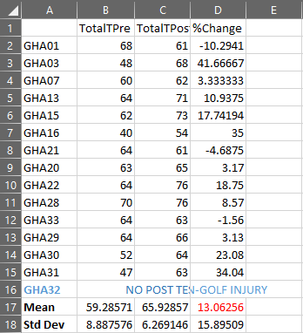
Excel
Excel is where our data is currently
We are working on creating a single file with all the data that we need
From there we can generate CSVs which we can use to work with the data in a Python program

Slide 7
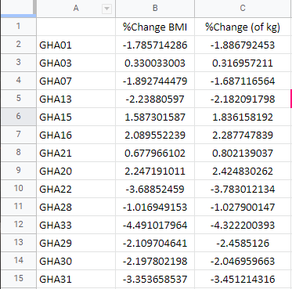
Project progress
Currently merging all %Change data into one CSV file

Slide 8
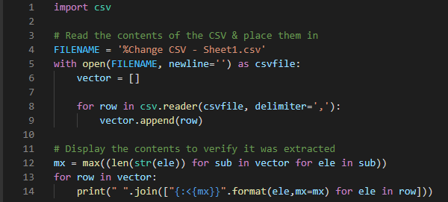
CSV Reading

